Slide 1
IPCC Inventory Software
Manual for inventory compilers

Slide 2
Using the IPCC Inventory Software to establish the
GHG inventory database and manage it
Tasks for the inventory compiler
Step-by-step explanation

Slide 3
This Manual is updated routinely as the Software is updated
Feedback can be provided to the IPCC TFI TSU at ipcc-software@iges.or.jp
This presentation is prepared by the Technical Support Unit (TSU) of the IPCC Task Force on National Greenhouse Gas Inventories to serve the users of the IPCC Inventory Software and thus it has not been a subject to the formal IPCC review process.

Slide 4
Topic | Slides
Introduction to the Software | 6-19
First run | 20-29
Set Software Preferences | 30-32
Set Database Preferences | 33-48
Creating/Initializing a New Database | 49-54
Navigation and Functionalities | 55-125
Main Window | 56-57
Application Window | 58-70
Database Menu | 71-77
Inventory Year Menu | 78-82
Admininstrate Menu | 83-90
Worksheets Menu | 91-95
Tools Menu | 96-100
Export/Input Menu | 101-112
Reports Menu | 114-120
Window Menu | 121-123
Help Menu | 124-125
Table of Contents
Topic | Slides
Data Entry | 127-149
Windows | 128-130
Calculation Worksheets | 131-140
Time Series Data Entry | 141-149
Interoperability with UNFCCC ETF Reporting Tool | 150- 209
Introduction | 151-153
CRT Data Set Manager | 154-168
Preparing your IPCC Inventory for Paris Agreement Reporting | 169-199
Generate IPCC JSON | 199-202
Upload into UNFCCC Reporting Tool | 203-209
Annex I- Confidentiality | 210-215

Slide 5

Disclaimer
Users that are not Administrator of the Database may limit the reading of this manual to those slides that have the following symbol in the left-hand side bottom corner, as in this slide

Slide 6
Introduction

Slide 7




The IPCC Inventory Software
Complete
All IPCC methods (all Tiers)
and all IPCC approaches
All sectors and categories of the National GHG Inventory
Automatically implements
AR5 GWP100 values
(and allows any other user-specific metric to be applied)
Cross-cutting elements
(Uncertainty Analysis
Key Category Analysis)
AR5

Slide 8





The IPCC Inventory Software
Easy to Use
Prepare an inventory using
IPCC default methods
with minimal efforts
All IPCC defaults
at your fingertips
Avoids methodological and calculation errors
Data Managers facilitate
data entry
(Fuels, Solid Waste, F-gases, Livestock, Land Representation, Land Use)
Have NGHGI estimates ready for Paris Agreement reporting

Slide 9




The IPCC Inventory Software
Pivotal for National GHG Inventory (NGHGI) Preparation
Adaptable to national circumstances
- Allows subnational level of reporting
Use multiple tiers across inventory, even within a category
Apply your own country-specific values wherever available
/
Organizing framework for data collection among national entities
Multiple experts in your country
can work on different categories/ sectors simultaneously
Establishes a single archive, in-country, to help you build for the future
Confidence that your inventory is consistent with the
2006 IPCC Guidelines &
UNFCCC requirements

Slide 10
Architecture
Administration functions: Country, Users, Years
Data Export and
Import + UNFCCC ETF Reporting Tool Interoperability
Contains IPCC default values
  MSAccess (ACE OLEDB 12) for WindowsOS
  ACCDB file, backup function
  Microsoft .NET Framework 4.6.2
  Password protected
  NEVER FORGET PASSWORD!
Data Archive
Tools:
*Uncertainty Analysis
*Key Category Analysis
*Reference Approach
Worksheets for data entry
Data Managers: *Fuel
*Land Representation
* Land Use
*Livestock
*Waste

Slide 11
IPCC Inventory Software : from 2012 until today
2012
First released in 2012. Initially, designed to be limited to implementing Tier 1 methods of the 2006 IPCC Guidelines
  UNFCCC COP26/CMA.3 (Glasgow, 2021), Parties formally recognize value of the IPCC Inventory Software as a tool to help countries report under the Paris Agreement
  By mid-2022 the Software implemented in the AFOLU & ENERGY sectors all IPCC Tiers and Approaches in the 2006 IPCC Guidelines and its Wetlands Supplement
The latest version implements ALL IPCC Tiers and Approaches for ALL SECTORS
June 2024, IPCC Inventory Software interoperable with UNFCCC ETF Reporting Tool for Paris Agreement reporting.
2021
2022
April 2024
June 2024

Slide 12
IPCC Inventory Software
Latest version, 2.96, released in March 2025. In addition to existing features, v.2.96 :
Additional improvements to export/import functionality to allow import at sector, category and subdivision level, including associated Data Managers
  Addressed bugs related to import/export of Data Managers
  Allow import/export of multiple years
In category 2.F, addressed calculation errors and improved QA/QC checks to inform on consistency with mass conservation
Improvements to facilitate interoperability with the UNFCCC ETF Inventory Reporting Tool
  Added feature to allow users to add information to documentation boxes for transfer to CRT
  Allow import and export of CRT tables in XML format
  Added option when creating a new inventory year, to carry over CRT information from the closest existing year
  Removed from the JSON file used for UNFCCC reporting, extraneous rows that did not contain any information (user will see these extraneous rows no longer appear in the generated CRT from the UNFCCC ETF Reporting Tool)

Slide 13
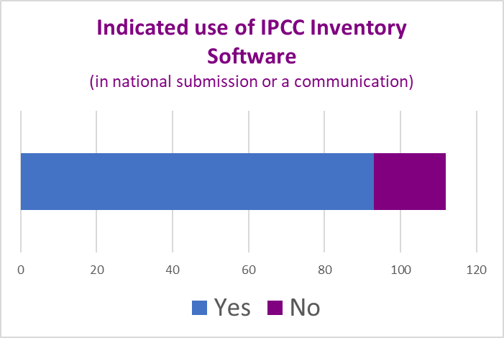
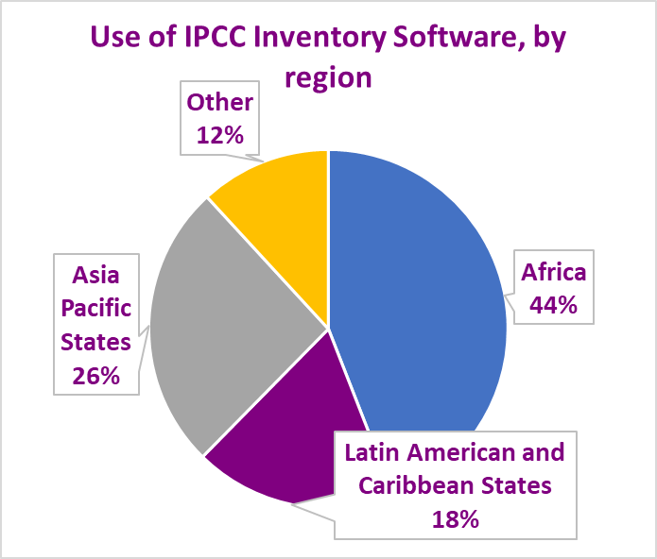
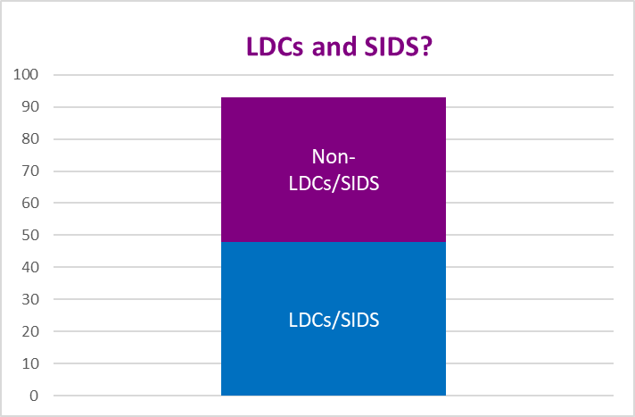
Who is using the IPCC Inventory Software – Historical NC/BUR
93 Parties
=
All information as of 4 March 2025

Slide 14
Software in Paris Agreement Reporting – A first glimpse
99 countries submitted a BTR (additional 7 submitted NID but no BTR)
Of these
80 countries submitted CRT as part of submission.
40 countries used IPCC Inventory Software
as part of their submission. This is:
~ 40% of all countries that submitted BTR and/or NID
~ 66% of developing countries that submitted BTR and/or NID
About half used the IPCC Software to populate CRT
Of these
Countries are seeing value of using IPCC Inventory Software for Paris Agreement reporting.
Once estimates calculated in IPCC Software, populating the CRT is simple.
All information as of 4 March 2025

Slide 15
What are Countries Saying?
  The extent to which the Software is used, varies, one or more sectors, some only for QA
Systematization and processing of data is easier thanks to the Software
The Software offers a better opportunity to choose
variables closer to our country
The Software is used as the national archiving system
Allows typing errors to be considerably eliminated, while avoiding methodological errors
The commenting feature in the Software is also used to input remarks in respective fields for continuity and improvement of the inventory in the future

Slide 16


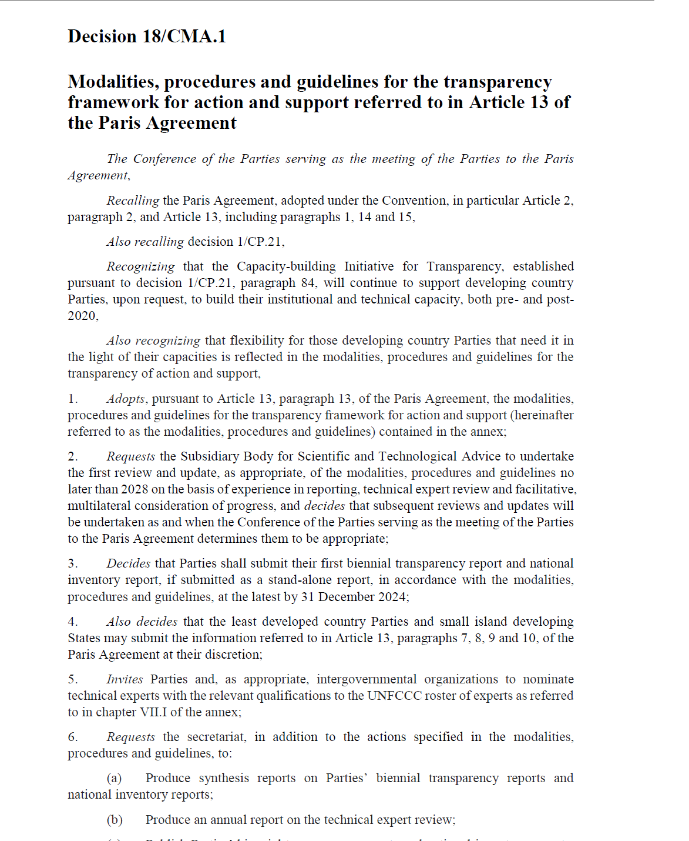

Available resources
The 2006 IPCC Guidelines for National GHG Inventories
  The Software is a tremendous tool to prepare a GHG inventory, although it does not replace knowledge of the 2006 IPCC Guidelines.
The Software’s Guidebooks
  Guide to use the Software to estimate anthropogenic GHG emissions and removals from each inventory category by implementing any of the methodological Tiers & Approaches of the 2006 IPCC Guidelines and its Wetlands Supplement, with elements of the 2019 Refinement. Already published:
    Energy Sector
    Livestock Categories 3.A.
    Land Representation
    IPPU (2.A, 2.B, 2.C, 2.D, 2.F (partial), 2.H)
    User Manual
    UNFCCC Interoperability – CRT Export Quick Start Guide
  Other sector-based Guidebooks are under development.
IPCC TFI TSU Support @ ipcc-software@iges.or.jp

Slide 17
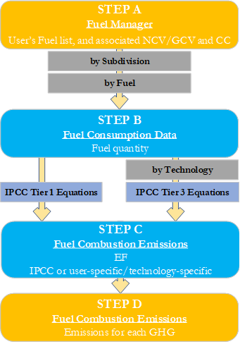
Guidebook - Structure
For each category, the Guidebook includes, inter alia, the following information:
The relevant equations from the 2006 IPCC Guidelines
A description of the relevant worksheets. For category 1.A.1.a.i this includes Fuel Manager, Fuel Consumption Data and Fuel Consumption Emissions
A User’s Work Flowchart
  Step A: Fuel Manager
  Step B: Fuel Consumption Data
  Step C: Fuel Combustion Emissions - EFs
  Step D: Fuel Combustion Emissions - Results
Step-by-step guidance to input activity data and emission factor information
Results

Slide 18
Other Supporting Tools
  Land representation Add-on
    Based on sampling data collection and analysis
    Under development
  Excel-based tool for data upload
    Harvested Wood Products (available on IPCC TFI website)
    Land Representation
      Under development

Slide 19
Ongoing Work
Paris Agreement requirements
Consistent with the SBSTA conclusions at COP29, continue to work with UNFCCC to maintain interoperability between the IPCC Inventory Software and UNFCCC ETF Inventory Reporting Tool
Addressing few outstanding issues and responding to user questions.
Extending capacity for Uncertainty Analysis and Key Category Analysis
Facilitating export/import of data (Time series)
Completing publication of Guidebooks (Land, IPPU)
Step-by-step instructions, in a ppt/video format, to implement IPCC default methods

Slide 20
First Run

Slide 21

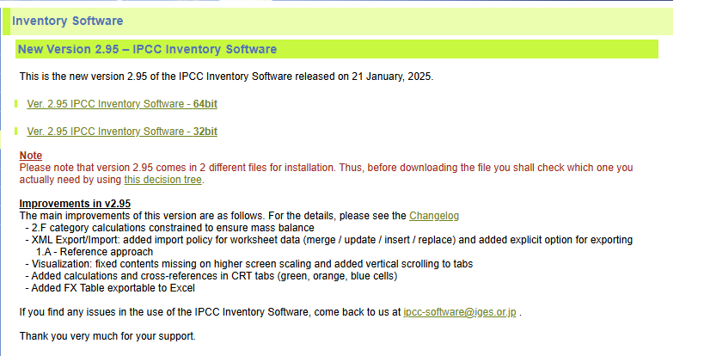
Download the IPCC Inventory Software
https://www.ipcc-nggip.iges.or.jp/software/index.html
This link takes you to a page similar to below, containing the latest version of the Software.

Slide 22
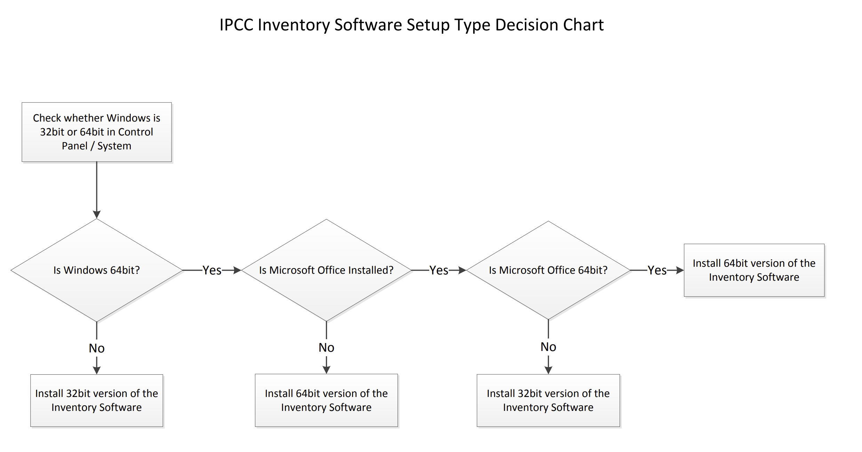
Software Download
The Software comes in two versions, 64 bit and 32 bit. Before downloading the Software, determine which version is appropriate for you by using the flowchart below.
If you find any issues in the use of the IPCC Inventory Software, come contact us at ipcc-software@iges.or.jp

Slide 23
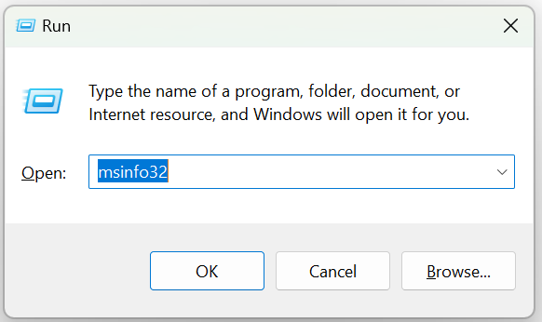
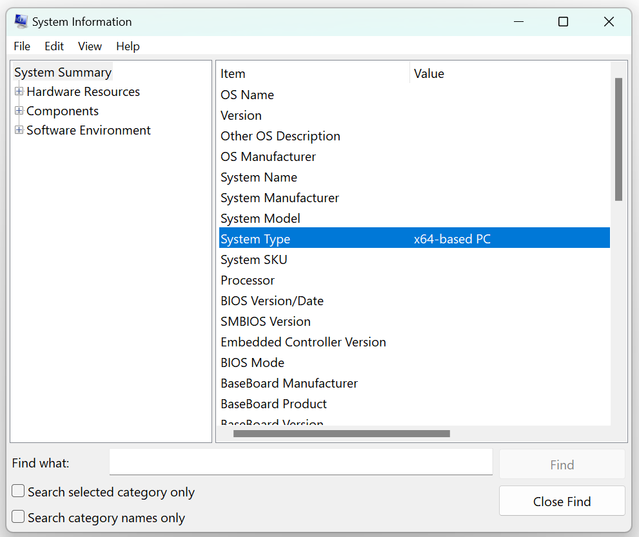
Software Download
First – Determine which version of Windows OS is installed on your computer
To check whether you have a 32-bit or 64-bit version of Windows installed, follow these steps:
Press Win + R to open the Run dialog window.
Type msinfo32 and press Enter
Look for the "System Type" entry:
  If it shows x64-based PC, your Windows is a 64-bit version.
  If it shows x86-based PC, your Windows is a 32-bit version.
With Windows 10 and 11 this information can also be found under Settings>System>About.

Slide 24
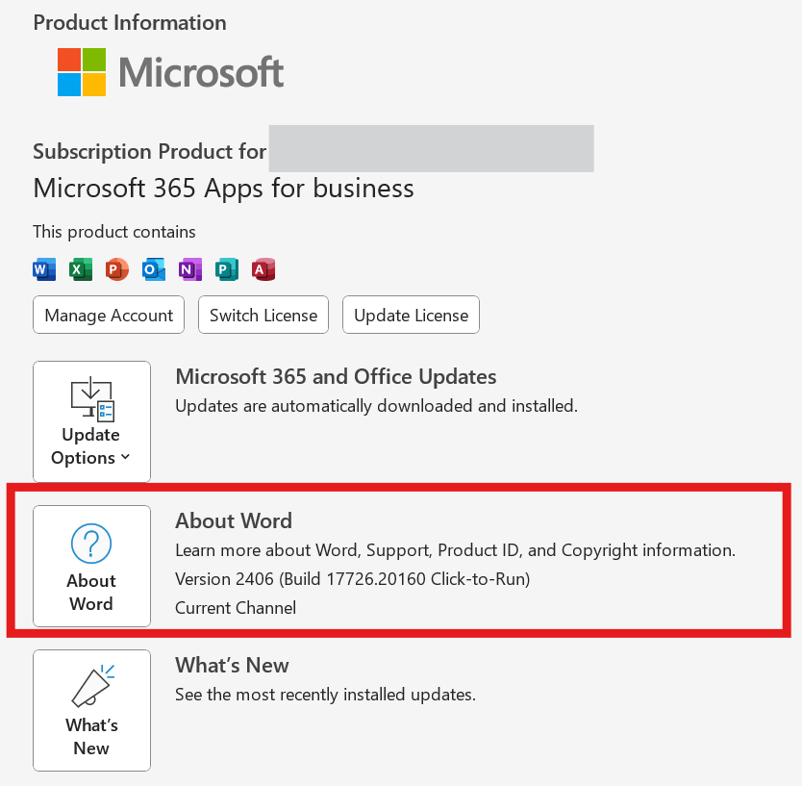
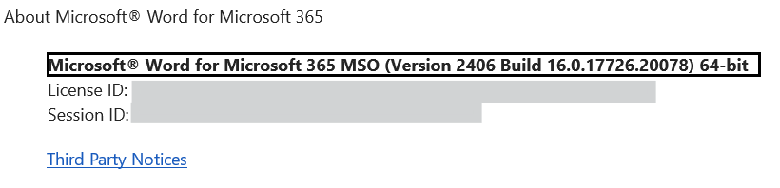
Software Download
Second – Determine which version of MS Office is installed on your computer
To check whether you have a 32-bit or 64-bit version of MS Office installed, follow these steps (suitable for Office 2013, Office 2016, Office 2019, Office 2021, and Microsoft 365):
Open any Office application: such as e.g. Word
Click on File in the top-left corner
Click on Account. If you don't see Account, click Help
Click on About [Application Name] (e.g., About Word)
In the About window, you will see the version information, including whether it is 32-bit or 64-bit.
Steps suitable for Office 2013, Office 2016, Office 2019, Office 2021, and Microsoft 365.

Slide 25
Software Download
Then:
If you have Windows 32-bit, and:
MS Office 32-bit: Download the 32-bit version of the Software
MS Office is not installed: Download the 32-bit version of the Software
If you have Windows 64-bit, and:
MS Office 32-bit: Download the 32-bit version of the Software
MS Office 64-bit: Download the 64-bit version of the Software
MS Office is not installed: Download the 64-bit version of the Software

Slide 26

First run
Set Software’s and Database Superuser
At First run the Software requires setting the Superuser of the Database initialized at first run
The Superuser of the application has full control over the application
The Superuser of a database is responsible for defining additional users.
A user can open databases set by other users as a Superuser or a simple user depending on the setting made by the Superuser that initialized the Database [and of course, so far as the user has a valid Login & password combination]
Thus, when setting an NGHGI that is to be compiled by more than one expert, first step for using the Software is to identify the Superuser, usually the NGHGI head, and the Superuser is the one that shall open and set the NGHGI database with his/her app and then share it with other users

Slide 27
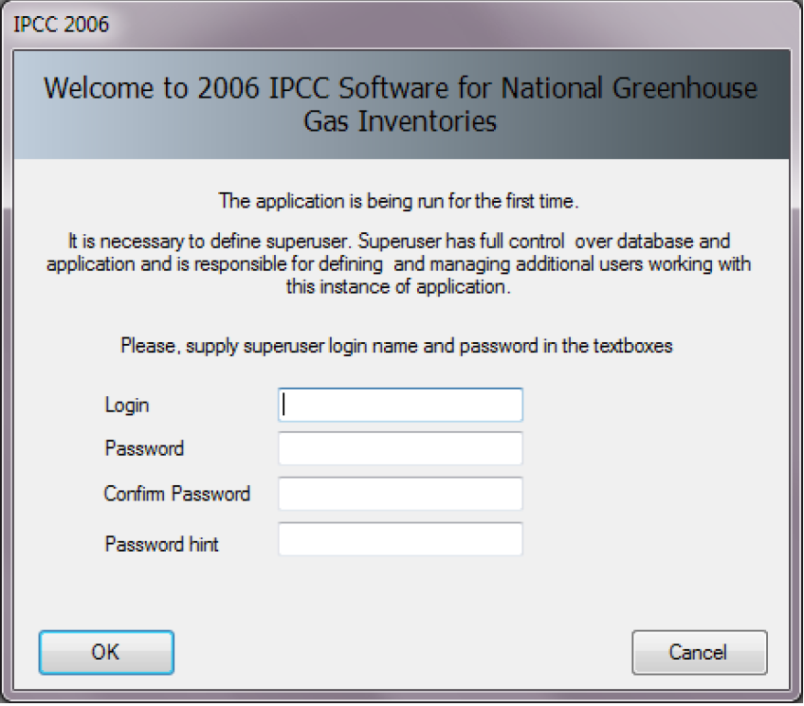
First run
Set Database’s Superuser & assign password/login to the database
At First run the application shows its welcome window where to enter Login (username) and Password of the Superuser of the Database to initialise.
Important!
When setting YOUR Password always set YOUR Password Hint too. It is highly recommended you take note of your password and store it in a safe place. In case you lose or forget your password, the Software does not have a mechanism to restore your password, this means that you may no longer access your database.
The Login & Password combination applies to the database, not to the Software, a Software can manage different databases with different Login & Passwords combinations

Slide 28
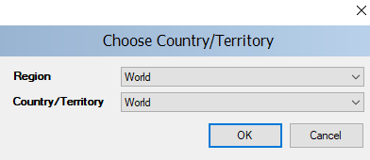
First run
Choose Country
In this step it is necessary to choose the desired Region and Country/Territory. The country will be relevant in cases where the default EFs and other parameters are country-specific and will ensure that the proper defaults are pre-populated (e.g. for AFOLU and Waste worksheets).
Notes:
When you export and import XML files into the Software, the country codes must match.
This country list is based on the UN list, which is available at http://unstats.un.org/unsd/methods/m49/m49regin.htm. In addition, you may select “World” as your country, in which case all defaults will appear in the relevant dropdowns
The country selection applies to the database, not to the Software, a Software can manage different databases with different Country/Territory setting

Slide 29
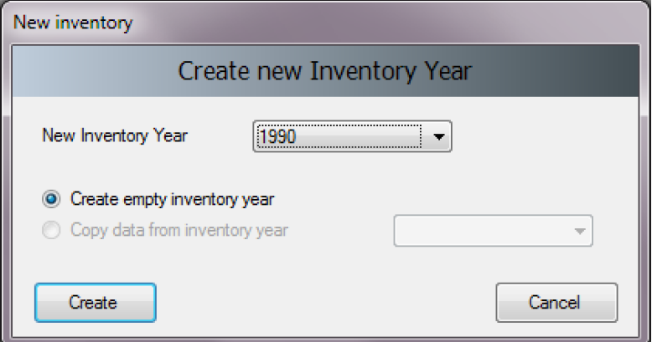
First run
Create Inventory Year
In this step it is necessary to create the initial Inventory Year. After creating the Inventory Year, the Software is successfully initialized and prepared for use or for further addition/refining of user settings, as described in the next sections.
In this initial step, you will “Create empty inventory year”.
When you create future inventory yeas, you will also have
the option to create the inventory year and copy data from
a previous inventory year.
Notes
It is recommended to start with the first year in your time series and build future inventory years on the previous year(s). When building the land representation, you MUST start with the first year of the time series. For further information, see the Land Representation Guidebook.
The Inventory Year selection applies to the database, not to the Software, when opening a new database a different year can be selected

Slide 30
Set Software Preferences
Apply to all databases open within the Software

Slide 31
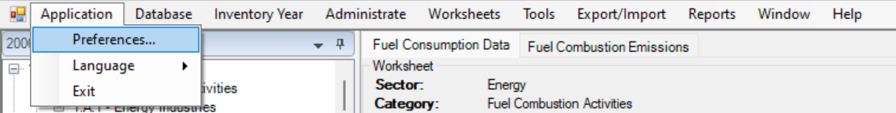
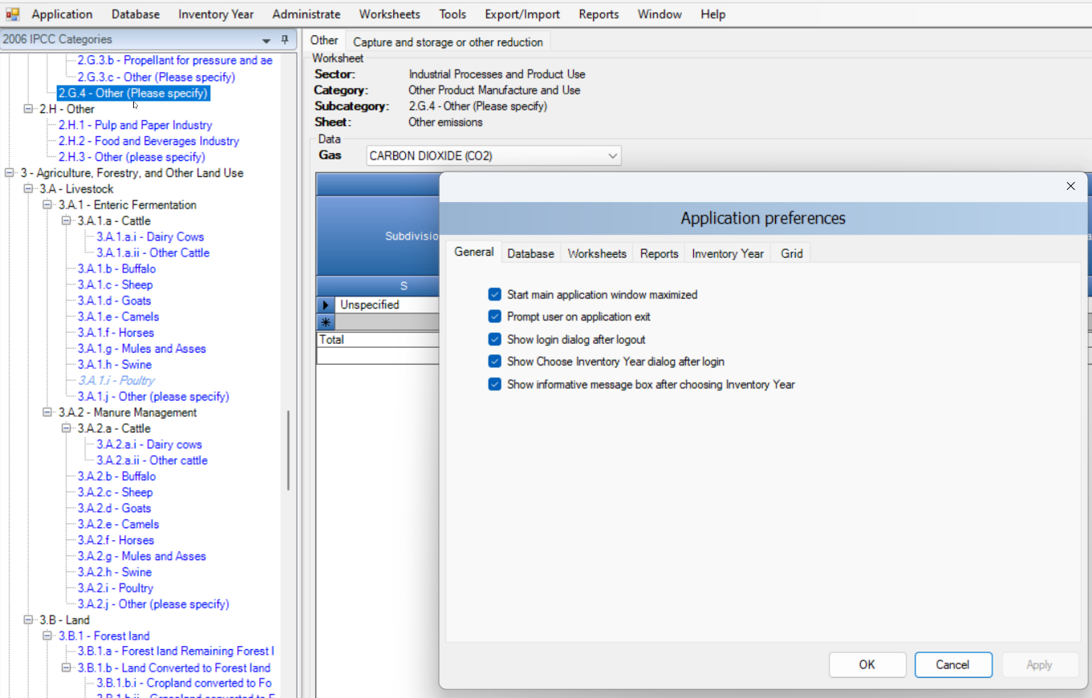
Application - Preferences
In main menu:
Select Application.
Select Preferences, to review/update your preferences, as necessary
This opens a dialog window that allows the user to adjust preferred working area settings, like appearance of dialogs, database-management preferences and backup, default number of decimal places shown in worksheets and reports, thousands separator and colors, format and other properties of grids.

Slide 32
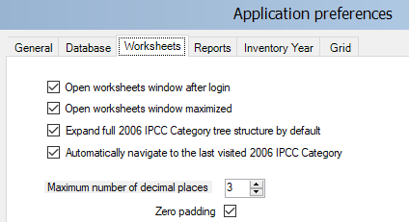
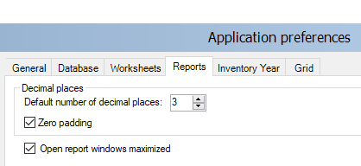
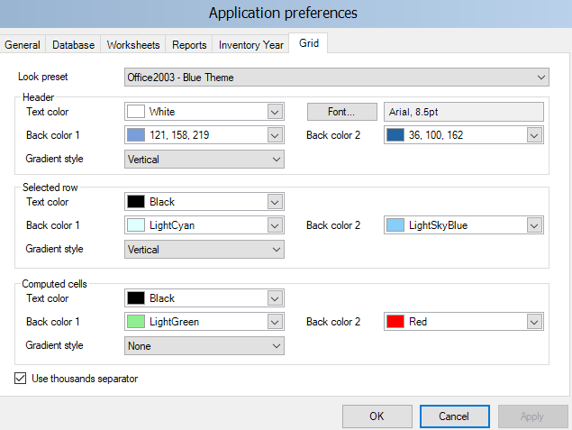
Application - Preferences
In main menu:
Select Application.
Select Preferences to review, and as necessary update,
your preferences.
We suggest to:
set to 3 the number of decimals and check the Zero
padding (both for Worksheets and for Reports) Check
the thousands separator
Leave remaining setting as it is, unless otherwise preferred
Note: All calculations are still performed with full precision

Slide 33
Set Database Preferences
each database contains 1 GHG inventory only

Slide 34
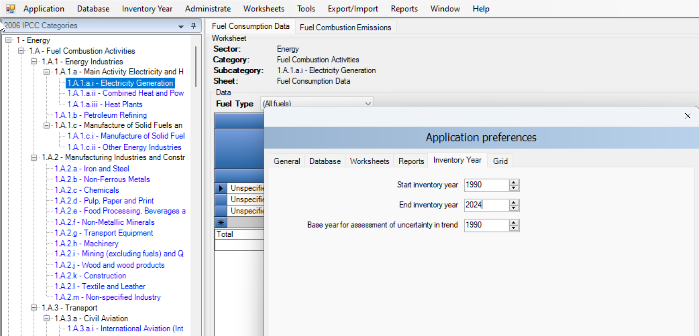
Set Inventory Time Series
In main menu:
Select Application.
Select Preferences to review, and as necessary update,
your preferences.
Set time series in “Inventory Year” tab:
Use Start inventory year numeric box to
set starting inventory year. Default is 1990.
Use End inventory year numeric box to set
ending inventory year. Default is current year.
Use Base Year for assessment of uncertainty in
trend numeric box to define Base Year for assessment of uncertainty in trend. Default is 1990.
Interoperability
For users preparing a GHG inventory for upload to the UNFCCC ETF Reporting Tool:
The inventory time series entered here may be longer than the inventory time series included in the file for upload to the UNFCCC

Slide 35
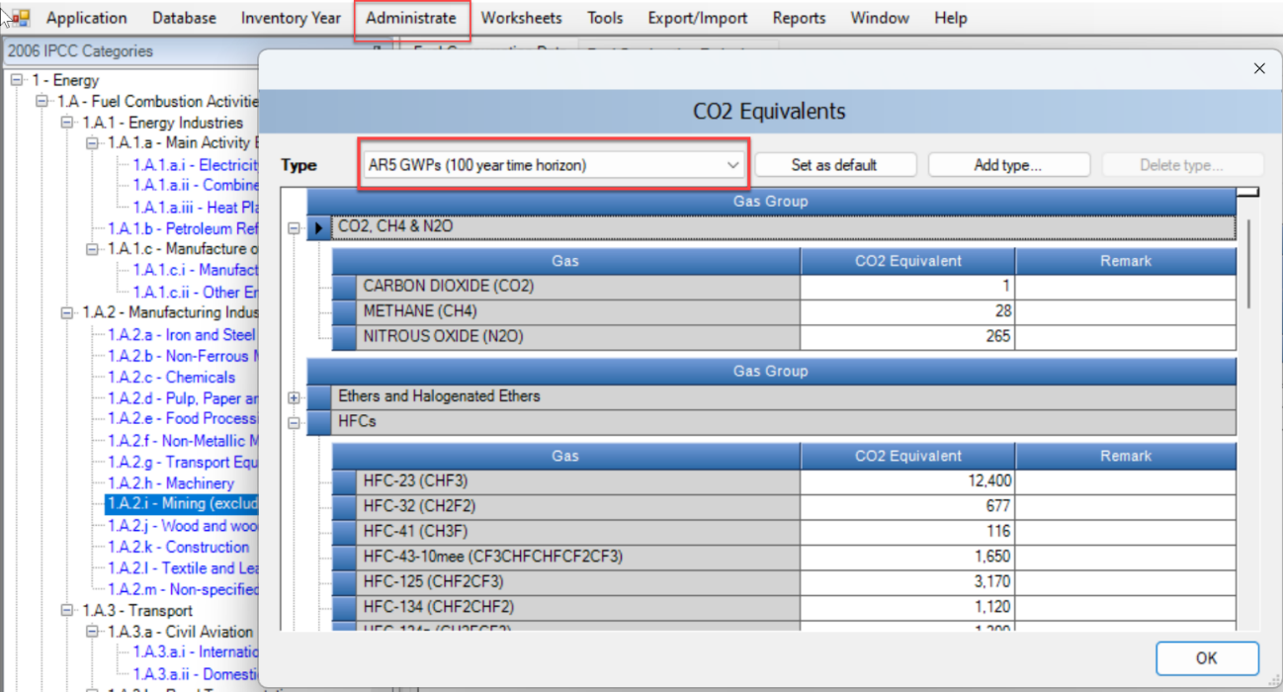
Set CO₂ Equivalent Values
Use default GWP values
The Software is capable of calculating GHG emissions in CO₂ equivalents using a variety of different global warming potential (GWP) values and other metrics for CO₂ equivalents.
To review and update GWP:
From the main menu, select Administrate /
CO₂ equivalents.
Select from one of the four types of fixed
CO₂ equivalents (fixed GWPs cannot be
changed or deleted)
  IPCC Second Assessment Report (SAR) GWPs
  IPCC Third Assessment Report (TAR) GWPs
  IPCC Fourth Assessment Report (AR4) GWPs
  IPCC Fifth Assessment Report (AR5) GWPs
Select OK

Slide 36
Set default CO₂ Equivalent type for use in Software
To set the default CO₂ Equivalent type to be used for calculations within the entire Software:
Use Type list to select desired CO₂ Equivalent type.
Click Set as default button to set it as default – the new default CO₂ Equivalent type will be indicated in the status bar located at the bottom of the main Software window.
Interoperability
For users preparing a GHG inventory for upload to the UNFCCC ETF Reporting Tool:
In accordance with paragraph 37 of the MPGs, “Each Party shall use the 100-year time-horizon global warming potential (GWP) values from the IPCC Fifth Assessment Report, or 100-year time-horizon GWP values from a subsequent IPCC assessment report as agreed upon by the CMA” and each Party may, in addition, also use alternative metrics, describing those in the national inventory document.
Although data in the Software will be uploaded to the UNFCCC ETF Reporting tool in mass units, and CO₂ equivalent values calculated in that tool using AR5 values, it is critical that users using the IPCC Software to prepare a JSON file for upload to the UNFCCC tool also use AR5 values in the Software. This is necessary because data for F-gases in the IPPU sector, in some circumstances, will be included in the JSON file in CO₂ equivalents. To ensure the correct calculation of those CO₂ equivalents, AR5 values must be used in the IPCC Software.

Slide 37
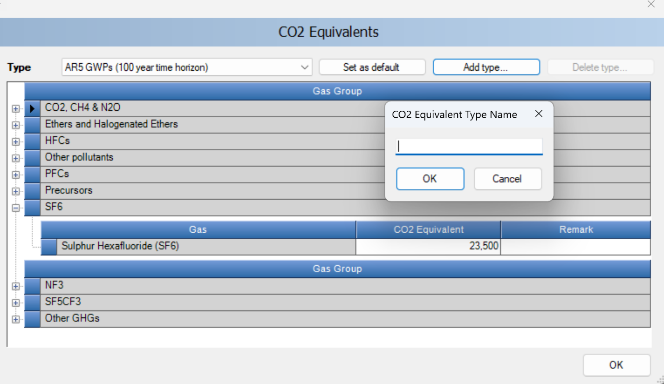



2.4 Set CO₂ Equivalent Values
Adding / Deleting Custom CO₂ Equivalent Type
To add a custom CO₂ equivalent type:
Select Add type.
Enter the unique name of the new type and select
OK - the new custom CO₂ Equivalent type will appear
within the Type list.
Use grid to enter desired CO₂ Equivalent for each gas
within all gas groups.
To delete a custom CO₂ equivalent type:
Use Type list to select custom CO₂ Equivalent type to
be deleted.
Click Delete type button and commit or cancel deletion
when asked.

Slide 38
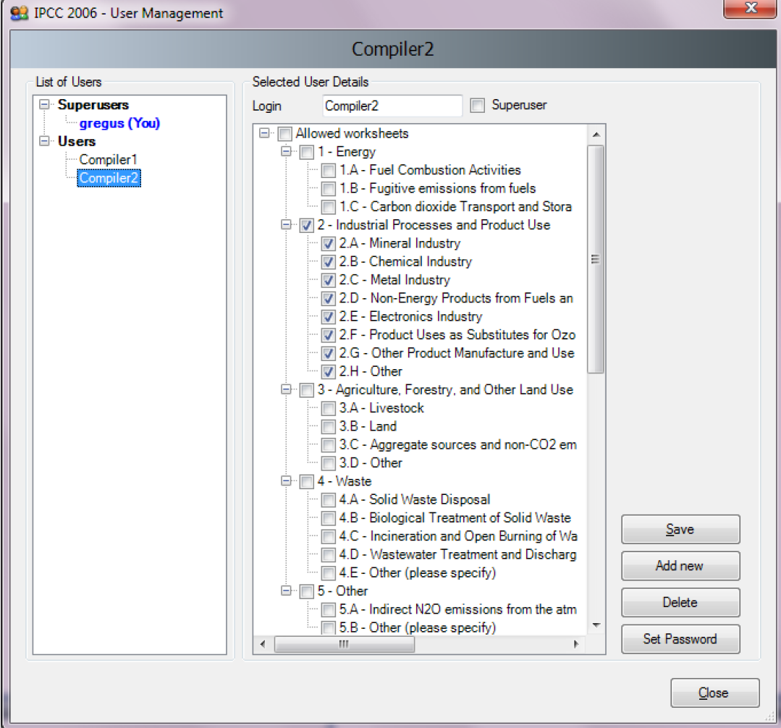
Define Database’s Users
To add, delete or modify users of the currently open database:
On the main menu, select Administrate
Select Users
List of Users
This section contains the list of all users defined in the database, divided
into two groups:
Superusers – contains the list of all Superusers. User marked in blue represents
the currently logged in user. Following restrictions apply for Superusers:
  Currently logged in superuser is prohibited to delete itself.
  All worksheets can be visualized and edited.
Users – contains the list of ordinary users. The following restrictions apply:
  Access to Administrate section of the Software is prohibited.
  Can visualize and edit only worksheets specified as Allowed Worksheets

Slide 39
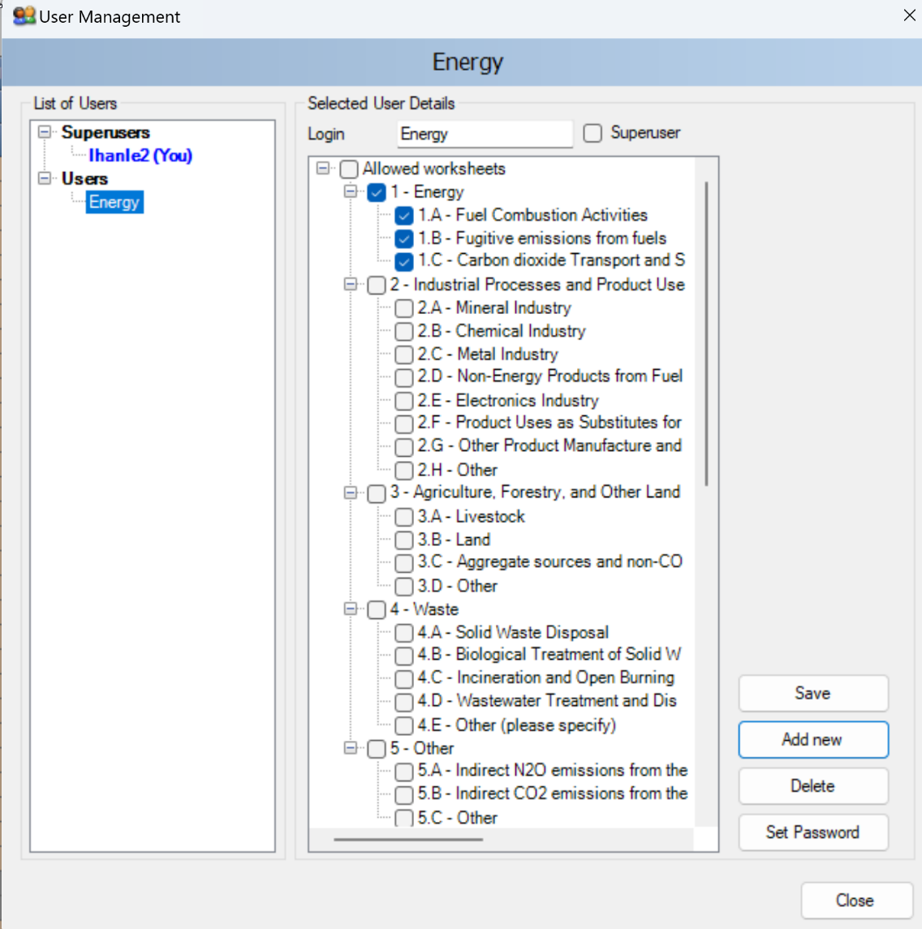



Adding Database’s Users
Adding new user
To add a new user:
Select “Users” so highlighted
Enter the desired unique login name into the Login textbox
Use Superuser checkbox to define user as a Superuser (checked) or ordinary user (unchecked)
In case of ordinary user, define Allowed Worksheets for the user to work with
Click Add new button to save new user into database
Click Set password button to explicitly set password for new user
Highlighting any user in the List of Users will indicate:
Login: representing the login name. Login name must be
unique for a particular database
Superuser: indicates if that user is a superuser
Allowed worksheets: defines the list of worksheets user can visualize and edit (applies to ordinary users only)

Slide 40
Manage Users
Editing existing user
Take following steps to edit existing user:
Select desired user within List of users
Change desired user details (e.g. worksheets that use may access/edit)
Click Save button to save changes into database
Deleting existing user
Take following steps to delete existing user:
1. Click on the desired user within List of users
2. Click Delete button to delete user
3. Confirm or cancel deletion when asked
4. Close window
Reset password of existing user
Take following steps to reset existing user’s password:
1. Click on the desired user within List of users
2. Click Set password to reset password to new one
3. Enter and confirm new password when asked

Slide 41
2.6 Distribute database
Next Steps
After performing all steps described in the previous slides, the database is ready to be used or distributed to additional inventory experts, if necessary.
The next steps are as follows:
Project manager / Inventory compiler saves database
See Save Database
Project manager / Inventory compiler decides how database will be shared – one shared database versus maintaining multiple databases
See Distribute database
Sector experts input data and send to Project manager/ Inventory compiler
See Maintaining Multiple Copies of the Database: Sharing Data

Slide 42
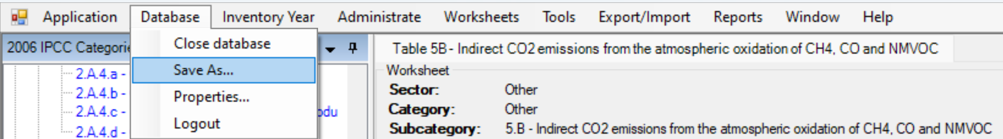
Save Database
To save currently open database:
On main menu, select Database.
Select Save as…
Select destination folder and file name
  You will be notified that the current database will be closed before saving; and reopened after saving and asked to confirm.
Choose whether to remove password protection.
Important : Do not remove password protection. Removing the password protection will prevent the database from opening in the Software (The Software strictly accepts password protected database only for security reasons).
Decide whether to compress (ZIP) database file (compressed database file must be uncompressed (unzipped) before opening it in the Software).

Slide 43
Distribute database
Share one database versus maintaining multiple database
Share database on network drive
Copy database file, as created in previous slides, to a shared folder on the network, where other inventory experts have read/write access.
This alternative is strongly recommended, because after making administrative changes, all compilers are automatically affected.
Send database to multiple users
(e.g. via email)
Administrative changes must be performed within each copy of the database to maintain consistency across inventory experts.
This approach can lead to inconsistency amongst compilers and therefore is not recommended.

Slide 44
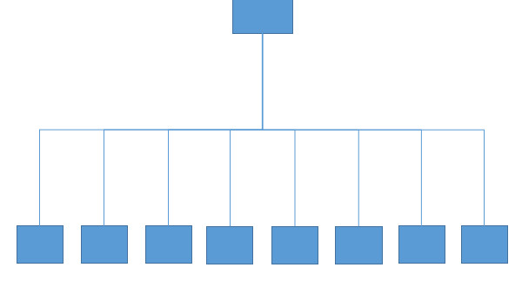
Sharing the Database in the Cloud
shared
database
users
Superuser shall set a shared drive
This approach is preferable, as all NGHGI data can be shared in real time, including information necessary for the CRT.
Note that sharing the database with
Microsoft Sharepoint will not allow users to access it
Googledrive may likely cause data losses
Microsoft SQL Server cannot be used with the current version of the Software

Slide 45
Sharing the Database in the Cloud
A single database is shared on an internet
Setup a Windows Server on a PC with Remote Desktop enabled, somewhere in the cloud (or in an intranet), and install the IPCC Inventory Software on it
Allow users to connect to the Windows Server PC with their PCs by using Remote Desktop application from anywhere just through internet connection
The use of a VPN (virtual private network) software is not needed, although may be desirable to enhance the security of the data flow

Slide 46
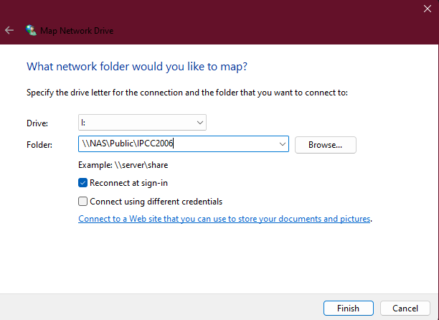
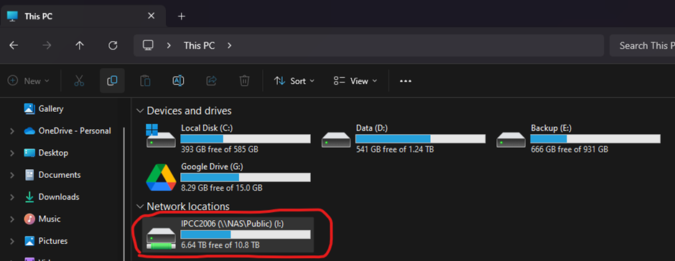
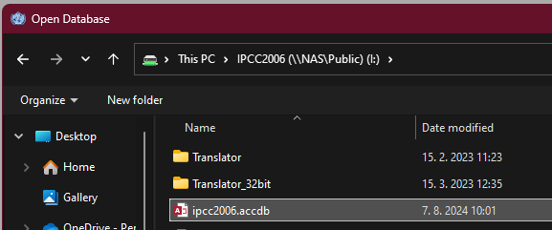
Sharing the Database in the Cloud
A single database is shared on an intranet
Superuser shall set a shared drive within a LAN (Local Access Network) where the database is saved and to which all experts are given access
Map network location where database file resides as local drive. In the example below „NAS“ is name of remote PC within LAN that has „Public“ folder shared to other PCs in the LAN
This is how mapped drive looks like in File explorer
This is how mapped drive looks like in File explorer

Slide 47
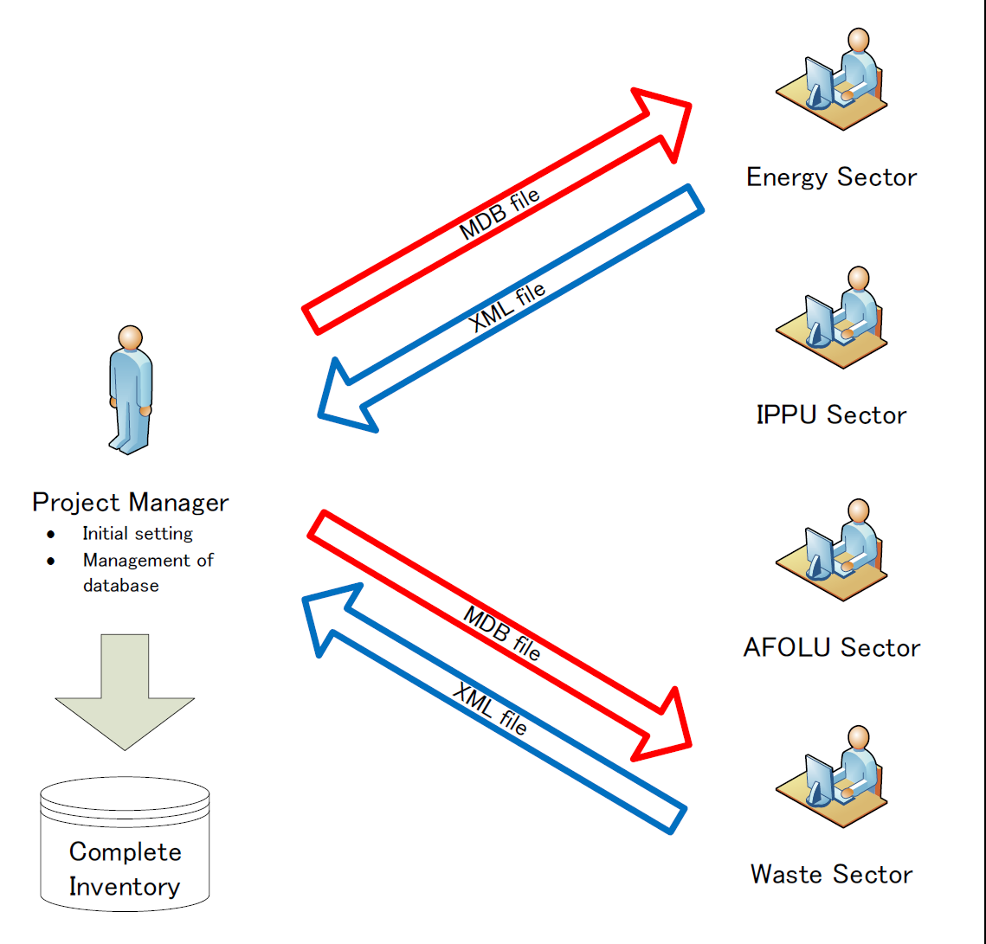

Maintaining Multiple Copies of the Database: Sharing Data
Sector experts enter data and send an XML file(s) to Project manager / Inventory compiler
The following steps, should be performed iteratively.
1. Inventory compiler initializes the database as described in previous slides.
2. Inventory compiler provides the database (ACCDB file) to each user.
3. After users update data in their database, worksheet data exported as XML file.
4. Inventory compiler imports the worksheet XML file(s) to his/her master database.
5. If applicable, after users input information for UNFCCC reporting, the CRT data set can be exported as XML file, for information. The Inventory compiler can import the CRT dataset into his/her application for viewing. However, the CRT data set is not automatically aligned with the worksheet data in the compiler’s database. The “Refresh” functions can be used to “link” the worksheet data and each CRT data set, and the CRT data set will be updated with latest worksheet data. It is currently not possible to link individual sectoral CRT data sets to the master inventory database.
Note: This approach likely requires the Inventory Compiler to compile additional explanatory information for the CRT after XML import, working with sector experts, as necessary
Workflow

Slide 48
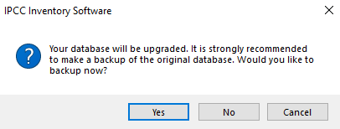
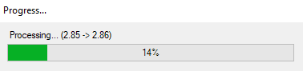
Automatic Database Upgrade
The Software supports automatic conversion of databases coming from previous versions of the Software. This means users can comfortably import their existing databases without additional effort.
When a database from an older version of the Software
is open in a new version, users will be prompted to start
automatic database conversion.
Important
- It is strongly recommended to make a backup version of the original
database prior to this conversion. Although data loss is not expected
during the upgrade process, maintaining a backup version ensures
that information can be recovered.
- Note that once a database is upgraded, it cannot be opened in older
versions of the Software. All members of an inventory team should
use the same version of the Software.
After the database is successfully converted it can be opened with the new version of the Software.

Slide 49
Creating and Initializing a new Database
each database contains 1 GHG inventory only
Note: When setting a new database, by default, the Software retains preferences set for the latest database

Slide 50
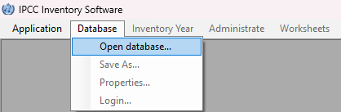
Creating a new Database
The IPCC Inventory Software enables users to work with multiple databases
Once a user completes the Software First Run, a database with specific settings and established access credentials for a Superuser is created. Furthermore, users may wish to create additional databases, and even with different settings.
For each new database, a Superuser Login and Password combination is required to be set, and such combination cam differ database by database.
To create a new database:
Take a blank database of the IPCC Inventory Software.
A blank database is one that has never been opened, allowing it to be initialized with a new Login and Password.
Open it with the relevant Database functionality accessed through the Main Ribbon of the Software:
Follow same instructions provided in the section First Run
Having completed this procedure, the initialization of the new database is done in the IPCC Inventory Software

Slide 51
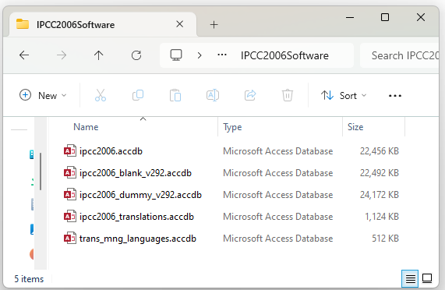


Where Databases are located
When the Software is installed on a computer, a folder (C:\ProgramData\IPCC2006Software) containing the following 3 databases is also created:
ipcc2006 - will be used during the "First Run“
ipcc2006_blank - blank database
Ipcc2006_dummy - database with dummy data pre-filled
The ipcc2006_blank_vxxx.accdb file contains a blank database that has never been opened, which thus has not been initialized with a Login and Password.
As soon as a blank database is opened in the Software and a Superuser is set, it ceases to be a blank database and can no longer be used to create a new one.
Thus, each new database is to be created first as a copy of the ipcc2006_blank_vxxx.accdb file to avoid to lose it.
Predictable location
Local Disc (C:)
>
ProgramData
>
IPCC2006Software

Slide 52
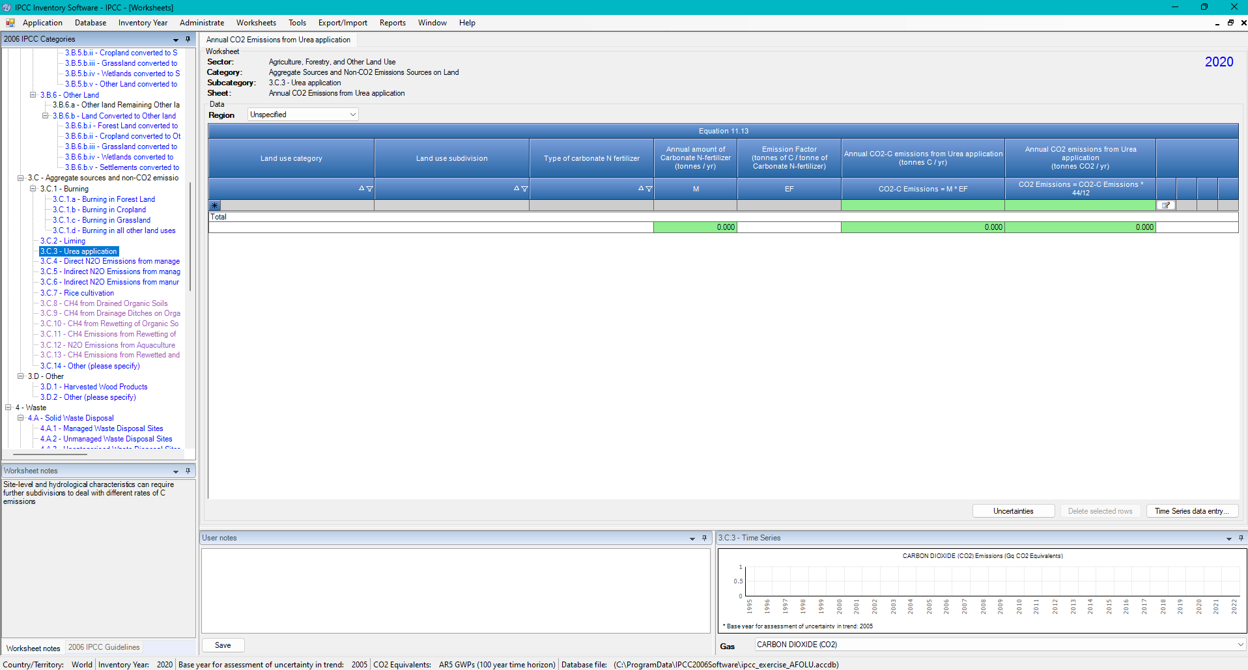
Where Databases are located
If you do not see ProgramData in C: , then verify that the folder where the databases are saved is in ProgramData by checking the location shown at the bottom of the main window
As for instance:

Slide 53
Visualizing a Hidden folder
if the location of databases is in ProgramData, and this folder is not visible, then according to the WindowsOS version installed on the computer:
Windows 11 | Windows 10
Open File Explorer Press Windows + E or click the File Explorer icon
Select View > Show > Hidden items | Select View > Options > Change folder and search options
 | Select View tab
 | (in Advanced settings) Select Show hidden files, folders, and drives
 | Press OK

Slide 54
Making copies of the Blank Database
Making a copy of the Blank Database
Open the folder @ C:\ProgramData\IPCC2006Software
Check if the folder contains a blank database, as ipcc2006_blank_vxxx.accdb.
If there is not a blank database, download it at https://www.ipcc-nggip.iges.or.jp/software/index.html
Make a copy of the blank database and save it, preferably in the same folder
  Either users select the file and copy it using Ctrl+C, then paste it using Ctrl+V
  Or users right-click on the file and select Copy, and then right-click on the folder and select Paste
  Finally, users Rename the copied file as needed.

Slide 55
Navigating the Main Ribbon

Slide 56
Main Window

Slide 57
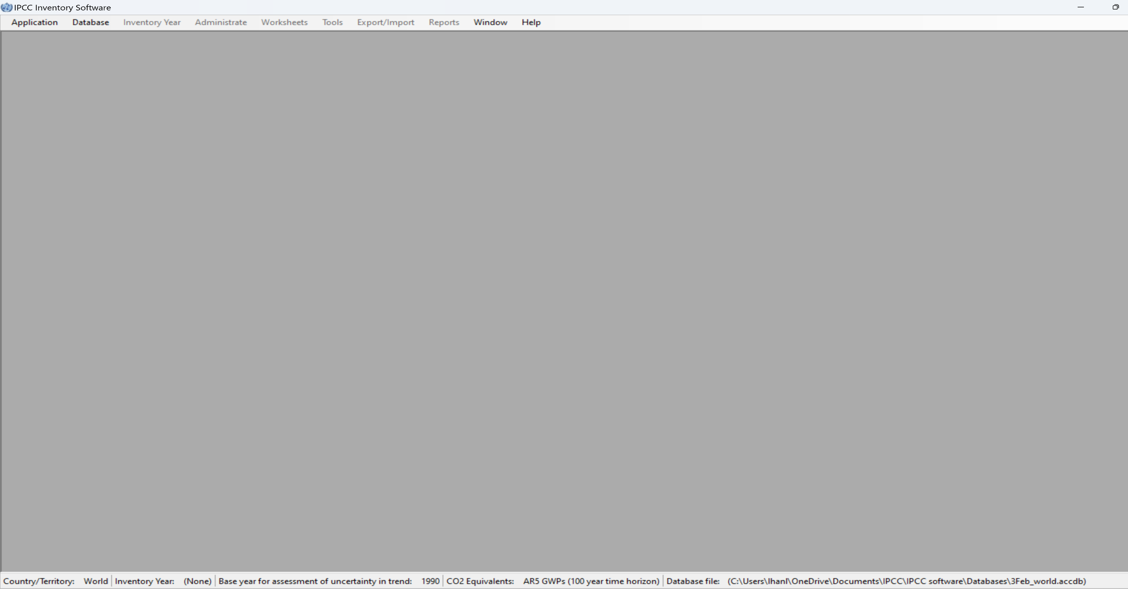
Main Window
The Main window is a Multiple Document Interface window which acts as a container for all other software dialogs and windows.
The main window consists of:
Window title – Main software title followed by the login name of user (when logged in)
Main ribbon (top) – for accessing all software functions / modules.
Working area (center) – place where all dialogs and child windows are displayed.
Status bar (bottom) – bar that contains useful information related to currently open database, currently chosen Inventory Year, etc.

Slide 58
Application Menu

Slide 59

Application Menu
1
2
3

Slide 60
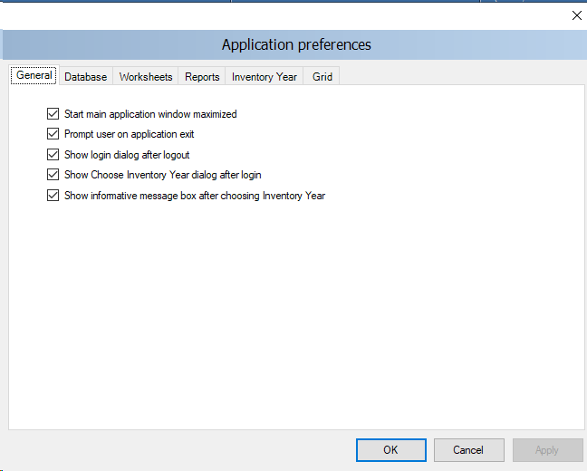
Application Menu - Preferences
1
2
3
4
5
6

Slide 61
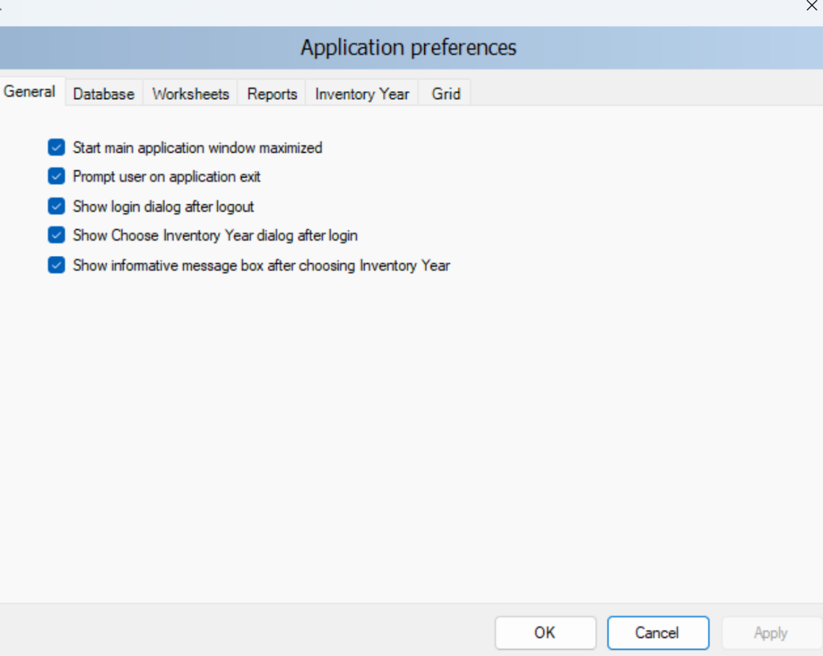
Application Menu - Preferences
Start main application window maximized – if checked, main application window size will be automatically scaled to fit the whole available screen after starting the Software.
General
The Project manager / Inventory compiler may have set initial preferences. Sector experts can adjust these under Preferences
Prompt user on application exit – if checked, user is always prompted whether to really exit application or not.
Show login dialog after logout – if checked, new login dialog will appear automatically after currently logged in user logs out.
Show informative message box after choosing Inventory Year – if checked, user is informed of currently active inventory year after activating particular inventory year (activated automatically or by user action).
Show choose inventory year dialog after login – if checked, user is prompted to choose inventory year to work with. If unchecked, previously used inventory year will be activated automatically.
Select Apply after making any changes.

Slide 62
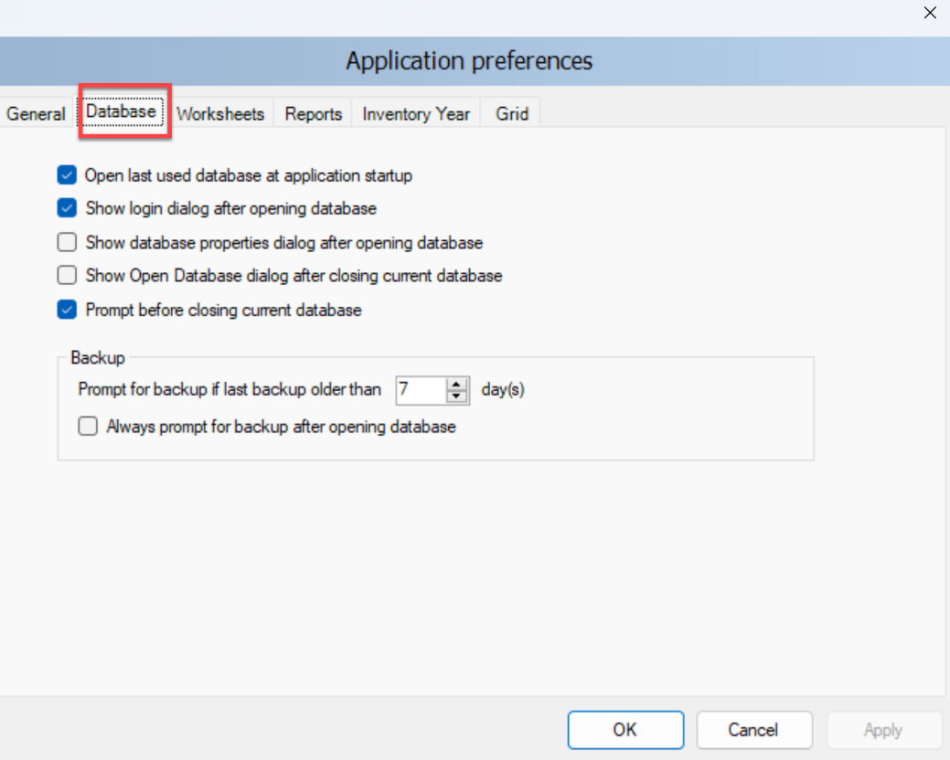
Application Menu - Preferences
Database
Open last used database at application startup – if checked, previous database will
automatically open at startup; otherwise user must explicitly open desired database.
Show login dialog after opening database – if checked, login dialog will be displayed
automatically after opening the database file; otherwise user must explicitly open login
dialog via menu.
Show database properties dialog after opening database – if checked, dialog
containing currently open database details will be shown automatically after
opening database file.
Show Open Database dialog after closing current database – if checked, Open
Database dialog will be automatically shown after closing current database.
Prompt before closing current database – if checked, user will be asked to confirm the
closing of the current database; otherwise the database will be closed without warning.
Prompt for backup if last backup older than N day(s) – user is automatically asked to make a backup of the database if last backup is older than N day(s).
Always prompt for backup after opening database – if checked, user is asked to make a backup of the database every time the database is open, no matter how old the last backup.
Select Apply after making any changes.

Slide 63
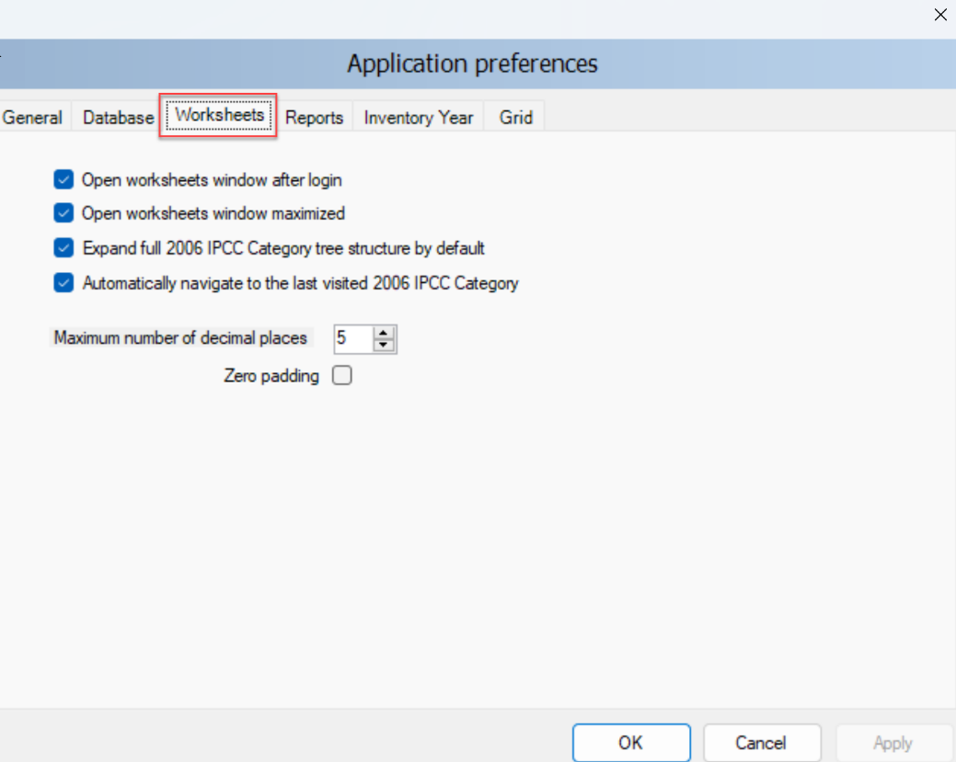
Application Menu - Preferences
Worksheets
Open worksheets window after login – if checked, window containing
worksheets will be automatically open after user login; otherwise user must
open worksheets window via menu.
Open worksheets window maximized – if checked, worksheets window will automatically scale to fit main application window.
Expand full IPCC 2006 category structure by default – if checked, tree
containing 2006 IPCC hierarchy will be expanded automatically to show the whole hierarchy; otherwise only main sectors will be shown initially.
Automatically navigate to last visited IPCC 2006 Category – if checked, last
visited IPCC category will be automatically selected upon opening the Worksheet window.
Maximum numbers of decimal places – defines maximum numbers of decimal places for numbers to be displayed in calculation sheets (worksheet grids).
Zero padding – if checked all decimal numbers in grids will be zero-aligned. E.g. 0.1 will become 0.10000 - padded with zeros up to the maximum number of decimal places – 5 in this case.
Select Apply after making any changes.

Slide 64
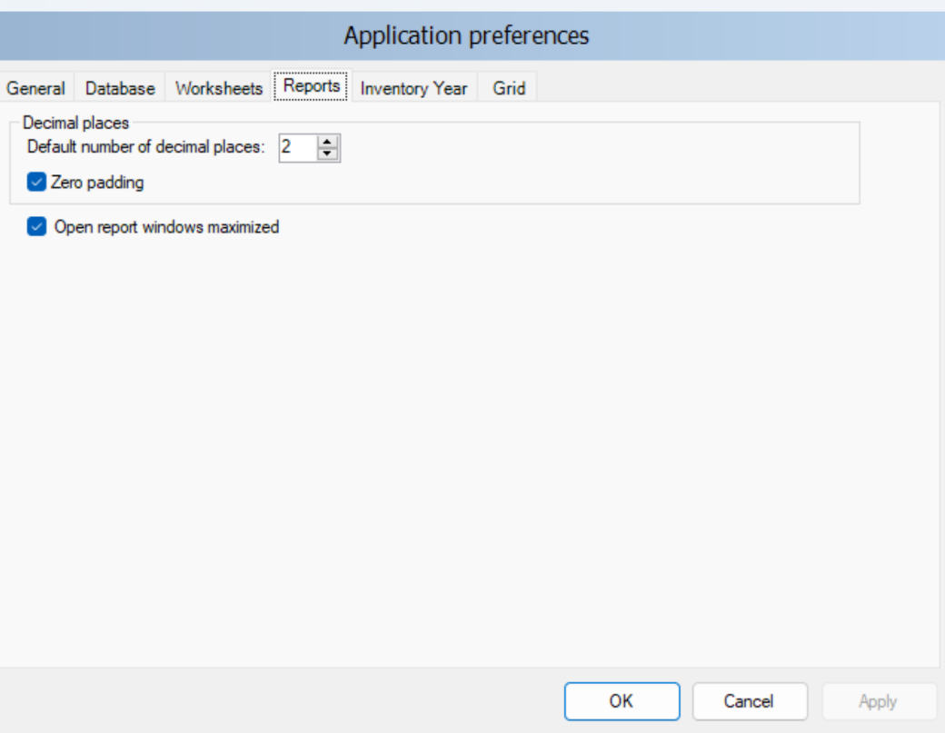
Application Menu - Preferences
Reports
Default number of decimal places – numbers in reports will be automatically rounded according to defined number of decimal places here.
Zero padding – if checked all decimal numbers in grids will be zero-aligned. E.g. 0.1 will become 0.100 - padded with zeros up to the maximum number of decimal places – 3 in this case.
Open report windows maximized - if checked, reporting windows will automatically scale to fit main application window.
Important According to WindowsOS Control Panel / Regional Settings in the computer, the Software requires the use of a period (.) or a comma (,) as decimal separator.
Select Apply after making any changes.

Slide 65
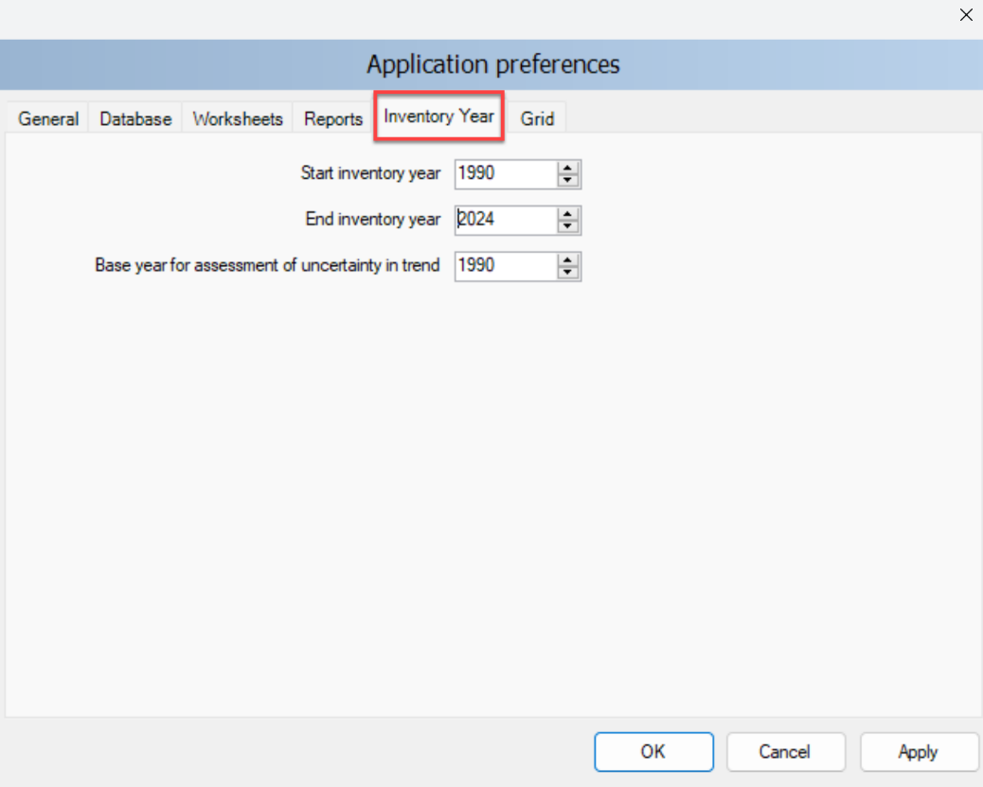
Application Menu - Preferences
Inventory year
The project manager already set the inventory year time series prior to distributing the database – see First Run.
Should you want to change this (e.g to include later years) you can.
A change in the Inventory Year panel shall be coordinated with the project manager given the manager can import data for inventory years set in its database only.
Select Apply after making any changes.

Slide 66
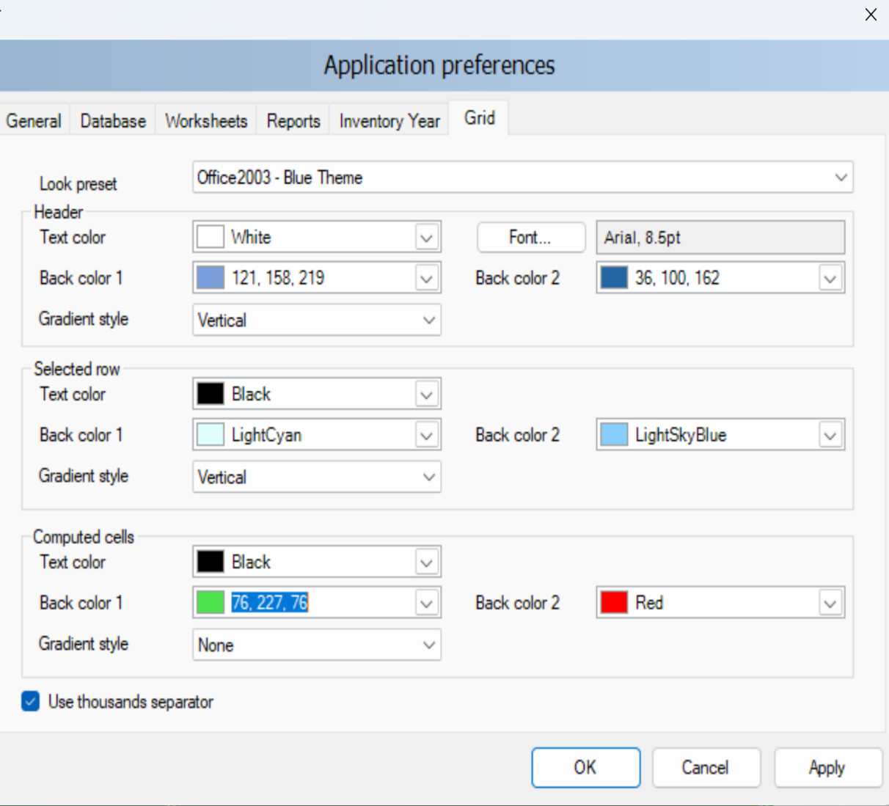
Application Menu - Preferences
Grid
The user has the ability to modify the appearance of the Software, based on their personal preferences
Look preset – provides the user with the set of standard predefined look presets to choose from
Header - defines the look of the grid header
Selected row – defines the look of the selected grid row
Computed cells – defines the look of grid cells that are computed (calculated)
Use thousands separator – if checked, thousand separator will be used to separate thousands in all numbers in grids.
Note: Thousands separator follows the operating system’s Control Panel / Regional Settings.
Select Apply after making any changes.

Slide 67

Application Menu - Language
1
…

Slide 68
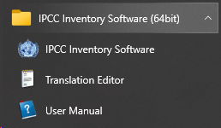
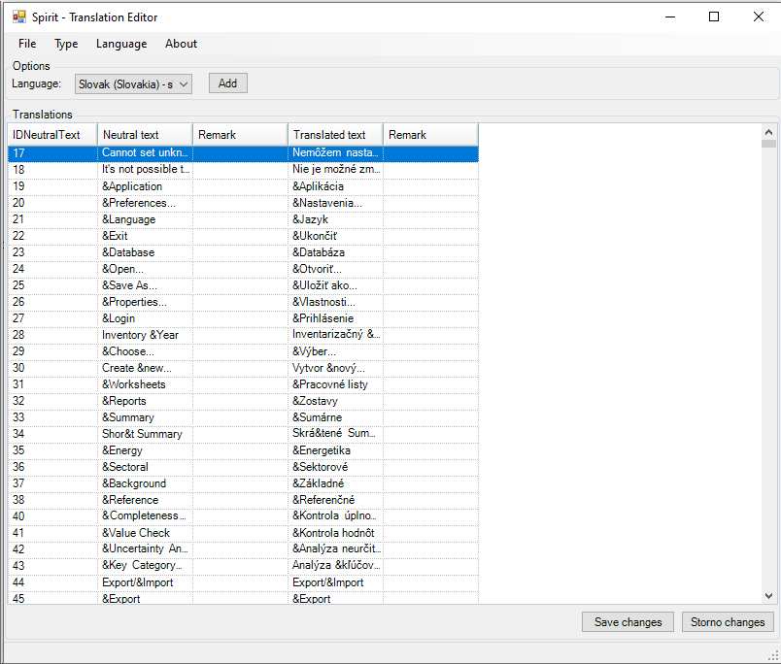
Application Menu - Language
Language
To set alternative languages in the menu
Users shall first create a file containing the translation by opening the Translation Editor (which is included in the setup of the Software)
Select Language from dropdown the user would like to add
3. To produce the file, users compile the translation of each word/sentence listed in the Translator
4. When the Software is re-opened, the user can switch between different languages. The default language is English.

Slide 69
Screen Resolution for Optimal Viewing of Software
When a Display is not set to its optimal resolution (i.e. recommended) and/or its optimal scale (i.e. recommended), the Software may not be correctly displayed and thus windows appear trunked
In case of problems in the visualization of the Software, please set the resolution and the scale to the value indicated in your computer as recommended
Where a problem in visualization persists, set resolution to 1600 x 900
Doing so, problems in Software’s visualization are addressed.

Slide 70
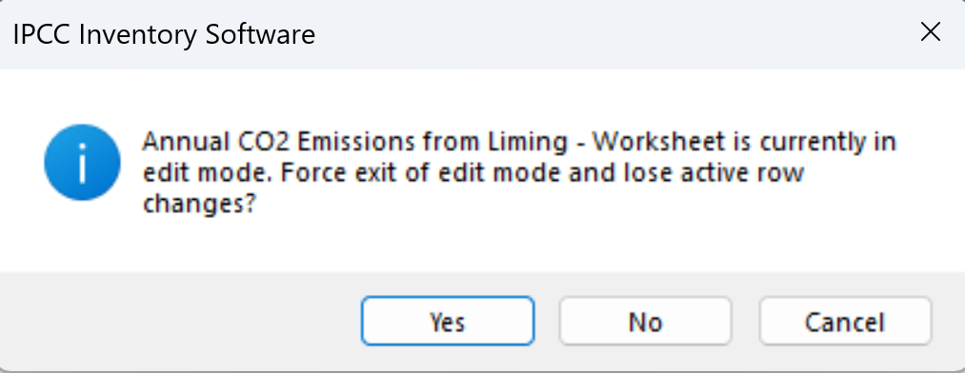
Application Menu - Exit
Upon exiting the Software, users are asked to confirm exit.
If any row of data has not been saved, users will be prompted again if you really want to exit:
Clicking “Yes”, exit is forced and all unsaved data are lost.
Clicking “No”, users are moved back to the worksheet to finalize data entry and to save entered data.

Slide 71
Database Menu

Slide 72
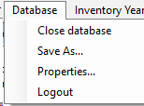
Database Menu
1
2
3
4

Slide 73
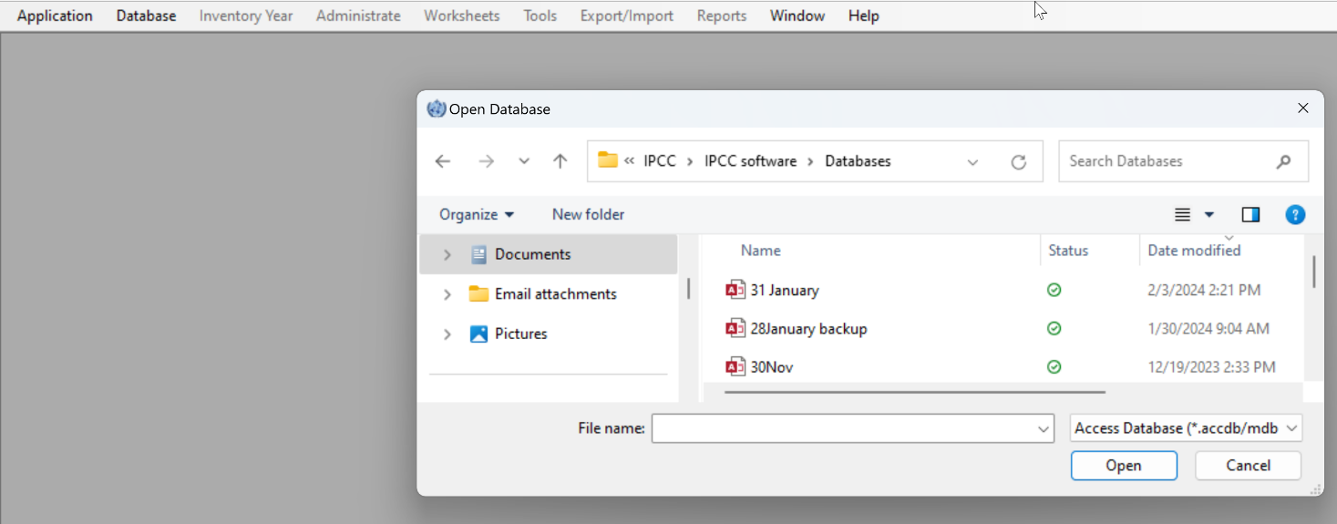
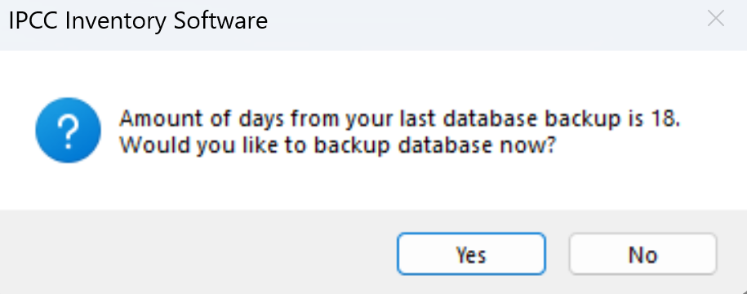
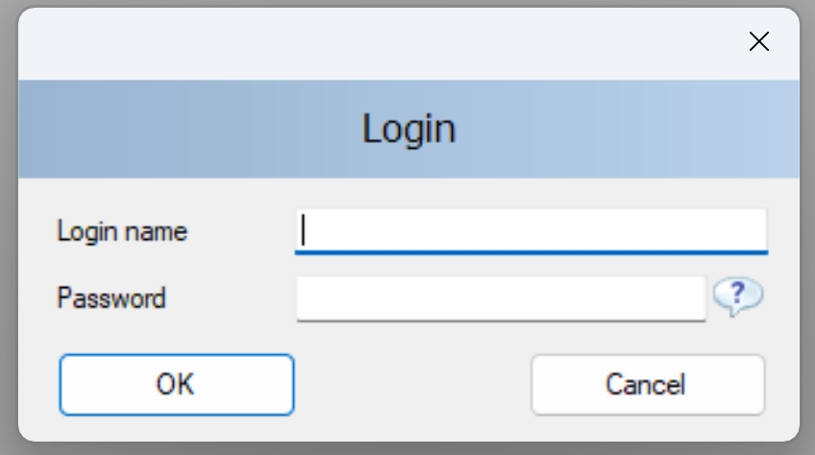
Database Menu – Close/Open
Open / Close Database
If the database is open, use this menu item to close the current database. You will be asked to confirm if you want to exit. If you select “Yes”, the currently logged-in user will be logged out automatically. All database-related functions and modules of the Software are disabled.
If database is closed, use this menu item to browse for, and open, the new database. You will be prompted if you want to make a backup upon opening (depending on selection in Preferences (see Preferences - Database).
All database related-functions will become available again after valid user logs in.

Slide 74
Database Menu – Save as
This menu item allows the user to save the database under a different file name to a different location. It is possible to compress (ZIP) the saved database file to save space. This opens the possibility to maintain several independent versions of the database (although compressed database file must be uncompressed (unzipped) before opening it in the Software)
The database is password protected. Although it is possible to remove password protection during saving, a database without a password cannot be opened in the Software.
Important
If password protection is removed, the database cannot be anymore opened by the Software.

Slide 75

2.6 Distribute database
Database Menu – Save as
On main menu, select Database. This will save the currently open database.
Select Save as…
Select destination folder and file name
  You will be notified that the current database will be closed before saving; and reopened after saving and asked to confirm. Where you do not confirm the database is not saved
4. Choose whether to remove password protection.
Important
Do not remove password protection. Removing the password protection will prevent the database from opening in the Software (The Software strictly accepts password protected database only for security reasons). Nevertheless, you may remove the password to make the database accessible by another software
5. Decide whether to compress (ZIP) database file (compressed database file must be uncompressed (unzipped) before opening it in the Software).

Slide 76

Database Menu – Properties
Selecting this menu item displays a dialog window containing properties of
the currently open database. The following information is displayed:
Database file – full path to currently open database file (ACCDB)
Database version – Software’s version
Database size – size of the database file in bytes
Date created – the date when the database was created
Date modified – the date of the last modification of data in the database
Last backup – the date of the last database backup
CO₂ Equivalents – currently selected default CO₂ equivalent type. CO₂ equivalent types can be managed using the Administrate / CO₂ Equivalents menu – see Set CO2 Equivalent Values
Inventory Years – the list of inventory years in the currently open database – to see inventory years, see Inventory Year Menu; to delete inventory years, see Delete Inventory Year
Users – the list of defined users in the currently open database – see Define Database’s Users and Adding Database’s Users
The button Compact & Repair is used to compact (i.e. reduce size on disk) or repair the database file (in case corrupted).

Slide 77


Database Menu – Logout
This menu item logs out currently logged in user. When selecting Logout:
If any row of data has not been saved, users will be prompted again if he/she really wants to exit:
Otherwise, user is instantly logged out and a login dialogue box appears to allow to log in again
Important
This functionality is likely to be used when users leave the working position for a break and want to avoid that somebody else access the database in their absence
This functionality is not to be used to switch from one database to another one (to do so users shall close the database and open the next one).

Slide 78
Inventory Year Menu

Slide 79

Inventory Year Menu
1
2

Slide 80

Inventory Year Menu - Choose
This menu allows the user to choose current inventory
year as well as to create new inventory year.
Users usually need to switch between inventory years when
Entering inventory data, to do so:
Select Inventory Year from main menu.
Select Choose.
Select the inventory year to work on from the dropdown list.
Select OK - all related Software modules will update data and
information to correspond to the new Inventory Year.
Important
The years available in the dropdown list are those that users have already added. Where the year of interest is not listed, users disengage the dropdown and select the option to Create new - see Inventory Year Menu - Create

Slide 81

Inventory Year Menu - Create
Take the following steps to create new Inventory Year:
Choose available Inventory Year from the New Inventory Year list.
The years available in the dropdown list includes years within the
Inventory time series set under Application Preferences –
Inventory year tab that have not yet been created. (see
Application Menu- Preferences - Inventory Year)
Decide whether to:
  Create empty inventory year or
  Copy data from an existing inventory year
by selecting the appropriate button. In case of copy, choose the source inventory year from the corresponding list of available inventory years.
Select Create to create the new inventory year. Once the new year, is created. it is automatically set as the current Inventory Year.

Slide 82

Inventory Year Menu – Data Entry
Efficient data entry using Inventory Year menu
Tip: The efficient and optimal way to enter data is:
Complete inventory for one basic year at first
2. Create additional years by copying data from the existing year inventory created in Step 1 (see Inventory Year Menu- Create) .
3. Use time series data entry to make adjustments to data across years (see further discussion on time series, beginning at Time Series Data Entry)
Important
Ideally you should start with the first inventory year in your inventory time series (e.g. 1990). For some sectors (e.g. entering data for the Land Representation – (see Guide to Land Representation) you must start with the first year.

Slide 83
Administrate Menu

Slide 84

Administrate Menu
1
2
3
4
5
6
7

Slide 85
Administrate Menu
This menu section is only available to Administrators (i.e. Superusers). From this menu, the Superuser(s) can:
Add / Delete / Modify Users – see discussion starting at Define Database’s Users
Set Country / territory – see First Run
Note that changing the Country/Territory determines the closure of the currently open database and the setting of a new database (all data entered won’t be transferred to the new database)
Add CO₂ equivalent types, and set default – see discussion starting at Set CO2 Equivalent Values
Delete Inventory year – next slide
Access Data Managers for the Energy, AFOLU, Waste and IPPU sectors – see discussion starting at Data Managers- Energy
Note Although the Administrate tab is only accessible by Superusers, the Data Managers are also accessible via the relevant sectoral worksheets. So, sector expert users may still access the relevant Data Manager for their sector to populate data, as needed.

Slide 86


Administrate Menu – Delete Inventory Year
If you entered an inventory year in error, or would like to delete an intervening year from the inventory time series:
Select from the main menu Administrate.
Select Delete Inventory.
Select Year you want to delete.
Select Delete.
You will be prompted to confirm your selection to permanently
remove all inventory data for that year from the inventory.
Note: The inventory year that is actively open on the screen cannot be deleted

Slide 87
Administrate Menu – Data Managers - Energy
For complete information on this data manager, please see the Energy Guidebook (available at https://www.ipcc-nggip.iges.or.jp/software/index.html)
  Data Managers provide the user a single landing page to add underlying AD and/or parameters that are relevant for multiple calculation worksheets in a given sector. The Data Managers are also accessible from relevant worksheets of a sector.
  Fuel manager: The Fuel Manager contains data on carbon content and calorific value for each fuel used in the NGHGI. All IPCC default fuels are listed in it; in addition, the user can enter its own user-specific fuels together with relevant data required by the Fuel Manager.
Users may instead access the Fuel Manager by clicking the relevant button at the bottom of the right-hand side of the relevant calculation worksheet .

Slide 88
Administrate Menu – Data Managers - IPPU
For more information on this data manager, please see the IPPU Guidebook, (available at https://www.ipcc-nggip.iges.or.jp/software/index.html).
  Data Managers provide the user a single landing page to add underlying AD and/or parameters that are relevant for multiple calculation worksheets in a given sector. The Data Managers are also accessible from relevant worksheets of a sector.
  F-gas manager (chemicals): It contains a list of F-gases, and associated climate-relevant value in the common metric (by default AR5 GWP₁₀₀), among which user selects those used in its NGHGI; in addition, the user can enter its own user-specific chemical together with the associated value in the common metric selected.
  F-gas manager (blends): It contains a list of chemical blends containing at least one F-gas, among which user selects those used in its NGHGI; in addition, the user can enter its own blends by providing, for each blend, each component as well as its percentual contribution. Note that each component for which the GHG contribution is to be calculated shall be listed in the CO₂ Equivalents Tab with the associated metric (e.g. AR5 GWP₁₀₀)

Slide 89
Administrate Menu – Data Managers - AFOLU
For more information on the respective data manager, please see the relevant Guidebook (available at https://www.ipcc-nggip.iges.or.jp/software/index.html)
  Data Managers provide the user a single landing page to add underlying AD and/or parameters that are relevant for multiple calculation worksheets in a given sector. The Data Managers are also accessible from relevant worksheets of a sector.
  Livestock Manager: This menu item opens a dialog window which allows managing of Livestock populations for AFOLU category 3.A – Livestock. The Manager is comprised of three tabs: Geographic zones, Livestock characterization and Manure Management System.
  Land Use Manager: This menu item opens a dialog window which allows managing of Land Use Subdivisions under AFOLU category 3.B – Land. The Manager is comprised of a single tab, Land use subdivision, that opens for all land use subcategories.
  Land Representation Manager: This menu item opens a dialog window which allows managing Land Representation for AFOLU categories under 3.B – Land. The Manager is comprised of four tabs; two tabs to enter data: Regions and Land representation table, and two summary tabs: Land-use conversion matrix (Approach 2&3) –limited to a single Region- and Total Land use conversion matrix (All regions and approaches) for the entire territory of the NGHGI.
Users may instead access any of the AFOLU Managers by clicking the relevant button at the bottom of the right-hand side of the relevant calculation worksheet .

Slide 90
Administrate Menu – Data Managers - Waste
For more information on this data manager, please see the relevant Guidebook (available at https://www.ipcc-nggip.iges.or.jp/software/index.html).
  Data Managers provide the user a single landing page to add underlying AD and/or parameters that are relevant for multiple calculation worksheets in a given sector. The Data Managers are also accessible from relevant worksheets of a sector.
  Waste manager: This menu item opens a dialog window which allows managing waste categories and associated waste types by decomposability class. For each waste type the following information is associated: DOC/DOCf/DM content/C in DM/Fossil C in DM. All IPCC default waste types are listed in it; in addition, the user can enter its own user-specific fuels together with relevant data required by the Fuel Manager.
Users may instead access the Waste Type Manager by clicking the relevant button in the Parameter worksheet of Category 4.A or at the bottom of the right-hand side of the relevant calculation worksheet for categories 4.B and 4.C.

Slide 91
Worksheets Menu

Slide 92

Worksheets Menu
This menu item displays the calculation worksheets as defined in the 2006 IPCC Guidelines, and, where applicable, the Wetlands Supplement and the 2019 Refinement.
Typically, the Software already displays the worksheets, and it is not necessary to use this menu function.
If you log in and do not see the worksheets, check in Application Menu - Preferences to see if you have checked open worksheets window after login. If this is unchecked in preferences, then selecting Worksheets from main menu will open the window containing the worksheets.
If you have checked the box “Open worksheets window after login”,
you will not need to select Worksheets from the main menu.
See next slides for detailed information on the list of Worksheets

Slide 93

Calculation Worksheet - Example
Categories
Worksheets
Sub-divisions
Default or User-defined process/technology
Default or User-defined EF & parameters
Activity Data
GHG emissions

Slide 94
Calculation Worksheets
The Software has been built to accommodate ALL methods and approaches in the 2006 IPCC Guidelines and the Wetlands Supplement, as well as the 2019 Refinement, where needed for interoperability.
The number of worksheets reflects the comprehensiveness of the system; a single inventory generally only use a fraction of these worksheets depending on approaches and methods applied.
Given that calculation worksheets have been built according to IPCC good practice, some calculation worksheets are used in a number of categories, while some categories may have a number of category-specific worksheets
Guidebooks, published by the Technical Support Unit (TSU) of the Task Force on National Greenhouse Gas Inventories (TFI) in the TFI website (https://www.ipcc-nggip.iges.or.jp/software/index.html), contain step-by-step instructions for the use of each and every calculation worksheet in the Software.

Slide 95
Calculation Worksheets - Summary
ADD Summary Table
For the full calculation worksheets map, by sector, see Annex I

Slide 96
Tools Menu

Slide 97

Tools Menu
1
2
3

Slide 98

Tools Menu – Reference approach
The Reference Approach is a top-down approach, using a country’s energy supply data to calculate emissions of CO₂ from combustion of fossil fuels.
The Reference Approach can be applied using relatively easily available energy supply statistics.
The Software has 4 TABs to enter data (3 TABS) and calculate results (1 TAB) for the Reference approach, see the Energy Sector Users’ Guidebook.
Interoperability
For users preparing a GHG inventory for upload to the UNFCCC ETF Reporting Tool:
According to para. 36 of the MPGs, “Each Party should compare the national estimates of CO₂ emissions from fuel combustion with those obtained using the reference approach, as contained in the IPCC Guidelines… …and report the results of this comparison in its national inventory report.” Thus, information added in the Reference approach tabs is included in the JSON file for upload to the UNFCCC ETF Reporting Tool .

Slide 99

Tools Menu – Uncertainty Analysis
This menu item creates Reporting Table 3.2 as defined in the 2006 IPCC Guidelines. The procedures for the calculations in this table are explained in Volume 1, chapter 3 of the 2006 IPCC Guidelines.
Uncertainty values are not entered here, but in each Worksheet. A user should enter uncertainty values for all activity and emission factors. Default uncertainty values are applied, where available, when the user does not enter any uncertainty values.
There is no limit and no check for uncertainty ranges, i.e. it is the responsibility of the user to define the appropriate values. Default uncertainty values presented in the 2006 IPCC Guidelines are pre-loaded as default upper and lower limits for most categories.
To perform Uncertainty Analysis, click the
Refresh Data button.
Interoperability
For users preparing a GHG inventory for upload to the UNFCCC ETF Reporting Tool:
Decision 5/CMA.3 does not contain a common reporting table for the reporting of uncertainty, therefore data entered in these worksheets are not included in the JSON file for upload to the UNFCCC ETF Reporting Tool. Information on the uncertainty analysis is to be included in the NID, consistent with the requirements in paragraphs 29 and 44 of decision 18/CMA.1

Slide 100

Tools Menu – Key Category Analysis
It is good practice for each country to identify its national key categories in a systematic and objective manner, by performing a quantitative analysis of the relationships between the level and the trend of each category’s emissions and removals and total national emissions and removals. Two Approaches for performing the key category analysis have been developed. Both Approaches identify key categories in terms of their contribution to the absolute level of national emissions and removals and to the trend of emissions and removals. The Software automatically calculates the key category analysis using Approach 1. The methods are described in Chapter 4.3, Volume 1 of 2006 IPCC Guidelines.
To perform Key Category Analysis, click the Refresh Data button.
Interoperability
For users preparing a GHG inventory for upload to the UNFCCC ETF Reporting Tool:
Countries reporting an inventory under the Paris Agreement are required to report in the NID a key category analysis, consistent with paras 25, 41 and 42 of the MPGs. The approach 1 key category analysis, which is to be reported in CRT table 7, will be automatically calculated in the UNFCCC ETF Reporting Tool, by that tool and based on data entered in that tool (including data that has been imported from the IPCC Inventory Software). The results of the Key Category Analysis in the Tools menu of the Software will not be included in the JSON. The results of the key category analysis in the Software and the UNFCCC ETF Reporting Tool may differ owing to different category classifications.

Slide 101
Export/Import Menu

Slide 102


Export/Import Menu
1
2
3
1
2

Slide 103



Export/Import Menu – Worksheet Data
Export Worksheet Data
This menu item opens a series of dialog boxes that allow users to select which sectors, sub-sectors, or categories and inventory years are to be included in the XML file.
To export worksheet data via XML:
1. Select one or more category/ies of interest. Categories containing worksheets (data) are marked blue. Click Next.
2. Select one or more years to export and click Export.
3. Select a folder and name the XML file when prompted. Close the Export process once 100% Progress is achieved

Slide 104

Export/Import Menu – Worksheet Data
Import Worksheet Data
This menu item opens a dialog window that allows import of an XML file containing an inventory or part thereof -i.e. one or more sectors or categories from one or more source inventory years- into one or more years of the target database.
To import worksheet data:
1. Select Open button to browse for XML file to be imported.
Check the details such as
  XML Import Version, shall be same XML version (as of version 2.96 XML versioning has been made separate from software versioning).
  Country/Territory, shall be same version of the Software running
  Source inventory year(s), inventory years included in XML import file.
IPCC Categories to import contains the list of all categories included in the source XML file. Select the categories of interest for import. All categories are selected by default.
Click Next button. In subsequent steps the users will select which year(s) to import, and the worksheets’ import policy.

Slide 105

Export/Import Menu – Worksheet Data
To import worksheet data – select years
Once category/ies are selected for import, the user has two choices for selection of inventory years to import:
Import selected source inventory year(s) into matching target inventory years
Select one or more years to import into the target database. Inventory years that are in the XML file, but not the target database will be designated as “new” and the Software will create the new inventory year upon import.
In the image to the right, the XML import file contains data for 1988-2024. The target database to which the file is being imported has only 1990 (this can be seen because entire list says (new) except for 1990).
Uncheck the box “automatically create missing (new) inventory years” to avoid creating new years. In the figure, only 1990 becomes an option for import.
2. Import single source inventory year into existing target inventory year
When this option is selected, import any inventory year in the XML import file into any inventory year in the target database.
3. Click Next button to select the worksheets’ import policy.

Slide 106


Export/Import Menu – Worksheet Data
To import worksheet data – select import policy
When importing XML, user has four options on how the worksheet data and any data populated in the Data Managers will be considered from the imported XML.
Functions of “merge, update existing, insert new, and replace” are determined at level of individual subdivisions/processes/technologies/etc
  Unique case: 2.F.1 and 2.F.3 (Tier 1 only), data will import as a new subdivision, in addition to the default “Unspecified”, so check the drop-down menu under Subdivision for the imported data!
Merge
Update existing records and insert new records
Update existing
Update existing records only and ignore new records
It is good practice to save a backup of your database prior to import.
Insert new
Insert new records only and keep existing records intact
Replace
Clear all existing records and replace with records in XML. Use with caution, as all existing data will be replaced.

Slide 107


XML Worksheet Import Scenario - Merge
Merge = Update existing records and insert new records
If the inventory compiler imports the sector expert file via merge, the compiler will have in database after import:
Inserted new record- 1.A.2.c
Inserted additional plants A and B for 1.A.2.f, retained Plant C.
Cement is unchanged, as there is no cement record from sector expert (this is result both if 2.A.1 is excluded from import file, and if 2.A.1 in import file, but blank).

Slide 108

XML Worksheet Import – Update Existing
Update existing: Update existing records only and ignore new records
If the inventory compiler imports the sector expert file via update existing, the compiler will have in database after import:
There would be no changes because there are no common records between the sector expert and the inventory compiler; so no existing records to update (this is result both if 2.A.1 is excluded from import file, and if 2.A.1 in import file, but blank).
If, for example, the sector expert had a “Plant C” in category 1.A.2.f, when the sector XML is imported by the inventory compiler, AD for Plant C would be updated.

Slide 109

XML Worksheet Import – Insert new
Insert new: Insert new records only and keep existing records intact
If the inventory compiler imports the sector expert file via insert new, the compiler will have in database after import:
1.A.2.c will import
Plant A and B will import; no change to Plant C
No change to cement
If, for example, the sector expert had a “Plant C” in category 1.A.2.f, when the sector XML is imported by the inventory compiler, Plant C from the sector expert would not import.
Notes:
If there are no common records between the sector expert and compiler, “insert new” and “merge” will have the same result.

Slide 110


XML Worksheet Import - Replace
Replace: Clear all existing records and replace with records in XML.
Use with caution, as all existing data will be replaced.
The inventory compiler’s database will be fully replaced for all categories that are checked in the XML import.
Important: This should be used with caution. For example, if the energy expert included IPPU in the XML file, but it was blank, and that XML is then imported in the inventory compiler’s database, all cement will be overwritten if the compiler selects “Replace”.

Slide 111

Export/Import Menu – CO₂ Equivalent [METRIC]
Export CO₂ equivalents
This menu item opens a dialog box that allows to export information of a custom metric into an XML file.
Information contained in the custom metric is hierarchically structured as: Custom metric / GHG group / GHGs.
To export a custom metric:
1. Select the desired Custom GWP type of interest or the particular Gases within a gas group(s) e.g. C4F10 among PFCs
2. Click the Export button, then select a folder and name the XML file when prompted.
Important:
Default metrics present in the Software CANNOT be exported

Slide 112

Export/Import Menu – CO₂ Equivalent [METRIC]
Import CO₂ equivalents
This menu item opens a dialog box that allows to import information of a custom metric saved in an XML file.
To import a custom metric:
1. Click the Open button to browse for the XML file to be imported.
2. Select in the GWP Types to import the information to import (e.g. the custom metric of interest or specific GHGs of interest). It contains the information hierarchically structured of all custom metrics included in the XML file. Select.
3. Click the Import button to begin importing. A progress bar will be shown to indicate the progress of import.
Important:
The Software can only import XML’ s generated by that version of the Software
Tip: Button View XML file is clicked to display the content of the XML file in a selected app

Slide 113

Export/Import Menu – Export to UNFCCC CRT
This menu item opens the dialog box CRT Data Set Manager that allows you to:
Visualize the UNFCCC CRT.
Complete additional fields in preparation for a submission to the UNFCCC.
Generate a JSON file that can be subsequently uploaded to the UNFCCC ETF Reporting Tool.
Export/import a UNFCCC CRT Data Set (in XML)
For further information on how to prepare the JSON file for upload to the UNFCCC ETF Reporting tool, see section on Interoperability.

Slide 114
Reports Menu

Slide 115

Reports Menu
1
2
3
4
5
6
7

Slide 116
Reports Menu
This menu item allows the user to view and download the 2006 IPCC Guidelines Reporting Tables.
Summary tables:
NGHGI Summary (1 table)
NGHGI Short Summary (1 table)
Sectoral Summary (1 table each sector, + Information item table for Energy)
Background sectoral tables:
  Energy, 5 (including 1 for the Reference Approach)
  IPPU, 11
  AFOLU, 10
  Waste, 3
All Tables allow users to:
Select the number of decimal places of the figures reported
Enter and save information in a documentation box
Export tables to Microsoft Excel
Interoperability
For users preparing a GHG inventory for upload to the UNFCCC ETF Reporting Tool:
The structure of the tables in the Reports menu follows the reporting tables in the 2006 IPCC Guidelines. The layout of these tables is not fully consistent with those agreed by Parties in decision 5/CMA.3. For those reporting under the Paris Agreement, the proper format of reporting tables are those contained in the main menu: Export / Import – Export – UNFCCC CRT

Slide 117


Reports Menu – Summary Tables
Summary table
This report displays all GHG emissions / removals divided into 2006 IPCC Guidelines Categories (up to level 3). The values are calculated from sectoral tables.
Short summary table
This reporting table displays all GHG emissions/removals divided into 2006 IPCC Guidelines Sub-sectors (up to level 2). The values are aggregated from Summary table.

Slide 118


Reports Menu – Sectoral Tables
Sectoral [summary] tables
This set of reporting tables is available for each sector and displays GHG emissions/removals divided into detailed 2006 IPCC Guidelines categorization (up to the most disaggregated level). The values are transferred from the Background tables. Sectoral tables contain additional functionality regarding Precursors (NOx, CO, NMVOCs, SO₂). The pale-yellow cells are editable.
Background [sectoral] tables
This set of reporting tables displays activity rates, fuel types (if applicable) and GHG emissions/removals divided into detailed 2006 IPCC Guidelines categorization (up to the most disaggregated level). The values are transferred from the calculation Worksheets. There is a special Reporting Table 1.4b for category 1.C CO₂ transport and storage which is editable.

Slide 119
Reporting – Summary
Main Menu
    → Report
IPCC Report | Level | Contents
Short summary (IPCC) | 1.A | Emissions/Removals
Summary (IPCC) | 1.A.1 | Emissions/Removals
Sectoral (IPCC) | 1.A.1.a.ii (most disaggregated level) | Emissions/Removals
Background (IPCC) | 1.A.1.a.ii (most disaggregated level) | AD, Emissions/Removals
Main Menu
    → Export
UNFCCC | Level | Contents
UNFCCC CRT | 1.A.1.a.ii (most disaggregated level) | AD, Emissions/Removals
Note: All reports, except UNFCCC CRT, can currently be exported as MS Excel file.
UNFCCC CRT can be saved as:
JSON file for upload to the UNFCCC ETF Reporting Tool
XML file that can be viewed in IPCC Software

Slide 120

Reports Menu – Uncertainties
This Reporting Table is an aggregated version of Uncertainty Analysis IPCC Table 3.2.
The list of aggregated IPCC categories is based on Vol.1, chpt. 4 (Methodological Choice IPCC Table 4.1).
Uncertainties from disaggregated levels are combined by multiplication according to Uncertainty Analysis IPCC Equation 3.1.

Slide 121
Window Menu

Slide 122


Window Menu
A
B
NOTE:
The list of worksheets you see in this window depends on what you have opened. When first starting, you will see just “Worksheets”. You can see here that this user has opened various reporting tables.

Slide 123

Window Menu
When working with the Software, users open a number of TABs while just visualizing one at time. Thus, the Software provides a function to:
Minimize all – minimizes all windows,
to display main working area
Close all – closes all open windows
Windows list – users can quickly switch the
visualization from a TAB to another TAB by
selecting from the Window list

Slide 124
Help Menu

Slide 125

Help Menu
1
2
3
4

Slide 126

Help Menu
PDF Manual – by selecting it, users download the Software Manual as a pdf file. The Manual is the first step to learn on how to use the Software
Check for updates – by selecting it, the Software checks if a new version has been published on the IPCC TFI website https://www.ipcc-nggip.iges.or.jp/software/index.html
Official website – by selecting it, the webpage dedicated to the Software -https://www.ipcc-nggip.iges.or.jp/software/index.html- opens in your internet browser
About… – by selecting it, users open a window with information on the Software

Slide 127
Data Entry

Slide 128
Windows

Slide 129

Windows
When working on data entry, the Software shows by default 5 windows
Categories – source/sink categories, those in black have no calculation worksheets, while categories from the 2019 Refinement are in magenta and those from the Wetlands Supplement are in lilac. Users select the category to work with by clicking on it.
Calculation worksheet or Timeseries graph – users select the calculation worksheet to work with by clicking on it among those listed on the top of the window. The timeseries graph appears in the window when the user selects a category listed in black ink.
Worksheets notes – Contains notes/guidance on the worksheet data enter, as provided by IPCC TFI TSU or text from the 2006 IPCC Guidelines
User Notes – enables users to edit and save information on data entered in the open worksheet
Time series graph of emissions/removals, of selected GHG, in Gg CO₂ Equivalents
Interoperability
For users preparing a GHG inventory for upload to the UNFCCC ETF Reporting Tool:
Notes entered into the “User Notes” are for internal use of the IPCC Inventory Software. These notes are not transferred in the JSON file to the UNFCCC ETF Reporting Tool. To enter comments for transfer in the JSON file, the comments need to be added to the CRT Visualization tables – see Providing Official and User Comments

Slide 130


2006 IPCC Categories Navigation Window (tree)
Press to open a subcategory
This window contains the full 2006 IPCC Guidelines Category tree structure. The navigation tree is useful to select the category to work with, by clicking on it. The worksheets relevant to the selected IPCC Category will be displayed in the main working area on the right.
Worksheets are available for all IPCC categories that are highlighted in blue, magenta and lilac.
Blue highlighted categories are from the 2006 IPCC Guidelines
Magenta highlighted categories are from the 2019 Refinement
Lilac highlighted categories are from the Wetlands Supplement
Clicking on the Black "Sector/ Sub-sector" level shows the CO₂e time series graph of the "Sector/ Sub-sector".

Slide 131
Calculation Worksheets

Slide 132


Worksheets: Working with the Grid
The worksheet grid is tabular tool comprising of:
Worksheet identification text on top, with currently open Inventory Year (top-right)
Worksheet specific parameters - Gas, fuel type, calculation type, parameters, etc.
The top header of the grid -
column headers are not editable by user.
Row status [Column] - indicates the active row that is selected and its.
Rows of the grid containing data - (e.g. activity data, emission factors, emissions, …). Each row represents a combination of subdivisions and relevant types of activity data. There are different types of cells in the row:
Cells Colors and icons
Editable cells (white background) - fields enabling to edit activity data, emission factors and other parameters.
Compiled cells (grey background) – fields automatically compiled by the Software
Calculated cells (green background) – e.g. emissions calculated from activity data and emission factor or total emissions calculated in the worksheet. These are not editable but automatically calculated.
You might also see this: alerting you to a validation error in the data entered
(e.g. fractions >1, allocations resulting in >100%)

Slide 133


Worksheets: Working with the Grid
Four functionalities are provided for all worksheets in the last four right-hand columns:
1. Edit Remark, If the record already contains some remark, the action button will be coloured green
2. Save row of data, to be clicked once data enter in the row is completed
3. Undo row changes
4. Delete Row
Clicking on 1 a dialogue box open where users can enter information specific to the single row of data entered. Once information is entered users shall click on OK to save it in the database.
1
2
3
4

Slide 134




Worksheets: Row Status [Column]
The left-most column of the grid is the Row Status that indicates the current activity being performed within the selected row.
There are several icons indicating the status as follows:
Indicates active row. This row is just selected - not in edit mode.
Currently selected row is in edit mode. Edit mode is activated as soon as users enter a value in any cell.
Indicates that the row is an "add-new" row that is used as a "template" for a new row.
“Add-new" row in edit mode. Edit mode is activated as soon as the users enter a value in any cell of "add-new" row.

Slide 135

Worksheets: Adding New Row
If the worksheet allows the user to add new rows, the "add-new" row can be found as the last row of the grid marked with Status Row icon. This row acts as a "template" for the new row.
As soon as the user starts entering data in cells of an "add-new" row, edit mode is activated and Status Row icon changes to
After data enter, data are saved in the database by clicking the button ; accordingly, the data are validated by the Software before storing those in the database, if any data is missing or an error is found, users are prompted.

Slide 136

Worksheets: Editing Rows
Editing existing row
Edit mode is activated as soon as the user starts modifying data in editable cells.
A modified row is saved into database as soon as the user leaves the row being edited or by pressing the button.
Validation of entered data is performed before the row is updated in the database. In case of any error in the supplied data, the user will be alerted to correct it.
.
Cancel editing of existing row / Undoing cell changes
Pressing the ESC key or action button can be used to undo row changes.
When selecting ESC key the behavior is as follows:
If the active cell is in edit mode, hitting ESC cancels edit mode of that cell and undoes changes made to cell data (if any).
  If there are no more cells changed in edited row this also cancels row editing.
If there are more cells that have been changed while editing the row, hitting ESC again undoes changes in all changed cells and cancels row editing returning it to its original state.
In case of using action button changes in all cells will be undone automatically at once and edit operation on row will be canceled.

Slide 137



Worksheets: Deleting Rows
To delete one row:
Select the for the row you want to delete.
You will be asked to confirm if you want to delete the row.
To delete multiple rows:
Highlight multiple rows by dragging the
cursor or use the Shift Key Function within
the Row Status column of the grid.
Select “Delete” on your keyboard
to delete all highlighted rows.
.

Slide 138


Worksheets: Dropdown Value List Cells
Some cells contain a dropdown value list, where user can choose from the pre-defined set of values or nomenclature data (e.g. emission factors). Such cells have the dropdown value list indicator .
To populate cells with dropdown value list indicator:
Click on the dropdown indicator
Select appropriate default,
taking into consideration any
regional information or remarks
provided.
Dropdown lists may be:
  Fixed: Users cannot overwrite.
  Editable: Users can overwrite with
  own country-specific information.

Slide 139




Worksheets: Apply Information to Multiple Years
In the case of solid waste disposal sites, there is a downward arrow icon, which allows the user to apply the same data to multiple years.
.
To apply information to multiple years:
Click on the downward arrow.
Confirm you want to apply the information to all
subsequent years.

Slide 140



Worksheets: Accessing Sub-tables
In several cases, particularly in IPPU and the waste sector, sub-tables must be opened when using higher-tiers input relevant information, e.g. by industry technology or waste management practice. To open these sub-tables you will see the icon
Note:
You have seen the icon before – it is also used to provide /edit remarks. You will be able to easily tell the difference, as the ability to “Edit remarks” is placed at the end of all data entry rows. Where this indicator is used for a sub-table, it will be in the middle of the table, and/or clearly marked.

Slide 141
Time Series Data Entry

Slide 142


Time Series Data Entry: Layout
Most worksheets support time series data entry. This means that parameters of a worksheet can be edited across existing inventory years, for which the activity has been entered into the Software.
Time series data entry worksheet can be activated by clicking the Time Series Data Entry button located under the grid. This will open the following window.
Current year in orange
Editable cells in white
Gray cells are not editable

Slide 143
Time Series Data Entry: Layout
1. Select Parameter: contains the list of all editable parameters contained in the worksheet. By choosing the particular parameter the grid will display the selected parameter values across existing inventory years grouped by all available combinations of row identifiers. Values in white cells are editable.
2. Note that grid columns preceding years are “Row Identifiers”. They uniquely identify the Worksheet rows across all existing years representing all existing combinations of identifiers across years. In case a parameter value is shaded for a certain year, this means that the combination of relevant row identifiers does not occur in that particular year.
3. Select “Export to Excel”

Slide 144

Time Series Data Entry: Copy Data
Time Series Data Entry table is the tool that implements the
Copy and Paste functions which can be used to transfer data
between the IPCC Inventory Software and other software
(e.g. Microsoft Excel).
To copy data:
Select Time Series Data entry for the worksheet of interest
Copy data onto clipboard by highlighting desired cells and
pressing Ctrl+C keys. Data stored in the clipboard can then be
pasted into any third-party software that supports data pasting.
There are 2 ways of highlighting cells to be copied:
• Using mouse – use left-most column to highlight cells by rows or column headers to highlight cells by columns
• Using keyboard – Select the starting cell from which you want to start highlighting the region, click Shift+keyboard arrows to highlight desired cells for copy.
Note: If the cell is editable it will switch to edit mode disabling the highlighting function. Therefore, it is necessary to press ESC to exit edit mode before highlighting the cell.

Slide 145

Time Series Data Entry: Paste Data
To paste data:
Data can be pasted from the clipboard into the Time Series Data Entry table, if the structure of data is tabular – e.g. copied from Microsoft Excel.
Select the starting cell for which data paste should start.
If you decide to define a paste region by highlighting cells using the Shift+keyboard arrows, be sure your region matches the structure stored in the clipboard – number of columns and rows must match.
Use Ctrl+V to paste data. Cells that are read-only (automatically calculated green cells or other non-editable cells) will be ignored.
Note: If the cell is editable it will switch to edit mode disabling the highlighting function. Therefore, it is necessary to press ESC to exit edit mode before highlighting the cell.

Slide 146


Time Series Data Entry: Copy & Paste Data
Important notes and reminders for copy and paste function:
Only existing rows /cells (i.e. white cells) can be updated by pasting data. If the source data in the clipboard contains more rows or columns than the Time Series Data Entry table, the additional rows (e.g. subdivisions or fuels) / columns (i.e. years) will not be created.
Creating new rows by pasting data is not supported, thus not possible.
Values from source Excel cells are copied to the clipboard exactly as they are formatted. E.g., if they are rounded for display and the real value stored in a cell has more precision, the rounded value will be copied instead of the full precision value. This is Excel’s standard behavior.
There may be a validation check upon pasting– for example, you cannot import text into a cell expecting data numeric value.

Slide 147

Time Series Data Entry: Export to Excel
After clicking the Export to Excel button, and saving the file on your computer, data for that parameter then can be modified in Excel and imported back into the Software. The following figure provides an example of the exported XLS:
Note: If you intended to add data for these fuels for 1991 and 1992, you must enter the fuels in the worksheets. To do this.
Go back to worksheet for 1.A.1.a.i
Go to Inventory Year on main menu and choose inventory year 1991.
Add the subdivision and fuel type of Lignite coke and biogasoline.
Repeat for 1992.
Go to Time Series Data Entry and select Export to Excel. These cells should now be white.
Once in Excel, you can use all the features of Excel, in the white cells. You may not change the structure of the worksheet or add information in gray cells.

Slide 148

Time series data entry: Import from Excel
Pressing the Import from Excel button. This will allow import of a previously exported parameter back into the Software.
The Software asks for the input XLS file and if it meets the conditions, it will be imported.
The format of data as Excel file can be obtained by exporting Excel file
Note: The Software can only import a file exported by the Software, and category code must match for import.

Slide 149

Time Series Data Entry: Chart
The chart at the bottom of the Time Series Data Entry window contains the visual representation of the selected parameter values for the selected grid row across all years. It can be used for visual checking of value variations across all years.

Slide 150
Interoperability with the UNFCCC
ETF |GHG INVENTORY| Reporting Tool

Slide 151
1. Introduction

Slide 152


Introducing “Interoperability” with the UNFCCC ETF Reporting Tool

Slide 153

Use NGHGI from Software for Paris Agreement Reporting
IPCC Inventory Software
UNFCCC ETF Reporting Tool
1. Prepare GHG Inventory in IPCC Software
Estimate GHG emissions consistent with IPCC Guidelines
Reduce errors
Supports national institutional arrangements
2. Review Visualized CRTs
Review results; if necessary, go back to calculation worksheets
Finalize notation keys for reporting
Incorporate information needed for reporting in the CRT, including flexibility, as applicable.
Complete, Easy to Use, Fundamental
IPCC Inventory Software used to complete 60 tables of the CRT for each year of the time series!
4. Upload file to UNFCCC ETF Reporting Tool
3. Produce JSON file
Save file on your computer

Slide 154
2. CRT Data Set Manager

Slide 155


Introducing CRT Data Set Manager
Access CRT Interface in Software
Navigate to Main Menu and select “Export/Import”
Select “Export” and “UNFCCC CRT”
This opens the CRT Data Set Manager interface

Slide 156

Functionalities of the CRT Data Set Manager
The CRT Data Set Manager is the interface allowing you to create one or more data sets to prepare your submission
to the UNFCCC ETF Reporting Tool.
Upon first opening, you two options:
  Create a New CRT Data Set
  Import CRT Data Set
Once you have one or more data sets, additional features
will be highlighted:
  Edit CRT Data Set
  Open tables
  Generate JSON
  Refresh Values
  Delete CRT Data Set
  Export CRT Data Set
A single CRT Data Set represents a particular instance of CRT export which holds CRT Tables with data for the set of years that were selected during CRT Data Set creation.
The Software allows the user to maintain multiple CRT Data Sets that are independent of each other and thus can be managed and exported independently (as JSON or XML).

Slide 157


Create New CRT Data Set
Select New CRT Data Set: This action button opens a screen where properties of the new CRT Data Set are specified, managed and exported to JSON independently.
Name – Enter name of new CRT Data Set
Years – Select years to include in your data set
Save – Select Save
A new data set is created
NOTES:
The list of years for selection will include only those years that you have created in the Software
You may save in the JSON a subset of years you have in your CRT data set

Slide 158


Create New CRT Data Set
You are then asked if you would like to perform data compilation for the new CRT Data Set
If you select “Yes” the underlying worksheet data will be transferred into the visualized CRT
If you select “No” this operation is postponed and you will return to the CRT Data Set Manager interface.
NOTES:
If you select “No”, the data compilation can be carried out later at various levels (at sector, table, cell or multi-cell selection level)

Slide 159




Import CRT Data Set
A user may also at this first stage, or any point, Import CRT Data Set. Only a CRT data set exported by the Software may be subsequently imported into another user’s application (see Export CRT Data Set).
To import a CRT Data Set
Select Import CRT Data Set
Select from the computer the CRT Data Set to import
Select Yes when asked if you would like to proceed.
Select OK when prompted that import is finished. The CRT data Set will appear in the window.
NOTES:
If a CRT data set with the same name already exists, a box will appear asking if the user wishes to update the existing CRT Data Set, or create a new one. If a new one is created, it will appear in the CRT Data Set Manager with “_1” at the end of the name.
The imported CRT data set is viewable but not “linked” to the new database. See section on Refresh here or here to learn more.

Slide 160


Edit CRT Data Set
This features is in the CRT Data Set Manager
Recall, to access this screen navigate to the Main Menu and select Export/Import / Export / UNFCCC CRT
In Edit CRT Data Set you may change the properties (Name or Years) of an existing CRT Data Set
You can access the CRT Data Set Manager at any time. Note, if you were previously in the “Open Tables” function of the CRT Data Set Manager you will see a prompt.
If you select “OK” you will return to Open Tables
If you select “Cancel” you will return to the CRT Data Set Manager

Slide 161



Edit CRT Data Set
1. Highlight the CRT Data Set you want to modify
2. Select Edit CRT Data Set
3. The Edit CRT Data Set selection box will appear to change the Name of the data set or Add/Remove Years
  Add /remove years: the user can add additional years, or delete existing years from the existing CRT Data Set by checking and unchecking years, respectively.
4. Check Copy data into newly added years from the closest existing year to automatically populate new years with information from the CRT Data Set of the closest (previous) existing year
If the last completed inventory year is 2019, if the CRT data set is edited to include 2020 and this box is checked, the 2020 CRT data set will be created to match the 2019 CRT Data Set).
After adding new years and saving data set user is prompted whether to feed data into CRT tables for newly added years and for all sectors.
Example

Slide 162

Open CRTs
Open Tables is an interface that visualizes the CRT and allows you to review, manage and finalize the data for the CRT across sectors and years for your selected CRT Data Set
1. Highlight the CRT Data Set you want to review
2. Select Open Tables
This action button opens a screen containing CRT for the currently selected CRT Data Set.
This screen will open in a mode that allows you to switch between the visualized CRT and other Software screens (e.g. Worksheets). Only one visualized CRT for one CRT Data Set can be open at a time.
Recall, to access this screen navigate to the Main Menu and select Export/Import / Export / UNFCCC CRT

Slide 163

Delete CRT Data Set
This action will permanently delete existing CRT Data Set
together with all data in all CRT Tables.
Highlight the CRT Data Set you want to delete
2. Select Delete CRT Data Set
You will be asked whether you really want to
permanently delete the CRT Data Set. The
action is not reversible.
NOTES:
What does it mean to say “the action is not reversible”? Although you can re-create the CRT Data Set from the latest available data in the underlying worksheets of the Software, you will lose any changes you made to default notation keys, and any information added as comments, documentation box explanations, etc.

Slide 164

Open CRTs - Functionalities
In Open Tables, you can separately visualize each table for each sector and each year and provide additional information that will be needed for your submission in the UNFCCC ETF Reporting Tool.
In the visualized CRT, you may:
  Review your data, including data aggregations
  Change notation keys
  Provide explanations for use of the notation keys
  “IE” (included elsewhere) and “NE” (not
  estimated) for CRT table 9, and “FX”
  Provide information on the method and EFs used,
  for Summary 3 of the CRT
  Designate information as confidential (notation
  key “C”)
  Add “User” and “Official” comments
  Provide information for documentation boxes
  Review CRT footnotes
  Review IPCC Inventory Software Notes

Slide 165

Toggle between Worksheets and CRT Data Set Manager
Once in Open Tables you may toggle back to the Software.
Select the desired element from Main Menu. For example, if you find an error in the worksheet data you may select “Worksheets” from Main Menu.
After making underlying change(s) in the Worksheet(s) to return to the Open Tables, navigate to the Main Menu and select Export/Import / Export / UNFCCC CRT
Select “Open Tables” from CRT Data Set Manager
If prompted that “CRT Tables window is currently open”, select “OK” to return to Open Tables or select “Cancel” to return to the CRT Data Set Manager

Slide 166


Refresh Values
This action button allows you to refresh all IPCC worksheet data within the selected CRT Data Set for all sectors and selected years. Updated values are compiled from the Software worksheets; replacing current values.
Other information already added by the user, such as notation key explanations, comments, documentation boxes, will be preserved.
To refresh data:
Highlight the CRT Data Set you want to refresh/update.
Select Refresh values.
Select Year(s) you would like to refresh (all sectors will be refreshed for the selected years).
Select “OK” , you will then be prompted to confirm your selection.
NOTES:
Refreshing values from CRT Data Set Manager will refresh the visualized CRT
with data from the underlying worksheets for all sectors for the selected Year(s).
Note if existing CRT Data Set was created from imported CRT XML file, this action will link the CRT Data Set to the users current database; this could lead to substantial changes.
You will learn how to refresh the values for a single or multiple cells in a single sector .

Slide 167


Delete CRT Data Set
The user may delete a CRT Data Set
Deleting a data set is “permanent” as it cannot be retrieved; however, the user may again create a new CRT data set from the current underlying database.
To Delete a CRT Data Set
Select the CRT Data Set to be deleted.
Select Delete CRT Data Set
Confirm with “Yes” that you really want to delete the data set.

Slide 168
Export CRT Data Set
This action allows the user to create an XML file with complete representation of single CRT Data Set.
The XML file can then be transferred and imported into any other IPCC Software database. For more information, see Import CRT Data Set.
To Export a CRT Data Set
Select the CRT Data Set to be exported.
Select Export CRT Data Set
Save the XML file on your computer.

Slide 169
3. Preparing your IPCC Inventory for Paris Agreement Reporting
How to review visualized CRT and prepare data
for upload to the UNFCCC ETF Reporting Tool

Slide 170



Functionalities in Open Tables (i.e. Visualized CRT)
You are presented with all CRTs for the CRT Data Set selected
What can you do here?
Review CRT table structure, including footnotes
Review category, sector totals
Provide additional information for white cells for inclusion in JSON for upload to CRT, including user comments, modify and provide explanations for notation keys for CRT table 9, designate data as confidential
Add information on method/EF for each category/gas for CRT Summary 3
Add notes to documentation box
Refresh values
Review any tips or notes for users of Software
In limited cases, update activity data, if appropriate
We will look at each functionality in turn…

Slide 171

Review category/sector aggregations
Review category, sector totals
Orange shaded cells contain CRT category names and data aggregations
Data aggregated in cells (e.g. AD and emissions) will generally not transfer in the JSON. They will be re-calculated in the UNFCCC ETF Reporting Tool. Totals have been calculated here for your information and to support QA/QC activities.
To see the cell formulas for the aggregations, review the mapping file between the Software and the CRT. Mapping tables can be found as an attachment to the corresponding sector Guidebook.
See the annex to the Energy Guidebook to review the mapping
files for the Energy Sector (available at https://www.ipcc-nggip.iges.or.jp/software/index.html)

Slide 172


Prepare Data for Upload to CRT
White shaded cells for AD and emissions represent data entered in underlying worksheets.
In a white cell a user can right click or double click to be presented with four options:
Edit
Notation key
Refresh value
JSON Export
Actions can be undertaken on a single cell or a selection of cells.
The functions available under the four options will depend on if the white cell(s) contain(s) a value or a notation key.
Note the white cells in the column of “categories” are not editable. These are standard categories that have been developed for users of the Software to ensure all GHG emissions/removals transfer to the UNFCCC ETF Reporting Tool (e.g. “other liquid fuels [IPCC Software 1.A.4.c.ii]” in image above).

Slide 173




Prepare Data for Upload to CRT
Edit
Right click or double click and Select “Edit” to open a dialog
box with all information relevant for the type of selected CRT Variable.
For all types of variables (values and notation keys), in both white cells and blue cells, the following options appear:
Summary: Contains basic information, such as the UID from the UNFCCC ETF Reporting Tool, as well as the current value
Description: Provides a space for the user to describe a variable (e.g. for CRT category 1.B.2) (see Description)
Two separate tabs for User comment and Official Comment (see Providing comments)
In addition, where selecting Edit on a cell that contains “IE”, “NE” or “FX”
an additional tab appears to allow you to insert needed information for the CRT.
“IE” – see Reporting of "IE"
“NE” – see Reporting of "NE"
“FX” see Reporting of "FX"

Slide 174


Prepare Data for Upload to CRT
Providing a variable description
To view and enter a description
Either right click or double click on the value associated with the
description and select Edit.
Toggle to Description; in most cases this box is blank. In the event the CRT has a “Description” column (e.g. for 2(I)A-H))
this will be pre-populated with description(s) from the Software
to be transferred to the UNFCCC ( Note as of March 2025, there remains a bug in the UNFCCC system and descriptions will have to be re-entered there).
To change the description enter new text in box and select Save.
Notes:
In Table 1.B, Unspecified is automatically transferred to UNFCCC owing to the various types of AD. However, in the description field, the user can see the description compiled by the Software.
In limited cases (e.g. in IPPU) the user may want to change the
description to reflect national AD reported. In IPPU these cells are shaded green. For more information, see Updating Activity Data

Slide 175
Prepare Data for Upload to CRT
Providing User and Official Comments
There are two types of comments a user may include in the visualized CRT tables
Type of Comment | Description
User | Comment entered by a user and is visible only to that user (e.g. user may want to put a reminder here).
Official | Comment entered by a user that he/she would like to include in the official inventory submission. This comment will transfer as part of the JSON.

Slide 176


Prepare Data for Upload to CRT
Providing User and Official Comments
To enter comments on a single cell
  Either right click on the cell and select Edit or
  Double click on the cell
  Toggle to the type of comment you want to enter: User or Official comment
  Add your user comment to the white box
  Select Save
Refreshing the value in a cell will not impact any comments already entered by the user. They will remain after the refresh.
To enter the same comment(s) for multiple cells
  Drag cursor over multiple cells
  Right click on selection
  Check box for “Apply comment specified” and follow steps above

Slide 177
Prepare Data for Upload to CRT
Reporting of “IE” (Included elsewhere)
The 2006 IPCC Guidelines provide guidance on the GHG emissions /removals to be reported for each category. A Party may not be able to report an activity according to this allocation because of data availability or confidentiality.
The IPCC Guidelines, and the UNFCCC CRT, allow for the use of the notation key “IE”.
When the visualized tables of the CRT are generated, a user may find two scenarios:
  An “NE” or “NO” has automatically generated for a category for which the Party has included emissions/removals elsewhere. In this case, the user can change the existing notation key to an “IE” to reflect the national circumstances.
  An “IE” has been automatically populated, because the equations in the 2006 IPCC Guidelines include the activity elsewhere.
In both cases, Table9 of the CRT must be completed with information to clarify the Parties reporting, specifically
  Source/sink category
  Allocation as per IPCC Guidelines
  Allocation used by the Party
  Explanation GHGs for some categories are automatically mapped as “IE” in the visualized CRT
The annex to each Sector Guidebook includes a table to explain the automatic reporting of “IE”, which may be used to help complete information in the visualized CRT for Table9 (see, for example, see Table A.1.6 of the Livestock Users Guidebook, available at https://www.ipcc-nggip.iges.or.jp/software/index.html.

Slide 178


Prepare Data for Upload to CRT
Providing explanations for “IE” (Included elsewhere)
To enter explanation for a single cell for emissions/removals:
Right click or double click on any white cell containing “IE”
Select Edit
Select tab labelled “IE” and provide requested information.
Select Save
To enter the same explanation(s) for multiple cells for emissions/
removals:
Drag cursor over multiple cells
Right click on selection
Check boxes for “Apply Notation Key comment…”. This applies
any explanation entered in the data entry field to all selected cells
Provide requested information, as above, and select Save
Notes
For further explanation of information expected for each field, see the footnotes to table 9 of the CRT (external to Software)

Slide 179
Prepare Data for Upload to CRT
Reporting of “NE” (Not estimated)
The 2006 IPCC Guidelines provide guidance on the sources and sinks to be included in a national GHG inventory to ensure that it is complete. A user may not be able to report one or more categories, or gases, because of lack of data or other national circumstances.
The IPCC Guidelines, and the UNFCCC CRT, call for the use of the notation key “NE” in this case.
When the visualized tables of the CRT are generated, a user may find that the Software has automatically generated an “NE” for a category because the user has not entered information for this category/gas in an underlying worksheet.
  If this was an error, the user may go back into the relevant underlying worksheet(s) and estimate GHG emissions /removals (see how to Toggle between Worksheets and the CRT Data Set Manager)
  If this is true, and the user does not have the necessary information to estimate emissions for this category, and the user wants to prepare a file for upload to the CRT, then the user should explain the reason for use of “NE” to populate CRT 9

Slide 180

Prepare Data for Upload to CRT
Providing explanations for “NE” (Not estimated)
When reporting emissions under the UNFCCC, users reporting “NE” are
required to include relevant explanations in table 9 of the CRT.
To enter explanation for a single cell for emissions/removals:
Right click or double click on any white cell containing “NE”
Select Edit
Select tab labelled “NE” and provide requested information.
Select Save
To enter the same explanation(s) for multiple cells for emissions/removals:
Drag cursor over multiple cells
Right click on selection
Check boxes for “Apply Notation Key comment…”. This applies
any explanation entered in the data entry field to all selected cells
Provide requested information, as above, and select Save
Notes
For further explanation of information expected for each field,
see the footnotes to table 9 of the CRT (external to Software)

Slide 181
Prepare Data for Upload to CRT
Reporting of “FX” (Flexibility)
Decisions 18/CMA.1 and 5/CMA.3 provide specific circumstances where a Party may apply “FX” in the CRT (see specific flexibility provisions of decision 18/CMA.1 and para. 5 of decision 5/CMA.3).
When the visualized tables of the CRT are generated, a user may find that the Software has automatically generated an “NE” for a category, but the user would like to assign an “FX” to this category, in accordance with the UNFCCC decisions.
According to para. 6 of the MPGs, Party’s applying flexibility shall clearly indicate:
  Indicate the provision to which flexibility is applied,
  Indicate capacity constraints, noting that some constraints may be relevant to several provisions,
  Provide self-determined estimated time frames for improvements in relation to those capacity constraints.

Slide 182

Prepare Data for Upload to CRT
Providing explanations for “FX” (Flexibility)
When reporting under the UNFCCC, developing countries that elect to apply flexibility are required to report information in accordance with paragraph 6 of the annex to decision 18/CMA.1
Information consistent with paragraph 6 can be entered for a single cell or multiple cells following the same steps as for “IE” and “NE”.

Slide 183


Prepare Data for Upload to CRT
Export to Excel information on use of “FX”
All information on use of “FX” is available for download to Excel aggregated in the “FX Table” available in the visualized CRT
To view and download information on “FX”
In visualized CRT navigate to Sector Summaries
Select tab FX Table
Select Export to Excel
Open the Excel file, may be included in BTR or NID.
Visualized CRT
Excel

Slide 184


Prepare Data for Upload to CRT
Select to change update mode
Current mode of update

Slide 185


Prepare Data for Upload to CRT
Notation Key
The actions available in the “Notation Key” menu depend on if the CRT variable in the white cell is a notation key or a value
In the case where the white cell contains a notation key (“IE” (included elsewhere), “NE” (not estimated), “NO” (not occurring), “NA” (not applicable), “FX” (flexibility), the user can change the type of notation key
In the case where the white cell contains a numerical value the user only has the option to change the notation key to “C” (confidential)
Right click – Selection Available for Notation Keys
Right click – Selection Available for Values

Slide 186

Prepare Data for Upload to CRT
Notation Key – Change
To change a notation key from the default notation key
included in the visualized CRT carry out the following steps:
Right click on a cell or group of cells with a
notation key
Select Notation Key from the dropdown menu
The current notation key will be checked (NA in
the example to the right) .
Select the desired Notation Key.
Do not forget:
If you change a notation key to “NE”, “IE” or “FX” you should also include the relevant explanations.

Slide 187
Prepare Data for Upload to CRT
Notation Key –Change to “C” (Confidential)
Decision 18/CMA.1 acknowledges the need to protect confidential information in reporting
  Users may use the notation key “C” in the CRT to designate information as confidential (para. 31(c))
  A minimum level of aggregation is needed to protect confidential business and military information (para. 47)
When calculating GHG emissions/removals in the Software, a user may need to use confidential data in the calculations. This information will appear in the visualized CRT.
Two different approaches to addressing confidentiality were necessary in the Software owing to the agreed structure of the CRT, one for the all categories not related to F-gases, and one for F-gases. In both approaches, the key guiding principles are:
  Allow user to mask confidential information as much as possible
  Ensure that a complete GHG inventory is included in the file for upload to the UNFCCC ETF Reporting Tool
  Maintain comparability among users, to the extent possible

Slide 188
Prepare Data for Upload to CRT
Notation Key –Change to “C” (Confidential)
Approach to confidentiality for non-F gases
The Software allows the user to designate specific information in the visualized CRT as “Confidential”. When a cell, or group of cells is designated as “C”, that information will not transfer at the more disaggregated level in the JSON, rather it will be included at a more aggregated level.
Users cannot insert a “C” for some rows of the visualized CRT, because at that point, the emissions would not be included in the national total.
Important
Annex II provides the comprehensive category-level listing at which AD/ emissions CANNOT be listed as “Confidential”.
Approach to Confidentiality for F-gases
User designates what combination of category/ F-gas is confidential prior to generation of the visualization CRT tables using the category level F-gases Managers.
Where a gas for a particular category is designated as “C”, the results will be reflected in the visualized CRT as follows:
  A “C” will be included for AD for that gas/category – AD will not appear in the JSON
  Emissions will be reported as “IE” and HFC/PFC emissions will be reported, aggregated, under category 2.H (in ktCO₂ eq) while SF₆ and NF₃ will be transferred to 2.H (in tons)
For emissions mapped into category 2.H all emissions will map into “stocks”

Slide 189

Prepare Data for Upload to CRT
Notation Key – Change to “C” (Confidential)
To enter confidentiality designation for a single cell: Right click on any white cell containing a value Select Notation Key Select “C” from the pop-up box A “C” is placed next to the confidential value; value will NOT be included in JSON | To enter confidentiality designation for multiple cells Drag cursor over multiple cells and follow steps for a single cell
To remove a confidentiality designation for a single cell or group of cells Select the relevant cell(s) for which you want to remove the confidentiality designation Select Notation Key Select “C” – the C will be removed from the value and the value will be included in the JSON file.

Slide 190



Prepare Data for Upload to CRT
Refresh Values
This action allows refreshing the information in a selected
white cell or group of white cells with the latest values or
notation keys from the worksheets of the Software. This
action can be performed for the current year, all years in
the data set or only years selected by user.
To Refresh Values:
Right click on a cell or group of cells
Select Refresh value
Select whether you want to update the value for Current Year,
All Years, or Selected Years
If Selected Years is checked, you will be presented with a box
to select the years you would like to refresh.
User is prompted to be sure they want to refresh.
Note:
Remember, you may also Refresh the Entire Inventory. You will also see how to Refresh values for a sector

Slide 191


Prepare Data for Upload to CRT
Providing Information on IPCC Method(s) used
Users reporting under the UNFCCC will be required to complete information on the IPCC methods and EFs used for each category/gas combination to complete Summary 3 of the CRT. Users of the Software can provide this information by clicking in any blue cell or group of blue cells.
To enter method(s) for a single cell: Right click or double click on any blue cell Select Edit Select method(s) used to estimate emissions Select Save To enter the same method(s) for multiple cells Drag cursor over multiple cells under “Method” Right click on selection and select Edit Check box for “Apply Notation Key…”. This applies any method entered in the data entry field to all selected cells. Select method(s) used to estimate emissions Select Save

Slide 192


Prepare Data for Upload to CRT
Providing information on IPCC EF(s) used
To enter EF(s) for a single cell: Right click or double click on any blue cell Select Edit Select EF(s) used to estimate emissions Select Save To enter the same EF(s) for multiple cells Drag cursor over multiple cells under “EF” Right click on selection and select Edit Check box for “Apply Notation Key…”. This applies any EF entered in the data entry field to all selected cells. Select EF(s) used to estimate emissions Select Save

Slide 193


Prepare Data for Upload to CRT
Add Notes to Documentation Box
A documentation box allows the user to specify additional textual information at the category level.
Instructions from the CRT regarding the documentation box can be found in relevant tables.
The agreed CRTs contains a white box for entry of documentation in the relevant tables. The UNFCCC has implemented this feature in the UNFCCC ETF Reporting Tool for the user to add documentation at the category level. IPCC has implemented entry of documentation at the category-level accordingly.
To enter information in the documentation box:
Navigate to category of interest and select the edit box
Enter text for category, click Save.
The edit box turns green after documentation is added (e.g. see category 3.D.1.f)

Slide 194



Refresh Values
The Refresh Values function allows you to update a cell, group of cells, sector or your entire GHG Inventory with the latest data from the IPCC Inventory Software worksheets. There are several ways to refresh values:
Refresh a single white cell or multiple white cells in the selected worksheet (refer here).
Refresh Value for selected years across a given sector. To do this:
  Select Refresh Values from the top of the visualized CRT
  Select the Year(s) you want to update and select OK
  The system will ask if you are sure you want to replace current values
  for the entire sector and selected year(s)
3. You may also refresh all values in all sectors, for the selected year(s) from the CRT Data Set Manager

Slide 195

Review IPCC Inventory Software Notes for Users
The lower right-hand box of all visualized CRT contains
“IPCC Inventory Software notes”. These tips and hints
provide information useful when reviewing and
finalizing the CRT.
For example, the box may provide the following
types of hints:
-Information on types of information to include in the
documentation box
-Reminders that underlying activity data may need to be
updated to reflect the full national coverage
- Explanations for some automatic notation keys
Remember:
If you need to make a change to underlying worksheet data, select “Worksheets” from the main ribbon. You can make changes to worksheets, return to the visualized CRT, and refresh values

Slide 196

Update Activity Data –Green Shaded Cells
Some cells highlighted with pale green color in the visualized CRT allow direct editing of a value. The user is allowed to change the value of such cells or set a notation key by direct input. This option is available resulting from two scenarios:
The IPCC methods for the category apply different types of AD for different tiers, and the different AD cannot be added in a meaningful way (e.g. clinker production (tier 2) and carbonates consumption (tier 3) for cement production). If multiple tiers are used, the Software maps only the Tier 1 (and 2 if the same) to the visualized CRT. To cover the national territory, this value should be updated to reflect the AD for the entire country. This scenario is the most prevalent reason for green cells, particularly in IPPU.
In three cases, the Software does not directly calculate values for an element included in the CRT, specifically “Waste incineration with energy recovery included as – biogenic and fossil”, to be reported in CRT 1.A(a)s4, feeding situation in the additional information of table 3.A, and the memo item “Emissions and subsequent removals from natural disturbances on managed lands, to be reported in CRT table 4 .
The presence of pale green shaded cells is discussed in the IPCC Inventory Software notes

Slide 197



Editing Green Shaded Cells
To update green shaded cell with a Notation Key
Right click, select Notation Key, and select appropriate notation key
For green cells in Natural Disturbances, enter in directly relevant values for Natural Disturbances
To update green shaded cell that contains a value
Single click in the value of the green cell, highlight and change the value
Value can be marked as confidential by entering “c” or “C” after the
numeric value. Alternatively, after entering a value you may right click, select Notation Key, and select “C”
For Agriculture
These green cells are blank; users should directly type in the relevant information
Note:
The mapping file in the relevant sector guidebook indicates cells that are shaded pale green by including “TI” in the mapping instructions. This is short-hand for “Tier 1 indicator”.

Slide 198

Update Mode and Green Shaded Cells
Recall, Update mode allows you to indicate if changes you make (e.g. notation keys, comments, etc), apply to a single year, selected years, or all years.
When selecting year(s) to be updated, there is a box at the bottom, asking if the user wishes to apply the selection to editable, pale green, cells.
If checked, changes will be made to green cells, consistent with update mode selected.

Slide 199
JSON Export
The IPCC JSON file can be generated for category, table, sector or entire GHG inventory

Slide 200

JSON Export – Parameter or Category Level
This action allows generation of a JSON file containing information for only the value(s) selected
To generate a JSON export file for single cell or multiple cells:
Right click on cell(s) of interest
Select JSON Export
Select whether you want to Generate the JSON for of the value for the Current Year, All Years, or Selected Years
If Selected Years is checked, you will be presented
with a box to select the years from which you would like to generatethe JSON

Slide 201

JSON Export – Table, Sector or Entire Inventory
This level of JSON export is done from the CRT Data Set Manager
All tables of the CRT that belong to the selected CRT Data Set and settings selected below, will be serialized into the JSON file for selected years.
To generate JSON file for upload to UNFCCC:
In CRT Data Set Manager, highlight the CRT Data Set for which you want to generate a JSON file.
Select Generate JSON
Select Sector(s) you would like to include in the JSON file. You may include one, multiple, or all sectors
Select specific table(s) of the CRT you would like to include in the JSON file.
Select the Year(s) you want to include in the JSON file. You may, but do not have to, include all years that are in your CRT Data Set.
Select “OK”
Notes:
Recall, to access this screen navigate to the Main Menu and select Export/Import / Export / UNFCCC CRT

Slide 202


Generate JSON
Save the JSON file to your computer. This is the file you can then upload to the UNFCCC ETF Reporting Tool

Slide 203
Upload to UNFCCC ETF Inventory Reporting Tool

Slide 204




Upload IPCC JSON into UNFCCC ETF Reporting Tool
IPCC JSON
Create inventory through Upload a file.
Selection prompts the user to set up the inventory in the UNFCCC ETF Reporting Tool.
Important to select version settings in the ETF Reporting Tool that are consistent with selections made in IPCC Inventory Software.
Want to Learn More?
See the UNFCCC CRT Export Quick Start Guide (available on main page of the link) and the ETF - Inventory reporting tool manual, readily accessible through the UNFCCC ETF GHG Inventory Reporting Tool for registered users of that tool.

Slide 205

Version Settings in UNFCCC ETF Reporting Tool
Users must carefully review questions in the UNFCCC version settings to avoid unintentionally making changes to IPCC Software inventory upon import into the UNFCCC tool.
Version settings in UNFCCC ETF Reporting Tool:
Users of the IPCC Inventory Software:
You must select “Yes” if:
You have used “FX” in IPCC Software
You have not used “FX” in Software, but plan on using flexibility for official reporting (e.g. years, F-gases, KCA)
You will use another flexibility provision not related to the reporting tables (e.g. uncertainty, QA/QC).
Want to Learn More?
For detailed information on each version setting refer to “Selecting Version Settings in the UNFCCC Reporting Tool” in the UNFCCC CRT Export Quick Start Guide.

Slide 206


Version Settings in UNFCCC ETF Reporting Tool
Version settings in UNFCCC ETF Reporting Tool:
Users of the IPCC Inventory Software:
These settings help you populate the cells with NCV/GCV and notation keys; this has already been done in the visualized CRT of the IPCC Inventory Software.
Do NOT enable these version settings.

Slide 207

Version Settings in UNFCCC ETF Reporting Tool
Version settings in UNFCCC ETF Reporting Tool:
Users of the IPCC Inventory Software:
The selection of Option A or Option B for Agriculture, must be consistent with your livestock characterization
(if unsure, you can see in the visualized CRT of the IPCC Inventory Software (Table 3.A, 3.B(a) or 3.B(b)) which Option has been used.)

Slide 208

Version Settings in UNFCCC ETF Reporting Tool
Version settings in UNFCCC ETF Reporting Tool:
Users of the IPCC Inventory Software:
The IPCC Inventory Software calculates all approaches for HWP, so you may select any and/or all approaches.
For Additional years for HWP (these are years prior to 1990) we are still working to transfer these data. If applicable, these are to be entered directly in the UNFCCC ETF Reporting Tool.
For Reporting Information in Table 4(II), maintain the default selection of “Land converted to” – the IPCC Inventory Software automatically transfers data at this level.

Slide 209


QA/QC IPCC JSON into UNFCCC ETF Reporting Tool
Users should QA/QC the inventory imported in the UNFCCC ETF Reporting Tool and compare it to the visualized CRT in the IPCC Inventory Software.
The few known issues on import can be found in Annex I of each Sector User’s Guidebook.
Users can make edits directly in the UNFCCC ETF Reporting Tool. However, more substantive changes should be made in IPCC Inventory Software directly and re-imported; as IPCC Inventory Software serves as basis for next Inventory.
← IPCC Inventory Software | CRT generated in ETF Reporting Tool

Slide 210
Annex I – Confidentiality

Slide 211

Confidentiality – Energy Sector
User are allowed to change values in white cells of visualized CRT to “C”
User are allowed to change orange cells to “C” up to a certain category level in each visualization table
The user cannot change the following rows to “C” (references to “row” refer to the row in the mapping tables appended to the Energy Sector Users’ Guidebook)
Visualized CRT | Rows where the user CANNOT mask a value as “Confidential”
Table 1.A(s)1 | Rows 10-23 (category 1.A.1)
Table 1.A(s)2 | Rows 10-16 (category 1.A.2), if a user makes category 1.A.2.g confidential, they should double check that the total emissions are correct after upload to the UNFCCC reporting tool, there is a known issue with this category.
Table 1.A(s)3 | Rows 10-15 (category 1.A.3)
Table 1.A(s)4 | Rows 10 -16 (category 1.A.4) and Rows 93-100 and 108 (category 1.A.5) – users should double check total emissions in 1.A.5 after upload into CRT, as there is a known issue with 1.A.5.
Table 1.A(b), Table 1.A(d) | White cells can be made confidential and will not transfer. Use should check in the UNFCCC reporting tool if exports, international bunkers or stock change are made “C” as there is a known issue.
Table 1.A(c) | Data in this table cannot be held confidential
Table 1.B.1 | Row 10 (category 1.B.1.a), Row 24 (category 1.B.1.b), Row 33 (category 1.B.1.c)
Table 1.B.2 | Row 10 (category 1.B.2.a), Row 21 (category 1.B.2.b), Row 33 (category 1.B.2.c), Row 42 (category 1.B.2.d)
Table 1.C | Row 10 (category 1.C.1), Row 15 (category 1.C.2), Row 18 (category 1.C.3)
Table 1.D | Row 10 (category 1.D.1.a), Row 14 (category 1.D.1.b), Row 24 (category 1.D.2)
Important:
It is the user’s responsibility to understand the implementation of confidentiality in the visualized CRT, and review what is included in the .json file for upload to the UNFCCC ETF Reporting Tool

Slide 212
Confidentiality –IPPU Sector
User are allowed to change values in white cells of visualized CRT to “C”
User are allowed to change orange cells to “C” up to a certain category level in each visualization table
The user cannot change the following rows to “C” (references to “row” refer to the row in the mapping tables appended to the IPPU Sector Users’ Guidebook)
Important:
It is the user’s responsibility to understand the implementation of confidentiality in the visualized CRT, and review what is included in the .json file for upload to the UNFCCC ETF Reporting Tool
Visualized CRT | Rows where the user CANNOT mask a value as “Confidential”
Table 2(I) A-H | Row 10 (category 2.A) Row 20 (category 2.B), Row 50 (category 2.C), Row 69 (category 2.D), Row 80 (category 2.E), Row 87 (category 2.G), Row 97 (category 2.H)
Table2(II).B-Hs1 Table2(II).B-Hs2 | Any gas can be made as “confidential”, if necessary. All confidential gases will map, in an aggregated manner, to category 2.H. Gases are designated as “confidential” through the category level F-gases Manager. To learn how to do this for a specific category, refer to the IPPU Sector Users’ Guidebook, available at https://www.ipcc-nggip.iges.or.jp/software/index.html.

Slide 213
Confidentiality –Agriculture Sector
User are allowed to change values in white cells of visualized CRT to “C”
User are allowed to change orange cells to “C” up to a certain category level in each visualization table
The user cannot change the following rows to “C” (references to “row” refer to the row in the mapping tables appended to the Agriculture Sector Users’ Guidebook)
Visualized CRT | Rows where the user CANNOT mask a value as “Confidential”
Table 3.A. | Rows 10 and 15 (cattle), Row 22 (sheep), Row 25 (swine), Row 28 (other livestock)
Table 3.B(a) | Rows 10 and 15 (cattle), Row 22 (sheep), Row 25 (swine), Row 28 (other livestock)
Table 3.B(b) | Rows 10 and 15 (cattle), Row 22 (sheep), Row 25 (swine), Row 28 (other livestock) and Row 47* (indirect N₂O emissions)
Table 3.C | Rows 10 (category 3.C.1), Row 15 (category 3.C.2), Row 18 (category 3.C.3), Row 21 (category 3.C.4)
Table 3.D | Row 10 (category 3.D.1), Row 21 (category 3.D.2)
Table 3.E | Row 10 (category 3.E.1), Row 12 (category 3.E.2)
Table 3.F | Row 10 (category 3.F.1), Row 17 (category 3.F.2), Row 20 (category 3.F.3) , Row 23 (category 3.F.4)** and Row 24 (Other)**
Table 3.G-J | Row 10 (category 3.G) , Row 13 (category 3.H ), Row 14 (category 3.I), Row 15 (category 3.J)**
Important:
It is the user’s responsibility to understand the implementation of confidentiality in the visualized CRT, and review what is included in the .json file for upload to the UNFCCC ETF Reporting Tool
Notes: Although agriculture sector emissions are not generally considered confidential, two important notes to be aware of given the structure of the CRT and the need to ensure all emissions are included in the national total.
*These white cells resulting from direct user entry cannot be labelled as “C”.
**Given the structure of the agreed CRT, even if the user includes a “C” for categories below these rows, data in the orange cell will transfer.

Slide 214
Confidentiality –LULUCF Sector
User are allowed to change values in white cells of visualized CRT to “C”
User are allowed to change orange cells to “C” up to a certain category level in each visualization table
The user cannot change the following rows to “C” (references to “row” refer to the row in the mapping tables appended to the LULUCF Sector Users’ Guidebook)
Visualized CRT | Rows where the user CANNOT mask a value as “Confidential”
Table 4.1 | Don’t overwrite any orange cells
Tables 4.A-4.F | Row 10 (Total Forest Land, Cropland etc.)
Table 4(I) | Row 12 (for Forest Land), Row 19 (for Wetlands), Row 26 (for Settlements) and Row 33 (other)
Table 4(II) | Row 11 (for Forest Land), Row 28 (for Cropland), Row 45 (for Grassland), Row 62 (for Wetlands), 111 (for Settlements), Row 128 (for Other Land), Row 134 (for Other)
Table 4(III) | Row 11 (Forest Land), Row 20 (Cropland), Row 28 (Grassland), Row 37 (Wetlands), Row 46 (Settlements), Row 55 (Other Land)
Table 4(IV) | Row 11 (Forest Land), Row 22 (Cropland), Row 33 (Grassland), Row 44 (Wetlands), Row 55 (Settlements), Row 66 (Other Land), Row 72 (Other)
Table 4.Gs1 | Row 10 (approach A), Rows 38 and 50 (Approach B), Row 66 (Approach C)
Important:
It is the user’s responsibility to understand the implementation of confidentiality in the visualized CRT, and review what is included in the .json file for upload to the UNFCCC ETF Reporting Tool

Slide 215
Confidentiality –Waste Sector
User are allowed to change values in white cells of visualized CRT to “C”
User are allowed to change orange cells to “C” up to a certain category level in each visualization table
The user cannot change the following rows to “C” (references to “row” refer to the row in the mapping tables appended to the Waste Sector Users’ Guidebook)
Important:
It is the user’s responsibility to understand the implementation of confidentiality in the visualized CRT, and review what is included in the .json file for upload to the UNFCCC ETF Reporting Tool
Visualized CRT | Rows where the user CANNOT mask a value as “Confidential”
Table 5.A | Row 10 (category 5.A.1), Row 29 (category 5.A.2), Row 35 (category 5.A.3)
Table 5.B | Row 10 (category 5.B.1) and Row 16 (category 5.B.2)
Table 5.C | Row 10 (category 5.C.1) and Row 32 (category 5.C.2) –the user should check the import of CO₂ emissions in the UNFCCC reporting tool if “C” used in this category to ensure all emissions transferred. This is a known issue and the total CO₂ emissions can be modified in that tool, if necessary.
Table 5.D | Data in this table cannot be held confidential

