Slide 1
IPCC Inventory Software
Manual for inventory compilers

Slide 2
Using the IPCC Inventory Software to establish the
GHG inventory database and manage it
Tasks for the inventory compiler
Step-by-step explanation

Slide 3
This Manual is updated routinely as the Software is updated
Feedback can be provided to the IPCC TFI TSU at ipcc-software@iges.or.jp
This presentation is prepared by the Technical Support Unit (TSU) of the IPCC Task Force on National Greenhouse Gas Inventories (TFI) to serve the users of
the IPCC Inventory Software and thus it has not been a subject to the formal IPCC review process.

Slide 4
Table of Contents
Topic | Slides
Introduction to the Software | 6-20
First run | 21-30
Set Software Preferences | 31-33
Set Database Preferences | 34-49
Creating/Initializing a New Database | 50-55
Navigation and Functionalities | 56-128
Main Window | 57-58
Application Window | 59-71
Database Menu | 72-78
Inventory Year Menu | 79-83
Admininstrate Menu | 84-91
Worksheets Menu | 92-96
Tools Menu | 97-101
Export/Input Menu | 102-116
Reports Menu | 117-126
Window Menu | 127-129
Help Menu | 130-132
Topic | Slides
Data Entry | 133-153
Windows | 134-136
Calculation Worksheets | 137-146
Time Series Data Entry | 147-155
Export to Excel | 156-157
Interoperability with the UNFCCC ETF Reporting Tool | 158-222
Introduction | 157-159
CRT Data Set Manager | 160-174
Preparing your IPCC Inventory for the Paris Agreement Reporting | 175-208
Generate IPCC JSON | 209-212
Upload into the UNFCCC Reporting Tool | 216-222
Annex I- Confidentiality | 223-228

Slide 5
Disclaimer
Users that are not Administrator of the Database may limit the reading of this manual to those slides that have the following icon in the left-hand side bottom corner, as in this slide

Slide 6
Introduction

Slide 7
The IPCC Inventory Software
Complete
All IPCC methods (all Tiers)
and all IPCC approaches
All sectors and categories of the National GHG Inventory
Automatically implements
AR5 GWP100 values
(and allows any other user-specific metric to be applied)
Cross-cutting elements
(Uncertainty Analysis
Key Category Analysis)
AR5

Slide 8
The IPCC Inventory Software
Easy to Use
Prepare an inventory using
IPCC default methods
with minimal efforts
All IPCC defaults
at your fingertips
Avoids methodological and calculation errors
Data Managers facilitate data entry (Fuels, Solid Waste, F-gases, Livestock, Land Representation, Land Use)
Have NGHGI estimates ready for Paris Agreement reporting

Slide 9
The IPCC Inventory Software
Pivotal for National GHG Inventory (NGHGI) Preparation
Adaptable to national circumstances
- Allows subnational level of reporting
Use multiple tiers across inventory, even within a category
Apply your own country-specific values wherever available
/
Organizing framework for data collection among national entities
Multiple experts in your country
can work on different categories/ sectors simultaneously
Establishes a single archive, in-country, to help you build for the future
Confidence that your inventory is consistent with the
2006 IPCC Guidelines &
UNFCCC requirements

Slide 10
Architecture
Administration functions: Country, Users, Years
Data Download, Data Export/Import + UNFCCC ETF Reporting Tool Interoperability
Contains IPCC default values
MSAccess (ACE OLEDB 12) for WindowsOS
ACCDB file, backup function
Microsoft .NET Framework 4.6.2
Password protected
NEVER FORGET PASSWORD!
Data Archive
Tools:
*Uncertainty Analysis
*Key Category Analysis
*Reference Approach
Worksheets for data entry
Data Managers: *Fuel
*Livestock
*Land Representation
* Land Use
*Waste
*F-gas. *Blends

Slide 11
IPCC Inventory Software : from 2012 until today
2012
First released in 2012. Initially, designed to be limited to implementing Tier 1 methods of the 2006 IPCC Guidelines
UNFCCC COP26/CMA.3 (Glasgow, 2021), Parties formally recognize value of the IPCC Inventory Software as a tool to help countries report under the Paris Agreement
By mid-2022 the Software implemented in the AFOLU & ENERGY sectors all IPCC Tiers and Approaches in the 2006 IPCC Guidelines and its Wetlands Supplement
The latest version implements ALL IPCC Tiers and Approaches for ALL SECTORS
June 2024, IPCC Inventory Software interoperable with the UNFCCC ETF Reporting Tool for the Paris Agreement reporting.
2021
2022
April 2024
June 2024

Slide 12
Latest Version: IPCC Inventory Software
Latest version, 2.98, released in June 2025. In addition to existing features, v.2.98 :
New feature Export to Excel allows to download all data of each individual calculation worksheet
Updated IPCC Reporting Tables, accessible from the Main Menu under Reports
Reflect the latest calculation worksheets (e.g. including all new categories and gases introduced for interoperability with the UNFCCC ETF reporting tool in recent years)
Introduced notation keys functionality (blank cells are automatically compiled with the notation key “NE”
to improve completeness. Users may change the notation key, if appropriate).
Introduced orange shading of cells as visual alert to users where calculation worksheets have implemented multiple methods with different AD (e.g. Energy and IPPU)
New background reporting table 1.4a on AD and emissions for CO₂ transport, injection and storage
Implemented fixes for bug identified by users- no action required by users, fixes automatically incorporated with update to latest version of the Software, including:
Emissions calculation for Biomass G&L in worksheet 3.B.1
Emission calculations for Cement Production (Tier 1) 2.A.1
Issue with “refresh” in Reference Approach addressed
Descriptions for categories in IPPU, 3.D.1.g and 4(IV) added to IPCC JSON file
In case you missed it:
Previous recent upgrades to the Software also have provided more options for XML import and export, while allowing the user to import/ export multiple years at a time. Quality checks have also recently been added to category 2.F to improve the quality of the F-gas inventory. Check out these features in the User Manual and relevant Guidebooks!

Slide 13
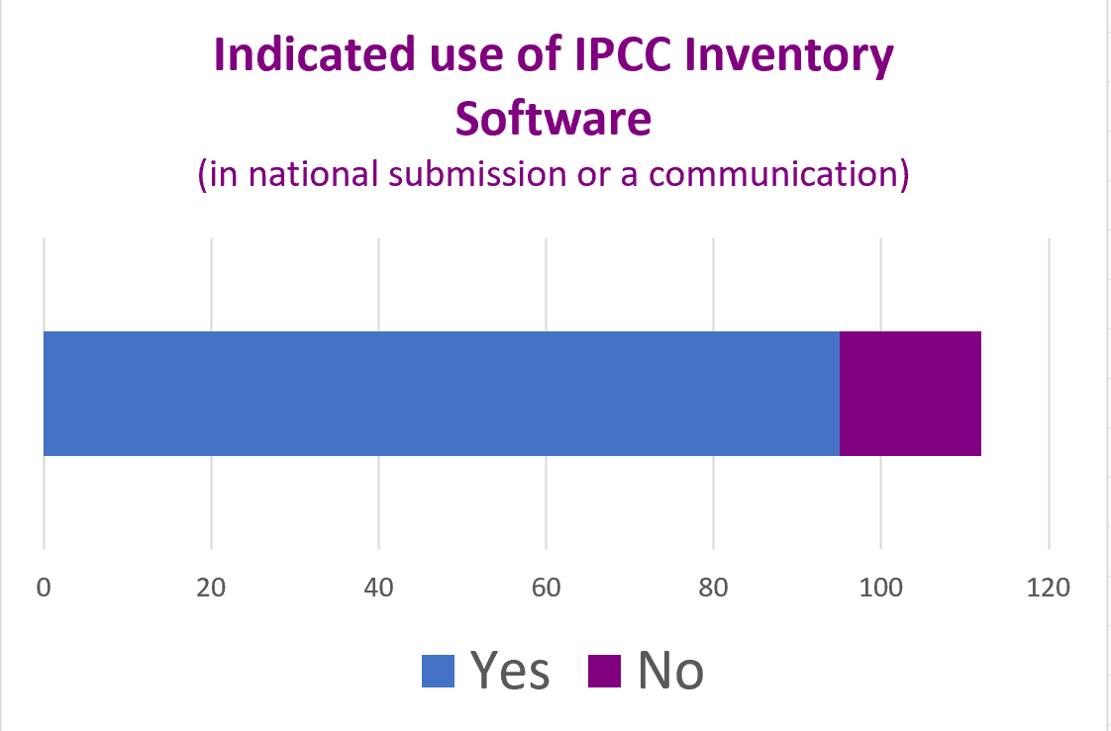
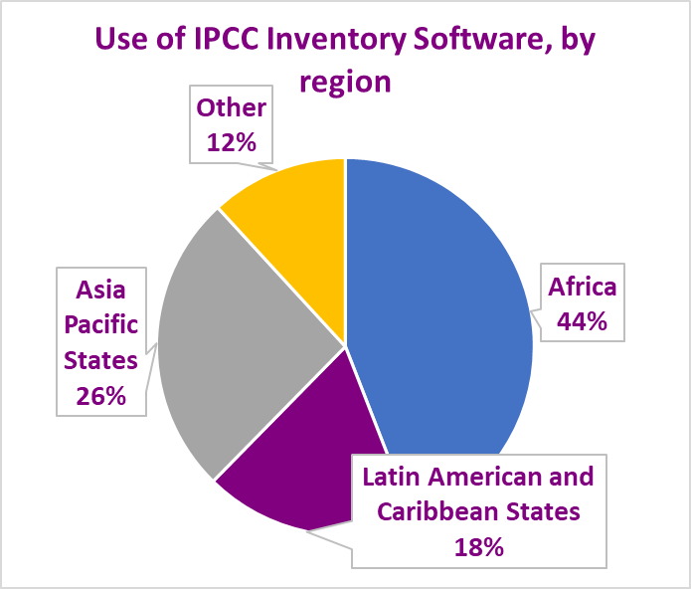
Who is using the IPCC Inventory Software – Historical NC/BUR
95 Parties
=
All information as of 3 June 2025

Slide 14
The Software in the Paris Agreement Reporting – A first glimpse
104 countries submitted a BTR (additional 6 submitted NID but no BTR)
Of these
84 countries submitted CRT as part of submission.
46 countries used the IPCC Inventory Software
as part of their submission. This is:
~ 44% of all countries that submitted BTR and/or NID
~ 70% of developing countries that submitted BTR and/or NID
About half used
the Software to populate CRTs
Of these
In addition, at least one developed country Party has used the Software, including for interoperability with the UNFCCC ETF Reporting Tool
Countries are seeing value of using the Software for the Paris Agreement reporting
Once estimates calculated with the Software, populating the CRTs is simple.
All information as of 3 June 2025

Slide 15
What are Countries Saying?
The extent to which the Software is used, varies, one or more sectors, some only for QA
Systematization and processing of data is easier thanks to the Software
The Software offers a better opportunity to choose
variables closer to our country
The Software is used as the national archiving system
Allows typing errors to be considerably eliminated, while avoiding methodological errors
The commenting feature in the Software is also used to input remarks in respective fields for continuity and improvement of the inventory in the future

Slide 16
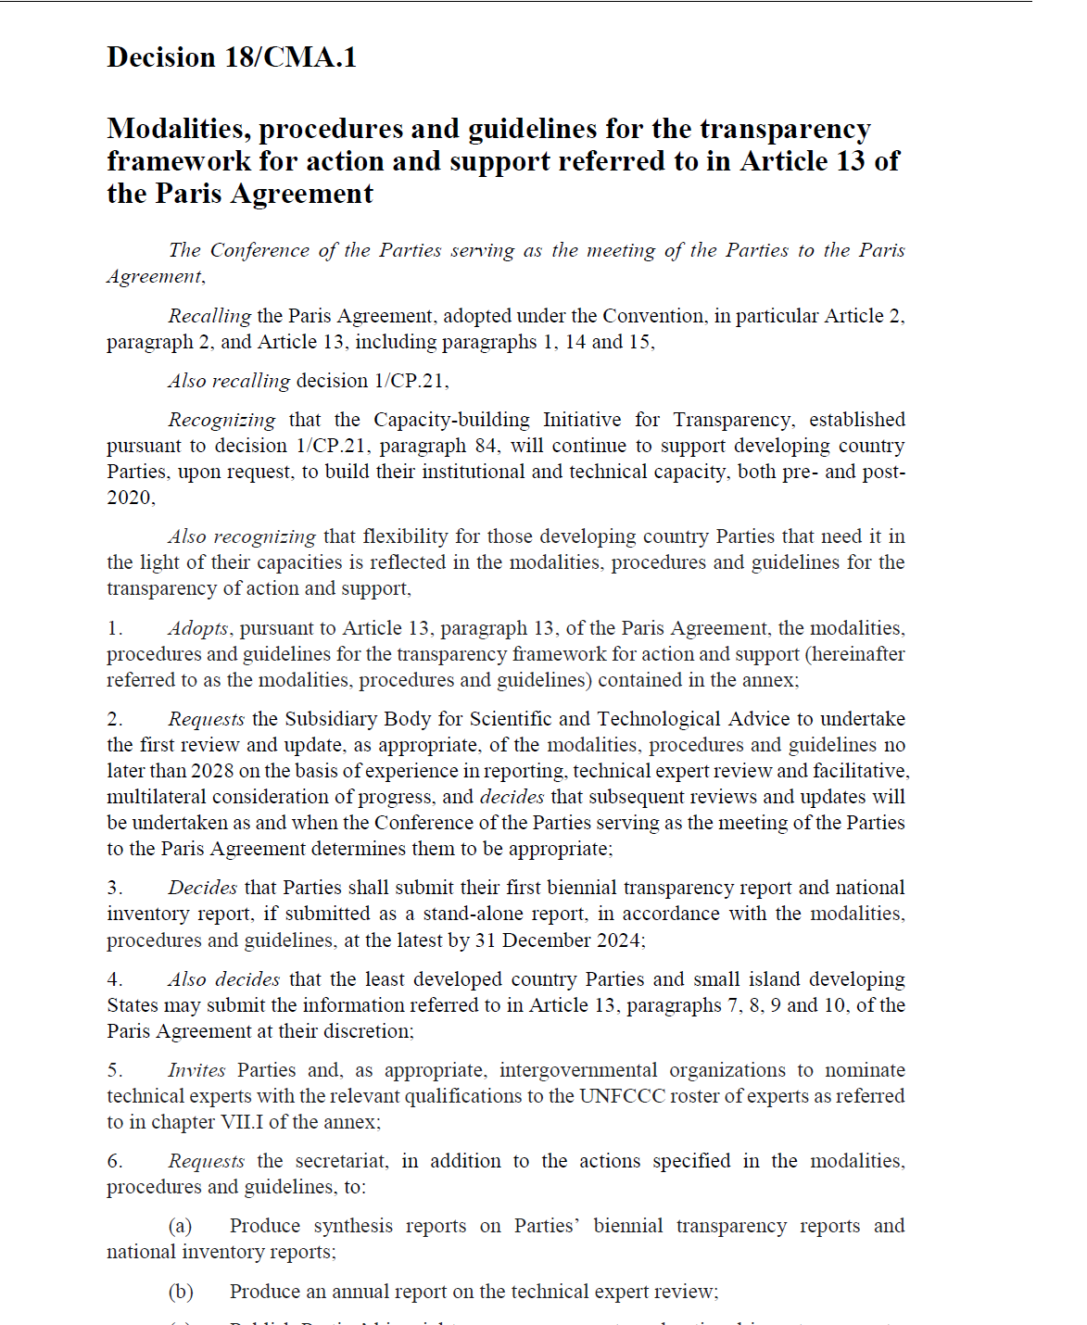
Available resources
The 2006 IPCC Guidelines for National GHG Inventories
The Software is a tremendous tool to prepare a GHG inventory, although it does not replace knowledge of the 2006 IPCC Guidelines.
The Software’s Guidebooks
Guide to use the Software to estimate anthropogenic GHG emissions and removals from each inventory category by implementing any of the methodological Tiers & Approaches of the 2006 IPCC Guidelines and its Wetlands Supplement, with elements of the 2019 Refinement. Already published:
Energy Sector
Livestock Categories 3.A.
Land Representation
IPPU
User Manual
UNFCCC Interoperability – CRT Export Quick Start Guide
Other sector-based Guidebooks are under development.
IPCC TFI TSU Support @ ipcc-software@iges.or.jp

Slide 17
Available resources
Come! be a part of our New Community of Users and gain access to:
The latest information on the Software, including releases and update notes
Technical and methodological support from the IPCC TFI TSU and colleagues
A growing international community of practitioners who, like you, are working to deliver the latest high quality GHG Inventory information. Engage in discussions, ask questions, contribute!
To join the Community of Users, contact the IPCC TFI TSU at ipcc-software@iges.or.jp or register here

Slide 18
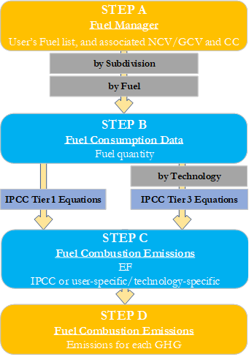
Guidebook - Structure
For each category, the Guidebook includes, inter alia, the following information:
The relevant equations from the 2006 IPCC Guidelines
A description of the relevant worksheets. For category 1.A.1.a.i this includes Fuel Manager, Fuel Consumption Data and Fuel Consumption Emissions
A User’s Work Flowchart
Step A: Fuel Manager
Step B: Fuel Consumption Data
Step C: Fuel Combustion Emissions - EFs
Step D: Fuel Combustion Emissions - Results
Step-by-step guidance to input activity data and emission factor information
Results

Slide 19
Other Supporting Tools
Land representation Add-on
Based on sampling data collection and analysis
Under development
Excel-based tool for data upload
Harvested Wood Products (available on IPCC TFI website)
Land Representation
Under development

Slide 20
Ongoing Work
Paris Agreement requirements
Consistent with the SBSTA conclusions at COP29, continue to work with UNFCCC to maintain interoperability between the IPCC Inventory Software and UNFCCC ETF Inventory Reporting Tool
Respond to user questions
Extending capacity for Uncertainty Analysis and Key Category Analysis
Adding Allocation tools for A.) F-gases, B. ) Solid Waste
Completing publication of Guidebooks (Land)
Step-by-step instructions, in a ppt/video format, to implement IPCC default methods

Slide 21
First Run

Slide 22
Download the IPCC Inventory Software
https://www.ipcc-nggip.iges.or.jp/software/index.html
On this page, you will be able to:
Download the latest version of the Software, and learn which installation package (32vs64 bits) is correct for your computer
Review improvements in the latest release
Learn where to turn to get answers to any questions you may have

Slide 23
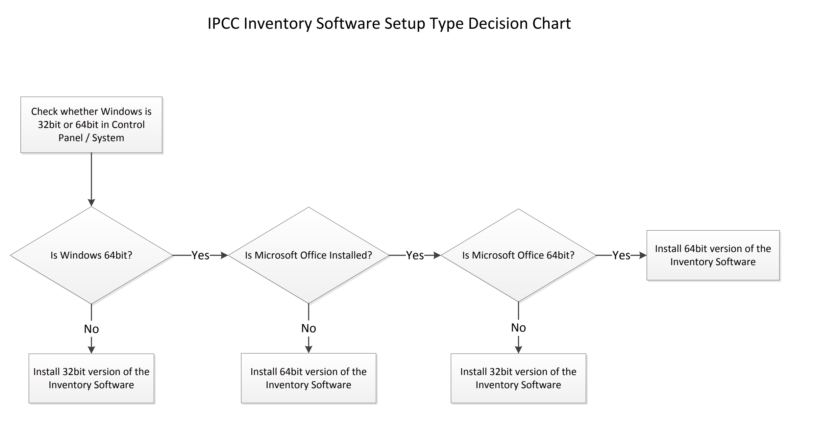
Software Download
The Software comes in two versions, 64 bit and 32 bit. Before downloading the Software, determine which version is appropriate for you by using the flowchart below.
If you find any issues in the use of the IPCC Inventory Software, come contact us at ipcc-software@iges.or.jp

Slide 24
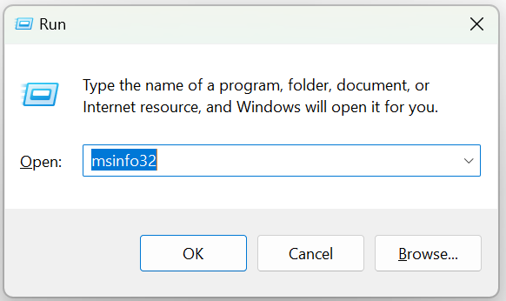
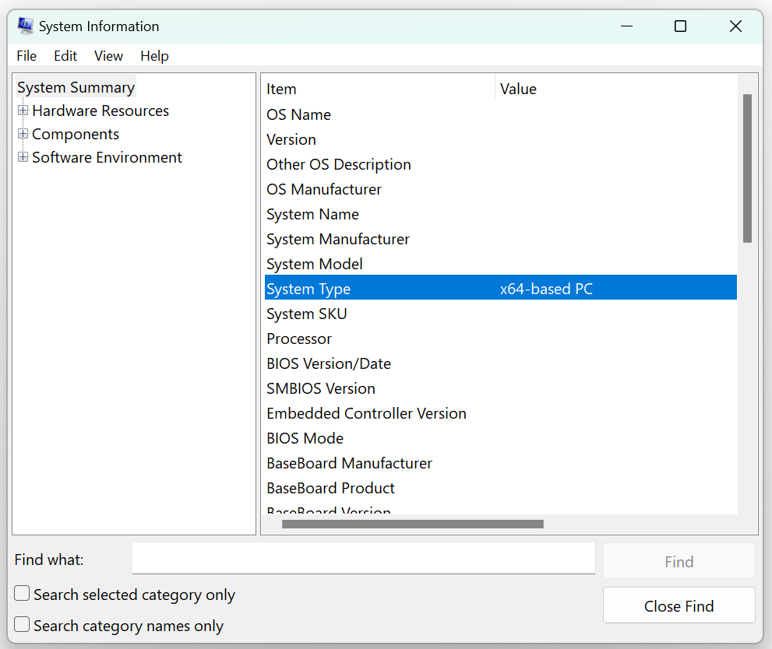
Software Download
First – Determine which version of Windows OS is installed on your computer
To check whether you have a 32-bit or 64-bit version of Windows installed, follow these steps:
Press Win + R to open the Run dialog window.
Type msinfo32 and press Enter
Look for the "System Type" entry:
If it shows x64-based PC, your Windows is a 64-bit version.
If it shows x86-based PC, your Windows is a 32-bit version.
With Windows 10 and 11 this information can also be found under Settings>System>About.

Slide 25
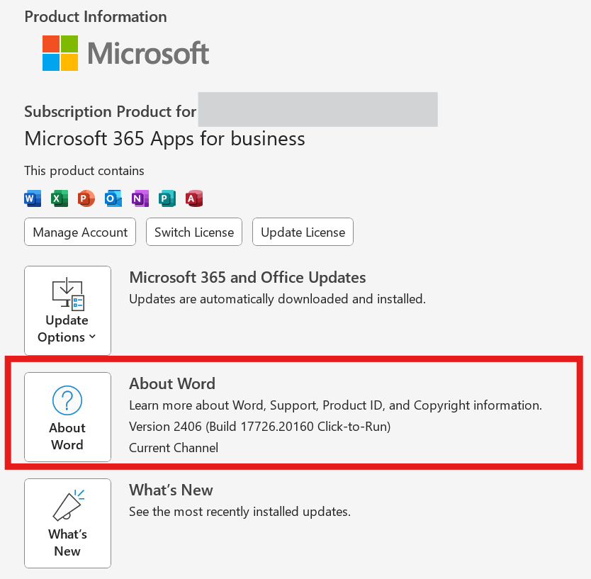
Software Download
Second – Determine which version of MS Office is installed on your computer
To check whether you have a 32-bit or 64-bit version of MS Office installed, follow these steps (suitable for Office 2013, Office 2016, Office 2019, Office 2021, and Microsoft 365):
Open any Office application: such as e.g. Word
Click on File in the top-left corner
Click on Account. If you don't see Account, click Help
Click on About [Application Name] (e.g., About Word)
In the About window, you will see the version information, including whether it is 32-bit or 64-bit.
Steps suitable for Office 2013, Office 2016, Office 2019, Office 2021, and Microsoft 365.

Slide 26
Software Download
Then:
If you have Windows 32-bit, and:
MS Office 32-bit: Download the 32-bit version of the Software
MS Office is not installed: Download the 32-bit version of the Software
If you have Windows 64-bit, and:
MS Office 32-bit: Download the 32-bit version of the Software
MS Office 64-bit: Download the 64-bit version of the Software
MS Office is not installed: Download the 64-bit version of the Software

Slide 27
First run
Set Software’s and Database Superuser
At First run the Software requires setting the Superuser of the Database initialized at first run
The Superuser of the application has full control over the application
The Superuser of a database is responsible for defining additional users.
A user can open databases set by other users as a Superuser or a simple user depending on the setting made by the Superuser that initialized the Database [and of course, so far as the user has a valid Login & password combination]
Thus, when setting an NGHGI that is to be compiled by more than one expert, first step for using the Software is to identify the Superuser, usually the NGHGI head, and the Superuser is the one that shall open and set the NGHGI database with his/her app and then share it with other users

Slide 28
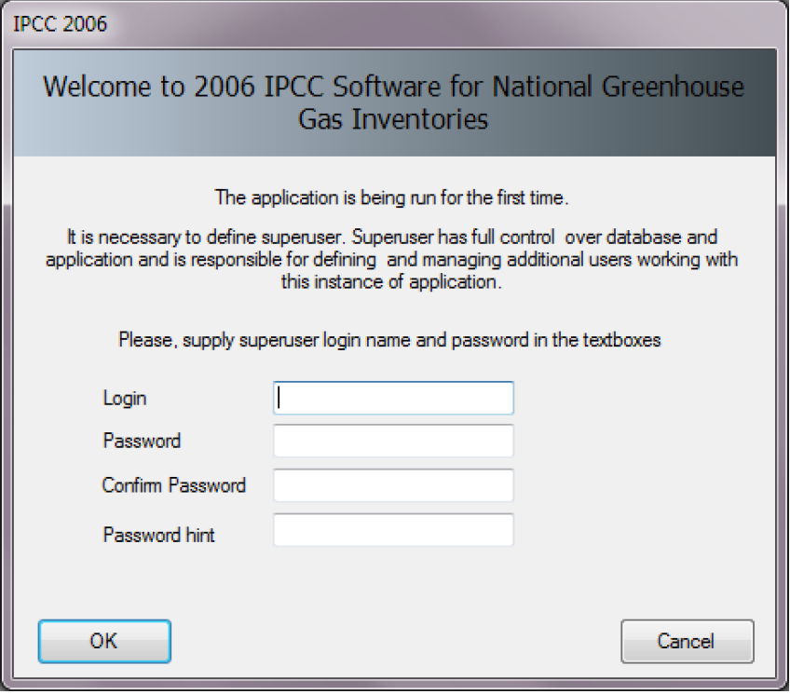
First run
Set Database’s Superuser & assign password/login to the database
At First run the application shows its welcome window where to enter Login (username) and Password of the Superuser of the Database to initialise.
Important!
When setting YOUR Password always set YOUR Password Hint too. It is highly recommended you take note of your password and store it in a safe place. In case you lose or forget your password, the Software does not have a mechanism to restore your password, this means that you may no longer access your database.
The Login & Password combination applies to the database, not to the Software, a Software can manage different databases with different Login & Password combinations

Slide 29
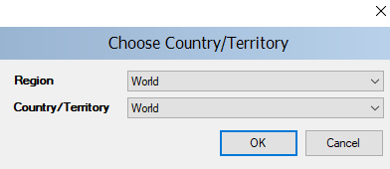
First run
Choose Country
In this step it is necessary to choose the desired Region and Country/Territory. The country will be relevant in cases where the default EFs and other parameters are country-specific and will ensure that the proper defaults are pre-populated (e.g. for AFOLU and Waste worksheets).
Notes:
When you export and import XML files into the Software, the country codes must match.
This country list is based on the UN list, which is available at http://unstats.un.org/unsd/methods/m49/m49regin.htm. In addition, you may select “World” as your country, in which case all default IPCC values will appear in the relevant dropdowns
The country selection applies to the database, not to the Software, a Software can manage different databases with different Country/Territory setting

Slide 30
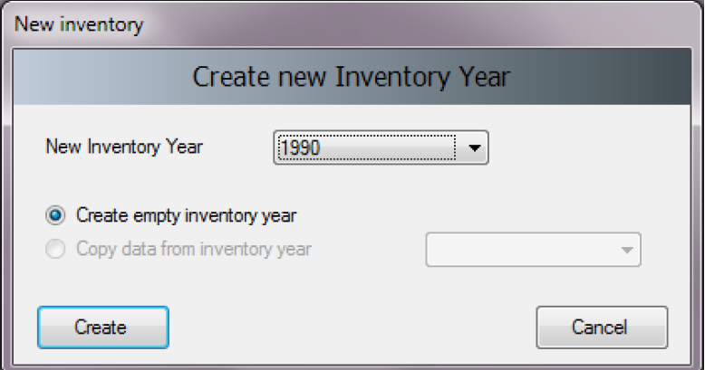
First run
Create Inventory Year
In this step it is necessary to create the initial Inventory Year. After creating the Inventory Year, the Software is successfully initialized and prepared for use or for further user’s settings, as described in the next sections.
In this initial step, you will “Create empty inventory year”.
When you create future inventory yeas, you will also have
the option to create an empty inventory year or to create it as a copy
of a previous inventory year (which one to be selected by the user).
Notes
It is recommended to start with the first year in your time series and build future inventory years on the previous year(s). When building the land representation, you MUST start with the first year of the time series. For further information, see the Land Representation Guidebook.
The Inventory Year selection applies to the database, not to the Software, when opening a new database a different year can be selected

Slide 31
Set Software Preferences
Apply to all databases open within the Software

Slide 32
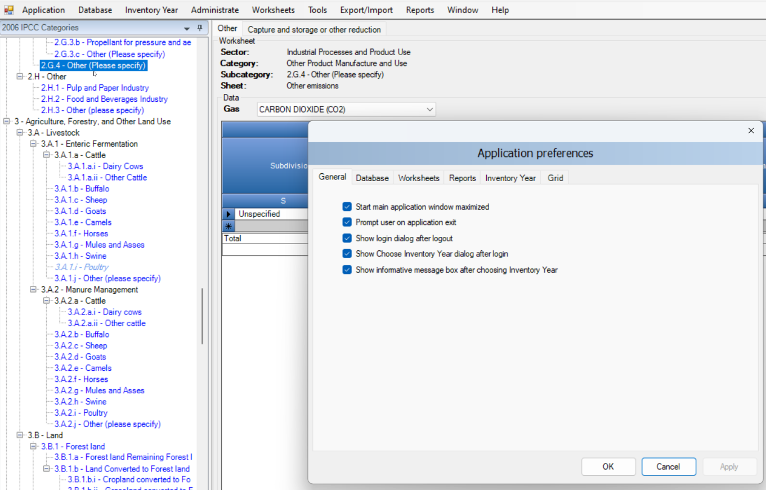
Application - Preferences
In main menu:
Select Application.
Select Preferences, to review/update your preferences, as necessary
This opens a dialog window that allows the user to adjust preferred working area settings, like appearance of dialogs, database-management preferences and backup, default number of decimal places shown in worksheets and reports, thousands separator and colors, format and other properties of grids.

Slide 33
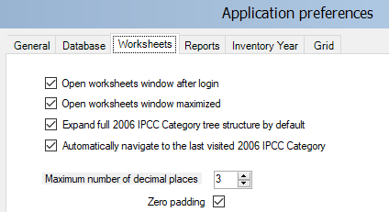
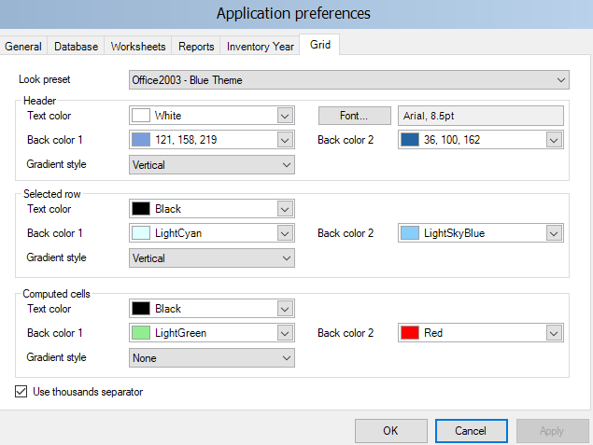
Application - Preferences
In main menu:
Select Application.
Select Preferences to review, and as necessary update, your preferences.
We suggest to:
set to 3 the number of decimals and check the Zero padding (both for Worksheets and for Reports)
Check the thousands separator
Leave remaining setting as it is, unless otherwise preferred
Note: regardless to the selection of decimals, all calculations are still performed with full precision

Slide 34
Set Database Preferences
each database contains 1 GHG inventory only

Slide 35
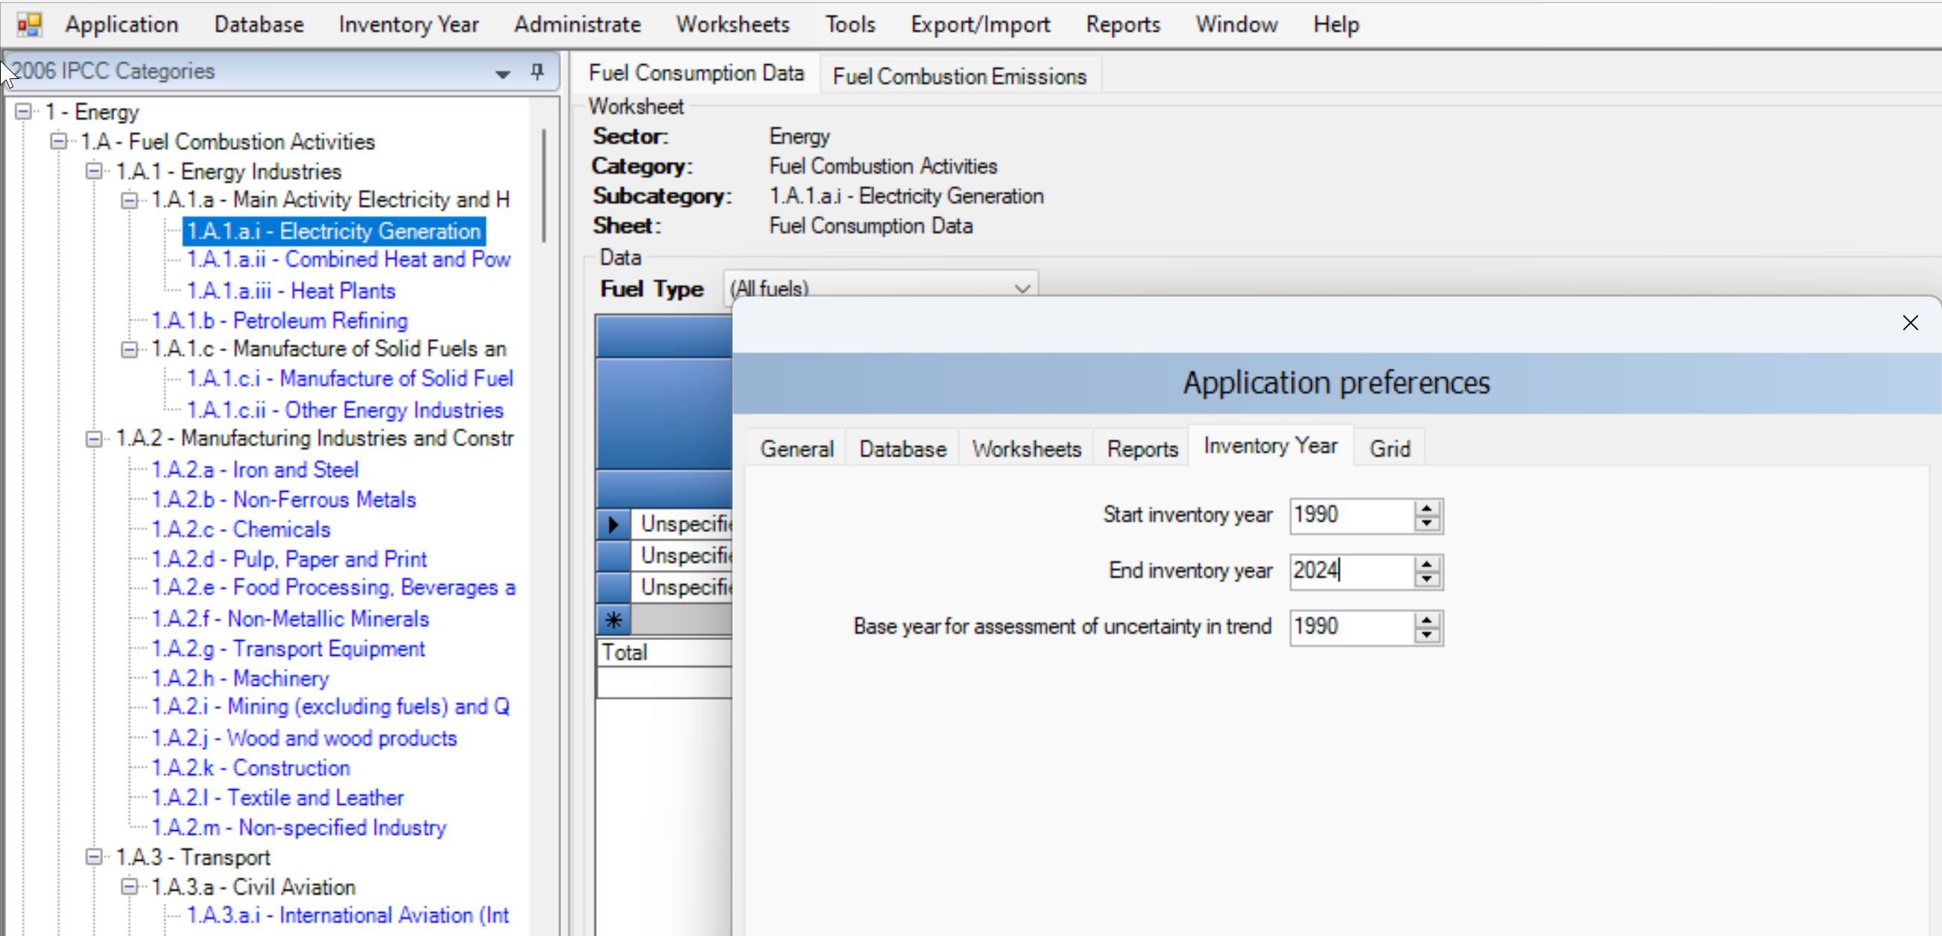
Set Inventory Time Series
In main menu:
Select Application.
Select Preferences to review, and as necessary update, your preferences.
Set time series in “Inventory Year” tab:
Use Start inventory year numeric box to set starting inventory year. Default is 1990.
Use End inventory year numeric box to set ending inventory year. Default is current year.
Use Base Year for assessment of uncertainty in trend numeric box to define Base Year for assessment of uncertainty in trend. Default is 1990.
Interoperability
For users preparing a GHG inventory for upload to the UNFCCC ETF Reporting Tool:
The inventory time series entered here may be longer than the inventory time series included in the file for upload to the UNFCCC

Slide 36
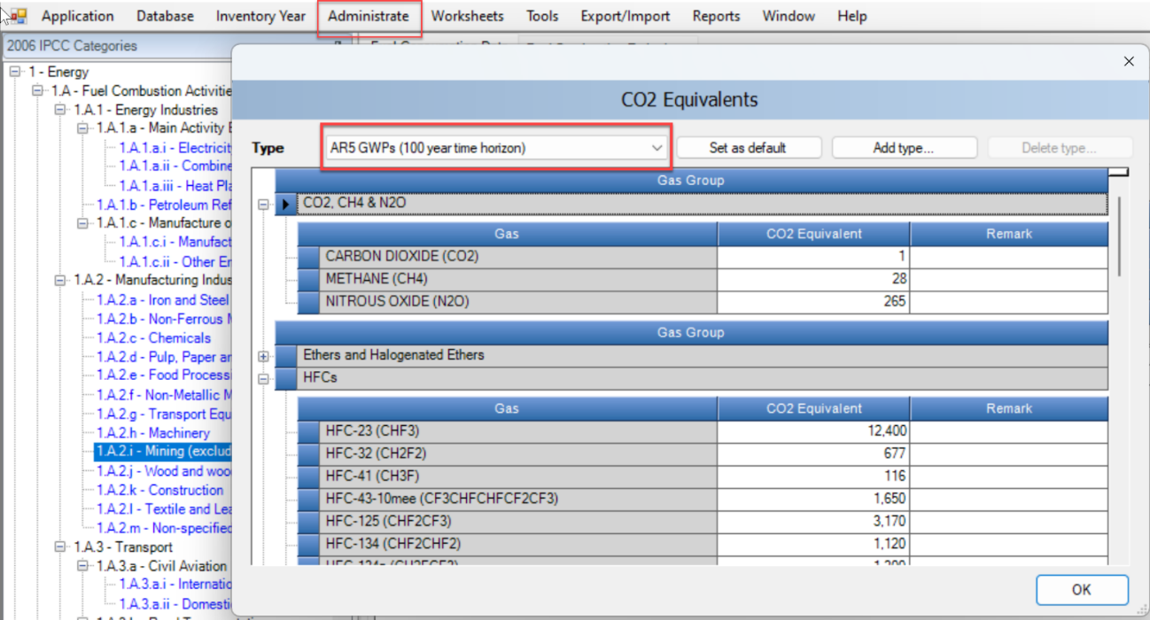
Set CO₂ Equivalent Values
The Software can calculate GHG emissions in CO₂ equivalents using a variety of different sets of global warming potential (GWP) values as well as in any other metrics for CO₂ equivalents.
Use default GWP values
The Software contains several sets of GWP₁₀₀ values as provided by IPCC in its Assessment Reports, to access those:
From the main menu, select Administrate / CO₂ equivalents.
Select one of the four sets (Note: GWP values in these sets
cannot be changed or deleted)
IPCC Second Assessment Report (SAR) GWP₁₀₀
IPCC Third Assessment Report (TAR) GWP₁₀₀
IPCC Fourth Assessment Report (AR4) GWP₁₀₀
IPCC Fifth Assessment Report (AR5) GWP₁₀₀
Click on OK

Slide 37
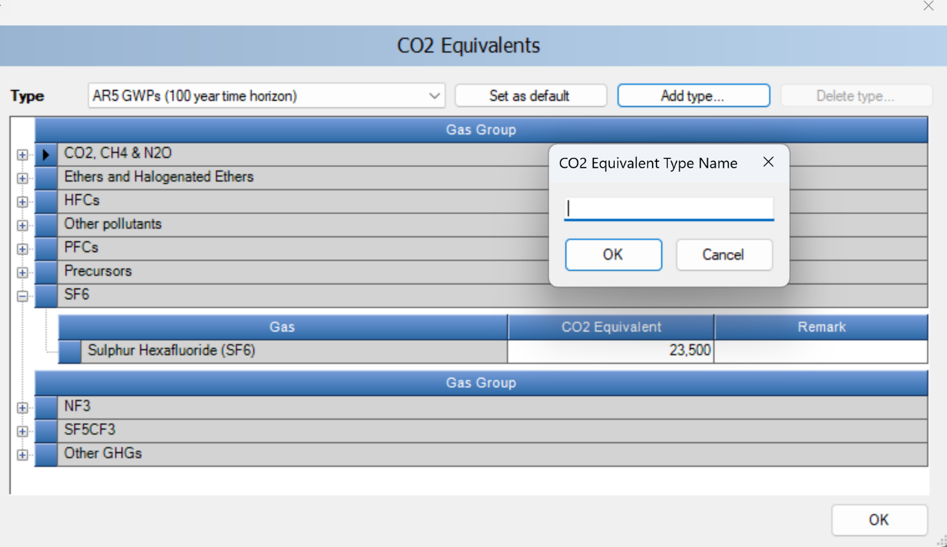
2.4 Set CO₂ Equivalent Values
Adding / Deleting Custom CO₂ Equivalent Type
To add a custom CO₂ equivalent type:
Select Add type.
Enter the unique name of the new type and select OK - the new custom CO₂ Equivalent type will appear within the Type list.
Use grid to enter desired CO₂ Equivalent for each gas within all gas groups.
To delete a custom CO₂ equivalent type:
Use Type list to select custom CO₂ Equivalent type to be deleted.
Click Delete type button and commit or cancel deletion when asked.

Slide 38
Set default CO₂ Equivalent type for use in Software
To set the default CO₂ Equivalent type to be used for calculations within the entire Software:
Use Type list to select desired CO₂ Equivalent type.
Click Set as default button to set it as default – the new default CO₂ Equivalent type will be indicated in the status bar located at the bottom of the main Software window.
Interoperability
For users preparing a GHG inventory for upload to the UNFCCC ETF Reporting Tool:
In accordance with paragraph 37 of the MPGs, “Each Party shall use the 100-year time-horizon global warming potential (GWP) values from the IPCC Fifth Assessment Report, or 100-year time-horizon GWP values from a subsequent IPCC assessment report as agreed upon by the CMA” and each Party may, in addition, also use alternative metrics, describing those in the national inventory document.
Although data in the Software will be uploaded to the UNFCCC ETF Reporting tool in mass units, and CO₂ equivalent values calculated in that tool using AR5 values, it is critical that users using the IPCC Software to prepare a JSON file for upload to the UNFCCC tool also use AR5 values in the Software. This is necessary because data for F-gases in the IPPU sector, in some circumstances, will be included in the JSON file in CO₂ equivalents. To ensure the correct calculation of those CO₂ equivalents, AR5 values must be used in the IPCC Software.

Slide 39
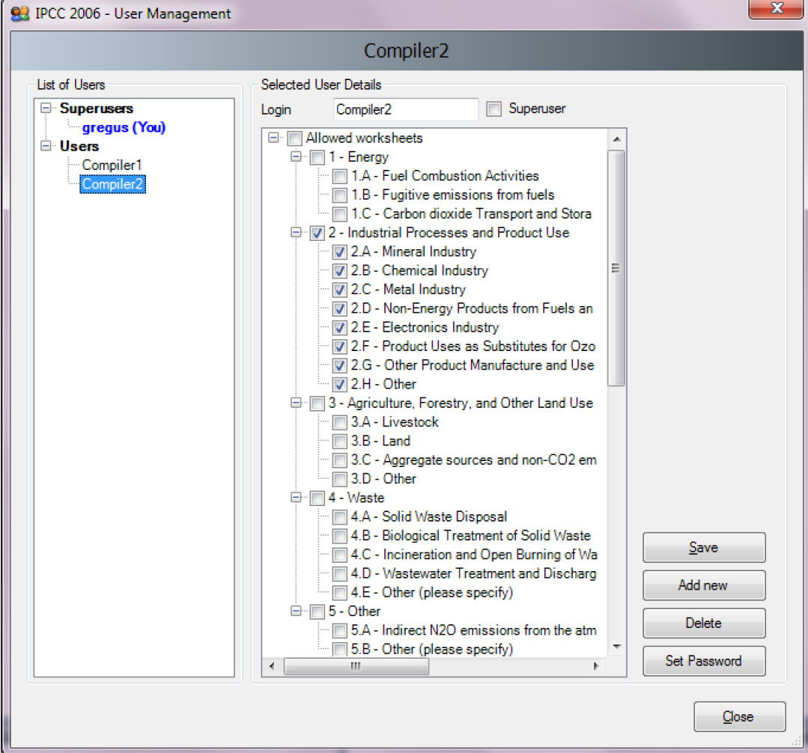
Define Database’s Users
To add, delete or modify users of the currently open database:
On the main menu, select Administrate
Select Users
List of Users
This section contains the list of all users defined in the database, divided into two groups:
Superusers – contains the list of all Superusers. User marked in blue represents the currently logged in user. Following rights&restrictions apply for Superusers:
Currently logged in superuser is prohibited to delete itself.
All worksheets can be visualized and edited.
Users – contains the list of ordinary users. The following restrictions apply:
Access to Administrate section of the Software is prohibited.
Can visualize and edit only worksheets specified as Allowed Worksheets

Slide 40
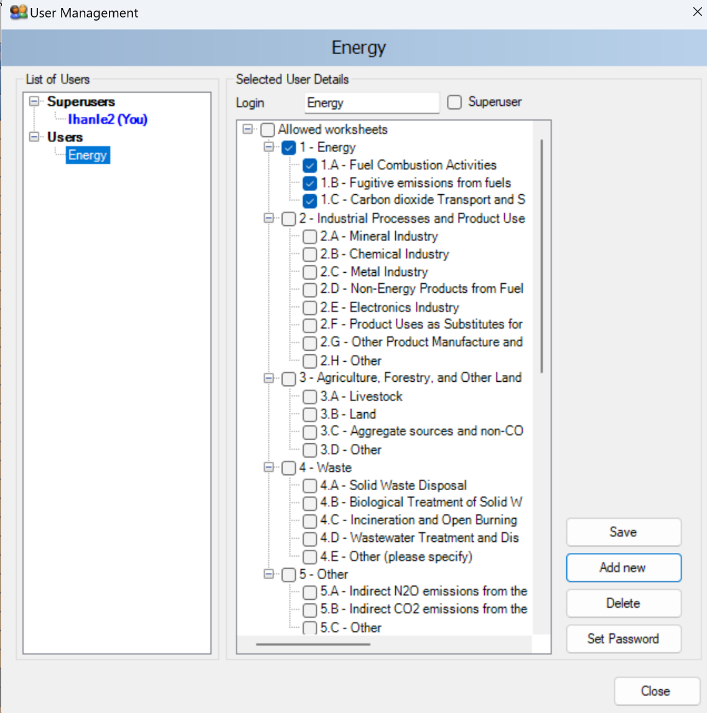
Adding Database’s Users
Adding new user
To add a new user:
Select “Users” so highlighted
Enter the desired unique login name into the Login textbox
Use Superuser checkbox to define user as a Superuser (checked) or ordinary user (unchecked)
In case of ordinary user, define Allowed Worksheets for the user to work with
Click Add new button to save new user into database
Click Set password button to explicitly set password for new user
Highlighting any user in the List of Users will indicate:
Login: representing the login name. Login name must be unique for a particular database
Superuser: indicates if that user is a superuser
Allowed worksheets: defines the list of worksheets user can visualize and edit (applies to ordinary users only)
Tip: If you do not see all five buttons in the lower right-hand corner review slide Screen Resolution for Optimal Viewing of Software

Slide 41
Manage Users
Editing existing user
Take following steps to edit existing user:
Select desired user within List of users
Change desired user details (e.g. worksheets that use may access/edit)
Click Save button to save changes into database
Deleting existing user
Take following steps to delete existing user:
1. Click on the desired user within List of users
2. Click Delete button to delete user
3. Confirm or cancel deletion when asked
4. Close window
Reset password of existing user
Take following steps to reset existing user’s password:
1. Click on the desired user within List of users
2. Click Set password to reset password to new one
3. Enter and confirm new password when asked

Slide 42
2.6 Distribute database
Next Steps
After performing all steps described in the previous slides, the database is ready to be used or distributed to additional inventory experts, if necessary.
The next steps are as follows:
Project manager / Inventory compiler saves database
See Save Database
Project manager / Inventory compiler decides how database will be shared – one shared database versus maintaining multiple databases
See Distribute database
Sector experts input data and send to Project manager/ Inventory compiler
See Maintaining Multiple Copies of the Database: Sharing Data

Slide 43
Save Database
To save currently open database:
On main menu, select Database.
Select Save as…
Select destination folder and file name
You will be notified that the current database will be closed before saving; and reopened after saving and asked to confirm.
Choose whether to remove password protection.
Important : Do not remove password protection. Removing the password protection will prevent the database from opening in the Software (The Software strictly accepts password protected database only for security reasons).
Decide whether to compress (ZIP) database file (compressed database file must be uncompressed (unzipped) before opening it in the Software).

Slide 44
Distribute database
Share one database versus maintaining multiple databases
Share database on network drive
Copy database file, as created in previous slides, to a shared folder on the network, where other inventory experts have read/write access.
This alternative is strongly recommended, because after making administrative changes, all compilers are automatically affected.
Send database to multiple users
(e.g. via email)
Administrative changes must be performed within each copy of the database to maintain consistency across inventory experts.
This approach can lead to inconsistency amongst compilers and therefore is not recommended.
Let’s look at each of these options in more detail….

Slide 45
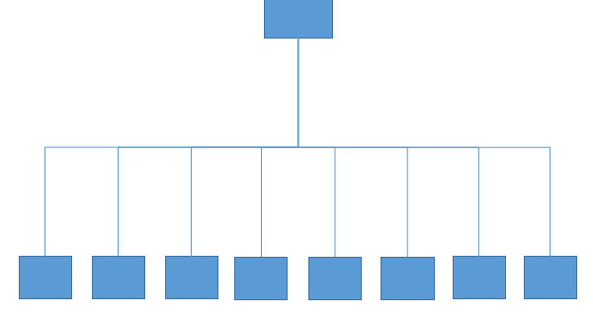
Sharing the Database in the Cloud
shared
database
users
Superuser shall set a shared drive
This approach is preferable, as all NGHGI data can be shared in real time, including information necessary for the CRT.
Note that sharing the database with
Microsoft Sharepoint will not allow users to access it
Googledrive may likely cause data losses
Microsoft SQL Server cannot be used with the current version of the Software

Slide 46
Sharing the Database in the Cloud
A single database is shared on internet
Setup a Windows Server on a PC with Remote Desktop enabled, somewhere in the cloud (or in an intranet), and install the IPCC Inventory Software on it
Allow users to connect to the Windows Server PC with their PCs by using Remote Desktop application from anywhere just through internet connection
The use of a VPN (virtual private network) software is not needed, although may be desirable to enhance the security of the data flow

Slide 47
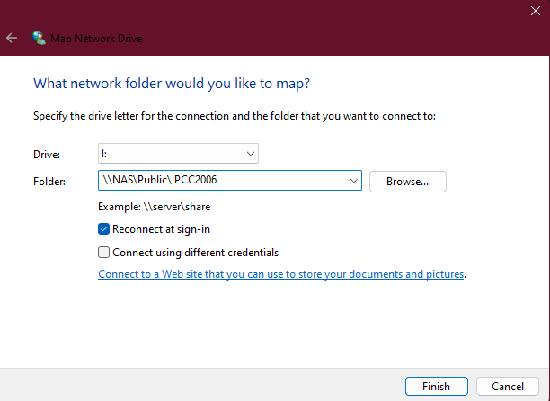
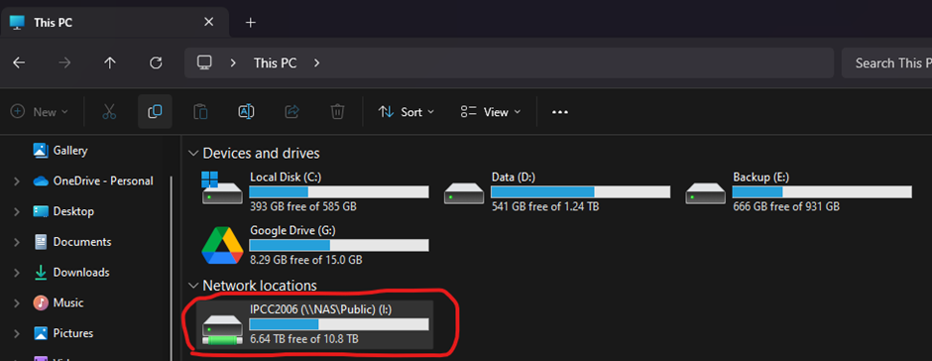
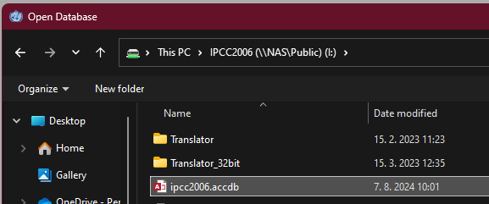
Sharing the Database in the Cloud
A single database is shared on an intranet
Superuser shall set a shared drive within a LAN (Local Access Network) where the database is saved and to which all experts are given access
Map network location where database file resides as local drive. In the example below „NAS“ is name of remote PC within LAN that has „Public“ folder shared to other PCs in the LAN
This is how mapped drive looks like in File explorer
This is how mapped drive looks like in File explorer

Slide 48
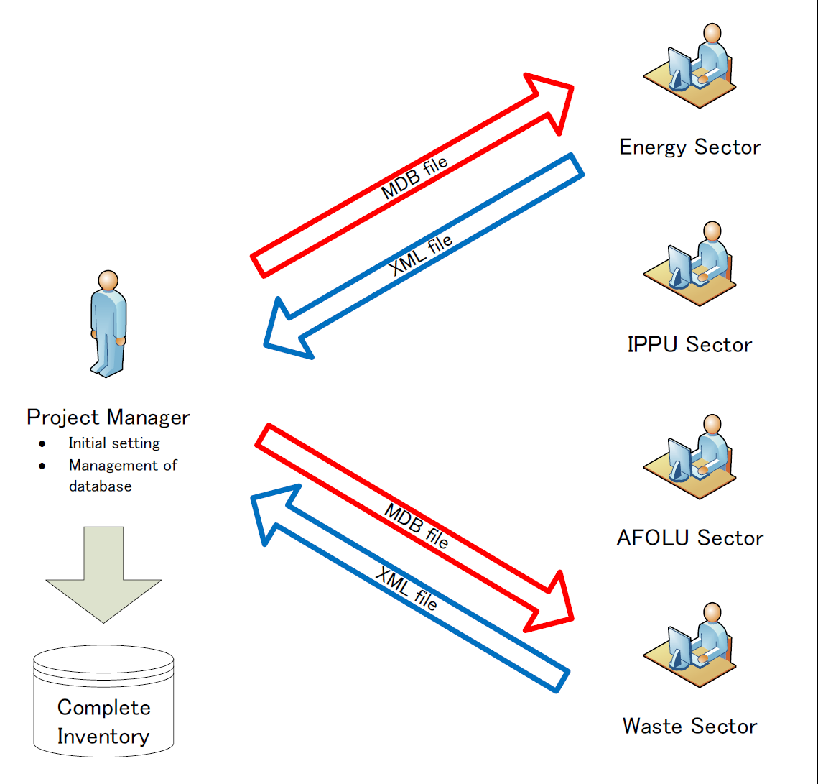
Maintaining Multiple Copies of the Database: Sharing Data
Sector experts enter data and send an XML file(s) to Project manager / Inventory compiler
The following steps, should be performed iteratively.
Inventory compiler initializes the database as described in previous slides.
Important: Owing to the complexity of data calculations for IPCC categories 2.F, 3.B and 4.A, the inventory compiler MUST input names of subdivisions for these categories (if any), as well as Regions in the case of IPCC category 3.B, before sharing the database (ACCDB file) with sector experts. Failure to carry out this step will lead to double counting in import/export of data from one user to another. For further information review the section on XML import/export.
2. Inventory compiler provides the database (ACCDB file) to each user.
3. After users update data in their database, worksheet data exported as XML file.
4. Inventory compiler imports the worksheet XML file(s) to his/her master database.
5. If applicable, after users input information for UNFCCC reporting, the CRT data set can be exported as XML file, for information. The Inventory compiler can import the CRT dataset into his/her application for viewing. However, the CRT data set is not automatically aligned with the worksheet data in the compiler’s database. The “Refresh” functions can be used to “link” the worksheet data and each CRT data set, and the CRT data set will be updated with latest worksheet data. It is currently not possible to link individual sectoral CRT data sets to the master inventory database.
Note: This approach likely requires the Inventory Compiler to compile additional explanatory information for the CRT after XML import, working with sector experts, as necessary
Workflow

Slide 49
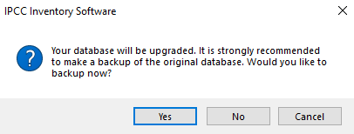
Automatic Database Upgrade
The Software supports automatic conversion of databases coming from previous versions of the Software. This means users can comfortably import their existing databases without additional effort.
When a database from an older version of the Software is open in a new version, users will be prompted to start automatic database conversion.
Important
- It is strongly recommended to make a backup version of the original database prior to this conversion. Although data loss is not expected during the upgrade process, maintaining a backup version ensures that information can be recovered.
- Note that once a database is upgraded, it cannot be opened in older versions of the Software. All members of an inventory team shall use the same version of the Software.
After the database is successfully converted it can be opened with the new version of the Software.

Slide 50
Creating and Initializing a new Database
each database contains 1 GHG inventory only
Note: When setting a new database, by default, the Software retains preferences set for the latest database

Slide 51
Creating a New Database
The IPCC Inventory Software enables users to work with multiple databases
Once a user completes the Software First Run, a database with specific settings and established access credentials for a Superuser is created. Furthermore, users may wish to create additional databases, and even with different settings.
For each new database, a Superuser Login and Password combination is required to be set, and such combination cam differ database by database.
To create a new database:
Take a blank database of the IPCC Inventory Software.
A blank database is one that has never been opened, allowing it to be initialized with a new Login and Password.
Open it with the relevant Database functionality accessed through the Main Ribbon of the Software:
Follow same instructions provided in the section First Run
Having completed this procedure, the initialization of the new database is done in the IPCC Inventory Software

Slide 52
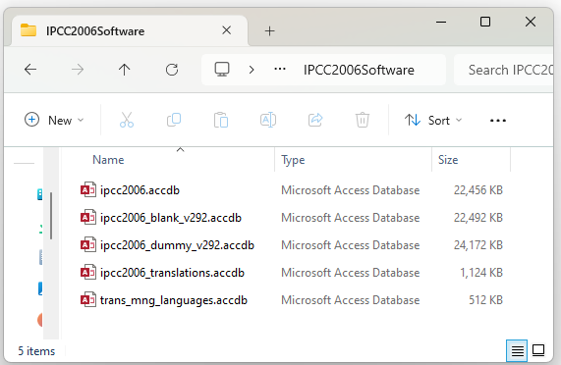
Where Databases are Located
When the Software is installed on a computer, a folder (C:\ProgramData\IPCC2006Software) containing the following 3 databases is also created:
ipcc2006 - will be used during the "First Run“
ipcc2006_blank - blank database
Ipcc2006_dummy - database with dummy data pre-filled
The ipcc2006_blank_vxxx.accdb file contains a blank database that has never been opened, which thus has not been initialized with a Login and Password.
As soon as a blank database is opened in the Software and a Superuser is set, it ceases to be a blank database and can no longer be used to create a new one.
Thus, each new database is to be created first as a copy of the ipcc2006_blank_vxxx.accdb file to avoid to lose it.
Predictable location
Local Disc (C:)
>
ProgramData
>
IPCC2006Software

Slide 53
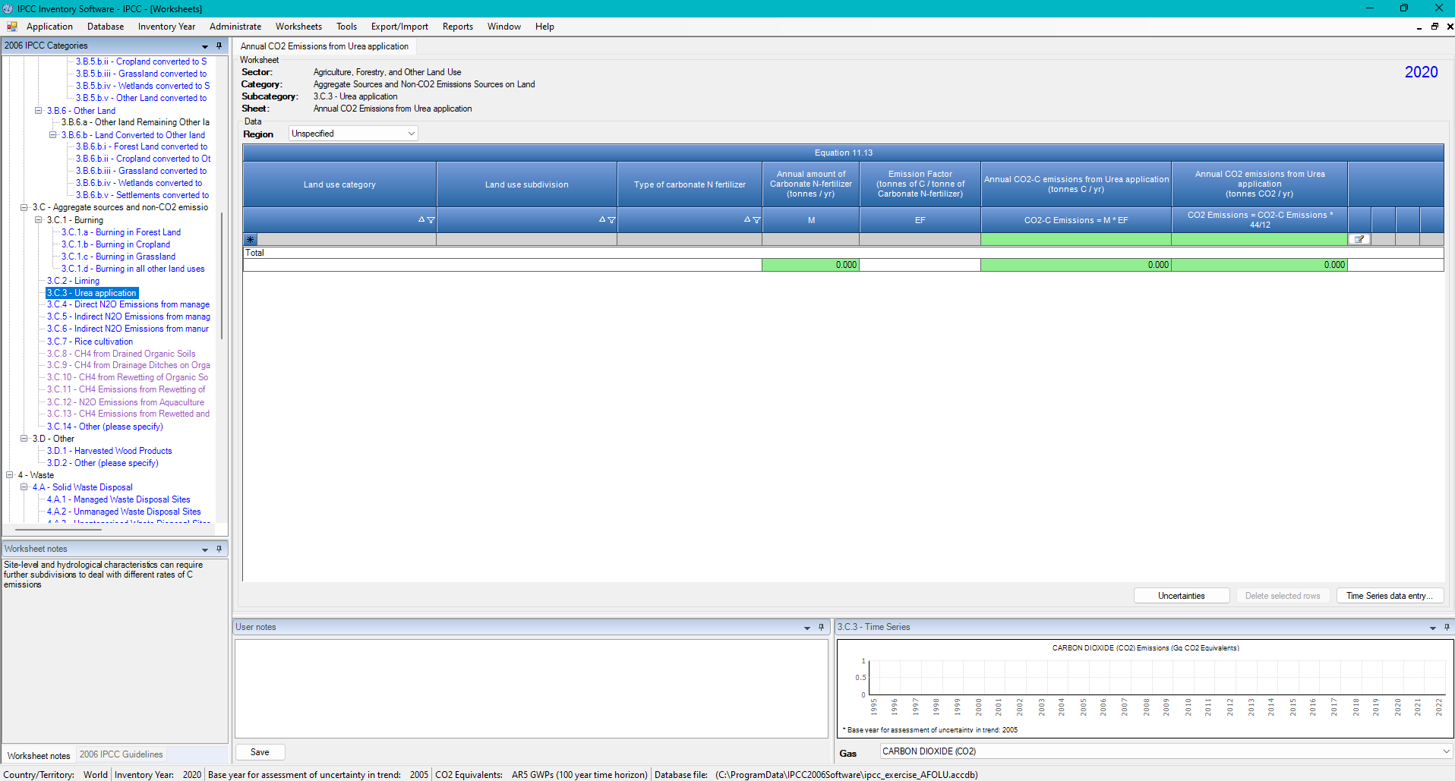
Where Databases are Located
If you do not see ProgramData in C: , then verify that the folder where the databases are saved is in ProgramData by checking the location shown at the bottom of the main window
As for instance:

Slide 54
Visualizing a Hidden Folder
If the location of databases is in ProgramData, and this folder is not visible, then according to the WindowsOS version installed on the computer:
Windows 11 | Windows 10
Open File Explorer Press Windows + E or click the File Explorer icon
Select View > Show > Hidden items | Select View > Options > Change folder and search options
 | Select View tab
 | (in Advanced settings) Select Show hidden files, folders, and drives
 | Press OK

Slide 55
Making Copies of the Blank Database
Making a copy of the Blank Database
Open the folder @ C:\ProgramData\IPCC2006Software
Check if the folder contains a blank database, as ipcc2006_blank_vxxx.accdb.
If there is not a blank database, download it at https://www.ipcc-nggip.iges.or.jp/software/index.html
Make a copy of the blank database and save it, preferably in the same folder
Either users select the file and copy it using Ctrl+C, then paste it using Ctrl+V
Or users right-click on the file and select Copy, and then right-click on the folder and select Paste
Finally, users Rename the copied file as needed.

Slide 56
Navigating the Main Ribbon

Slide 57
Main Window

Slide 58
Main Window
The Main window is a Multiple Document Interface window which acts as a container for all other software dialogs and windows.
The main window consists of:
Window title – Main software title followed by the login name of user (when logged in)
Main ribbon (top) – for accessing all software functions / modules.
Working area (center) – place where all dialogs and child windows are displayed.
Status bar (bottom) – bar that contains useful information related to currently open database, currently chosen Inventory Year, etc.

Slide 59
Application Menu

Slide 60
Application Menu
1
2
3

Slide 61
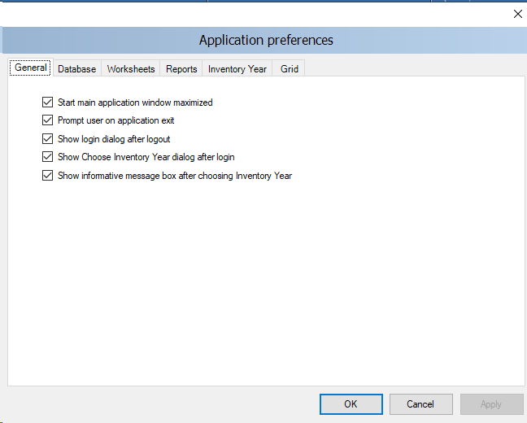
Application Menu - Preferences
1
2
3
4
5
6

Slide 62
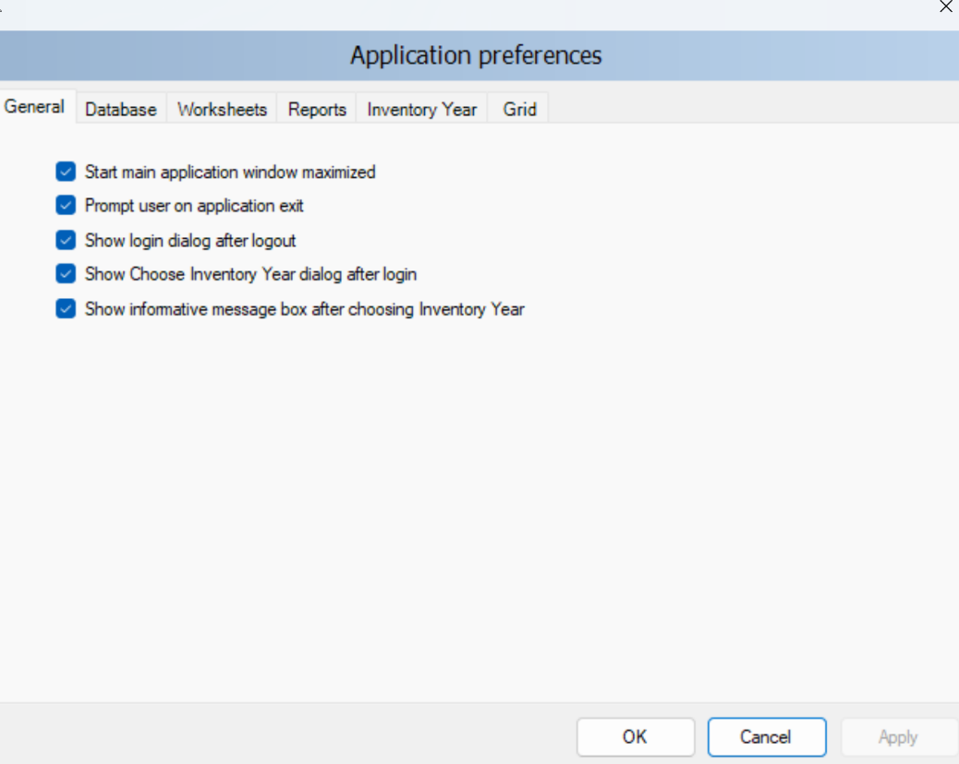
Application Menu - Preferences
Start main application window maximized – if checked, main application window size will be automatically scaled to fit the whole available screen after starting the Software.
General
The Project manager / Inventory compiler may have set initial preferences. Sector experts can adjust these under Preferences
Prompt user on application exit – if checked, user is always prompted whether to really exit application or not.
Show login dialog after logout – if checked, new login dialog will appear automatically after currently logged in user logs out.
Show informative message box after choosing Inventory Year – if checked, user is informed of currently active inventory year after user has opened/moved-to an inventory year (activated automatically or by user action).
Show choose inventory year dialog after login – if checked, user is prompted to choose inventory year to work with. If unchecked, previously used inventory year will be activated automatically.
Select Apply after making any changes.

Slide 63
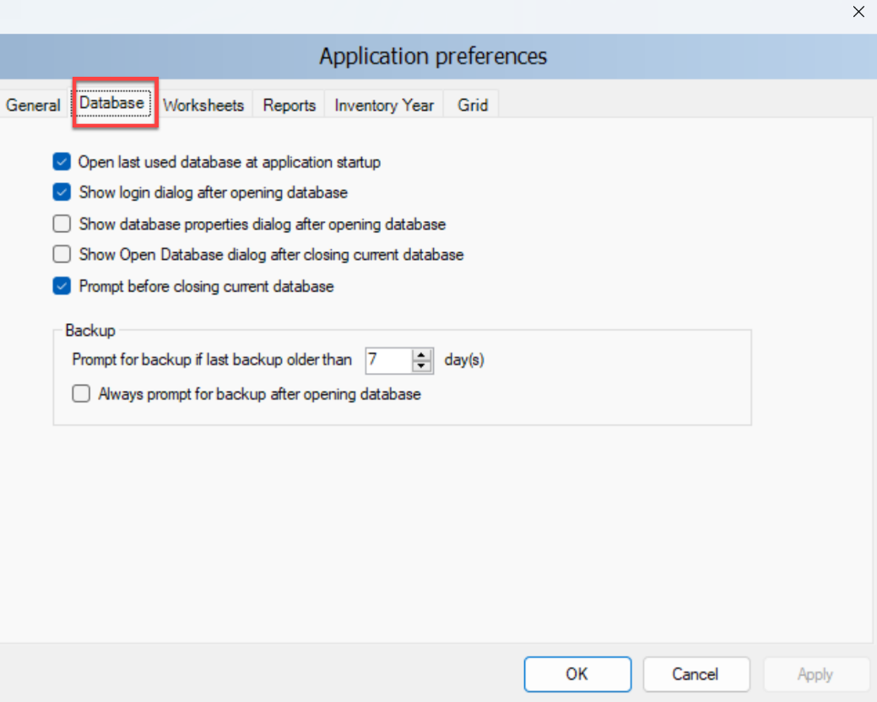
Application Menu - Preferences
Database
Open last used database at application startup – if checked, previous database will automatically open at startup; otherwise user must explicitly open desired database.
Show login dialog after opening database – if checked, login dialog will be displayed automatically after opening the database file; otherwise user must explicitly open login dialog via menu.
Show database properties dialog after opening database – if checked, dialog containing currently open database details will be shown automatically after opening database file.
Show Open Database dialog after closing current database – if checked, Open Database dialog will be automatically shown after closing current database.
Prompt before closing current database – if checked, user will be asked to confirm the closing of the current database; otherwise the database will be closed without warning.
Prompt for backup if last backup older than N day(s) – user is automatically asked to make a backup of the database if last backup is older than N day(s).
Always prompt for backup after opening database – if checked, user is asked to make a backup of the database every time the database is open, no matter how old the last backup.
Select Apply after making any changes.

Slide 64
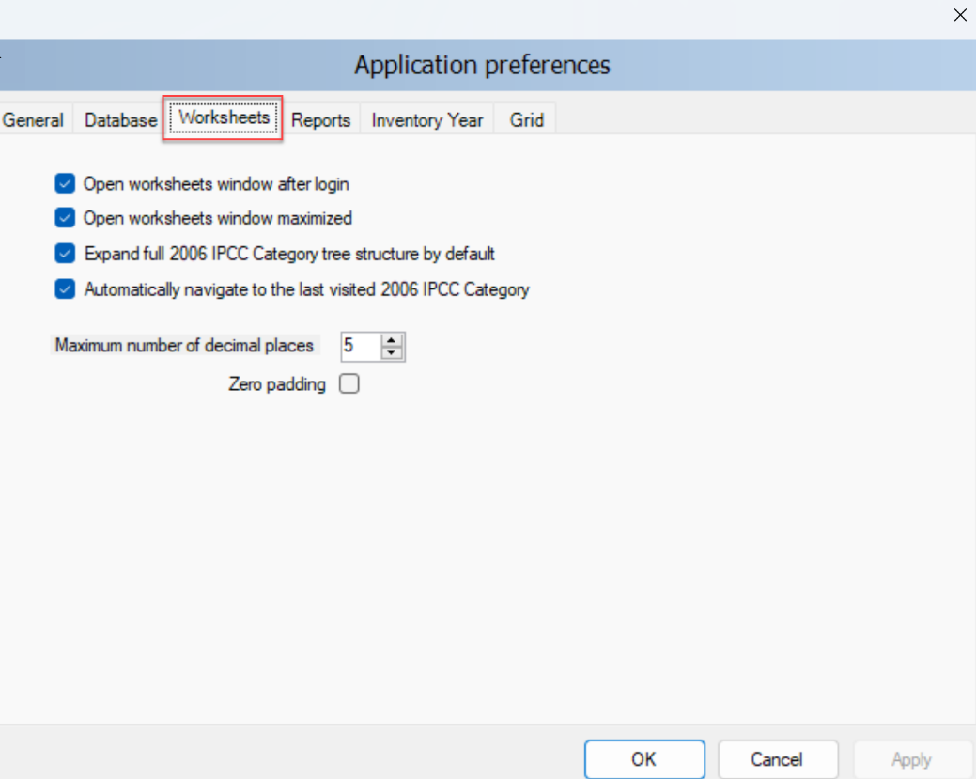
Application Menu - Preferences
Worksheets
Open worksheets window after login – if checked, window containing worksheets will be automatically open after user login; otherwise user must open worksheets window via menu.
Open worksheets window maximized – if checked, worksheets window will automatically scale to fit main application window.
Expand full IPCC 2006 category structure by default – if checked, tree containing 2006 IPCC hierarchy will be expanded automatically to show the whole hierarchy; otherwise only main sectors will be shown initially.
Automatically navigate to last visited IPCC 2006 Category – if checked, last visited IPCC category will be automatically selected upon opening the Worksheet window.
Maximum numbers of decimal places – defines maximum numbers of decimal places for numbers to be displayed in calculation sheets (worksheet grids).
Zero padding – if checked all decimal numbers in grids will be zero-aligned. E.g. 0.1 will become 0.10000 - padded with zeros up to the maximum number of decimal places – 5 in this case.
Select Apply after making any changes.

Slide 65
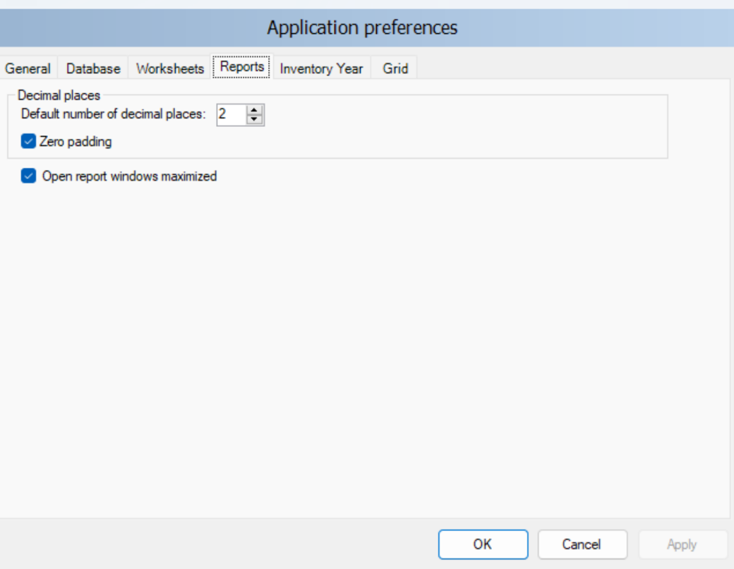
Application Menu - Preferences
Reports
Default number of decimal places – numbers in reports will be automatically rounded according to defined number of decimal places here.
Zero padding – if checked all decimal numbers in grids will be zero-aligned. E.g. 0.1 will become 0.100 - padded with zeros up to the maximum number of decimal places – 3 in this case.
Open report windows maximized - if checked, reporting windows will automatically scale to fit main application window.
Important According to WindowsOS Control Panel / Regional Settings in the computer, the Software requires the use of a period (.) or a comma (,) as decimal separator.
Select Apply after making any changes.

Slide 66
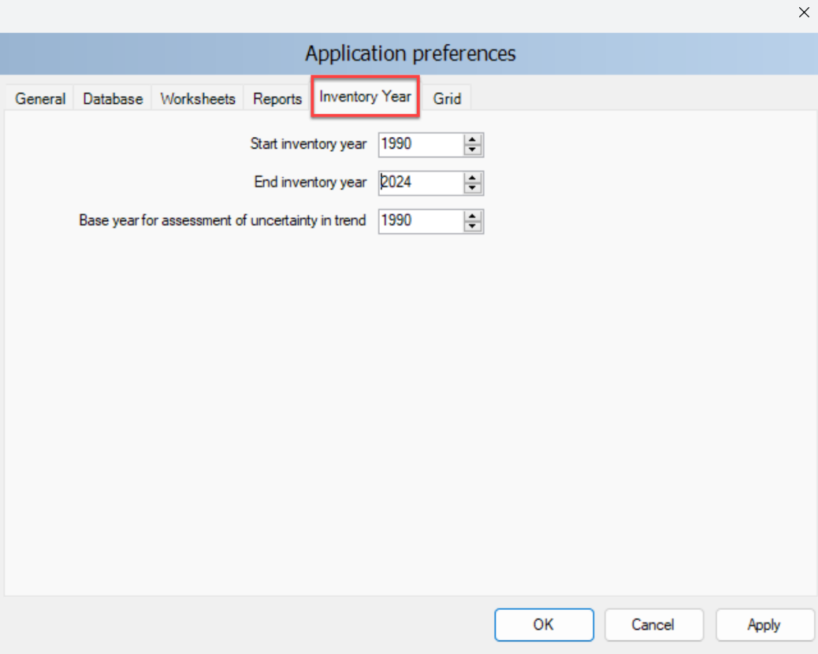
Application Menu - Preferences
Inventory year
The project manager already set the inventory year time series prior to distributing the database – see First Run.
Should you want to change this (e.g to include later years) you can.
A change in the Inventory Year panel shall be coordinated with the project manager given the manager can import data for inventory years set in its database only.
Select Apply after making any changes.

Slide 67
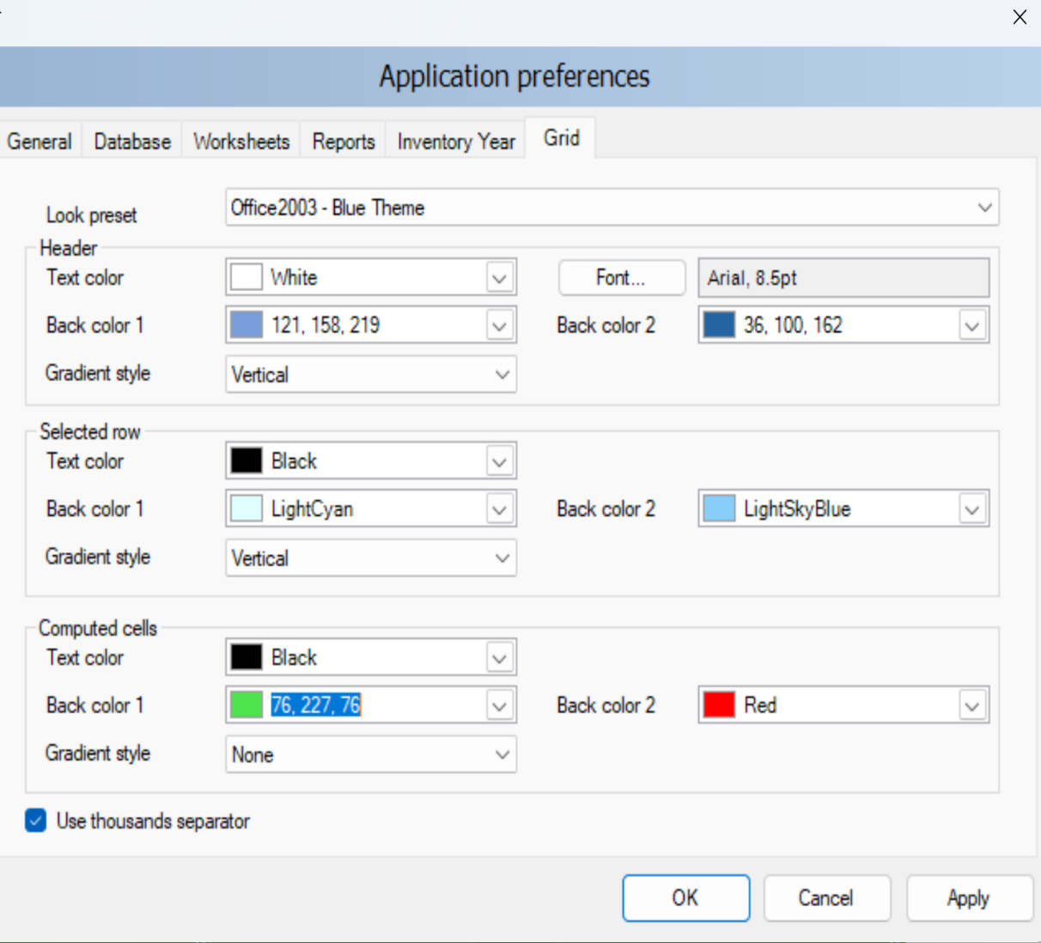
Application Menu - Preferences
Grid
Users have the ability to modify the appearance of the Software, based on their personal preferences
Look preset – provides the user with the set of standard predefined look presets to choose from
Header - defines the look of the grid header
Selected row – defines the look of the selected grid row
Computed cells – defines the look of grid cells that are computed (calculated)
Use thousands separator – if checked, thousand separator will be used to separate thousands in all numbers in grids.
Note: Thousands separator [i.e. “,” vs “.”] follows the operating system’s Control Panel / Regional Settings.
Select Apply after making any changes.

Slide 68
Application Menu - Language
1
…

Slide 69
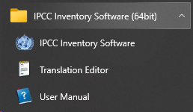
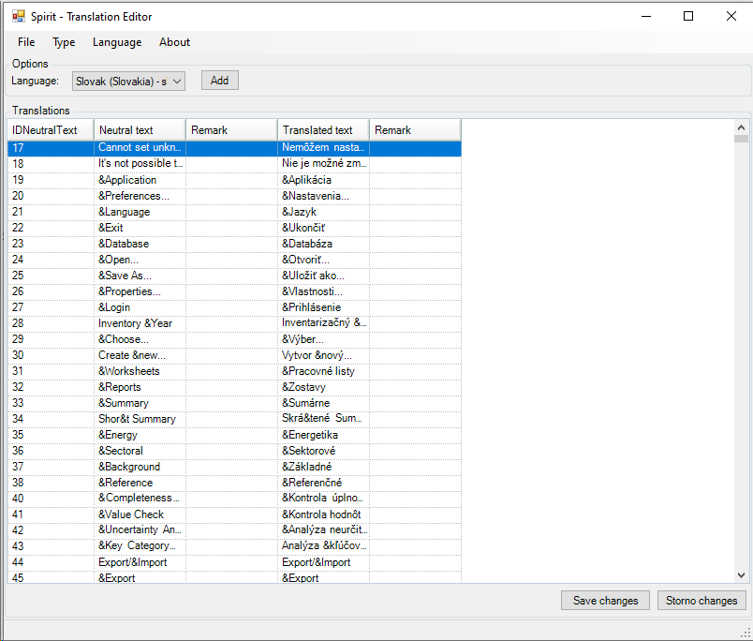
Application Menu - Language
Language
To set alternative languages in the menu
Users shall first create a file containing the translation by opening the Translation Editor (which is included in the setup of the Software)
Select Language from dropdown the user would like to add
3. To produce the file, users compile the translation of each word/sentence listed in the Translator
4. When the Software is re-opened, the user can switch between different languages. The default language is English.

Slide 70
Screen Resolution for Optimal Viewing of Software
When a Display is not set to its optimal resolution (i.e. recommended) and/or its optimal scale (i.e. recommended), the Software may not be correctly displayed and thus windows appear trunked
In case of problems in the visualization of the Software, please set the resolution and the scale to the value indicated in your computer as recommended
Where a problem in visualization persists, set resolution to 1600 x 900
Doing so, problems in Software’s visualization are addressed.

Slide 71
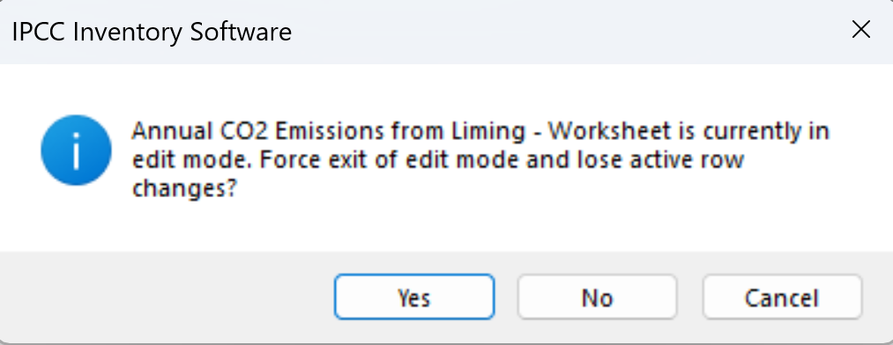
Application Menu - Exit
Upon exiting the Software, users are asked to confirm exit.
If any row of data has not been saved, users will be prompted again if you really want to exit:
Clicking “Yes”, exit is forced and all unsaved data are lost.
Clicking “No”, users are moved back to the worksheet to finalize data entry and to save entered data.

Slide 72
Database Menu

Slide 73
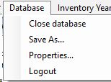
Database Menu
1
2
3
4

Slide 74
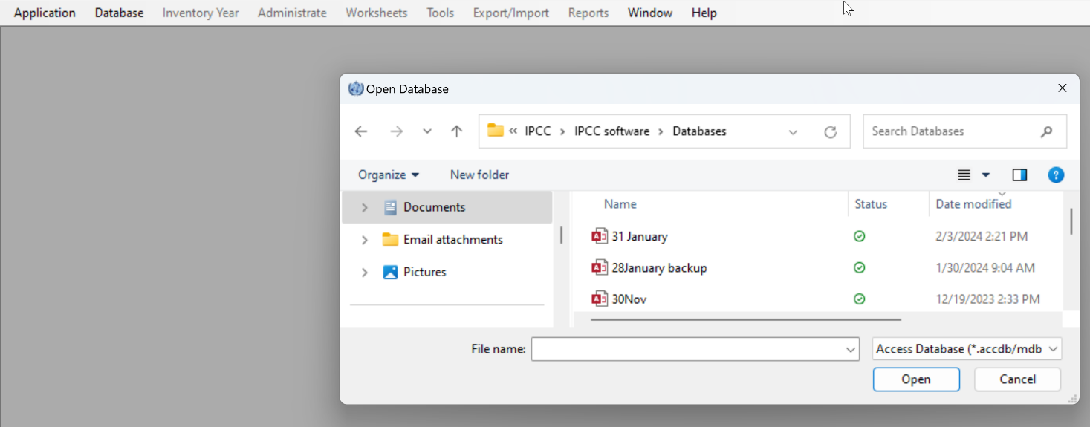
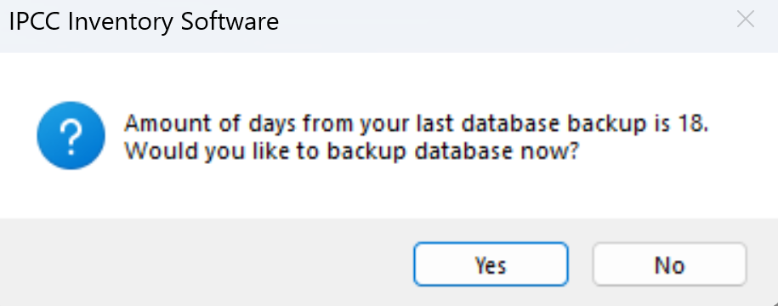
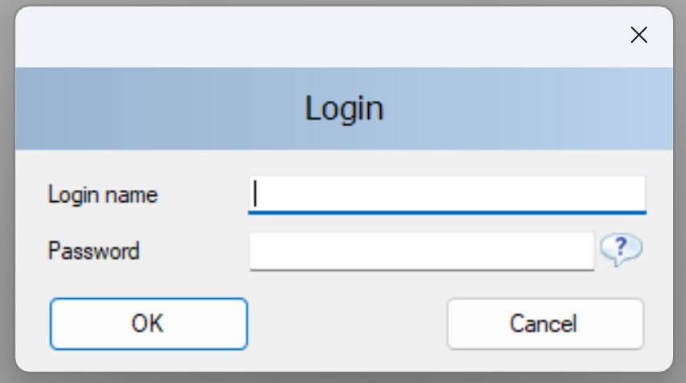
Database Menu – Close/Open
Open / Close Database
If the database is open, use this menu item to close the current database. You will be asked to confirm if you want to exit. If you select “Yes”, the currently logged-in user will be logged out automatically. All database-related functions and modules of the Software are disabled.
If database is closed, use this menu item to browse for, and open, the new database. You will be prompted if you want to make a backup upon opening (depending on selection in Preferences (see Preferences - Database).
All database related-functions will become available again after valid user logs in.

Slide 75
Database Menu – Save as
This menu item allows the user to save the database under a different file name to a different location. It is possible to compress (ZIP) the saved database file to save space. This opens the possibility to maintain several independent versions of the database (although compressed database file must be uncompressed (unzipped) before opening it in the Software)
The database is password protected. Although it is possible to remove password protection during saving, a database without a password cannot be opened in the Software.
Important
If password protection is removed, the database cannot be anymore opened by the Software.

Slide 76
2.6 Distribute database
Database Menu – Save as
On main menu, select Database. This will save the currently open database.
Select Save as…
Select destination folder and file name
You will be notified that the current database will be closed before saving; and reopened after saving and asked to confirm. Where you do not confirm the database is not saved
4. Choose whether to remove password protection.
Important
Do not remove password protection. Removing the password protection will prevent the database from opening in the Software (The Software strictly accepts password protected database only for security reasons). Nevertheless, you may remove the password to make the database accessible by another software
5. Decide whether to compress (ZIP) database file (compressed database file must be uncompressed (unzipped) before opening it in the Software).

Slide 77
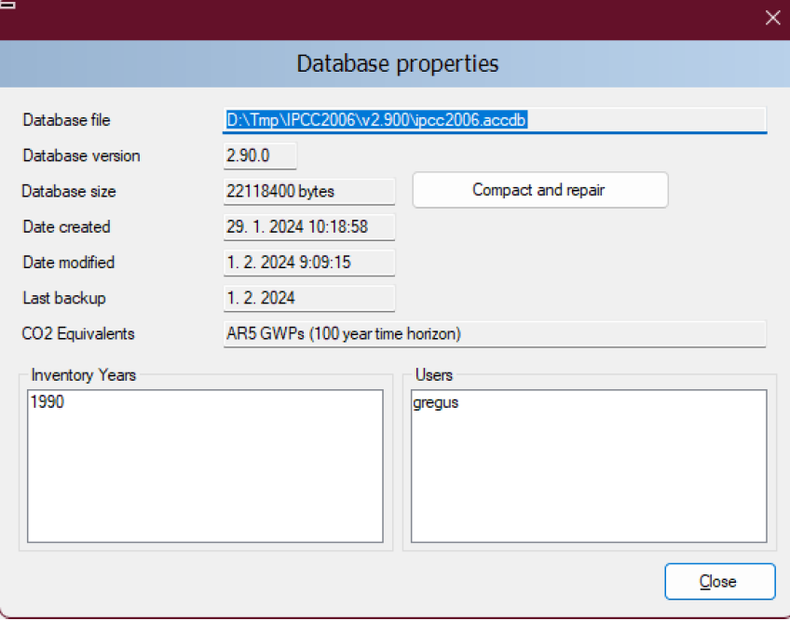
Database Menu – Properties
Selecting this menu item displays a dialog window containing properties of
the currently open database. The following information is displayed:
Database file – full path to currently open database file (ACCDB)
Database version – Software’s version
Database size – size of the database file in bytes
Date created – the date when the database was created
Date modified – the date of the last modification of data in the database
Last backup – the date of the last database backup
CO₂ Equivalents – currently selected default CO₂ equivalent type. CO₂ equivalent types can be managed using the Administrate / CO₂ Equivalents menu – see Set CO2 Equivalent Values
Inventory Years – the list of inventory years in the currently open database – to see inventory years, see Inventory Year Menu; to delete inventory years, see Delete Inventory Year
Users – the list of defined users in the currently open database – see Define Database’s Users and Adding Database’s Users
The button Compact & Repair is used to compact (i.e. reduce size on disk) or repair the database file (in case corrupted).

Slide 78
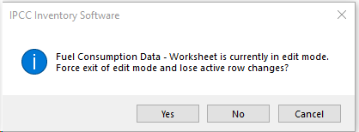
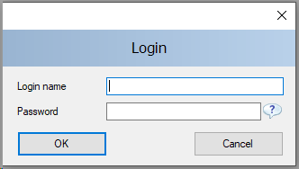
Database Menu – Logout
This menu item logs out currently logged in user. When selecting Logout:
If any row of data has not been saved, users will be prompted again if he/she really wants to exit:
Otherwise, user is instantly logged out and a login dialogue box appears to allow to log in again
Important
This functionality is likely to be used when users leave the working position for a break and want to avoid that somebody else access the database in their absence
This functionality is not to be used to switch from one database to another one (to do so users shall close the database and open the next one).

Slide 79
Inventory Year Menu

Slide 80
Inventory Year Menu
1
2

Slide 81
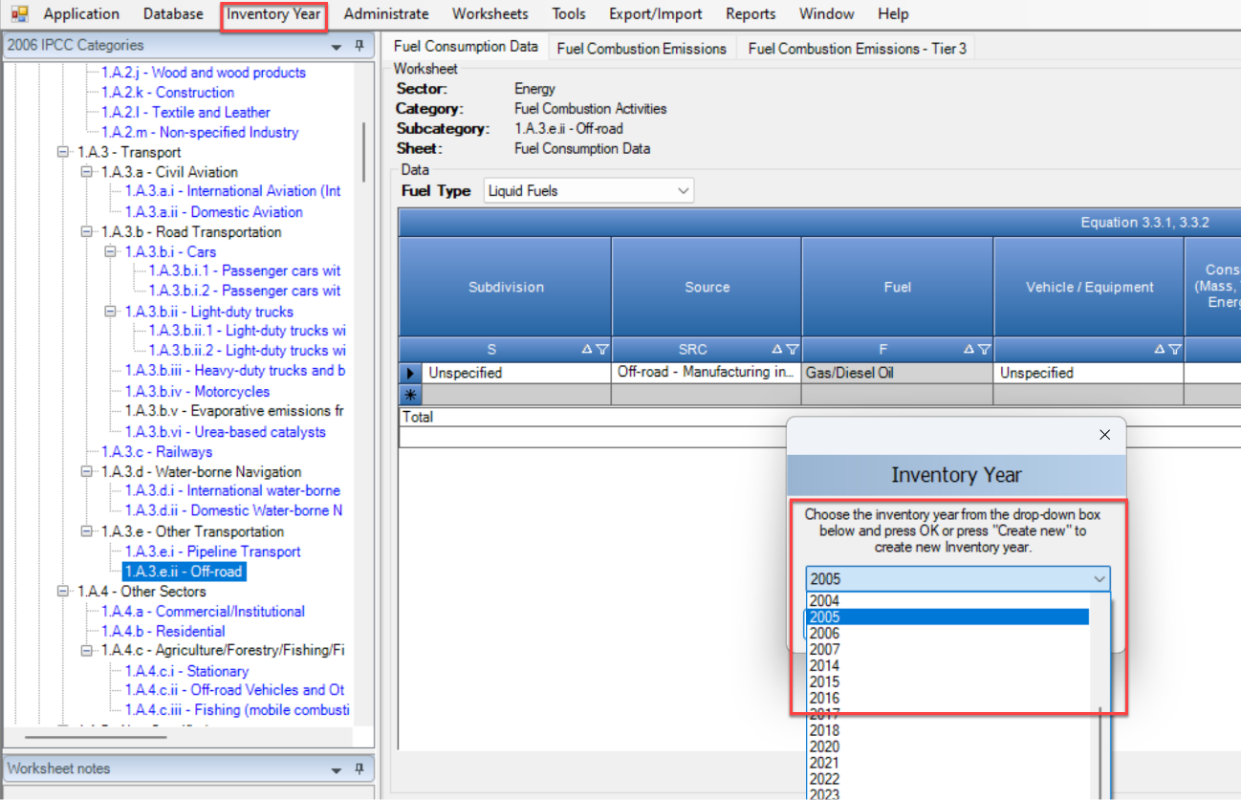
Inventory Year Menu - Choose
This menu allows the user to choose current inventory year as well as to create new inventory year.
Users usually need to switch between inventory years when
Entering inventory data, to do so:
Select Inventory Year from main menu.
Select Choose.
Select the inventory year to work on from the dropdown list.
Select OK - all related Software modules will update data and information to correspond to the new Inventory Year.
Important
The years available in the dropdown list are those that users have already added. Where the year of interest is not listed, users disengage the dropdown and select the option to Create new - see Inventory Year Menu - Create

Slide 82
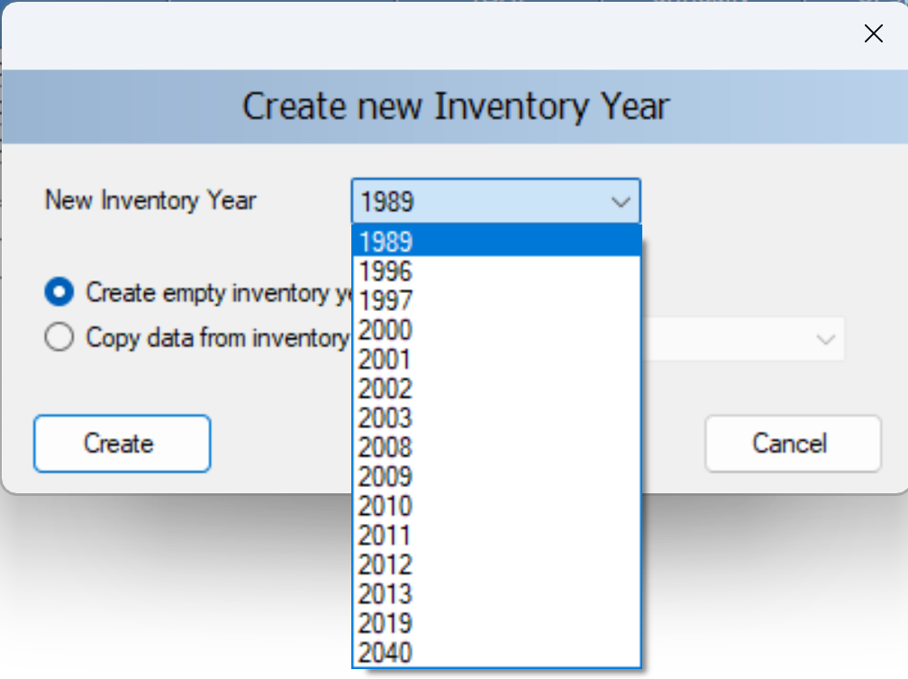
Inventory Year Menu - Create
Take the following steps to create new Inventory Year:
Choose available Inventory Year from the New Inventory Year list.
The years available in the dropdown list includes years within the Inventory time series set under Application Preferences – Inventory year tab that have not yet been created. (see Application Menu- Preferences - Inventory Year)
Decide whether to:
Create empty inventory year or
Copy data from an existing inventory year
by selecting the appropriate button. In case of copy, choose the source inventory year from the corresponding list of available inventory years.
Select Create to create the new inventory year. Once the new year, is created. it is automatically set as the current Inventory Year.

Slide 83
Inventory Year Menu – Data Entry
Efficient data entry using Inventory Year menu
Tip: The efficient and optimal way to enter data is:
Complete inventory for one basic year at first
2. Create additional years by copying data from the existing year inventory created in Step 1 (see Inventory Year Menu- Create) .
3. Use time series data entry to make adjustments to data across years (see further discussion on time series, beginning at Time Series Data Entry)
Important
Ideally you should start with the first inventory year in your inventory time series (e.g. 1990). For some sectors (e.g. entering data for the Land Representation – (see Guide to Land Representation) you must start with the first year.

Slide 84
Administrate Menu

Slide 85
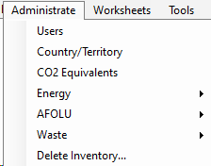
Administrate Menu
1
2
3
4
5
6
7

Slide 86
Administrate Menu
This menu section is only available to Administrators (i.e. Superusers). From this menu, the Superuser(s) can:
Add / Delete / Modify Users – see discussion starting at Define Database’s Users
Set Country / territory – see First Run
Note that changing the Country/Territory determines the closure of the currently open database and the setting of a new database (all data entered won’t be transferred to the new database)
Add CO₂ equivalent types, and set default – see discussion starting at Set CO2 Equivalent Values
Delete Inventory year – next slide
Access Data Managers for the Energy, IPPU, AFOLU, and Waste sectors – see discussion starting at Data Managers- Energy
Note Although the Administrate tab is only accessible by Superusers, the Data Managers are accessible to users via the relevant sectoral worksheets.

Slide 87
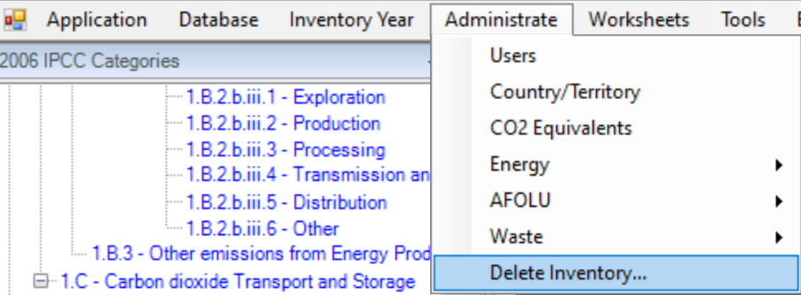
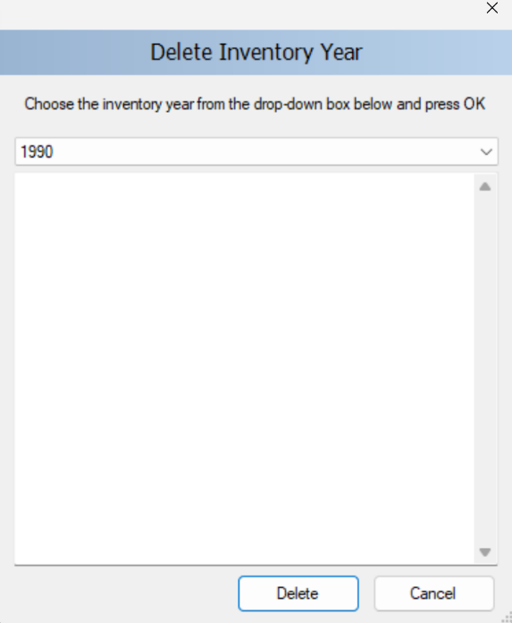
Administrate Menu – Delete Inventory Year
If you entered an inventory year in error, or would like to delete an intervening year from the inventory time series:
Select from the main menu Administrate.
Select Delete Inventory.
Select Year you want to delete.
Select Delete.
You will be prompted to confirm your selection to permanently remove all inventory data for that year from the inventory.
Note: The inventory year that is actively open on the screen cannot be deleted

Slide 88
Administrate Menu – Data Managers - Energy
For complete information on this data manager, please see the Energy Guidebook (available at https://www.ipcc-nggip.iges.or.jp/software/index.html)
Data Managers provide the user a single landing page to add underlying AD and/or parameters that are relevant for multiple calculation worksheets in a given sector. The Data Managers are also accessible from relevant worksheets of a sector.
Fuel manager: The Fuel Manager contains data on carbon content and calorific value for each fuel used in the NGHGI. All IPCC default fuels are listed in it; in addition, the user can enter its own user-specific fuels together with relevant data required by the Fuel Manager.
Users may instead access the Fuel Manager by clicking the relevant button at the bottom of the right-hand side of the relevant calculation worksheet .

Slide 89
Administrate Menu – Data Managers - IPPU
For more information on this data manager, please see the IPPU Guidebook, (available at https://www.ipcc-nggip.iges.or.jp/software/index.html).
Data Managers provide the user a single landing page to add underlying AD and/or parameters that are relevant for multiple calculation worksheets in a given sector. The Data Managers are also accessible from relevant worksheets of a sector.
F-gas manager (chemicals): It contains a list of F-gases, and associated climate-relevant value in the common metric (by default AR5 GWP₁₀₀), among which user selects those used in its NGHGI; in addition, the user can enter its own user-specific chemical together with the associated value in the common metric selected.
F-gas manager (blends): It contains a list of chemical blends containing at least one F-gas, among which user selects those used in its NGHGI; in addition, the user can enter its own blends by providing, for each blend, each component as well as its percentual contribution. Note that each component for which the GHG contribution is to be calculated shall be listed in the CO₂ Equivalents Tab with the associated metric (e.g. AR5 GWP₁₀₀)

Slide 90
Administrate Menu – Data Managers - AFOLU
For more information on the respective data manager, please see the relevant Guidebook (available at https://www.ipcc-nggip.iges.or.jp/software/index.html)
Data Managers provide the user a single landing page to add underlying AD and/or parameters that are relevant for multiple calculation worksheets in a given sector. The Data Managers are also accessible from relevant worksheets of a sector.
Livestock Manager: This menu item opens a dialog window which allows managing of Livestock populations for AFOLU category 3.A – Livestock. The Manager is comprised of three tabs: Geographic zones, Livestock characterization and Manure Management System.
Land Use Manager: This menu item opens a dialog window which allows managing of Land Use Subdivisions under AFOLU category 3.B – Land (and relevant 3.C categories). The Manager is comprised of a single tab, Land use subdivision, that opens for all land use subcategories.
Land Representation Manager: This menu item opens a dialog window which allows managing Land Representation for AFOLU categories under 3.B – Land (and relevant 3.C categories). The Manager is comprised of four tabs; two tabs to enter data: Regions and Land representation table, and two summary tabs: Land-use conversion matrix (Approach 2&3) –limited to a single Region- and Total Land use conversion matrix (All regions and approaches) for the entire territory of the NGHGI.
Users may instead access any of the AFOLU Managers by clicking the relevant button at the bottom of the right-hand side of the relevant calculation worksheet .

Slide 91
Administrate Menu – Data Managers - Waste
For more information on this data manager, please see the relevant Guidebook (available at https://www.ipcc-nggip.iges.or.jp/software/index.html).
Data Managers provide the user a single landing page to add underlying AD and/or parameters that are relevant for multiple calculation worksheets in a given sector. The Data Managers are also accessible from relevant worksheets of a sector.
Waste manager: This menu item opens a dialog window which allows managing waste categories and associated waste types by decomposability class. For each waste type the following information is associated: DOC/DOCf/DM content/C in DM/Fossil C in DM. All IPCC default waste types are listed in it; in addition, the user can enter its own user-specific waste types together with relevant data required by the Fuel Manager.
Users may instead access the Waste Type Manager by clicking the relevant button in the Parameter worksheet of Category 4.A or at the bottom of the right-hand side of the relevant calculation worksheet for categories 4.B and 4.C.

Slide 92
Worksheets Menu

Slide 93
Worksheets Menu
This menu item displays the calculation worksheets as defined in the 2006 IPCC Guidelines, and, where applicable, the Wetlands Supplement and the 2019 Refinement.
Typically, the Software already displays the worksheets, and it is not necessary to use this menu function.
If you log in and do not see the worksheets, check in Application Menu - Preferences to see if you have checked open worksheets window after login. If this is unchecked in preferences, then selecting Worksheets from main menu will open the window containing the worksheets.
If you have checked the box “Open worksheets window after login”, you will not need to select Worksheets from the main menu.
See next slides for detailed information on the list of Worksheets

Slide 94
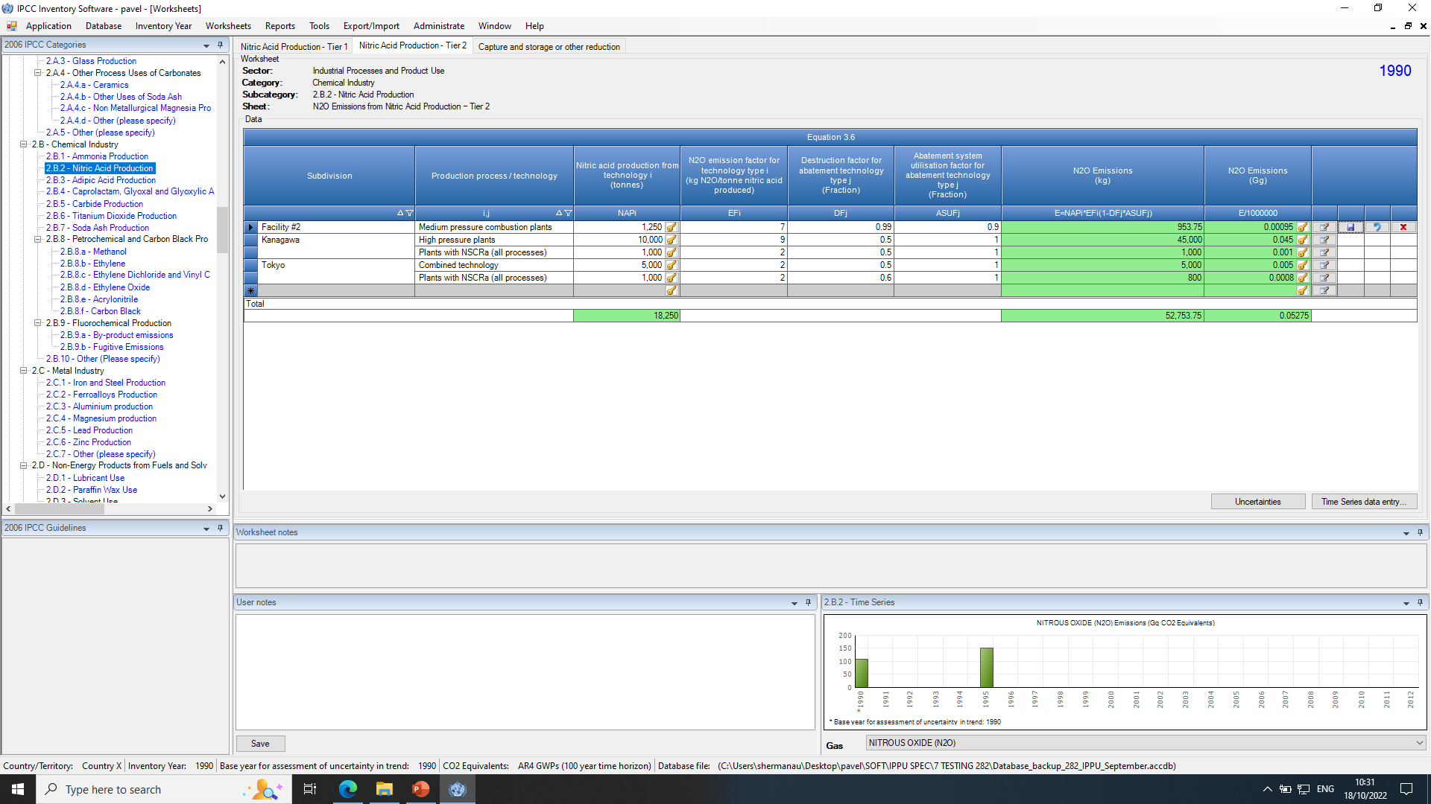
Calculation Worksheet - Example
Categories
Worksheets
Sub-divisions
Default or User-defined process/technology
Default or User-defined EF & parameters
Activity Data
GHG emissions

Slide 95
Calculation Worksheets
The Software has been built to accommodate ALL methods and approaches in the 2006 IPCC Guidelines and the Wetlands Supplement, as well as the 2019 Refinement, where needed for interoperability.
The number of worksheets reflects the comprehensiveness of the system; a single inventory generally only use a fraction of these worksheets depending on approaches and methods applied.
Given that calculation worksheets have been built according to IPCC good practice, some calculation worksheets are used in multiple categories, while some categories may have several category-specific worksheets
Guidebooks, published by the Technical Support Unit (TSU) of the Task Force on National Greenhouse Gas Inventories (TFI) in the TFI website (https://www.ipcc-nggip.iges.or.jp/software/index.html), contain step-by-step instructions for the use of each and every calculation worksheet in the Software.

Slide 96
Calculation Worksheets - Summary
ADD Summary Table
For the full calculation worksheets map, by sector, see Annex I

Slide 97
Tools Menu

Slide 98
Tools Menu
1
2
3

Slide 99
Tools Menu – Reference approach
The Reference Approach is a top-down approach, using a country’s energy supply data to calculate emissions of CO₂ from combustion of fossil fuels.
The Reference Approach can be applied using relatively easily available energy supply statistics.
The Software has 4 TABs to enter data (3 TABS) and calculate results (1 TAB) for the Reference approach, see the Energy Sector Users’ Guidebook.
Interoperability
For users preparing a GHG inventory for upload to the UNFCCC ETF Reporting Tool:
According to para. 36 of the MPGs, “Each Party should compare the national estimates of CO₂ emissions from fuel combustion with those obtained using the reference approach, as contained in the IPCC Guidelines… …and report the results of this comparison in its national inventory report.” Thus, information added in the Reference approach tabs is included in the JSON file for upload to the UNFCCC ETF Reporting Tool .

Slide 100
Tools Menu – Uncertainty Analysis
This menu item creates Reporting Table 3.2 as defined in the 2006 IPCC Guidelines. The procedures for the calculations in this table are explained in Volume 1, chapter 3 of the 2006 IPCC Guidelines.
Uncertainty values are not entered here, but in each Worksheet. A user should enter uncertainty values for all activity and emission factors. Default uncertainty values are applied, where available, when the user does not enter any uncertainty values.
There is no limit and no check for uncertainty ranges, i.e. it is the responsibility of the user to define the appropriate values. Default uncertainty values presented in the 2006 IPCC Guidelines are pre-loaded as default upper and lower limits for most categories.
To perform Uncertainty Analysis, click the Refresh Data button.
Interoperability
For users preparing a GHG inventory for upload to the UNFCCC ETF Reporting Tool:
Decision 5/CMA.3 does not contain a common reporting table for the reporting of uncertainty, therefore data entered in these worksheets are not included in the JSON file for upload to the UNFCCC ETF Reporting Tool. Information on the uncertainty analysis is to be included in the NID, consistent with the requirements in paragraphs 29 and 44 of decision 18/CMA.1

Slide 101
Tools Menu – Key Category Analysis
It is good practice for each country to identify its national key categories in a systematic and objective manner, by performing a quantitative analysis of the relationships between the level and the trend of each category’s emissions and removals and total national emissions and removals. Two Approaches for performing the key category analysis have been developed. Both Approaches identify key categories in terms of their contribution to the absolute level of national emissions and removals and to the trend of emissions and removals. The Software automatically calculates the key category analysis using Approach 1. The methods are described in Chapter 4.3, Volume 1 of 2006 IPCC Guidelines.
To perform Key Category Analysis, click the Refresh Data button.
Interoperability
For users preparing a GHG inventory for upload to the UNFCCC ETF Reporting Tool:
Countries reporting an inventory under the Paris Agreement are required to report in the NID a key category analysis, consistent with paras 25, 41 and 42 of the MPGs. The approach 1 key category analysis, which is to be reported in CRT table 7, will be automatically calculated in the UNFCCC ETF Reporting Tool, by that tool and based on data entered in that tool (including data that has been imported from the IPCC Inventory Software). The results of the Key Category Analysis in the Tools menu of the Software will not be included in the JSON. The results of the key category analysis in the Software and the UNFCCC ETF Reporting Tool may differ owing to different category classifications. Furthermore, the Software does not produce a key category analysis that excludes “LULUCF” categories

Slide 102
Export/Import Menu

Slide 103
Export/Import Menu
1
2
3
1
2
Important:The Software can only import XML’ s generated by that version of the Software

Slide 104
Export/Import Menu – Worksheet Data
Export Worksheet Data
This menu item opens a series of dialog boxes that allow users to select which sectors, sub-sectors, or categories and inventory years are to be included in the XML file.
To export worksheet data via XML:
1. Select one or more category/ies of interest. Categories containing worksheets (data) are marked blue. Click Next.
2. Select one or more years to export and click Export.
3. Select a folder and name the XML file when prompted. Close the Export process once 100% Progress is achieved
Note: where a category selected uses a data manager, then also data in the Data Manager are exported [see Administrate Menu – Data Managers]

Slide 105
Export/Import Menu – Worksheet Data
Import Worksheet Data
This menu item opens a dialog window that allows import of an XML file containing an inventory or part thereof -i.e. one or more sectors or categories from one or more source inventory years- into one or more years of the target database.
To import worksheet data:
1. Select Open button to browse for XML file to be imported.
Check the details such as
XML Import Version, shall be same XML version (as of version 2.96 XML versioning has been made separate from software versioning).
Country/Territory, shall be same version of the Software running
Source inventory year(s), inventory years included in XML import file.
IPCC Categories to import contains the list of all categories included in the source XML file. Select the categories of interest for import. All categories are selected by default.
Click Next button. In subsequent steps the users will select which year(s) to import, and the import policy.
Note: where a category selected uses a data manager, then also data in the Data Manager are imported [see Administrate Menu – Data Managers] according to the import policy selected for that category

Slide 106
Export/Import Menu – Worksheet Data
To import worksheet data – select years
Once category/ies are selected for import, the user has two choices for selection of inventory years to import:
Import selected source inventory year(s) into matching target inventory years
Select one or more years to import into the target database. Each inventory year that is in the XML file but is not in the target database will be shown as “new” and the Software will create the new inventory year in the database upon import.
In the image to the right, the XML import file contains data for 1988-2024. The target database to which the file is being imported has only 1990 (this can be seen because entire list says (new) except for 1990). Where this is not desired:
Uncheck the box “automatically create missing (new) inventory years” to avoid creating new years. In the figure, only 1990 becomes an option for import.
2. Import single source inventory year into existing target inventory year
When this option is selected, import a single inventory year in the XML import file into a single inventory year in the target database. Both years are to be selected in the dedicated dropdown menu
3. Click Next button to select the import policy.

Slide 107
Export/Import Menu – Worksheet Data
To import data – select import policy
When importing XML, user has four options -“merge”, “update existing”, “insert new”, “replace”- on how the worksheet data and any data populated in the relevant Data Managers will be considered from the imported XML.
Functions are determined at level of individual subdivisions/processes/ technologies/etc
Merge
Update existing records and insert new records
Update existing
Update existing records only and ignore new records
It is good practice to save a backup of your database prior to import.
Insert new
Insert new records only and keep existing records intact
Replace
Clear all existing records and replace with records in XML.
Use it with caution, as all existing data will be replaced.

Slide 108
Export/Import Menu – Worksheet Data
For Import/Export:
The software generally distinguishes each row of data -i.e. record- based on the alphanumeric string composed by the name of the unique combination that identifies it -e.g. subdivision/technology-, and uses it to implement each of the import option
e.g. a subdivision “Plant A” is identified through the alphanumeric string composed by its name, i.e. “Plant A”, and accordingly each of the import options is implemented.
However, owing to the complexity of the stratification in categories 2.F, 3.A, 3.B, 4.A, the Software instead assigns a random GUID (Globally Unique Identifier) to each record -e.g. subdivision/application/sub-application/gas- and uses the GUID to implement each of the import option.
Note that, given the Software assigns each GUID randomly, two different computers will assign 2 different GUIDs to the same record of data -e.g. subdivision/application/sub-application/gas-

Slide 109
Export/Import Menu – Worksheet Data
Thus, for categories 2.F, 3.A, 3.B, 4.A, new record of data shall be created only by the single user that enter/entered data for those. It can be the main inventory responsible or more likely the expert to which the category is assigned (others while importing the new record will get the original GUID too)
For instance, a national inventory compiler shares its database for 2.F.1 category with an expert that populates it with subdivisions/application/subapplication/gas and generates an export xml file for the inventory compiler. IF the inventory compiler populates its database with the identical combination of subdivisions/application/subapplication/gas before importing the data, THEN the Software will see the imported records different from those already present in the database, although those are instead identical, and it will insert those records as new, by adding the subfix “_1” to the subdivision name to avoid homonymies, whatever import policy is chosen
For further information, refer to sharing data

Slide 110
XML Worksheet Import Scenario - Merge
Merge = Update existing records and insert new records
If the inventory compiler imports the sector-expert file via merge, the compiler will have in database after import:
Inserted new record- 1.A.2.c
Inserted additional plants A and B for 1.A.2.f, retained Plant C.
Cement is unchanged, as there is no cement record from sector expert
(this is for both cases: a category is not in the import file, or the category is in the import file but blank)

Slide 111
XML Worksheet Import – Update Existing
Update existing: Update existing records only and ignore new records
If the inventory compiler imports the sector-expert file via update existing, the compiler will have in database after import:
There would be no changes because there are no common records between the sector expert and the inventory compiler; so no existing records to update (this is for both cases: a category is not in the import file, or the category is in the import file but blank).
If, for example, the sector expert had a “Plant C” in category 1.A.2.f, when the sector XML is imported by the inventory compiler, AD for Plant C would be updated.

Slide 112
XML Worksheet Import – Insert new
Insert new: Insert new records only and keep existing records intact
If the inventory compiler imports the sector expert file via insert new, the compiler will have in database after import:
1.A.2.c will import
1.A.2.fPlant A and B will import; no change to Plant C
No change to 2.A.1 Cement
If, for example, the sector expert had a “Plant C” in category 1.A.2.f, when the sector XML is imported by the inventory compiler, Plant C from the sector expert would not import.
Notes:
If there are no common records between the sector expert and compiler, “insert new” and “merge” will have the same result.

Slide 113
XML Worksheet Import - Replace
Replace: Clear all existing records and replace with records in XML Use with caution, as all existing data will be replaced
The inventory compiler’s database will be fully replaced for all categories that are checked in the XML import.
Important: This should be used with caution. For example, if the energy expert included IPPU in the XML file although it was blank, and the inventory compiler selects it, its database for cement will be overwritten with blank worksheets

Slide 114
Export/Import Menu – CO₂ Equivalent [METRIC]
Export CO₂ equivalents
This menu item opens a dialog box that allows to export information of a custom metric into an XML file.
Information contained in the custom metric is hierarchically structured as: Custom metric / GHG group / GHGs.
To export a custom metric:
1. Select the desired Custom GWP type of interest or the particular Gases within a gas group(s) e.g. C4F10 among PFCs
2. Click the Export button, then select a folder and name the XML file when prompted.
Important:
Default metrics present in the Software CANNOT be exported

Slide 115
Export/Import Menu – CO₂ Equivalent [METRIC]
Import CO₂ equivalents
This menu item opens a dialog box that allows to import information of a custom metric saved in an XML file.
To import a custom metric:
1. Click the Open button to browse for the XML file to be imported.
2. Select in the GWP Types to import the information to import (e.g. the custom metric of interest or specific GHGs of interest). It contains the information hierarchically structured of all custom metrics included in the XML file. Select.
3. Click the Import button to begin importing. A progress bar will be shown to indicate the progress of import.
Important:
The Software can only import XML’ s generated by that version of the Software
Tip: Button View XML file is clicked to display the content of the XML file in a selected app

Slide 116
Export/Import Menu – Export to UNFCCC CRT
This menu item opens the dialog box CRT Data Set Manager that allows you to:
Visualize the UNFCCC CRT.
Complete additional fields in preparation for a submission to the UNFCCC.
Generate a JSON file that can be subsequently uploaded to the UNFCCC ETF Reporting Tool.
Export/import a UNFCCC CRT Data Set (in XML)
For further information on how to prepare the JSON file for upload to the UNFCCC ETF Reporting tool, see section on Interoperability.

Slide 117
Reports Menu

Slide 118
Reports Menu
1
2
3
4
5
6
7

Slide 119
Reports Menu
This menu item allows the user to view and download in Excel the 2006 IPCC Guidelines Reporting Tables.
Summary tables:
NGHGI Summary (1 table)
NGHGI Short Summary (1 table)
Sectoral Summary (1 table for each sector, + Information item table for Energy)
Background sectoral tables:
Energy, 5 (including 1 for the Reference Approach)
IPPU, 11
AFOLU, 10
Waste, 3
Interoperability
For users preparing a GHG inventory for upload to the UNFCCC ETF Reporting Tool:
The structure of the tables in the Reports menu follows the reporting tables in the 2006 IPCC Guidelines. The layout of these tables is not fully consistent with those agreed by Parties in decision 5/CMA.3. For those reporting under the Paris Agreement, the proper format of reporting tables are those contained in the main menu: Export / Import – Export – UNFCCC CRT

Slide 120
Reports Menu - Tables
All Tables allow users to:
Select the number of decimal places of the figures reported as well as select zero padding
Enter and save information in a documentation box
Export tables to Microsoft Excel
Grey cells are not editable
White cells contain data compiled by the Software
Green cells are calculated by the Software
Pale-yellow cells are editable by users

Slide 121
Reports Menu – Background Sectoral Tables
Background [sectoral] tables
This set of reporting tables displays activity rates, fuel types (if applicable) and GHG emissions/removals divided into detailed 2006 IPCC Guidelines categorization (up to the most disaggregated level). The values are transferred from the calculation Worksheets.
Light orange cells signal that the
category calculation worksheets rely
on different AD, and thus AD may
not be meaningful
Background Table 1.4b
Category 1.C CO₂ transport and storage
is not compiled by the Software in any cells;
thus, it needs to be fully edited by users
(pale-yellow cells)

Slide 122
Reports Menu – Background Sectoral Tables Notation Keys
Background [sectoral] tables
Where in the relevant cell of the relevant calculation worksheet to be mapped by the Software into the relevant background table there is not a value, the Software compiles the cell with the Notation Key “NE” (not estimated). Users can:
Modify the default Notation Key “NE”
by right clicking on one or multiple cells
and select the appropriate notation key
Mark values with the Notation Key “C”
(confidential), by right clicking on one or multiple
cells and select the notation key “C”

Slide 123
Reports Menu – Sectoral Summary Tables
Sectoral [summary] tables
One Sectoral Summary Table is available for each sector and it displays GHG emissions/removals divided into detailed 2006 IPCC Guidelines categorization (up to the most disaggregated level). The values are transferred from the Background tables.
Sectoral Summary tables are the reporting element where emissions of Precursors (NOx, CO, NMVOCs, SO₂) can be entered in editable pale-yellow cells.

Slide 124
Reports Menu – Summary Tables
Summary table
This report displays all GHG emissions / removals divided into 2006 IPCC Guidelines Categories (up to level 3). The values are calculated from sectoral summary tables.
Short summary table
This reporting table displays all GHG emissions/removals divided into 2006 IPCC Guidelines Sub-sectors (up to level 2). The values are aggregated from Summary table.

Slide 125
Reporting – Summary
Main Menu
→ Report
IPCC Report | Level | Contents
Short summary (IPCC) | 1.A | Emissions/Removals
Summary (IPCC) | 1.A.1 | Emissions/Removals
Sectoral (IPCC) | 1.A.1.a.ii (most disaggregated level) | Emissions/Removals
Background (IPCC) | 1.A.1.a.ii (most disaggregated level) | AD, Emissions/Removals
Main Menu
→ Export
UNFCCC | Level | Contents
UNFCCC CRT | 1.A.1.a.ii (most disaggregated level) | AD, Emissions/Removals
Note: All reports, except UNFCCC CRT, can be exported as MS Excel file.
UNFCCC CRT can be saved as:
JSON file for upload to the UNFCCC ETF Reporting Tool
XML file that can be viewed in the IPCC Software

Slide 126
Reports Menu – Uncertainties
This Reporting Table is an aggregated version of Uncertainty Analysis IPCC Table 3.2.
The list of aggregated IPCC categories is based on IPCC Table 4.1 in Vol.1.
Uncertainties from disaggregated levels are combined by multiplication according to Uncertainty Analysis IPCC Equation 3.1.

Slide 127
Window Menu

Slide 128
Window Menu
A
B
NOTE:
The list of worksheets you see in this window depends on what you have opened. When first starting, you will see just “Worksheets”. You can see here that this user has opened various reporting tables.

Slide 129
Window Menu
When working with the Software, users open a number of TABs while just visualizing one at time. Thus, the Software provides a function to:
Minimize all – minimizes all windows, to display main working area
Close all – closes all open windows
Windows list – users can quickly switch the visualization from a TAB to another TAB by selecting from the Window list

Slide 130
Help Menu

Slide 131
Help Menu
1
2
3
4

Slide 132
Help Menu
PDF Manual – by selecting it, users download the Software Manual as a pdf file. The Manual is the first step to learn on how to use the Software
Check for updates – by selecting it, the Software checks if a new version has been published on the IPCC TFI website https://www.ipcc-nggip.iges.or.jp/software/index.html
Note: from version 2.98, the Software at its run checks whether the IPCC TFI website has a new version published and accordingly alert the users. Please recall that IT IS RECOMMENDED TO HAVE ALWAYS THE LATEST VERSION INSTALLED in your computer.
Official website – by selecting it, the webpage dedicated to the Software -https://www.ipcc-nggip.iges.or.jp/software/index.html- opens in your internet browser
About… – by selecting it, users open a window with information on the Software
This is the way to know which version of the Software your computer is running

Slide 133
Data Entry

Slide 134
Windows

Slide 135
Windows
When working on data entry, the Software shows by default 5 windows
Categories – source/sink categories, those in black have no calculation worksheets, while categories from the 2019 Refinement are in magenta and those from the Wetlands Supplement are in lilac. Users select the category to work with by clicking on it.
Calculation worksheet – users select the calculation worksheet to work with by clicking on it among those listed on the top of the window.
Timeseries graph appears in the window when the user selects a category listed in black ink.
Worksheets notes – contains notes/guidance on the worksheet data enter, as provided by IPCC TFI TSU or text from the 2006 IPCC Guidelines
User Notes – enables users to edit and save information on data entered in the open worksheet
Time series graph of emissions/removals, of selected GHG, in Gg CO₂ Equivalents
Interoperability
For users preparing a GHG inventory for upload to the UNFCCC ETF Reporting Tool:
Notes entered into the “User Notes” are for internal use of the IPCC Inventory Software. These notes are not transferred in the JSON file to the UNFCCC ETF Reporting Tool. To enter comments for transfer in the JSON file, the comments need to be added to the CRT Visualization tables – see Providing Official and User Comments

Slide 136
2006 IPCC Categories Navigation Window (tree)
Press to open a subcategory
This window contains the full 2006 IPCC Guidelines Category tree structure. The navigation tree is useful to select the category to work with, by clicking on it. The worksheets relevant to the selected IPCC Category will be displayed in the main working area on the right.
Worksheets are available for all IPCC categories that are highlighted in blue, magenta and lilac.
Blue highlighted categories are from the 2006 IPCC Guidelines
Magenta highlighted categories are from the 2019 Refinement
Lilac highlighted categories are from the Wetlands Supplement
Clicking on the Black "Sector/ Sub-sector" level shows the CO₂e time series graph of the "Sector/ Sub-sector".

Slide 137
Calculation Worksheets

Slide 138
Worksheets: Working with the Grid
The worksheet grid is tabular tool comprising of:
Worksheet identification text on top, with currently open Inventory Year (top-right)
Worksheet specific parameters - Gas, fuel type, calculation type, parameters, etc.
The top header of the grid -
column headers are not editable by user.
Row status [Column] - indicates the active row that is selected.
Rows of the grid containing data - (e.g. activity data, emission factors, emissions, …). Each row represents a combination of subdivisions and relevant types of activity data. There are different types of cells in the row:
Cells Colors and icons
Editable cells (white background) - fields enabling to edit activity data, emission factors and other parameters.
Compiled cells (grey background) – fields automatically compiled by the Software – Not Editable
Calculated cells (green background) – e.g. emissions calculated from activity data and emission factor – Not Editable
You might also see this: alerting you to a validation error in the data entered (e.g. fractions >1, allocations resulting in >100%)

Slide 139
Worksheets: Working with the Grid
Four functionalities are provided for all worksheets in the last four right-hand columns:
1. Edit Remark, If the record already contains some remark, the action button will be coloured green
2. Save row of data, to be clicked once data enter in the row is completed
3. Undo row changes
4. Delete Row
Clicking on 1 a dialogue box open where users can enter information specific to the single row of data entered. Once information is entered users shall click on OK to save it in the database.
1
2
3
4

Slide 140
Worksheets: Row Status [Column]
The left-most column of the grid is the Row Status, and indicates the current activity being performed within the selected row.
There are several icons indicating the status as follows:
Indicates active row. This row is just selected - not in edit mode.
Currently selected row is in edit mode. Edit mode is activated as soon as users enter a value in any cell.
Indicates that the row is an "add-new" row and is used as a "template" for a new row.
“Add-new" row in edit mode. Edit mode is activated as soon as the users enter a value in any cell of "add-new" row.

Slide 141
Worksheets: Adding New Row
If the worksheet allows the user to add new rows, the "add-new" row can be found as the last row of the grid marked with Status Row icon. This row acts as a "template" for the new row.
As soon as the user starts entering data in cells of an "add-new" row, edit mode is activated and Status Row icon changes to
After data enter, data are saved in the database by clicking the button ; accordingly, the data are validated by the Software before storing those in the database, if any data is missing or an error is found, users are prompted. Automatically an “add-new” row is added right below

Slide 142
Worksheets: Editing Rows
Cancel editing of existing row / Undoing cell changes
Pressing the ESC key or the action button to undo row changes.
When selecting ESC key the behavior is as follows:
If the active cell is in edit mode, hitting ESC cancels edit mode of that cell and undoes changes made to cell data (if any).
If there are no more cells changed in edited row this also cancels row editing.
If there are more cells that have been changed while editing the row, hitting ESC again undoes changes in all changed cells and cancels row editing returning it to its original state.
In case of using the action button, changes in all cells will be undone automatically at once and edit operation on row will be canceled.
Editing existing row
Edit mode is activated as soon as the user starts modifying data in editable cells.
A modified row is saved into database as soon as the user leaves the row being edited or by pressing the button
Validation of entered data is performed before the row is updated in the database. In case of any error in the supplied data, the user will be alerted to correct it.

Slide 143
Worksheets: Deleting Rows
To delete one row:
Select the for the row you want to delete.
You will be asked to confirm if you want to delete the row.
To delete multiple rows:
Highlight multiple rows by dragging the cursor or use the Shift Key Function within the Row Status column of the grid.
Select “Delete” on your keyboard to delete all highlighted rows.
.

Slide 144
Worksheets: Drop-down Value List Cells
Some cells contain a dropdown value list, where user can choose from the pre-defined set of values or nomenclature data (e.g. emission factors). Such cells have the drop-down value list indicator .
To populate cells with dropdown value list indicator:
Click on the drop-down indicator
Select appropriate default, taking into consideration any regional information or remarks provided.
Drop-down lists may be:
Fixed: Users cannot overwrite (e.g.
Tier selection)
Editable: Users can overwrite with own country-specific information.

Slide 145
Worksheets: Apply Information to Multiple Years
In the case of solid waste disposal sites, there is a downward arrow icon, which allows the user to apply the same data to multiple years.
.
To apply information to multiple years:
Click on the downward arrow.
Confirm you want to apply the information to all subsequent years.

Slide 146
Worksheets: Accessing Sub-tables
In several cases, particularly in IPPU and Waste sectors, sub-tables must be opened when using higher-tiers to input relevant information, e.g. by industry technology or waste management practice. To open these sub-tables you will click the icon
Note:
You have seen the icon before – it is also used to provide /edit remarks. You will be able to easily tell the difference, as the ability to “Edit remarks” is placed at the end of all data entry rows. Where this indicator is used for a sub-table, it will be in one of the columns for calculation.

Slide 147
Time Series Data Entry

Slide 148
Time Series Data Entry: Layout
Most worksheets support time series data entry. This means that parameters of a worksheet can be edited across existing inventory years, for which the activity has been entered into the Software.
Time series data entry worksheet can be activated by clicking the Time Series Data Entry button located under the grid. This will open the following window.
Current year in orange
Editable cells in white
Gray cells are not editable

Slide 149
Time Series Data Entry: Layout
1. Select Parameter: contains the list of all editable parameters contained in the worksheet. By choosing the parameter the grid will display the values the parameter has across existing inventory years grouped by all available combinations of row identifiers. Values in white cells are editable.
2. Note that grid-columns preceding year-columns are “Row Identifiers”. They uniquely identify the Worksheet rows across all existing years representing all existing combinations of identifiers across years. In case a parameter value is shaded for a certain year, this means that the combination of relevant row identifiers does not occur in that particular year, or the database section of that year has not yet been created
3. Select “Export to Excel”

Slide 150
Time Series Data Entry: Copy Data
Time Series Data Entry table is the tool that implements the Copy and Paste functions which can be used to transfer data between the IPCC Inventory Software and other software (e.g. Microsoft Excel).
To copy data:
Select Time Series Data entry for the worksheet of interest
Copy data onto clipboard by highlighting desired cells and pressing Ctrl+C keys. Data stored in the clipboard can then be pasted into any third-party software that supports data pasting.
There are 2 ways of highlighting cells to be copied:
• Using mouse – use left-most column to highlight cells by rows or column headers to highlight cells by columns
• Using keyboard – Select the starting cell from which you want to start highlighting the region, click Shift+keyboard arrows to highlight desired cells for copy.
Note: If the cell is editable it will switch to edit mode disabling the highlighting function. Therefore, it is necessary to press ESC to exit edit mode before highlighting the cell.

Slide 151
Time Series Data Entry: Paste Data
To paste data:
Data can be pasted from the clipboard into the Time Series Data Entry table, if the structure of data is tabular – e.g. copied from Microsoft Excel.
Select the starting cell for which data paste should start.
If you decide to define a paste area by highlighting cells using the Shift+keyboard arrows, be sure your area matches the structure stored in the clipboard – number of columns and rows must match.
Use Ctrl+V to paste data. Cells that are read-only (automatically calculated green cells or other non-editable cells) will be ignored.
Note: If the cell is editable it will switch to edit mode disabling the highlighting function. Therefore, it is necessary to press ESC to exit edit mode before highlighting the cell.

Slide 152
Time Series Data Entry: Copy & Paste Data
Important notes and reminders for copy and paste function:
Only existing rows /cells (i.e. white cells) can be updated by pasting data. If the source data in the clipboard contains more rows or columns than the Time Series Data Entry table, the additional rows (e.g. subdivisions or fuels) / columns (i.e. years) will not be created.
Creating new rows by pasting data is not supported, thus not possible.
Values from source Excel cells are copied to the clipboard exactly as they are formatted. E.g., if they are rounded for display and the real value stored in a cell has more precision, the rounded value will be copied instead of the full precision value. This is Excel’s standard behavior.
There may be a validation check upon pasting– for example, you cannot import text into a cell expecting data numeric value.

Slide 153
Time Series Data Entry: Export to Excel
After clicking the Export to Excel button, and saving the file on your computer, data for that parameter then can be modified in Excel and imported back into the Software. The following figure provides an example of the exported XLS:
Note: If you intended to add data for these fuels for 1991 and 1992, you must enter the fuels in the worksheets. To do this.
Go back to worksheet for 1.A.1.a.i
Go to Inventory Year on main menu and choose inventory year 1991.
Add the subdivision and fuel type of Lignite coke and biogasoline.
Repeat for 1992.
Go to Time Series Data Entry and select Export to Excel. These cells should now be white.
Once in Excel, you can use all the features of Excel, in the white cells. You may not change the structure of the worksheet or add information in gray cells.

Slide 154
Time series data entry: Import from Excel
Pressing the Import from Excel button. This will allow import of a previously exported parameter back into the Software.
The Software asks for the input XLS file and if it meets the conditions, it will be imported.
For each variable of each category, the only Excel form suitable to upload data is the one exported by the Software
Note: The Software can only import a file exported by the Software, and category code must match for import.

Slide 155
Time Series Data Entry: Chart
The chart at the bottom of the Time Series Data Entry window contains the visual representation of the selected parameter values for the selected grid row across all years. It can be used for visual checking of value variations across all years.

Slide 156
Export to Excel

Slide 157
Export to Excel
Each calculation worksheet can be exported to Excel by selecting the Export to Excel button located at the bottom of a worksheet.
The user may select a single worksheet to export, or it is also possible to export multiple worksheets of the same category into a single workbook.
To export a single worksheet, simply select Export to Excel and then Yes.
Multiple worksheets may be “stacked” for export. To select multiple worksheets, select Export to Excel to add the first worksheet to the stack and then select “No” if you wish to add additional worksheets for export. Repeat the steps to select each worksheet for export, and “No” until all worksheets of interest but the last are selected and then indicate “Yes” download all of them at once within a single excel file.
Note: in the current version of the Software, export to Excel may only be done one year at a time.

Slide 158
Interoperability with the UNFCCC ETF |GHG INVENTORY| Reporting Tool

Slide 159
1. Introduction

Slide 160
Introducing “Interoperability” with the UNFCCC ETF Reporting Tool

Slide 161
Use NGHGI from Software for Paris Agreement
IPCC Inventory Software
UNFCCC ETF Reporting Tool
1. Prepare GHG Inventory in IPCC Software
Estimate GHG emissions consistent with IPCC Guidelines
Reduce errors
Supports national institutional arrangements
2. Review Visualized CRTs
Review results; if necessary, go back to calculation worksheets
Finalize notation keys for reporting
Incorporate information needed for reporting in the CRT, including flexibility, as applicable.
Complete, Easy to Use, Fundamental IPCC Inventory Software used to complete 60 tables of the CRT for each year of the time series!
4. Upload file to UNFCCC ETF Reporting Tool
3. Produce JSON file
Save file on your computer

Slide 162
2. CRT Data Set Manager

Slide 163
Introducing CRT Data Set Manager
Access CRT Interface in Software
Navigate to Main Menu and select “Export/Import”
Select “Export” and “UNFCCC CRT”
This opens the CRT Data Set Manager interface

Slide 164
Functionalities of the CRT Data Set Manager
The CRT Data Set Manager is the interface allowing you to create one or more data sets to prepare your submission to the UNFCCC ETF Reporting Tool.
Upon first opening, you have two options:
Create a New CRT Data Set
Import CRT Data Set
Once you have one or more data sets, additional features will be highlighted:
Edit CRT Data Set
Open tables
Generate JSON
Refresh Values
Delete CRT Data Set
Export CRT Data Set
A single CRT Data Set represents a particular instance of CRT export which holds CRT Tables with data for the set of years that were selected during CRT Data Set creation.
The Software allows the user to maintain multiple CRT Data Sets that are independent of each other and thus can be managed and exported independently (as JSON or XML).

Slide 165
Create New CRT Data Set
Select New CRT Data Set: This action button opens a screen where properties of the new CRT Data Set are specified, managed and exported to JSON independently.
Name – Enter name of new CRT Data Set
Years – Select years to include in your data set
Save – Select Save
A new data set is created
Dataset name is unique (i.e. same name cannot be assigned to more than one dataset)
NOTES:
The list of years for selection will include only those years that you have created in the database
You may save in the JSON a subset of years you have in your CRT data set

Slide 166
Create New CRT Data Set
You are then asked if you would like to perform data compilation for the new CRT Data Set
If you select “Yes” the underlying worksheet data will be transferred into the visualized CRT
If you select “No” this operation is postponed and you will return to the CRT Data Set Manager interface.
NOTES:
If you select “No”, the data compilation can be carried out later at various levels (at sector, table, cell or multi-cell selection level)

Slide 167
Import CRT Data Set
A user may also at this first stage, or any point, Import CRT Data Set. Only a CRT data set exported by the Software may be subsequently imported into another user’s application (see Export CRT Data Set).
To import a CRT Data Set
Select Import CRT Data Set
Select from the computer the CRT Data Set to import
Select Yes when asked if you would like to proceed.
Select OK when prompted that import is finished. The CRT data Set will appear in the window.
NOTES:
If a CRT data set with the same name already exists, a box will appear asking if the user wishes to update the existing CRT Data Set, or create a new one. If a new one is created, it will appear in the CRT Data Set Manager with “_1” at the end of the name.
The imported CRT data set is viewable but not “linked” to the database. See section on Refresh here or here to learn more.

Slide 168
Edit CRT Data Set
This features is in the CRT Data Set Manager
Recall, to access this screen navigate to the Main Menu and select Export/Import / Export / UNFCCC CRT
In Edit CRT Data Set you may change the properties (Name or Years) of an existing CRT Data Set
You can access the CRT Data Set Manager at any time. Note, if you were previously in the “Open Tables” function of the CRT Data Set Manager you will see a prompt.
If you select “OK” you will return to Open Tables
If you select “Cancel” you will return to the CRT Data Set Manager

Slide 169
Edit CRT Data Set
1. Highlight the CRT Data Set you want to modify
2. Select Edit CRT Data Set
3. The Edit CRT Data Set selection box will appear to change the Name of the data set or Add/Remove Years
Add /remove years: the user can add additional years, or delete existing years from the existing CRT Data Set by checking and unchecking years, respectively.
4. Check Copy data into newly added years from the closest existing year to automatically populate new years with information from the CRT Data Set of the closest (previous) existing year
If the last completed inventory year is 2019 and the CRT data set is edited to include 2020, by checking this box the 2020 CRT data set will be created to match the 2019 CRT Data Set.
After adding new years to the data set and saving, user is prompted whether to feed data into CRT tables for newly added years and for all sectors.
Example

Slide 170
Open CRTs
Open Tables is an interface that visualizes the CRT and allows you to review, manage and finalize the data for the CRT across sectors and years for your selected CRT Data Set
1. Highlight the CRT Data Set you want to review
2. Select Open Tables
This action button opens a screen containing CRT for the currently selected CRT Data Set.
This screen will open in a mode that allows you to switch between the visualized CRT and other Software screens (e.g. Worksheets). Only one visualized CRT for one CRT Data Set can be open at a time.
Recall, to access this screen navigate to the Main Menu and select Export/Import / Export / UNFCCC CRT

Slide 171
Delete CRT Data Set
This action will permanently delete existing CRT Data Set together with all data in all CRT Tables.
Highlight the CRT Data Set you want to delete
2. Select Delete CRT Data Set
You will be asked whether you really want to permanently delete the CRT Data Set. The action is not reversible.
NOTES:
What does it mean to say “the action is not reversible”? Although you can re-create the CRT Data Set from the latest available data in the underlying worksheets of the Software, you will lose any changes you made to default notation keys, and any information added as comments, documentation box explanations, etc.

Slide 172
Open CRTs - Functionalities
In Open Tables, you can separately visualize each table for each sector and each year and provide additional information that will be needed for your submission in the UNFCCC ETF Reporting Tool.
In the visualized CRT, you may:
Review your data, including data aggregations
Change notation keys
Provide explanations for use of the notation keys “IE” (included elsewhere) and “NE” (not estimated) for CRT table 9, and “FX”
Provide information on the method and EFs used, for Summary 3 of the CRT
Designate information as confidential (notation key “C”)
Add “User” and “Official” comments
Provide information for documentation boxes
Review CRT footnotes
Review IPCC Inventory Software Notes

Slide 173
Toggle between Worksheets and CRT Data Set Manager
Once in Open Tables you may toggle back to the Software.
Select the desired element from Main Menu. For example, if you find an error in the worksheet data you may select “Worksheets” from Main Menu.
After making underlying change(s) in the Worksheet(s) to return to the Open Tables, navigate to the Main Menu and select Export/Import / Export / UNFCCC CRT
Select “Open Tables” from CRT Data Set Manager
If prompted that “CRT Tables window is currently open”, select “OK” to return to Open Tables or select “Cancel” to return to the CRT Data Set Manager

Slide 174
Refresh Values
This action button allows you to refresh all IPCC worksheet data within the selected CRT Data Set for all sectors and selected years. Updated values are compiled from the Software worksheets; replacing current values.
Other information already added by the user, such as notation key explanations, comments, documentation boxes, will be preserved.
To refresh data:
Highlight the CRT Data Set you want to refresh/update.
Select Refresh values.
Select Year(s) you would like to refresh (all sectors will be refreshed for the selected years).
Select “OK”, you will then be prompted to confirm your selection.
NOTES:
Refreshing values from CRT Data Set Manager will refresh the visualized CRT with data from the underlying worksheets for all sectors for the selected Year(s).
Note if existing CRT Data Set was created from imported CRT XML file, this action will link the CRT Data Set to the users current database; this could lead to substantial changes.
You will learn how to refresh the values for a single or multiple cells in a single sector .

Slide 175
Delete CRT Data Set
The user may delete a CRT Data Set
Deleting a CRT data set is “permanent” as it cannot be retrieved; however, the user may again create a new CRT data set from the current underlying database.
To Delete a CRT Data Set
Select the CRT Data Set to be deleted.
Select Delete CRT Data Set
Confirm with “Yes” that you really want to delete the data set.

Slide 176
Export CRT Data Set
This action allows the user to create an XML file with complete representation of a single CRT Data Set.
The XML file can then be transferred and imported into any other IPCC Software database. For more information, see Import CRT Data Set.
To Export a CRT Data Set
Select the CRT Data Set to be exported.
Select Export CRT Data Set
Save the XML file on your computer.

Slide 177
3. Preparing your IPCC Inventory for Paris Agreement Reporting How to review visualized CRT and prepare data
for upload to the UNFCCC ETF Reporting Tool

Slide 178
Functionalities in Open Tables (i.e. Visualized CRT)
You are presented with all CRTs for the CRT Data Set selected
What can you do here?
Review any tips or notes for users of Software
For actions in #3-6, indicate Update Mode- i.e. if changes are for one or more years
Provide additional information for white cells for inclusion in JSON for upload to CRT, including (a) user comments; (b) modify and provide explanations for notation keys for CRT table 9; (c) designate data as confidential
for each category/gas, for CRT Summary 3, add information on: (a) method (b) EF
In limited cases, update activity data, if appropriate
Add notes to documentation box
Refresh values
Review Category and Sector Totals
We will look at each functionality in turn…

Slide 179
Prepare Data for Upload to UNFCCC CRT
The logic process to review category/sector totals and prepare data for upload to the UNFCCC CRT is as follows (and following slides will guide according to it):
Review IPCC Inventory Software Notes for Users
Select the Upload Mode
Finalize any notations in White cells
Edit information (e.g. notation key explanations, user or official comments)
Revise Notation Keys (if necessary)
Refresh values (if necessary)
Update Activity Data –Pale-green Cells
Input method/EF information in Pale-blue cells
Edit information (user-specific documentation could be input here; will not transfer to UNFCCC)
Add Notes to Documentation Box
Review final category and sector totals
Once all these tasks are finished, the user is ready to the generate the IPCC JSON. A JSON file can be generated for a single cell (including white, green or pale blue cells), a table, a sector or the entire inventory. See next section for further information on how to generate the JSON.

Slide 180
Review IPCC Inventory Software Notes for Users
The lower right-hand box of all visualized CRT contains “IPCC Inventory Software notes”. These tips and hints provide information useful when reviewing and finalizing the CRT.
For example, the box may provide the following types of hints:
-Information on types of information to include in the documentation box
-Reminders that underlying activity data may need to be updated to reflect the full national coverage
- Explanations for some automatic notation keys
Remember: If you need to make a change to underlying worksheet data, select “Worksheets” from the main ribbon. You will make changes to worksheets, return to the visualized CRT, and refresh values

Slide 181
Select Update Mode
Indicated if changes made in the visualized CRT should apply to:
Current year only
All years
Selected years
Select to change update mode
Current mode of update
Check box if changes apply to green shaded cells also

Slide 182
Prepare Data for Upload to CRT - White Cells
White cells for AD and emissions contain data compiled by the Software from underlying worksheets.
In a white cell a user can right click or double click to be presented with four options:
Edit
Notation key
Refresh value
JSON Export (covered in next section)
Actions can be undertaken on a single cell or a selection of cells.
The functions available under the four options will depend on if the white cell(s) contain(s) a value or a notation key.
Note the white cells in the column of “categories” are not editable. These are standard categories that have been developed for users of the Software to ensure all GHG emissions/removals transfer to the UNFCCC ETF Reporting Tool (e.g. “other liquid fuels [IPCC Software 1.A.4.c.ii]” in the image above).

Slide 183
Edit - White Cells
Right click or double click and Select “Edit” to open a dialog box where to compile all information relevant for the type of selected
CRT Variable.
For all types of variables (values and notation keys) the following options appear:
Summary: Contains basic information, such as the UID for the UNFCCC ETF Reporting Tool, as well as the current value (this is not visible in case of multiple cells selection)
Description: Provides a space for the user to describe a variable (e.g. for CRT category 1.B.2) (see Description)
Two separate tabs for User comment and Official Comment (see Providing comments)
In addition, where selecting Edit on a cell that contains “IE”, “NE” or “FX” an additional tab appears to allow you to insert needed information for the CRT.
“IE” – see Reporting of "IE"
“NE” – see Reporting of "NE"
“FX” see Reporting of "FX"

Slide 184
To View and Enter a Description - White Cells
Either right click or double click on the value associated with the description and select Edit.
Toggle to Description; in most cases this box is blank. In the event the CRT has a “Description” column (e.g. for 2(I)A-H)) this will be pre-populated with description(s) from the Software to be transferred to the UNFCCC.
Where there is no specific “Description” column in the CRT, the user may still input user specific documentation in this cell, however this information will not transfer to UNFCCC.
To change the description, enter new text in box and select Save.
To apply the description to all cells selected check the box: “Apply Description specified in the box above to all selected cells” which is at the bottom of the window
Notes:
In Table 1.B, Unspecified is automatically transferred to UNFCCC owing to the various types of AD. However, in the description field, the user can see the description compiled by the Software.
In limited cases (e.g. in IPPU) the user may want to change the description to reflect national AD reported. In IPPU these cells are shaded green. For more information, see Update Activity Data - Pale Green Cells

Slide 185
Providing User and Official Comments – White Cells
There are two types of comments a user may include in the visualized CRT tables
Type of Comment | Description
User | Comment entered by a user and is visible only to that user (e.g. user may want to put a reminder here).
Official | Comment entered by a user that he/she would like to include in the official inventory submission. This comment will transfer as part of the JSON.

Slide 186
Providing User and Official Comments – White Cells
To enter comments on a single cell
Either right click on the cell and select Edit or
Double click on the cell
Toggle to the type of comment you want to enter: User or Official comment
Add your user comment to the white box
Select Save
Refreshing the value in a cell will not impact any comments already entered by the user. They will remain after the refresh.
To enter the same comment(s) for multiple cells
Drag cursor over multiple cells
Right click on selection
Check box at the bottom of the window for “Apply comment specified…” and follow steps above

Slide 187
Notation Keys – White Cells
The 2006 IPCC Guidelines, Volume 1, provide six Notation Keys to support completeness and confidentiality of information reported in a national GHG inventory:
Further, when reporting under the UNFCCC, in accordance with paragraph 6 of the annex to decision 18/CMA.1 and paragraph 5 of decision 3/CMA.3, developing country Parties may elect to apply flexibility and thus provide in the UNFCCC CRTs the notation key “FX” instead of the required information

Slide 188
Notation Key “IE”– White Cells
Reporting of “IE” (Included elsewhere)
The 2006 IPCC Guidelines provide guidance on the GHG emissions /removals to be reported for each category. A Party may not be able to report an activity according to this allocation because of data availability.
The IPCC Guidelines, and the UNFCCC CRT, allow for the use of the notation key “IE”.
When the visualized tables of the CRT are generated, a user may find two scenarios:
An “NE” or “NO” has automatically generated for a category for which the Party has included emissions/removals elsewhere. In this case, the user can change the existing notation key to an “IE” to reflect the national circumstances.
An “IE” has been automatically populated, because the equations in the 2006 IPCC Guidelines include the activity elsewhere.
In both cases, Table 9 of the CRT must be completed with information to clarify the Parties reporting, specifically
Source/sink category
Allocation as per IPCC Guidelines
Allocation used by the Party
Further information on the automatic mapping of “IE” for a specific CRT may be found in the IPCC Inventory Software Notes in the visualized CRT. In addition, the annex to each Sector Guidebook includes a table to explain the automatic reporting of “IE”, which may be used to help complete information in the visualized CRT for Table 9 (see, for example, Table A.1.6 of the Livestock Users Guidebook, available at https://www.ipcc-nggip.iges.or.jp/software/index.html)

Slide 189
Notation Key “IE”– White Cells
Providing explanations for “IE” (Included elsewhere)
To enter explanation for a single cell for emissions/removals:
Right click or double click on any white cell containing “IE”
Select Edit
Select tab labelled “IE” and provide requested information.
Select Save
To enter the same explanation(s) for multiple cells for emissions/ removals:
Drag cursor over multiple cells
Right click on selection
Check boxes for “Apply Notation Key comment…”. This applies any explanation entered in the data entry field to all selected cells
Provide requested information, as above, and select Save
Notes
For guidance on information expected for each field, see the footnotes to table 9 of the CRT (external to Software)

Slide 190
Notation Key “NE” – White Cells
Reporting of “NE” (Not estimated)
The 2006 IPCC Guidelines provide guidance on the sources and sinks to be included in a national GHG inventory to ensure that it is complete.
A user may not be able to report one or more categories, or gases, because of lack of data or other national circumstances. The IPCC Guidelines, and the UNFCCC CRT, call for the use of the notation key “NE” in this case.
When the visualized tables of the CRT are generated, a user may find that the Software has automatically generated an “NE” for a category because the user has not entered information for this category/gas in an underlying worksheet:
If this was an error, the user may go back into the relevant underlying worksheet(s) and estimate GHG emissions /removals (see how to Toggle between Worksheets and the CRT Data Set Manager)
If this is true, and the user does not have the necessary information to estimate emissions for this category, and the user wants to prepare a file for upload to the CRT, then the user should explain the reason for use of “NE” to populate CRT 9

Slide 191
Notation Key “NE”– White Cells
Providing explanations for “NE” (Not estimated) When reporting emissions under the UNFCCC, users reporting “NE” are required to include relevant explanations in table 9 of the CRT.
To enter explanation for a single cell for emissions/removals:
Right click or double click on any white cell containing “NE”
Select Edit
Select tab labelled “NE” and provide requested information.
Select Save
To enter the same explanation(s) for multiple cells for emissions/removals:
Drag cursor over multiple cells
Right click on selection
Check box for “Apply Notation Key comment…”. This applies any explanation entered in the data entry field to all selected cells
Provide requested information, as above, and select Save
Notes
For guidance on information expected for each field, see the footnotes to table 9 of the CRT (external to Software)

Slide 192
Notation Key “FX”– White Cells
Reporting of “FX” (Flexibility)
Decisions 18/CMA.1 and 5/CMA.3 provide specific circumstances where a Party may apply “FX” in the CRT (see specific flexibility provisions of decision 18/CMA.1 and para. 5 of decision 5/CMA.3).
When the visualized tables of the CRT are generated, a user may find that the Software has automatically generated an “NE” for a category, but the user would like to assign an “FX” to this category, in accordance with the UNFCCC decisions.
According to para. 6 of the MPGs, Party’s applying flexibility shall clearly:
Indicate the provision to which flexibility is applied,
Indicate capacity constraints, noting that some constraints may be relevant to several provisions,
Provide self-determined estimated time frames for improvements in relation to those capacity constraints.

Slide 193
Notation Key “FX”– White Cells
Providing explanations for “FX” (Flexibility)
When reporting under the UNFCCC, developing countries that elect to apply flexibility are required to report information in accordance with paragraph 6 of the annex to decision 18/CMA.1
Information consistent with paragraph 6 can be entered for a single cell or multiple cells following the same steps as for “IE” and “NE”.

Slide 194
Notation Key Options – White Cells
Notation Key
The actions available in the “Notation Key” menu depend on if the CRT variable in the white cell is a notation key or a value
In the case where the white cell contains a notation key (“IE” (included elsewhere), “NE” (not estimated), “NO” (not occurring), “NA” (not applicable), “FX” (flexibility), the user can change the type of notation key
In the case where the white cell contains a numerical value only the user has the option to mark it with the notation key “C” (confidential)
Right click – Selection Available for Notation Keys
Right click – Selection Available for Values

Slide 195
Notation Key Options– White Cells
Notation Key – Change
To change a notation key from the default notation key included in the visualized CRT carry out the following steps:
Right click on a cell or group of cells with a notation key
Select Notation Key from the dropdown menu
The current notation key will be checked (NA in the example to the right) .
Select the desired Notation Key.
Do not forget:
If you change a notation key to “NE”, “IE” or “FX” you shall also provide in “Edit” the relevant explanations.

Slide 196
Confidentiality - White Cells
Notation Key – “C” (Confidential)
Decision 18/CMA.1 acknowledges the need to protect confidential information in reporting
Users may use the notation key “C” in the CRT to designate information as confidential (para. 31(c))
A minimum level of aggregation is needed to protect confidential business and military information (para. 47)
When calculating GHG emissions/removals in the Software, a user may need to use confidential data in the calculations. This information will appear in the visualized CRT.
Two different approaches are applied to addressing confidentiality, were necessary, in the Software owing to the agreed structure of the CRT:
one for the all categories not related to F-gases,
one for F-gases
In both approaches, the key guiding principles are:
Allow users to mask confidential information as much as possible
Ensure that a complete GHG inventory is included in the file for upload to the UNFCCC ETF Reporting Tool
Maintain comparability among users, to the extent possible
Note:
Confidentiality can also be applied to some Orange cells. See Annex I

Slide 197
Confidentiality - White Cells
Notation Key – “C” (Confidential)
Approach to confidentiality for non-F gases
The Software allows the user to designate specific information in the visualized CRT as “Confidential”. When a cell, or group of cells is designated as “C”, that information will not transfer at the more disaggregated level in the JSON, rather it will be included at a more aggregated level.
Users cannot use “C” to exclude emissions/removals of one or more rows of the visualized CRT from the national total.
Important
Annex II provides the comprehensive category-level listing at which AD/ emissions CANNOT be listed as “Confidential”.
Approach to Confidentiality for F-gases
Using the category level F-gases Managers, users designate what combination of category/F-gas is confidential prior to generating the visualization CRT tables.
Where a gas for a particular category is designated as “C”, in the visualized CRT:
The NK “C” is compiled for AD for that gas/category – AD will not appear in the JSON
Emissions will be reported as “IE” and HFC/PFC emissions will be reported, aggregated, under category 2.H (in ktCO₂ eq) while SF₆ and NF₃ will be transferred to 2.H (in tons)
All Emissions in category 2.H will map into “from stocks”

Slide 198
Confidentiality – White Cells
Notation Key – Designate a value as confidential with “C” (Confidential) (non-F-gases only)
To designate confidential the value in a single cell: Right click on any white cell containing a value Select Notation Key Select “C” from the pop-up box A “C” is placed next to the confidential value; value will NOT be included in JSON | To enter confidentiality designation for multiple cells Drag cursor over multiple cells and follow steps for a single cell
To remove a confidentiality designation for a single cell or group of cells Select the relevant cell(s) for which you want to remove the confidentiality designation Select Notation Key Select “C” – the C will be removed from the value and the value will be included in the JSON file.

Slide 199
Refresh Values – White Cells
This action allows refreshing the information in a selected
white cell or group of white cells with the latest values or
notation keys from the worksheets of the Software. This
action can be performed for the current year, all years in
the data set or only years selected by user.
To Refresh Values:
Right click on a cell or group of cells
Select Refresh value
Select whether you want to update the value for Current Year, All Years, or Selected Years
If Selected Years is checked, you will be presented with a box to select the years you would like to refresh.
You are prompted to be sure you want to refresh.
Note:
Remember, you may also Refresh the Entire Inventory. You will also see how to Refresh values for a sector

Slide 200
Refresh Values – White Cells
The Refresh Values function allows you to update a cell, group of cells, sector or your entire GHG Inventory with the latest data from the IPCC Inventory Software worksheets. There are several ways to refresh values:
Refresh a single white cell or multiple white cells in the selected worksheet (refer here).
Refresh Value for selected years across a given sector. To do this:
Select Refresh Values from the top of the visualized CRT
Select the Year(s) you want to update and select OK
The system will ask if you are sure you want to replace current values for the entire sector and selected year(s)
You may also refresh all values in all sectors, for the selected year(s) from the CRT Data Set Manager

Slide 201
Update Activity Data – Pale-Green Cells
Some cells highlighted with pale-green color in the visualized CRT allow direct editing of a value. The user is allowed to change the value of such cells or set a notation key by direct input. This option is available resulting from two scenarios:
The IPCC methods for the category apply different types of AD for different tiers, and the different AD cannot be added in a meaningful way (e.g. clinker production (tier 2) and carbonates consumption (tier 3) for cement production). If multiple tiers are used, the Software maps only the Tier 1 (and 2 if the same) to the visualized CRT. To cover the national territory, this value should be updated to reflect the AD for the entire country. This scenario is the most prevalent reason for green cells, particularly in IPPU.
In three cases, the Software does not directly calculate values for an element included in the CRT, specifically
“Waste incineration with energy recovery included as – biogenic and fossil” to be reported in CRT 1.A(a)s4
“Feeding situation” in the additional information of table 3.A,
Memo item “Emissions and subsequent removals from natural disturbances on managed lands” to be reported in CRT table 4 .
Remember: The presence of pale green shaded cells is discussed in the IPCC Inventory Software notes of the relevant visualized CRT

Slide 202
Update Activity Data – Pale-Green Cells
To update pale-green shaded cell with a Notation Key
Right click, select Notation Key, and select appropriate notation key
To update green shaded cell that contains a value
Single click in the value of the pale-green cell, highlight and change the value
Value can be marked as confidential by entering “c” or “C” after the numeric value. Alternatively, after entering a value you may right click, select Notation Key, and select “C”
For AFOLU – Agriculture + LULUCF
Pale-green cells in CRT 3.A and for Natural Disturbances: input relevant information directly in the cells
Note:
The mapping file in the relevant Users’ Sector Guidebook indicates cells that are shaded pale-green by including “TI” in the mapping instructions. This is short-hand for “Tier 1 indicator”.

Slide 203
Update Mode and Pale-Green Cells
Recall, Update mode allows you to indicate if changes you make (e.g. notation keys, comments, etc), apply to a single year, selected years, or all years.
When selecting year(s) to be updated, there is a box at the bottom, asking if the user wishes to apply the selection to editable, pale-green, cells.
If checked, changes will be made to green cells, consistent with update mode selected.

Slide 204
Prepare Data for Upload to CRT – Pale-blue Cells
Pale-blue shaded cells where users enter information on methods and EFs for CRT Summary 3.
In a white cell a user can right click or double click to be presented with two options:
Edit
JSON Export (covered in next section)
Actions can be undertaken on a single cell or a selection of cells.

Slide 205
Providing Information on IPCC Method(s) Used – Pale-blue Cells
Users reporting under the UNFCCC will be required to complete information on the IPCC methods and EFs used for each category/gas combination to complete Summary 3 of the CRT. Users of the Software can provide this information by clicking in any pale-blue cell or group of pale-blue cells.
To enter method(s) for a single cell: Right click or double click on any blue cell Select Edit Select method(s) used to estimate emissions Select Save To enter the same method(s) for multiple cells Drag cursor over multiple cells under “Method” Right click on selection and select Edit Check box for “Apply Notation Key…”. This applies any method entered in the data entry field to all selected cells. Select method(s) used to estimate emissions Select Save

Slide 206
Providing Information on IPCC EF(s) Used – Pale-blue Cells
To enter EF(s) for a single cell: Right click or double click on any blue cell Select Edit Select EF(s) used to estimate emissions Select Save To enter the same EF(s) for multiple cells Drag cursor over multiple cells under “EF” Right click on selection and select Edit Check box for “Apply Notation Key…”. This applies any EF entered in the data entry field to all selected cells. Select EF(s) used to estimate emissions Select Save

Slide 207
Provide a Variable Description – Pale-blue Cells
As described above when discussing options to modify white cells, there is the possibility to input a “Description” for pale blue cells.
As noted earlier, this field is only relevant where the CRT has a “Description” column (e.g. for 2(I)A-H)), in which case this field is pre-populated with description(s) from the Software to be transferred to the UNFCCC. For all other cells, including pale blue cells, this field is optional. Information input here could include documentation for the user, if desired, but this information will not transfer to UNFCCC.
To enter a description
Either right click or double click on the pale blue cell(s) and select Edit.
Toggle to Description; Input text in box and select Save.
To apply the description to all cells selected check the box: “Apply Description specified in the box above to all selected cells”

Slide 208
Add Notes to Documentation Boxes
A documentation box allows the user to specify additional textual information at the category level for transfer to the UNFCCC.
Instructions from the CRT regarding the documentation box can be found in relevant tables.
The agreed CRTs contains a white box for entry of documentation in the relevant tables. The UNFCCC has implemented this feature in the UNFCCC ETF Reporting Tool for the user to add documentation at the category level. IPCC has implemented entry of documentation at the category-level accordingly.
To enter information in the documentation box:
Navigate to category of interest and select the edit box
Enter text for category, click Save.
The edit box turns green after documentation is added (e.g. see category 3.D.1.f)

Slide 209
Final Review Category Aggregations
Orange cells contain CRT category names and data aggregations (i.e. IEFs weighted averages and totals)
Data aggregated in these cells (e.g. AD and emissions) will generally not transfer in the JSON. They will be re-calculated in the UNFCCC ETF Reporting Tool. Totals have been calculated here for your information and to support QA/QC activities.
To see the cell formulas for the aggregations, review the mapping file between the Software and the CRT. Mapping tables can be found as an attachment to the corresponding sector Guidebook.
See the annex to the Energy Guidebook to review the mapping files for the Energy Sector (available at https://www.ipcc-nggip.iges.or.jp/software/index.html)

Slide 210
Final Review Sector Aggregations
contain CRT sector tables and data aggregations, as well as total precursor emissions at the sector level
Data aggregated in these cells (total emissions) will not transfer in the JSON. They will be re-calculated in the UNFCCC ETF Reporting Tool. Totals have been calculated here for your information and to support QA/QC activities.
Some white cells in sector tables (e.g. precursors in the accompanying figure) are mapped from the IPCC Reporting tables of the relevant sector and will transfer to the UNFCCC.
To see the cell formulas for the aggregations and mappings of all cells, review the mapping file between the Software and the CRT. Mapping tables can be found as an attachment to the corresponding sector Guidebook.
Green cells
e.g. see the annex to the Energy Guidebook to review the mapping files for the Energy Sector (available at https://www.ipcc-nggip.iges.or.jp/software/index.html )

Slide 211
4. JSON Export
The IPCC JSON file can be generated for category, table, sector or entire GHG inventory to transfer GHG inventory information
CRT “Flex_Summary” is not included in the IPCC JSON file and is exported as a Excel file for inclusion in the NID and /or BTR

Slide 212
JSON Export – Parameter or Category Level
This action allows generation of a JSON file containing information for only the value(s) selected
To generate a JSON export file for single cell or multiple cells:
Right click on cell(s) of interest
Select JSON Export
Select whether you want to Generate the JSON for the Current Year, All Years, or Selected Years
If Selected Years is checked, you will be presented with a box to select the years from which you would like to generate the JSON

Slide 213
JSON Export – Table, Sector or Entire Inventory
This level of JSON export is done from the CRT Data Set Manager
All tables of the CRT that belong to the selected CRT Data Set and settings selected below, will be serialized into the JSON file for selected years.
To generate JSON file for upload to UNFCCC:
In CRT Data Set Manager, highlight the CRT Data Set for which you want to generate a JSON file.
Select Generate JSON
Select Sector(s) you would like to include in the JSON file. You may select one, multiple, or all sectors
Select specific table(s) of the CRT you would like to include in the JSON file.
Select the Year(s) you want to include in the JSON file.
Select “OK”
Notes: Recall, to access this screen navigate to the Main Menu and select Export/Import / Export / UNFCCC CRT

Slide 214
Generate JSON
Save the JSON file to your computer. This is the file you can then upload to the UNFCCC ETF Reporting Tool

Slide 215
Export to Excel Information on Use of “FX”
All information on use of “FX” is available for download to Excel aggregated in the “FX Table” available in the visualized CRT
To view and download information on “FX”
In visualized CRT navigate to Sector Summaries
Select tab FX Table
Select Export to Excel
The Excel file, may be included in BTR or NID.
Visualized CRT
Export to Excel

Slide 216
Upload to UNFCCC ETF Inventory Reporting Tool

Slide 217
Upload IPCC JSON into UNFCCC ETF Reporting Tool
IPCC JSON
In the UNFCCC ETF Reporting Tool:
Create inventory through Upload a file.
Selection prompts the user to set up the inventory
Critical to select version settings that are consistent with selections made in the IPCC Inventory Software.
Want to Learn More?
See the UNFCCC CRT Export Quick Start Guide (available on main page of the link) and the ETF - Inventory reporting tool manual, readily accessible through the UNFCCC ETF GHG Inventory Reporting Tool for registered users of that tool.

Slide 218
Version Settings in UNFCCC ETF Reporting Tool
Users must carefully review questions in the UNFCCC version settings to avoid unintentionally making changes to the IPCC Software inventory upon import into the UNFCCC tool.
Version settings in UNFCCC ETF Reporting Tool:
Users of the IPCC Inventory Software:
You must select “Yes” if you:
have used “FX” in the IPCC Software
have not used “FX” in the IPCC Software, but plan on using flexibility for official reporting (e.g. years, F-gases, KCA)
You will use another flexibility provision not related to the reporting tables (e.g. uncertainty, QA/QC).
Want to Learn More?
For detailed information on each version setting refer to “Selecting Version Settings in the UNFCCC Reporting Tool” in the UNFCCC CRT Export Quick Start Guide.

Slide 219
Version Settings in UNFCCC ETF Reporting Tool
Version settings in UNFCCC ETF Reporting Tool:
Users of the IPCC Inventory Software:
These settings help you populate the cells with NCV/GCV and notation keys; this has already been done in the visualized CRT of the IPCC Inventory Software.
Do NOT enable these version settings.

Slide 220
Version Settings in UNFCCC ETF Reporting Tool
Version settings in UNFCCC ETF Reporting Tool:
Users of the IPCC Inventory Software:
The selection of Option A or Option B for Agriculture, must be consistent with your livestock characterization
(if unsure, you can see in the visualized CRT of the IPCC Inventory Software (Table 3.A, 3.B(a) or 3.B(b)) which Option has been used.)

Slide 221
Version Settings in UNFCCC ETF Reporting Tool
Version settings in UNFCCC ETF Reporting Tool:
Users of the IPCC Inventory Software:
The IPCC Inventory Software calculates all approaches for HWP, so you may select any and/or all approaches.
For Additional years for HWP (these are years prior to 1990) we are still working to transfer these data. If applicable, these are to be entered directly in the UNFCCC ETF Reporting Tool.
For Reporting Information in Table 4(II), maintain the default selection of “Land converted to” – the IPCC Inventory Software automatically transfers data at this level.

Slide 222
QA/QC IPCC JSON into UNFCCC ETF Reporting Tool
Users should QA/QC the inventory imported in the UNFCCC ETF Reporting Tool and compare it to the visualized CRT in the IPCC Inventory Software.
The few known issues on import can be found in Annex I of each Sector User’s Guidebook.
Users can make edits directly in the UNFCCC ETF Reporting Tool. However, more substantive changes should be made in the IPCC Inventory Software directly and the Json re-imported; as the IPCC Inventory Software serves as basis for the next Inventory
← IPCC Inventory Software | CRT generated in ETF Reporting Tool

Slide 223
Annex I – Confidentiality

Slide 224
Confidentiality – Energy Sector
User are allowed to change values in white cells of visualized CRT to “C”
User are allowed to change orange cells to “C” up to a certain category level in each visualization table
The user cannot change the following rows to “C” (references to “row” refer to the row in the mapping tables appended to the Energy Sector Users’ Guidebook)
Visualized CRT | Rows where the user CANNOT mask a value as “Confidential”
Table 1.A(s)1 | Rows 10-23 (category 1.A.1)
Table 1.A(s)2 | Rows 10-16 (category 1.A.2), if a user makes category 1.A.2.g confidential, they should double check that the total emissions are correct after upload to the UNFCCC reporting tool, there is a known issue with this category.
Table 1.A(s)3 | Rows 10-15 (category 1.A.3)
Table 1.A(s)4 | Rows 10 -16 (category 1.A.4) and Rows 93-100 and 108 (category 1.A.5) – users should double check total emissions in 1.A.5 after upload into CRT, as there is a known issue with 1.A.5.
Table 1.A(b), Table 1.A(d) | White cells can be made confidential and will not transfer. Use should check in the UNFCCC reporting tool if exports, international bunkers or stock change are made “C” as there is a known issue.
Table 1.A(c) | Data in this table cannot be held confidential
Table 1.B.1 | Row 10 (category 1.B.1.a), Row 24 (category 1.B.1.b), Row 33 (category 1.B.1.c)
Table 1.B.2 | Row 10 (category 1.B.2.a), Row 21 (category 1.B.2.b), Row 33 (category 1.B.2.c), Row 42 (category 1.B.2.d)
Table 1.C | Row 10 (category 1.C.1), Row 15 (category 1.C.2), Row 18 (category 1.C.3)
Table 1.D | Row 10 (category 1.D.1.a), Row 14 (category 1.D.1.b), Row 24 (category 1.D.2)
Important: It is the user’s responsibility to understand the implementation of confidentiality in the visualized CRT, and review what is included in the .json file for upload to the UNFCCC ETF Reporting Tool

Slide 225
Confidentiality –IPPU Sector
User are allowed to change values in white cells of visualized CRT to “C”
User are allowed to change orange cells to “C” up to a certain category level in each visualization table
The user cannot change the following rows to “C” (references to “row” refer to the row in the mapping tables appended to the IPPU Sector Users’ Guidebook)
Important: It is the user’s responsibility to understand the implementation of confidentiality in the visualized CRT, and review what is included in the .json file for upload to the UNFCCC ETF Reporting Tool
Visualized CRT | Rows where the user CANNOT mask a value as “Confidential”
Table 2(I) A-H | Row 10 (category 2.A) Row 20 (category 2.B), Row 50 (category 2.C), Row 69 (category 2.D), Row 80 (category 2.E), Row 87 (category 2.G), Row 97 (category 2.H)
Table2(II).B-Hs1 Table2(II).B-Hs2 | Any gas can be made as “confidential”, if necessary. All confidential gases will map, in an aggregated manner, to category 2.H. Gases are designated as “confidential” through the category level F-gases Manager. To learn how to do this for a specific category, refer to the IPPU Sector Users’ Guidebook, available at https://www.ipcc-nggip.iges.or.jp/software/index.html.

Slide 226
Confidentiality –Agriculture Sector
User are allowed to change values in white cells of visualized CRT to “C”
User are allowed to change orange cells to “C” up to a certain category level in each visualization table
The user cannot change the following rows to “C” (references to “row” refer to the row in the mapping tables appended to the Agriculture Sector Users’ Guidebook)
Visualized CRT | Rows where the user CANNOT mask a value as “Confidential”
Table 3.A. | Rows 10 and 15 (cattle), Row 22 (sheep), Row 25 (swine), Row 28 (other livestock)
Table 3.B(a) | Rows 10 and 15 (cattle), Row 22 (sheep), Row 25 (swine), Row 28 (other livestock)
Table 3.B(b) | Rows 10 and 15 (cattle), Row 22 (sheep), Row 25 (swine), Row 28 (other livestock) and Row 47* (indirect N₂O emissions)
Table 3.C | Rows 10 (category 3.C.1), Row 15 (category 3.C.2), Row 18 (category 3.C.3), Row 21 (category 3.C.4)
Table 3.D | Row 10 (category 3.D.1), Row 21 (category 3.D.2)
Table 3.E | Row 10 (category 3.E.1), Row 12 (category 3.E.2)
Table 3.F | Row 10 (category 3.F.1), Row 17 (category 3.F.2), Row 20 (category 3.F.3) , Row 23 (category 3.F.4)** and Row 24 (Other)**
Table 3.G-J | Row 10 (category 3.G) , Row 13 (category 3.H ), Row 14 (category 3.I), Row 15 (category 3.J)**
Important: It is the user’s responsibility to understand the implementation of confidentiality in the visualized CRT, and review what is included in the .json file for upload to the UNFCCC ETF Reporting Tool
Notes: Although agriculture sector emissions are not generally considered confidential, two important notes to be aware of given the structure of the CRT and the need to ensure all emissions are included in the national total. *These white cells resulting from direct user entry cannot be labelled as “C”. **Given the structure of the agreed CRT, even if the user includes a “C” for categories below these rows, data in the orange cell will transfer.

Slide 227
Confidentiality –LULUCF Sector
User are allowed to change values in white cells of visualized CRT to “C”
User are allowed to change orange cells to “C” up to a certain category level in each visualization table
The user cannot change the following rows to “C” (references to “row” refer to the row in the mapping tables appended to the LULUCF Sector Users’ Guidebook)
Visualized CRT | Rows where the user CANNOT mask a value as “Confidential”
Table 4.1 | Don’t overwrite any orange cells
Tables 4.A-4.F | Row 10 (Total Forest Land, Cropland etc.)
Table 4(I) | Row 12 (for Forest Land), Row 19 (for Wetlands), Row 26 (for Settlements) and Row 33 (other)
Table 4(II) | Row 11 (for Forest Land), Row 28 (for Cropland), Row 45 (for Grassland), Row 62 (for Wetlands), 111 (for Settlements), Row 128 (for Other Land), Row 134 (for Other)
Table 4(III) | Row 11 (Forest Land), Row 20 (Cropland), Row 28 (Grassland), Row 37 (Wetlands), Row 46 (Settlements), Row 55 (Other Land)
Table 4(IV) | Row 11 (Forest Land), Row 22 (Cropland), Row 33 (Grassland), Row 44 (Wetlands), Row 55 (Settlements), Row 66 (Other Land), Row 72 (Other)
Table 4.Gs1 | Row 10 (approach A), Rows 38 and 50 (Approach B), Row 66 (Approach C)
Important: It is the user’s responsibility to understand the implementation of confidentiality in the visualized CRT, and review what is included in the .json file for upload to the UNFCCC ETF Reporting Tool

Slide 228
Confidentiality –Waste Sector
User are allowed to change values in white cells of visualized CRT to “C”
User are allowed to change orange cells to “C” up to a certain category level in each visualization table
The user cannot change the following rows to “C” (references to “row” refer to the row in the mapping tables appended to the Waste Sector Users’ Guidebook)
Important: It is the user’s responsibility to understand the implementation of confidentiality in the visualized CRT, and review what is included in the .json file for upload to the UNFCCC ETF Reporting Tool
Visualized CRT | Rows where the user CANNOT mask a value as “Confidential”
Table 5.A | Row 10 (category 5.A.1), Row 29 (category 5.A.2), Row 35 (category 5.A.3)
Table 5.B | Row 10 (category 5.B.1) and Row 16 (category 5.B.2)
Table 5.C | Row 10 (category 5.C.1) and Row 32 (category 5.C.2) –the user should check the import of CO₂ emissions in the UNFCCC reporting tool if “C” used in this category to ensure all emissions transferred. This is a known issue and the total CO₂ emissions can be modified in that tool, if necessary.
Table 5.D | Data in this table cannot be held confidential

