Slide 1







Energy Sector
Africa Regional Workshop on the Building of Sustainable National
Greenhouse Gas Inventory Management Systems, and
the use of the 2006 IPCC Guidelines for National Greenhouse Gas Inventories
24-28 April 2017, Swakopmund, Namibia
Pavel Shermanau, IPCC TFI TSU

Slide 2
Outline
1. Energy Sector: scope and importance
2. Fuel Combustion (stationary and mobile): CO2 emissions
3. Fuel Combustion: CH4 and N2O emissions
4. Methodological issues:
  4.1 Biomass
  4.2 Road Transport
  4.3 International bunker
  4.4 Waste as a fuel
  4.5 Reference Approach
  4.6 Excluded carbon
5. Fugitive Emissions
  5.1 Coal mines
  5.2 Oil and gas systems
6. Carbon Dioxide Transport, Injection and Geological Storage
7. Summary

Slide 3
Energy Sector: Scope
Exploration and exploitation of primary energy sources
Conversion of primary energy sources into more useable energy forms in refineries and power plants
Transmission and distribution of fuels
Use of fuels in stationary and mobile applications

Slide 4
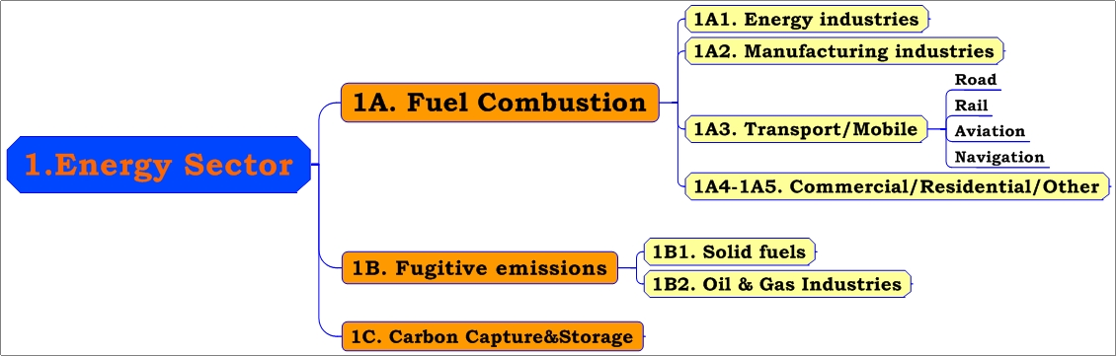
Energy Sector

Slide 5
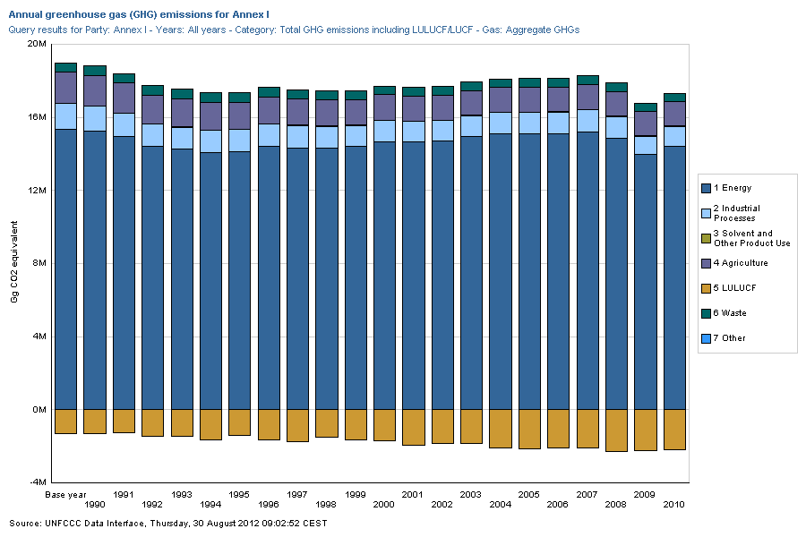

Slide 6
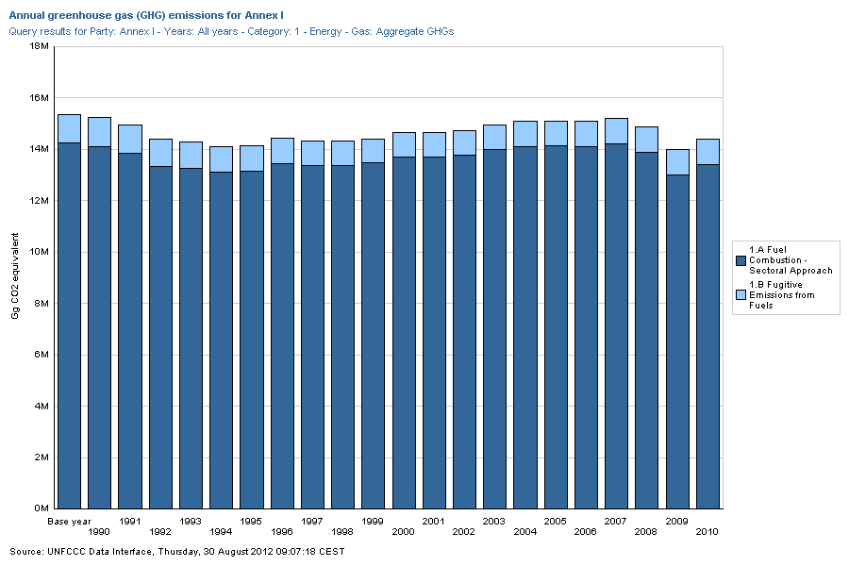

Slide 7
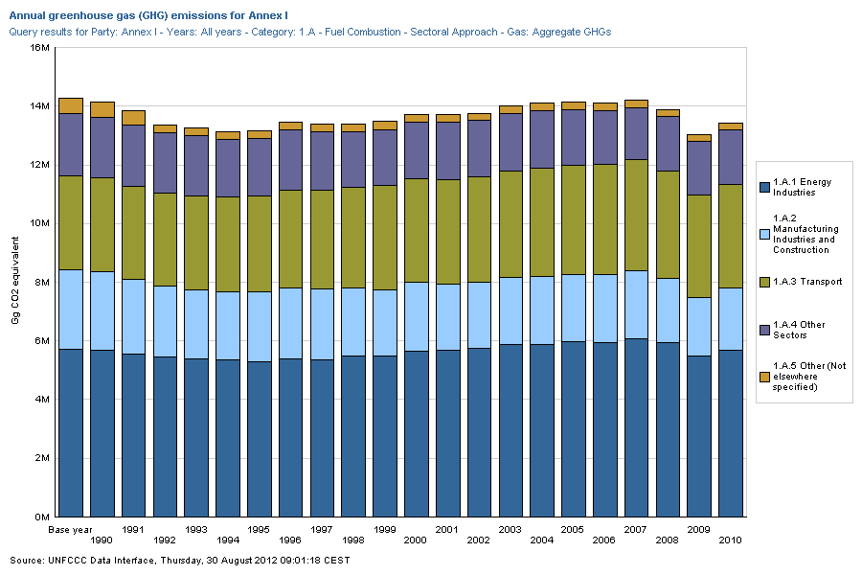

Slide 8
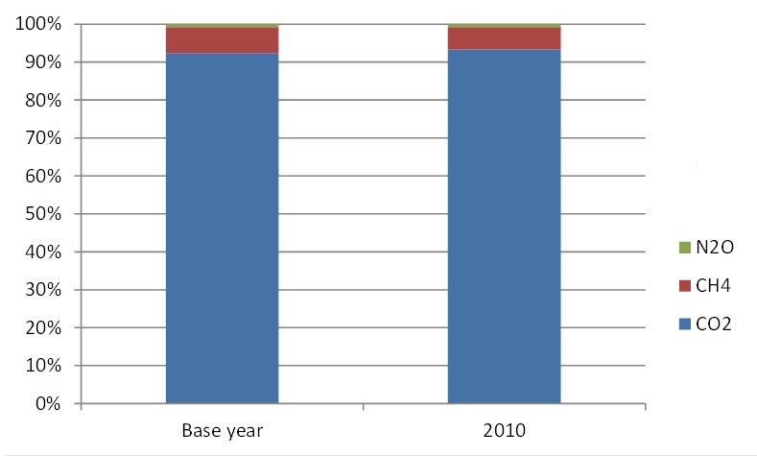
Annex I: Energy Sector Emissions by gas

Slide 9
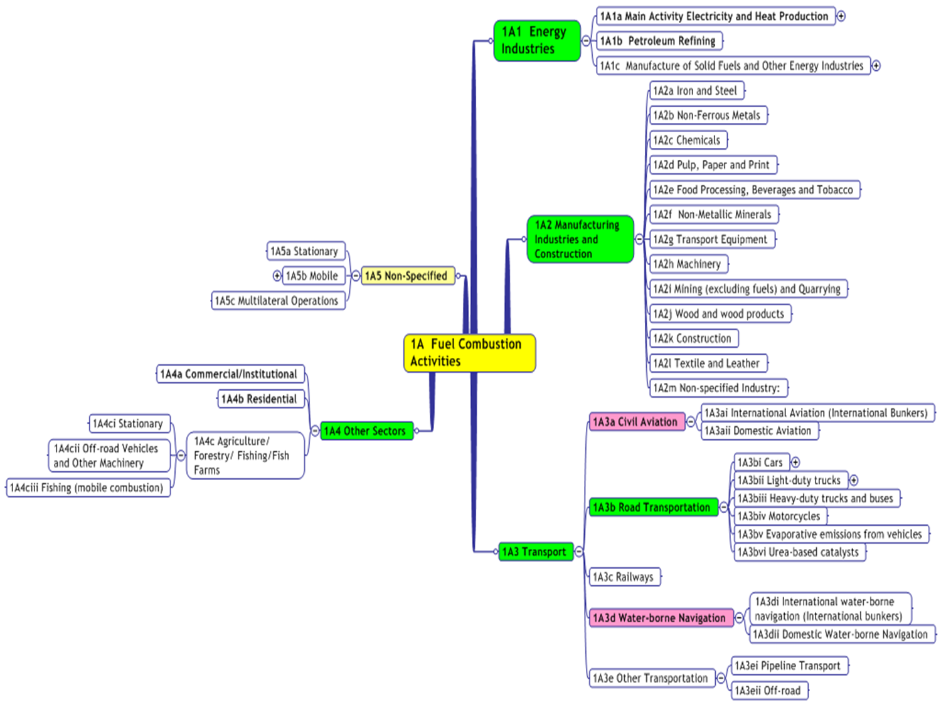

Slide 10
1A. Fuel Combustion
For inventory purposes, fuel combustion may be defined as the intentional oxidation of materials within an apparatus that is designed to provide heat or mechanical work to a process, or for use away from the apparatus
Not Energy Sector:
  waste incineration without energy recovery → Waste
  use of fossil fuels as a feedstock in the Industrial Sector (e.g., coke in Iron&Steel) → IPPU
  biomass fires/open burning → AFOLU
Coal mines fires, Gas flaring are in Fugitive Emissions

Slide 11
1A. Fuel Combustion. CO2
CO₂ emissions depend almost entirely on the carbon content of the fuel, though a small amount of carbon is un-oxidized (less than 1%).
During the combustion process, most carbon is immediately emitted as CO2 regardless combustion technology
By default the 2006 IPCC Guidelines assume a complete combustion process (100% carbon conversion or oxidation fraction is 1)
C + O2 = CO2
1 tonne C => 3.667 tonne CO2
(44/12)

Slide 12
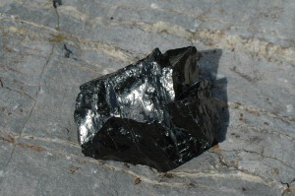
Exercise 1: CO2 emissions - ?
Anthracite (80-98% of Carbon, by mass):
  “Hypothetical Anthracite”: 100% of Carbon, 100% combustion
  Anthracite: 85% of Carbon, 100% combustion
  Anthracite: 85 % of Carbon, 99% combustion
  Anthracite: 85% of Carbon, 95% combustion
  Anthracite: 80% of Carbon, 99% combustion
CO2 emissions = Amount of Fuel * Emission Factor
EF = Carbon content * Oxidation fraction * 44/12
      Anthracite - 1 tonne:
        CO2 emissions = 1 * 1* 1 * 44/12 = 3.667 tonne
        CO2 emissions = 1 * 0.85 * 1 * 44/12 = 3.117 tonne
        CO2 emissions = 1 * 0.85 * 0.99 * 44/12 = 3.086 tonne
        CO2 emissions = 1 * 0.85 * 0.95 * 44/12 = 2.961 tonne
        CO2 emissions = 1 * 0.80 * 0.99 * 44/12 = 2.904 tonne
Image (anthracite): applied from the US Geological Service:
http://www.usgs.gov/blogs/features/slidedeck2/types-of-coal/anthracite-2/ (April, 16, 2015)

Slide 13
1A. Fuel Combustion. Fuels
SOLID (Coal and Coal Products)
  including Coal, Coke and Derived Gases
LIQUID (Crude Oil and Petroleum Products)
  Including Fuel Oil, Gasoline, LPG, Ethane and Petroleum Coke
GAS (Natural Gas)
OTHER FOSSIL FUELS (Non-biomass municipal & Industrial wastes, waste oils)
PEAT
  treated as fossil fuel
BIOMASS (Wood, Charcoal, Biofuels, Biomass fraction of MSW)
  CO2 emissions not included in total Energy emissions
See definition of fuel types in Table 1.1, Volume 2, 2006 IPCC Guidelines

Slide 14
1A. Fuel Combustion. Units
The carbon content may vary considerably both among and within primary fuel types on a per mass or per volume basis. By converting to energy units this variability is reduced.
Fuel units:
  Volume: barrels (gallons), cubic feet, cubic meters, litres
  Mass: tonnes, kg
  Energy (expressed as either NCV or GCV): oil/coal-equivalent, calories, kW, MJ, BTU
The 2006 IPCC Guidelines - SI units :
  Fuel – Gg (TJ)
  NCV – TJ/Gg
  Carbon content – kg/GJ
  CO2 EF – kg/TJ (per energy basis)

Slide 15
IPCC Energy Units

Slide 16
NCV vs. GCV
Some statistical offices use gross calorific values (GCV)
The difference between NCV and GCV is the latent heat of vaporisation of the water produced during combustion of the fuel:
  for coal and oil, the NCV is about 5 % less than the GCV
  for most natural and manufactured gas, the NCV is about 10 % less
Where fuel characteristics (moisture, hydrogen and oxygen contents) are known, the 2006 IPCC Guidelines give a more precise method to convert GCV to NCV data:
NCV = GCV − 0.212H − 0.0245M − 0.008Y
M – Moisture, H – Hydrogen, Y – Oxygen, %

Slide 17
Exercise 2: CO2 emissions - ?
1. Diesel burnt by:
  Stationary source – a diesel-generator
  Mobile source – a car
2. Amount of diesel burnt - 1 Giga-gram (or 1 201 923 litres, or 317 561 gallons)*
3. Assuming complete combustion
CO2 emissions = Amount of Fuel * NCV * EF
CO2 emissions = 1 * 43 * 74 100 = 3 186 300 kg CO2
= 3.19 Gg CO2
___________
* density of diesel 0.832 kg/litres or 6.943 lb/US gallon

Slide 18
Non-CO2: CH4 and N2O
Emission factors for non-CO2 gases from fuel combustion are dependent on fuel and technology used (operating conditions, control technologies, quality of maintenance, age of equipment)
Since the set of technologies, applied in each sector varies considerably, so do the emission factors
Therefore it is not useful to provide default emission factors for these gases on the basis of fuels only

Slide 19
Non-CO2: CH4 and N2O

Slide 20
Non-CO2: CH4 and N2O

Slide 21
Combustion Emissions – Higher Tiers
Tier 1
  Amount of fuel combusted, default NCV, carbon content, CO2 EF (complete combustion)
Emissions = AD * EF
Tier 2
  Amount of fuel, country-specific NCV, carbon content and CO2 EF (oxidation rate), N2O EF, CH4 EF
Tier 3
  Emissions depend on fuel type used, combustion technology, operating conditions, control technology, quality of maintenance, age of the equipment used to burn the fuel – plant-specific EFs (measurements)

Slide 22
Biomass
Biomass is a special case:
  CO₂ emissions from biomass combustion are not included in the national total. They are reported separately (information item)
  Non-CO₂ emissions are reported in the national total
  Net carbon emissions are accounted for in the LULUCF/AFOLU sector
  Peat is treated as a fossil fuel

Slide 23
Road Transport
All fuel sold in a country is included in national estimates even if a vehicle crosses a border or fuel exported in fuel tanks of vehicles
Bio-fuels carbon removed from total and reported separately
Carbon is also emitted from urea based catalysts and included here (not strictly combustion)
CH₄ and N₂O strongly technology related. At higher tiers need to know technologies in fleet (especially type and proportion of catalysts)
Caution with “fuel sold” data:
  overlaps with off-road and potentially other sectors (e.g. agriculture)
  blended fuels (e.g. bio-ethanol) and lubricants
  smuggling

Slide 24
International bunker
Aviation and Shipping (water-borne navigation):
  Domestic emissions included in National Total
  International emissions reported separately as
  “Bunker Fuels”
  Domestic trips are journeys between points in one country
  International trips - between countries

Slide 25
Waste as a Fuel
Some waste incinerators also produce heat or power
In such cases the waste stream will show up in national energy statistics and it is good practice to report these emissions under the energy sector
This could lead to double counting when in the waste sector the total volume of waste is used to estimate emissions
Only the fossil fuel derived fraction of CO2 from waste is included in national total emissions

Slide 26
Reference approach
Reference Approach is a top-down approach, using a country’s energy supply data to calculate the emissions of CO2 from fuel combustion:
CO2 emissions = (Apparent Consumption - Excluded Carbon) * EF
Apparent consumption = Production + Import - Export - International bunker - Stock change
  CO₂ only
  used as a check for Sectoral Approach

Slide 27
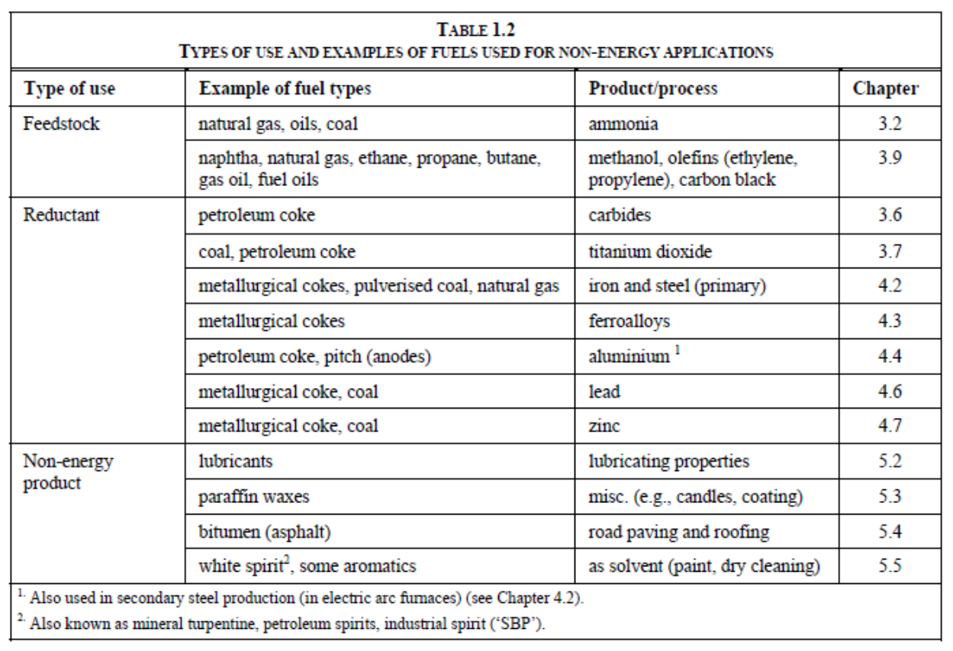
Excluded Carbon/Non-Energy Use of Fuels

Slide 28
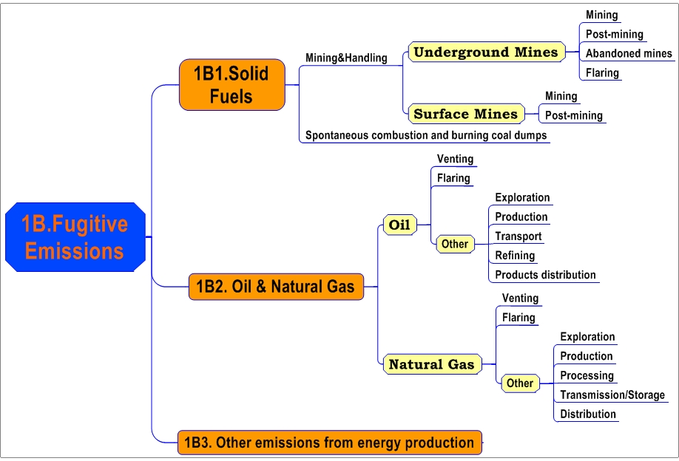
1B. Fugitive Emissions

Slide 29
1B. Fugitive Emissions
Fugitive emissions are emissions of gases or vapour from equipment due to leaks and other unintended or irregular releases of gases, mostly from activities associated with the production and distribution of fossil fuels. It includes leaks from pressurised equipment, evaporation and displacement of vapour, and accidental releases
Significant CH4 emissions from:
  Coal mines
  Refinery leaks
  Gas distribution pipelines
Simple Emission Factor methods at Tier 1. Higher Tiers need more details on technologies and age of plant/mines etc.

Slide 30
Coal Mines
CH4 is the major GHG emitted from coal mining and handling. CO2 may also be present in some coal seams. The major stages for the GHG emissions for both underground and surface coal mines are:
  Mining emissions - gas liberated by fracturing coal during mining. This may be collected (for safety) and flared or used for energy. Emission can continue after mine closure
  Post-mining emissions - emissions during processing, handling and distribution
  Low temperature oxidation - coal slowly oxidises to CO₂ when exposed to the air
  Uncontrolled combustion - oxidation may lead to an active fire in coal storage or exposed coal seams with a rapid CO2 formation. This can occur naturally
Simple emission factors are provided for Tier 1, country-specific data is required for better estimates

Slide 31
Oil and Gas
Oil & Gas fugitive emissions include all emissions from oil and gas systems except those for the use of oil and gas for energy purpose or as a feedstock
It covers everything from an oil well to a consumer:
  Exploration and Production
  Processing and Refining
  Distribution and Delivery
Includes equipment leaks, evaporation loses, venting, flaring and accidental releases

Slide 32
Oil and Gas. Fugitive GHGs
CO₂ may be contained in the oil or gas as extracted from the reservoir
CH₄ can be released directly (e.g. leaks of natural gas)
CO₂, CH₄ and N₂O can also be formed in non-useful energy combustion (e.g. flaring)
General Tier 1 EFs (for developing and developed countries) are available
At higher tiers detailed knowledge of the system is needed. Country-specific EFs will need to be developed based on measurements

Slide 33
Oil and Gas. AD and EFs
Tier 1:
The available Tier 1 default EFs are presented in the 2006 IPCC Guidelines. All of the presented EFs are expressed in units of mass emissions per unit volume of oil or gas throughput
While some types of fugitive emissions correlate poorly with, or are unrelated to, throughput on an individual source basis (e.g., fugitive equipment leaks), the correlations with throughput become more reasonable when large populations of sources are considered
Furthermore, throughput statistics are the most consistently available AD for use in Tier 1 calculations

Slide 34
Oil and Gas. Default EFs

Slide 35
1C. Carbon Dioxide Transport, Injection and Geological Storage
Notes:
For both of Oil and Natural gas system, sources are considered according to the type of activity.

Slide 36
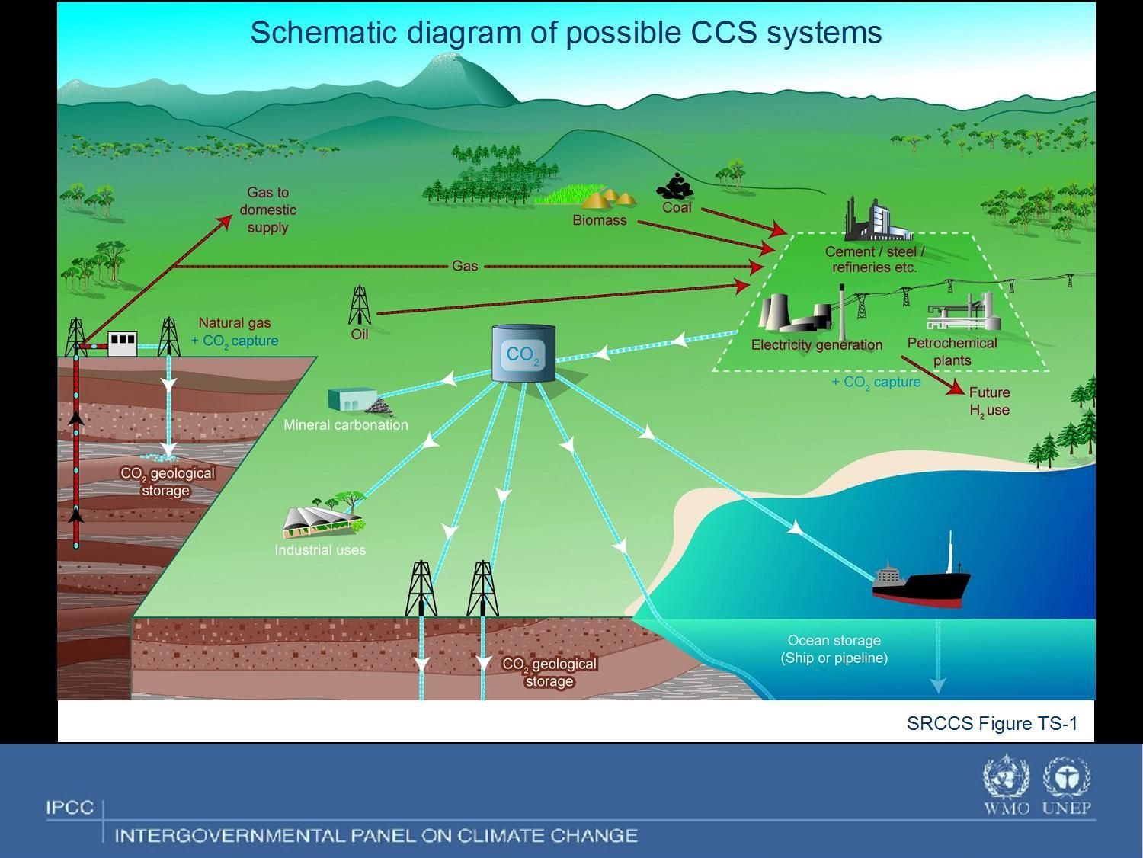

Slide 37
1C. Carbon Dioxide Transport, Injection and Geological Storage
CO2 can be captured via pre-combustion, post-combustion and oxy-fuel capture activities and also at some industrial processes (e.g., in cement industry)
  The Category 1C does NOT include guidance for CO2 capture and compression (the relevant emissions should be estimated in the respective sectors (e.g., Energy, IPPU)
CO2 transport can be organized mainly by pipelines (and ships)
  The only subcategory which provides with default values is 1C1a. Pipelines
CO2 can be stored onshore and offshore in deep saline formations, depleted (partially depleted) oil and gas fields with or without enhanced oil/gas recovery, and in coal seams with or without enhanced coalbed methane recovery
  Although the Summary for Policymakers of the SRCCS suggests that properly selected geological storage sites are likely to retain greater than 99 percent of the stored CO2 over 1000 years and may retain it for up to millions of years, at the time of writing, the small number of monitored storage sites means that there is insufficient empirical evidence to produce emission factors that could be applied to leakage from geological storage reservoirs. Consequently, this guidance does not include Tier 1 or Tier 2 methodology. However, there is the possibility of developing such methodologies in the future, when more monitored storage sites are in operation and existing sites have been operating for a long time. However a site-specific Tier 3 approach can be developed

Slide 38
Summary
Energy Sector = Fuel combustion (mobile and stationary) + Fugitive emissions + CCS
Energy emissions are usually the most important
  CO₂ from fuel combustion is major source
  CH₄ mainly comes from fugitive emissions
CO₂ emission factor depends on carbon content of fuel, non-CO2 – on the technology used
Methodological issues (biomass, international bunker, excluded carbon/fuels in other sectors)
Reference approach is used for checking (CO2)

Slide 39
Thank you for your attention!
Any questions?

