Slide 1
AGRICULTURE, FORESTRY AND OTHER LAND USE (AFOLU)
Africa Regional Workshop on the Building of Sustainable National
Greenhouse Gas Inventory Management Systems, and the use of the
2006 IPCC Guidelines for National Greenhouse Gas Inventories
Swakopmund, Namibia
24-28 April 2017
Sekai Ngarize
IPCC TFI TSU

Slide 2
Outline
Introduction
IPCC Guidelines for Agriculture, Forestry and Other land-use (AFOLU)
AFOLU
  3A. Livestock
  3B. Land
  3C. Aggregate sources and non-CO₂ emissions on land
Cross-cutting issues

Slide 3
Introduction
Livestock, Land use change and management have a significant influence on the greenhouse gas concentrations in the atmosphere.
Processes covered by IPCC guidance that account for emissions and removals in the biosphere include: photosynthesis, respiration, decomposition, nitrification/denitrification, enteric fermentation, and combustion that are driven by the biological activity and physical processes.
AFOLU represents 24% of net anthropogenic emissions, equivalent to about 12 Gt CO₂-eq/year (AR5, 2010 GHG Inventory datasets and EDGAR).
A significant proportion of GHG emissions/removals in the AFOLU sector come from developing countries.
Notes:
Globally AFOLU largest emission sector after energy
Mainly from deforestation, agricultural emissions from soil and nutrient management and livestock.
GHG emissions/removals in the AFOLU sector are mostly originated from developing countries (emissions in Agriculture and net removals in FOLU from Annex I countries based on the UNFCCC GHG data in 2010 amounted to 1.44 and -1.86 Gt CO₂-eq. respectively).

Slide 4
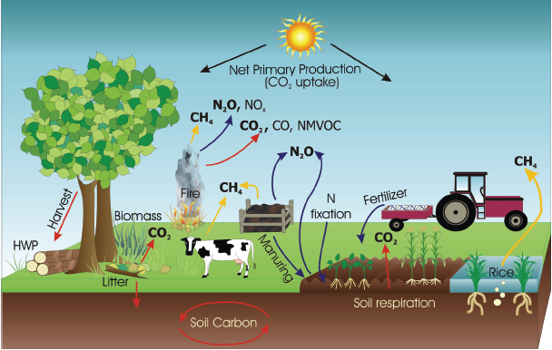
Terrestrial sources/sinks of GHGs
Oxidation
Photosynthesis
Methanogenesis
Methanogenesis
Oxidation
Nitrification & denitrification
Notes:
The way land is used and managed affect a variety of ecosystem processes that affect GHG fluxes, i.e., such as photosynthesis, respiration, nitrification, these processes involve transformation of carbon and nitrogen ( driven by biological processes- activity of microbes, plants and animals) and physical processes ( combustion or leaching).
Key GHGs for AFOLU are CO2, N2O and, CH4.
CO2 fluxes between atmosphere and ecosystems primarily through plant photosynthesis and release via respiration, decomposition and combustion of organic matter
N2O emitted as a by-product of nitrification and denitrification
CH4 mitted under through methanogenesis under anaerobic conditions in soils, manure management, enteric fermentation, incomplete combustion of organic matter.
Other gases from combustion and soils are NO, NH3, NMVOC and CO (mostly precursors for GHGs - their formation is considered as indirect emission
Indirect emissions a

Slide 5
Evolution of IPCC Guidance on agriculture, forestry and other land-use
Provides good practice and uncertainty management guidance
Agriculture and Land Use and Change and Forestry (LUCF) combined into a single sector Agriculture, Forestry and Other Land Use (AFOLU)
Only the most important activities resulting in GHG emissions/removals
Implicit assumption about estimating emissions and removals only over lands subject to human intervention
Now includes all land use emissions/ removals split into six land-use categories from all pools
Explicit Use of managed land as a proxy for anthropogenic emissions/removals
Retained use of managed land
Inclusion and consolidation of several previously optional categories
Refinement of methods and improved defaults
Agriculture and Land Use and Change and Forestry (LUCF) separate sectors
GPG & GPG-LULUCF
2006 IPCC Guidelines
1996 IPCC GLs
Agriculture and Land Use, Land-use Change and Forestry (LULUCF) separate sectors
Same approach as GPG-LULUCF
Only accounted for above-ground biomass and soil C pools
Notes:
In the 1996 IPCC guidelines the E/R now covered in Vol 4 of the 2006 were previously separated in chapter 4 (agriculture) and chapter 5 (LUCF)
The fundamental methodological basis for LUCF rested on 2 key themes- (a) flux of CO2 to and from atmosphere equated to changes in terrestrial carbon stocks and product pools (b) changes in carbon stocks can be estimated by determining LUC and management ( e.g. logging, burning and tillage) at various point sin time
In contrast, agriculture dealt only with direct flux estimates from different source categories and did not incorporate carbon stock change concept
For agriculture the 1996 guidelines only focused on activities associated with managed agricultural systems that are large sources of emissions in a country: included: - CH4 emissions from Enteric fermentation in domestic livestock, CH4 and N2O from manure management, CH4 from rice cultivation, CH4, N2O, NOx, CO emissions from prescribed burning of savannas and crop residues, emissions from N2O from soils.
For LUCF – focused on LUC and management changes that resulted in CO2 emissions/removals- four broad categories – (i) changes in forest and other woody biomass stocks, (ii) forest and grassland conversion, (iii) abandonment of managed land (Cl, pastures, plantation forest e.t.c.)., (iv) CO2 E/R in soils.
GPG 2000-
Updated and complemented earlier guidelines while providing the concept of good practice
Good practice inventories are: “ those that contain neither over-nor underestimates sofas as can be judged and in which uncertainties are reduced as far as is practical”
Good practice inventories are: transparent, accurate, complete, consistent and comparable and efficient in resource use
provides (a) supplementary information to the 1996 to improve TACCC and documentation, (b) also provided methods for addressing uncertainties and implementation of QC/QA, (c) also introduced key category analysis methodology- identified key sources that should be prioritized
GPG LULUCF 2003-
Introduced comprehensive coverage of land by diving land into 6 land use categories
adopted approach based on land use categories for organizing the methodologies and good practices associated with estimating E/R for LULUCF- i.e., 6 land use categories (FL,CL, GL, WL, SL and OL) including land remaining in same category or converted to another land category., Methods for estimating carbon stock changes in HWP, in appendix at the time.
GPG-LULUCF also adopted the hierarchical tier approach for methods descriptions and the concept of key category sources , also provided guidance on QA/QC, reconstruction of missing data, time series consistency,, sampling techniques, quantification and combination of uncertainties and verification.
2006 GL- restructured main categories and subsectors to clarify and simplify inventories and to reduce double counting- for AFOLU- Agriculture and LULUCF were merged into AFOLU

Slide 6
Evolution of IPCC Guidance on Agriculture and LUCF/LULUCF

Slide 7
Agriculture, Forestry and Other Land Use (AFOLU)
AFOLU
3A. Livestock
3B. Land
3C. Aggregate Sources and Non-CO₂ Emissions on Land

Slide 8

3a. livestock

Slide 9
3A. Livestock emissions
3A. Livestock
3.A.1Enteric Fermentation
3.A.2 Manure Management
N₂O
CH₄
CH₄
Notes:
Livestock production can result in methane (CH4) emissions from enteric fermentation and both CH4 and nitrous oxide (N2O) emissions from livestock manure management systems.

Slide 10
Three methodological Tiers
Tier 2:
A more accurate approach
country or region-specific values for the general defaults
more disaggregated activity data
relatively smaller uncertainties
Tier 1:
Simple first order approach
default values of the parameters from the IPCC guidelines
spatially coarse default data based on globally available data
large uncertainties & simplifying assumptions
Tier 3:
Higher order methods
detailed modeling and/or inventory measurement systems
data at a greater resolution
lower uncertainties than the previous two methods
Notes:
Estimations of emissions and removals can be obtained in different ways. Therefore, the IPCC has classified the methodological approaches in three different ‘Tiers’, which vary according to the growing quantity of necessary information and the degree of analytical complexity (IPCC, 2006).
“A tier represents a level of methodological complexity. Usually three tiers are provided. Tier 1 is the basic method, Tier 2 intermediate and Tier 3 most demanding in terms of complexity and data requirements. Tiers 2 and 3 are sometimes referred to as higher tier methods and are generally considered to be more accurate.”

Slide 11
Tier 1 - Step 1: Livestock populations (1)
To calculate CH₄ and N₂O emissions, you first need to collect data on livestock population and MMS. To obtain this information, you should follow these steps:
Assess whether a domestic livestock population exists in the country.
Produce a characterization of the animal species.
Calculate the annual average population (AAP).
Stratify animals by annual average temperature (AAT).
Collect data on manure management systems (MMS).

Slide 12
Tier 1 - Step 1: Livestock populations (2)
Assess whether a domestic livestock population exists in the country.
You should use:
population data from official national statistics; or
FAOSTAT if national data are unavailable. In FAOSTAT, data on livestock population have been directly reported by the country or estimated by FAO in case of gaps.
When data available in FAOSTAT differ from official national statistics, it is good practice to contact the national focal point for FAO data to reconcile information.
Notes:
Estimations of emissions and removals can be obtained in different ways. Therefore, the IPCC has classified the methodological approaches in three different ‘Tiers’, which vary according to the growing quantity of necessary information and the degree of analytical complexity (IPCC, 2006).
“A tier represents a level of methodological complexity. Usually three tiers are provided. Tier 1 is the basic method, Tier 2 intermediate and Tier 3 most demanding in terms of complexity and data requirements. Tiers 2 and 3 are sometimes referred to as higher tier methods and are generally considered to be more accurate.”

Slide 13
Tier 1- Step 2: Livestock characterization
Identify livestock species that contribute to more than one source category:
Typically: cattle, buffalo, sheep, goats, swine, horses, camels, mules/asses, and poultry
Some developing countries have substantial population of e.g. llamas, alpacas or deer
Review the emission estimation method
(tier) for each relevant source category (EF & MM)
Identify the most detailed characterisation required for each livestock species
Existing inventory or Tier 1 methods
Basic characterization sufficient for Tier 1 methods for both EF & MM but “Enhanced” characterization is required if Tier 2 and/or Tier 3 is implemented for either of them.
Notes:
Livestock population and feed characterization
1. Identify livestock species applicable to each emission source category:
• The livestock species that contribute to more than one emission source category should first be listed (these species are typically: cattle, buffalo, sheep, goats, swine, horses, camels, mules/asses, and poultry).
2. Review the emission estimation method for each relevant source category:
• For the source categories of enteric fermentation and manure management, identify the emission estimating method for each species for that source category.
• Similarly, manure management CH4 emissions from cattle, buffalo, swine, and poultry should be examined to determine whether the Tier 2 or Tier 3 emissions estimate is appropriate. Existing inventory estimates can be used to conduct this assessment. If no inventory has been developed to date, Tier 1 emissions estimates should be calculated to provide initial estimates for conducting this assessment.
3. On the basis of the assessments for each species under each source category, identify the most detailed characterization required to support each emissions estimate for each species

Slide 14
Tier 1 - Step 2: How to decide which livestock characterization to use?
Once you have identified whether a basic or enhanced characterisation is required for each livestock species based on key category analysis
Ask for each livestock species: “Are data available to support the level of detail required for the characterisation?
If YES - Perform characterisation at the required level of detail
If NO - Ask if data can be collected to support characterisation?
If NO - Set the characterisation to the available data
Notes:
See Figure 10.1 Decision tree for livestock population characterisation (2006GL)

Slide 15
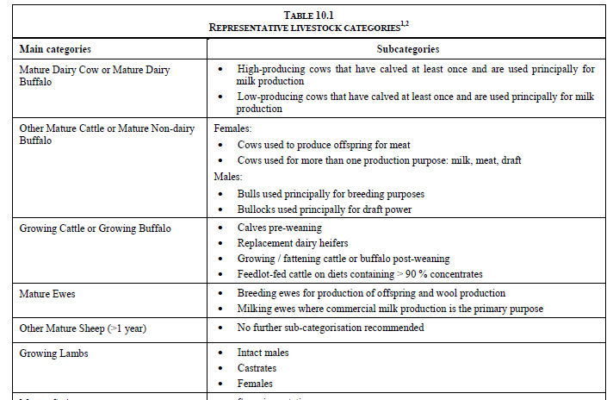
Notes:
Table 10.1 is provided just for illustration.

Slide 16
Step 2: Livestock population and feed characterization
For higher Tier methods estimating CH₄ and N₂O emissions from livestock require definitions of livestock subcategories, annual populations, feed intake and characterisation.
It is a good practice to identify the appropriate method for estimating emissions for each source category, and then base the livestock information (characterisation) on the most detailed requirements identified for each livestock species.
Basic Characterization
Livestock species and categories
Annual population
Enhanced Characterization
Definitions for livestock subcategories
Dairy cows and milk production
Livestock population by subcategory
Feed intake estimates
Used for Tier 1 methods
Used for Tier 2/3 methods
Characterization may undergo iteration based on the needs assessed during the emissions estimation process.
Notes:
The methods for estimating CH4 and N2O emissions from livestock require definitions of livestock subcategories, annual populations and, for higher Tier methods, feed intake and characterization.
Livestock population and feed characterization
• Good practice is to identify the appropriate method for estimating emissions for each source category, and then base the characterization on the most detailed requirements identified for each livestock species.
• The livestock characterization used by a country will probably undergo iterations as the needs of each source category are assessed during the emissions estimation process.
• The approach is divided into 3 steps.- next slide

Slide 17
Tier 1 - Step 2: Basic characterisation for livestock populations (1)
Basic characterisation supporting Tier 1 requires the following information:
Livestock species and categories: A complete list of all livestock populations that have default emission factor values must be developed (e.g., dairy cows, other cattle, buffalo, sheep, goats, camels, llamas, alpacas, deer, horses, rabbits, mules and asses, swine, and poultry) if these categories are relevant to the country.
Annual population: Annual population data from national statistics or FAO. Adjustments should be made for seasonal births and slaughters. Annual average population should be estimated for growing population (e.g., meat animals, such as broilers, turkeys, beef cattle, and market swine)

Slide 18
Tier 1 - Step 2: Basic characterisation for livestock populations (2)
Dairy cows and milk production:
  The dairy cow population is estimated separately from other cattle.
  Dairy cows are defined in this method as mature cows producing milk in commercial quantities for human consumption (FAO Production Yearbook).
  Sometimes dairy cows are divided into high milk producing commercial breeds and low milk producing cows.
  Dairy cows do not include low productivity multi-purpose cows that should be considered ‘other cattle’.
  Data on the average milk production of dairy cows are also required.
  Country-specific or FAO data may be used.
  Dairy buffalo may be categorized in a similar manner to dairy cows.

Slide 19
Tier 1 - Step 3: Calculate Average Annual Population
In the case of static animal populations (e.g. dairy cows, breeding swine, layers), estimating the AAP may be as simple as obtaining data from a one-time animal inventory. Livestock data available usually already represent the AAP, so no further calculation is needed.
In the case of animal categories with a life cycle of less than one year, such as poultry, the AAP is calculated applying the following equation:
Example: AAP: 60 days X 60000/365days = 9,863 chickens

Slide 20
Tier 1 - Step 4: Annual Average Temperature
Stratify livestock by annual average temperature (AAT).
In order to estimate CH₄ emissions from manure management, the basic characterization of the animal population needs to be further stratified for the geographical location and its temperature.
Estimate the percentage of the animal population located in different temperature zones.
Note: Temperature has a major impact on the rate of the microbial activity that causes CH₄ emissions from manure. Higher emissions rates correspond to higher temperatures rates.
The temperature data should be based on national meteorological statistics where available. Countries should estimate the percentage of animal populations in different temperature zones. Where this is not possible, the AAT for the entire country can be used.

Slide 21
Tier 1 - Step 5: Manure Management Systems (1)
Collect data on manure management systems (MMS).
Manure (dung and urine) produced by domestic animals is usually stored in different management systems before being applied to soils as fertilizer or otherwise used for feed, fuel, or construction purposes.
To estimate N₂O emissions from manure management, in addition to the animal characterization, data must be collected on the fraction of manure that is managed in each type of system for each livestock category.

Slide 22
Tier 1 - Step 5: Manure Management Systems (2)
IPCC provides definitions for 17 MMS in Table 10.18.
IPCC provides default MCF and N₂O EFs for defined MMS in Table 10.17 and Table 10.21 respectively.
IPCC provides default values of cattle, buffalo and swine manure allocation per MMS (MS%) for 9 systems (Tables from 10A-4 to 10A-8):
Lagoon (uncovered anaerobic lagoon).
Liquid/slurry.
Solid storage.
Dry lot.
Pit<1 month.
Pit>1 month.
Daily spread.
Digester (anaerobic digester).
Other.

Slide 23
Tier 2: Enhanced characterisation for livestock populations
The Tier 2 livestock characterisation seeks to create relatively homogenous sub-groupings of animals dividing the population into these subcategories reflecting country-specific variations in age structure and animal performance within the overall livestock population.
The Tier 2 characterisation methodology is meant to support a more accurate estimate of feed intake for use in estimating methane production from enteric fermentation by defining animals, animal productivity, diet quality and
management circumstances.

Slide 24
Tier 2 - additional step: Average daily feed intake (1)
The feed intake is the amount of energy an animal needs for maintenance and for activities such as growth, lactation, and pregnancy, and it is typically measured in terms of:
gross energy GE (e.g., megajoules (MJ) per day) or
dry matter intake DMI (e.g., kilograms (kg) per day).
For all estimates of feed intake, good practice is to:
Collect data on the animal’s typical diet and performance in each subcategory;
Estimate feed intake from the animal performance and diet data for each subcategory.
In some cases, the equations to estimate the feed intake may be applied on a seasonal basis, for example under conditions in which livestock gains weight in one season and looses weight in another (average annual population should be adjusted accordingly).

Slide 25
Tier 2 - additional step: Average daily feed intake (2)
Data to be collected for estimating feed intake:
Average Live-Weight (W and BW), kg; of the single animal of the sub-category [net energy for maintenance and growth (net energy for activity is used only for sheep)].
Average weight gain per day (WG), kg day⁻¹; [net energy for growth].
Average Mature weight (MW), kg; The mature weight of the adult animal (when skeletal development is complete) of the inventoried group is required to define a growth pattern, including the feed and energy required for growth [net energy for growth]. At maturity as a rule W=MW.
Average number of hours worked per day. [net energy for work]
Feeding situation: [net energy for activity]

Slide 26
Tier 2 - additional step: Average daily feed intake (3)
Data to be collected for estimating feed intake:
Mean winter temperature, ºC; [net energy for maintenance of animals in colder climates]
Average daily milk production, kg day⁻¹, and fat content, %; the average daily production should be calculated by dividing the total annual production by 365 [net energy for lactation]
Percent of females that give birth in a year: [net energy for pregnancy]
Number of off spring produced per year: [net energy for pregnancy]
Feed digestibility (DE%): The portion of gross energy (GE) in the feed not excreted in the faeces is known as digestible feed, percentage (%) of GE. Table 10.2, Volume 4, IPCC 2006.
Average annual wool production per sheep, kg yr⁻¹; [net energy for wool production]

Slide 27
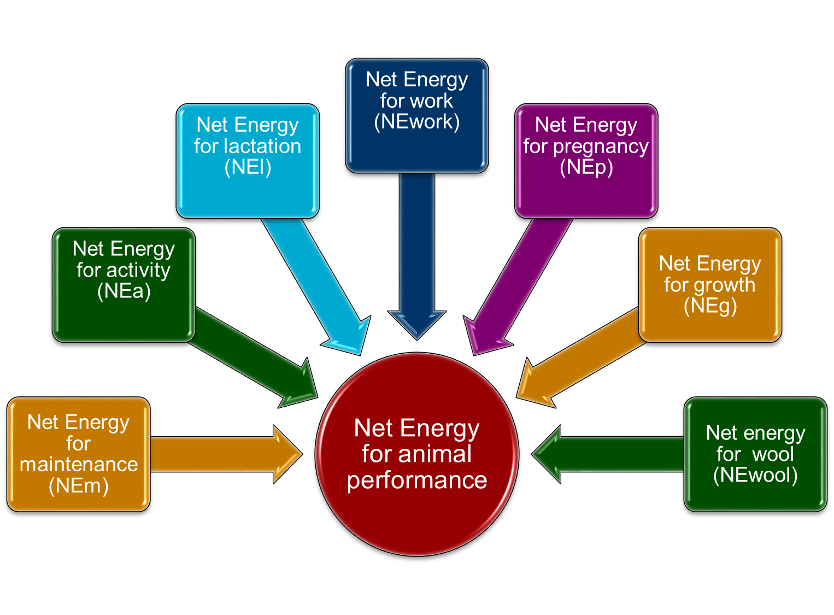
Tier 2 - additional step: Average daily feed intake (4)
Notes:
Globally AFOLU largest emission sector after energy
Mainly from deforestation, agricultural emissions from soil and nutrient management and livestock.

Slide 28
Tier 2: Gross energy
Total net energy requirement for animal performance and feed digestibility data are used to estimate the Gross Energy (GE).
Gross Energy (GE) is then estimated from net energy requirement divided by feed digestibility (45-55% for low quality forage).
As a QC procedure GE in energy units should be converted to dry matter intake (DMI) by dividing GE by the energy density of feed, default value 18.45 MJ kg⁻¹ (the daily DMI should be 2-3% of the body weight of animals).

Slide 29
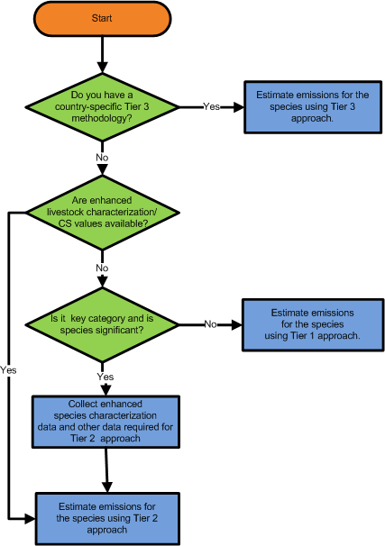
Decision Tree for livestock categories
To be repeated for each livestock species and gas
Significant livestock species account for 25-30% or more of emissions from the source category

Slide 30
IPCC Methodological Guidance: Calculating emissions for Enteric Fermentation and Manure Management
Notes:
Globally AFOLU largest emission sector after energy
Mainly from deforestation, agricultural emissions from soil and nutrient management and livestock.

Slide 31
CH₄ emissions from Enteric Fermentation
CH₄ emissions from enteric fermentation are produced during digestion of carbohydrates, which are broken down into simple molecules for absorption into the bloodstream.
Ruminant livestock (e.g. cattle, sheep) are major sources of CH₄, while moderate amounts are produced from non-ruminant livestock (e.g. pigs, horses).
The amount of CH₄ produced is a function of:
type of digestive system;
age of the animal;
weight of the animal; and
quality and quantity of food.

Slide 32
Methodological tiers- Enteric Fermentation
Tier 1.
-Enteric fermentation is not a key source category
-Enhanced characterization data not available.
-Approximate enteric emissions are derived by extrapolation from main livestock categories
Tier 2
-Uses country-specific data on gross energy intake and methane conversion factors for specific livestock categories.
-Should be used if enteric fermentation is a key source category for the animal category that represents a large portion of the country’s total emissions.
Tier 3
-Sophisticated models that consider diet composition in detail, concentration of products rising from ruminant fermentation, seasonal variation in animal population or feed quality and availability, and possible mitigation strategies.

Slide 33
Enteric fermentation: Calculation steps for all Tiers
Step 1: Divide the livestock population into subgroups and characterize each subgroup preferably using annual averages (production cycles and seasonal influences on population numbers.
Step 2: Estimate emission factors for each subgroup in kg CH₄/animal/yr
Step 3: Multiply the subgroup emission factors by the subgroup populations to estimate subgroup emission, and sum across the subgroups to estimate total emission.

Slide 34


CH₄ emissions from Enteric Fermentation -Tier 1 Method
Once you have collected data on Average Annual population (AAP) of the livestock species present in your country, you can apply equation 10.19. This is the methodology to follow.
Where:
Emissions = methane emissions from Enteric Fermentation, Gg CH₄ yr⁻¹
EF(T) = emission factor for the defined livestock population, kg CH₄ head⁻¹ yr⁻¹
N(T) = the number of head of livestock species / category T in the country
T = species/category of livestock
Then, sum emissions from all defined livestock categories to determine total national emissions from enteric fermentation. Apply equation 10.20 below:
Where:
Total CH_{4Enteric} = total methane emissions from Enteric Fermentation, Gg CH₄ yr⁻¹
E_{i} = is the emissions for the i^{th} livestock categories and subcategories

Slide 35

CH₄ emissions from Enteric Fermentation - Tier 1 Method
Notes:
Data sources for defaults

Slide 36
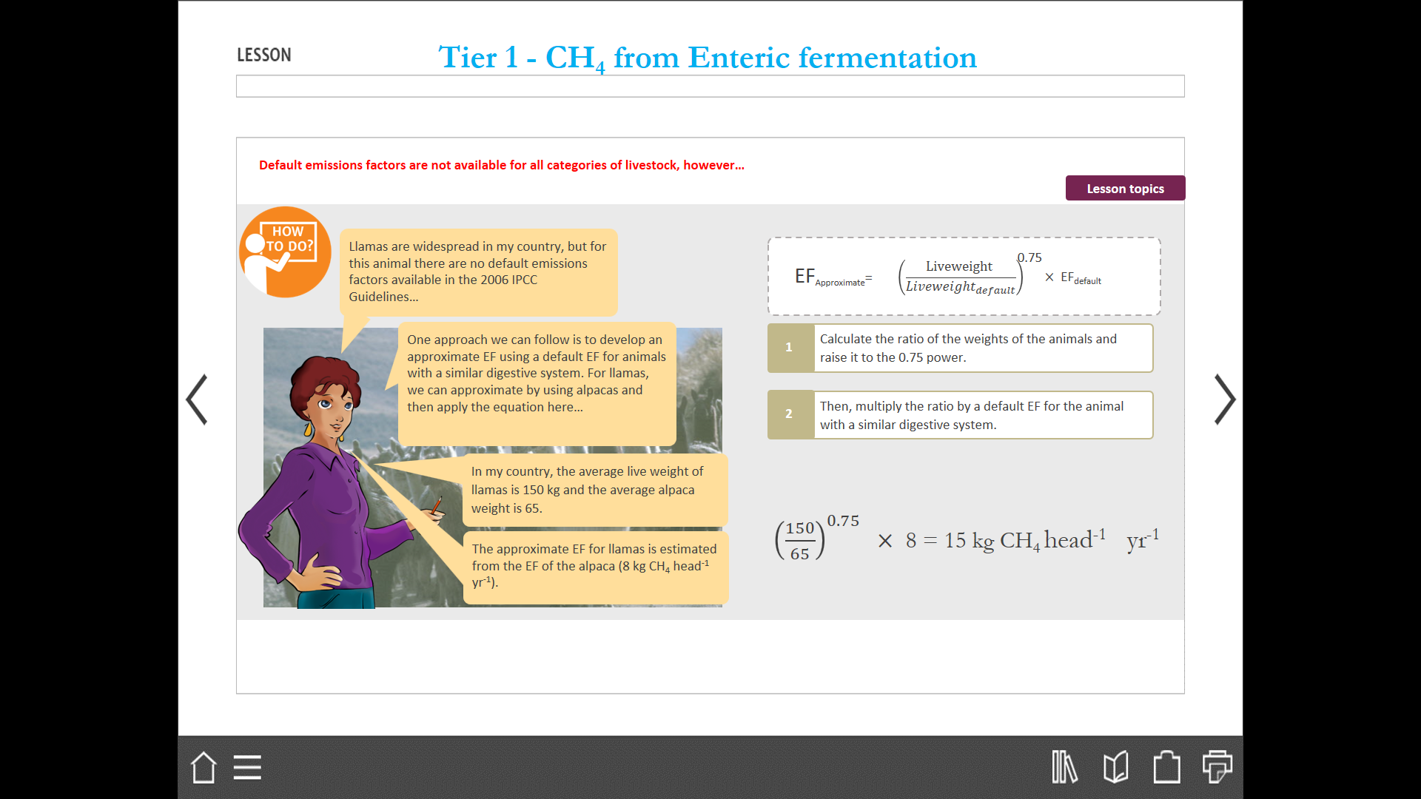

What do we do when default emissions factors are not available for all categories of livestock …
For Example: Llamas are widespread in my country, but for this animal there are no default emissions factors available in the 2006 IPCC Guidelines…
One approach we can follow is to develop an approximate EF using a default EF for animals with a similar digestive system. For llamas, we can approximate by using alpacas and then apply the equation below…
In my country, the average live weight of llamas is 150 kg and the average alpaca weight is 65.
The approximate EF for llamas is estimated from the EF of the alpaca (8 kg CH₄ head⁻¹ yr⁻¹).
1) Calculate the ratio of the weights of the animals and raise it to the 0.75 power.
2) Then, multiply the ratio by a default EF for the animal with a similar digestive system.
${\left(\frac{150}{65}\right)}^{0.75} \text{×}$ 8 = 15 kg CH₄ head⁻¹ yr⁻¹

Slide 37
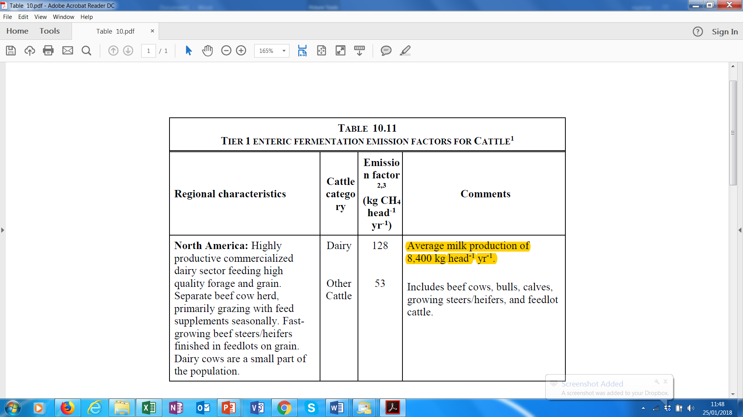
CH₄ emissions from Enteric Fermentation -Tier 1 Method - What to do when IPCC regional EFs for Dairy cows are not suitable?
In case the IPCC regional default emission factor for dairy cows is considered unsuitable for the national circumstances, an alternative provided by IPCC (Vol.1, Ch.5, section 5.3.3.1 “Overlap”).
To do so, you should first estimate relationship between default EF and milk yields from 2006 IPCC Guidelines, Table 10.11 and then apply it for the time series of national milk production data.
For example, overlap approach to derive adjusted EFs based on national milk production (dummy data) for North America:
128 kg CH₄ head⁻¹ yr⁻¹ divide by 8400 kg head⁻¹ yr⁻¹ = 0.015 (ratio).
8500 kg head⁻¹ yr⁻¹ multiply by 0.015 = 130 kg CH₄ head⁻¹ yr⁻¹
Average annual milk production | 8400 | 8500 | 8700 | 8900
EF | 128 | 130 | 133 | 136
Notes:
CH4 emissions from Enteric Fermentation -Tier 1 Method- What to when IPCC regional EF for Dairy cows are not suitable? Contd
In practice, you plot on the x axis the average annual milk production and on the y axis the associated emission factor.
Country XX is located in the Latin America and has dairy cows with an average milk production of 4 000 kg head-1 yr-1. The default IPCC factor associated with the production of 800 kg head-1 yr-1, reported in for the Latin America region, is not suitable for the country’s national circumstances

Slide 38

Enteric Fermentation: Tier 2 Method
Where:
EF = emission factor, kg CH₄ head⁻¹ yr⁻¹
GE = gross energy intake, MJ head⁻¹ day⁻¹
Ym = methane conversion factor, per cent of gross energy in feed converted to methane. The factor 55.65 (MJ/kg CH₄) is the energy content of methane
Equation 10.21

Slide 39
Choice of emission factors
Tier 1 method requires default EFs for the livestock categories according to the basic characterization scheme.
Tier 2 methods require country-specific EFs estimated for each animal subcategory based on the gross energy intake estimated using the detailed data on animal feed and performance and methane conversion factor for the subcategory.

Slide 40
Choice of activity data
Tier 1 method requires collection of livestock population data according to basic characterization.
Tier 2 method requires animal population data according to single livestock enhanced characterisation depending upon the most disaggregated data requirements between enteric fermentation and manure management categories.

Slide 41
Manure Management (CH₄)
CH₄ is generated during the storage and treatment of manure, produced from decomposition of manure under low oxygen or anaerobic conditions.
These conditions often occur when large numbers of animals are managed in a confined area (e.g. dairy farms, beef feedlots, and swine and poultry farms), where manure is typically stored in large piles or disposed in lagoons or other types of MMS.
At Tier 1 the amount of CH₄ produced is a function of:
number of animals;
amount of manure produced; and
temperature.
At higher tiers the amount is also a function of:
type of MMS;
portion of manure that decomposes anaerobically; and
retention time.

Slide 42

Tier 1 method - CH₄ from Manure management
For each livestock category, calculate the emissions by multiplying the respective emission factor by the AAP, both stratified by AAT.
Then, sum emissions from all defined livestock categories to determine total national emissions. (Equation 10.22, 2006GL below)
Where:
CH_{4Manure} = CH₄ emissions from manure management, for a defined population, Gg CH₄ yr⁻¹
EF(T) = emission factor for the defined livestock population, kg CH₄ head⁻¹ yr⁻¹
N(T) = the number of head of livestock species/category T in the country
T = species/category of livestock

Slide 43
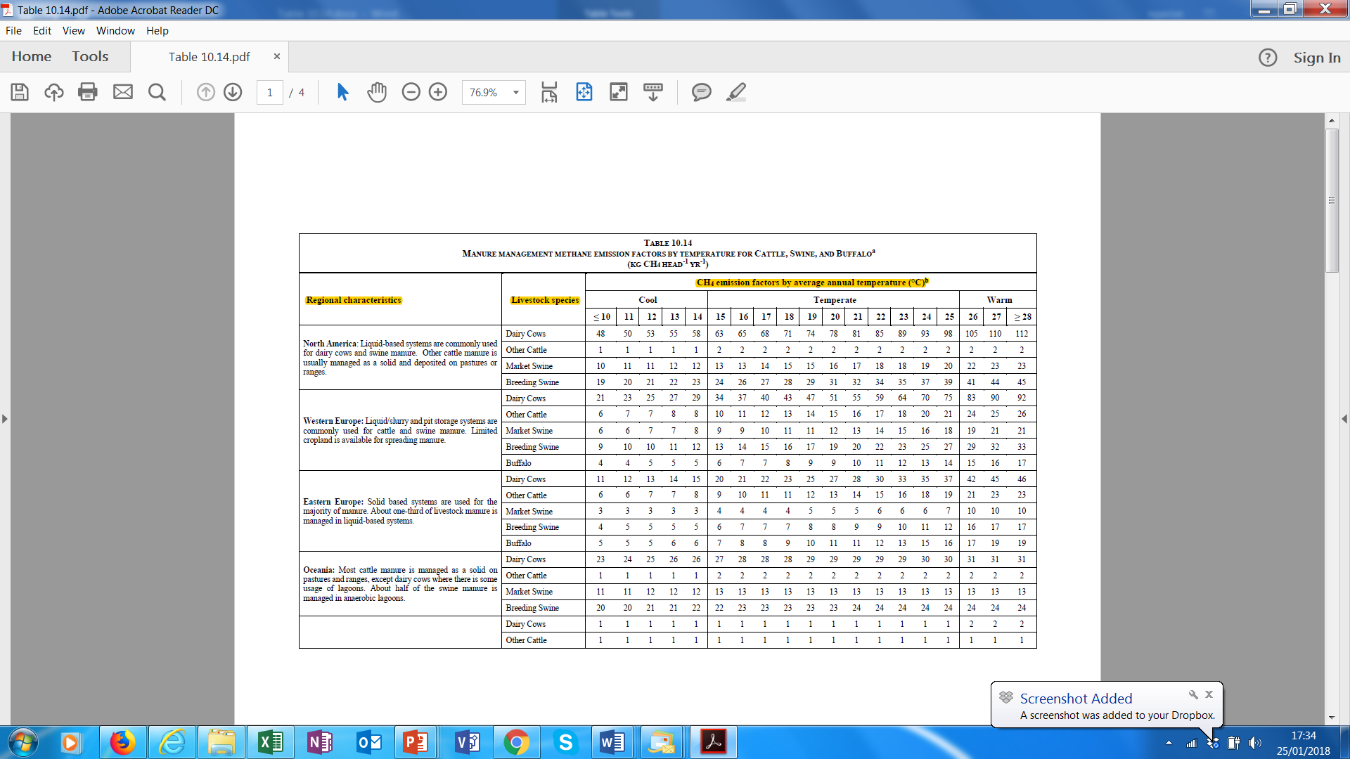
Tier 1 - CH₄ from Manure management - Data for Emission factors
Default emission factors by AAT are shown in Table 10.14, Table 10.15, and Table 10.16 in the 2006 IPCC Guidelines for the main livestock categories
Default emission factors are mostly stratified by:

Slide 44
Tier 1 - CH₄ from Manure management - Activity data
Activity data needed for the calculation of CH₄ emissions from manure management are the number of animals (in terms of AAP) for each livestock category identified through the basic livestock characterisation and stratified by AAT
Livestock characterization
AAP
AAT
This includes domestic animal species for which an IPCC default emission factor exists
This should be estimated particularly for animals like poultry with more than one life cycle per year
This is needed to estimate the percentage of animal population located in different temperature zones

Slide 45
Methodological Tiers – Manure Management - CH₄ emissions
Tier 1.
-A simplified method that only requires livestock population data by animal species/category and climate region or temperature, in combination with IPCC default emission factors, to estimate emissions
Tier 2
-A more complex method for estimating CH₄ emissions from manure management
-Should be used where a particular livestock species/category represents a significant share of a country’s emissions or
- When the data used to develop the
default values do not correspond well with the country's livestock and manure management conditions
-Requires detailed information on animal characteristics, manure and MMS characteristics
Tier 3
-Use country-specific methodologies using sophisticated models or measurement–based approaches to quantify emission factors.
Notes:
Methane emissions from manure management.
The method chosen will depend on data availability and national circumstances. The Tier 1 method should only be used if it is determined that the source is not a key category or subcategory and there is no possibility to use the Tier 2 method. Countries for which livestock emissions are particularly important may wish to go beyond the Tier 2 method and develop models for country specific methodologies or use measurement–based approaches to quantify emission factors (Tier 3).
Tier 1
– only requires livestock population data by animal species/category and climate region or temperature, in combination with IPCC default emission factors, to estimate emissions. Tables 10A-4 through 10A-9 (IPCC GL 2006 - Annex 10A.2) present the underlying assumptions used for each region; countries using a Tier 1 method should review the regional variables to identify the region that most closely matches their animal operations, and use the default emission factors for that region.
Default emission factors by average annual temperature are presented in Table 10.14, Table 10.15, and Table 10.16 for each of the recommended population subcategories. These emission factors represent the range in manure volatile solids content and in manure management practices used in each region, as well as the difference in emissions due to temperature.
Tier 2
– Detailed information on animal characteristics and manure management practices are required; the information is used to develop emission factors specific to the conditions of the country.
- The Tier 2 method relies on two primary types of inputs that affect the calculation of methane emission factors from manure:
- Manure Characteristics: Includes the amount of volatile solids (VS) produced in the manure and the maximum amount of methane able to be produced from that manure (Bo). Production of manure VS can be estimated based on feed intake and digestibility, which are the variables also used to develop the Tier 2 enteric fermentation emission factors.
- Manure Management: Includes the types of systems used to manage manure and a system-specific methane conversion factor (MCF) that reflects the portion of Bo that is achieved. Regional assessments of manure management systems are used to estimate the portion of the manure that is handled with each manure management technique.

Slide 46
Manure Management (CH₄): calculation steps for all Tiers
Step 1: Divide the livestock population subgroups and characterize each subgroup preferably using annual averages considering production cycles and seasonal influences on population numbers
Step 2: Estimate emission factors for each subgroup in kg CH₄/animal/yr
Step 3: Multiply the subgroup emission factors by the subgroup populations to estimate subgroup emission, and sum across the subgroups to estimate total emission

Slide 47
Choice of emission factors (1)
Tier 1
  Default methane emission factors for manure management by livestock category or subcategory are used.
  Default emission factors represent the range in manure volatile solids content and in manure management practices used in each region.
Tier 2
  The Tier 2 method relies on two primary types of inputs that affect the calculation of methane emission factors from manure: manure characteristics and MMS characteristics.

Slide 48
Choice of emission factors (2)
Manure characteristics includes:
  the amount of volatile solids (VS) produced in the manure
    VS can be estimated based on feed intake, digestibility (which are the variables also used to develop the Tier 2 enteric fermentation emission factors) and ASH content in the manure.
  the maximum methane-producing capacity of the manure (Bo)
    Bo varies by animal species and feed regimen and is a maximum theoretical methane yield based on the amount of total as-excreted VS in the manure.
Manure management system characteristics includes:
  the types of systems used to manage manure and a system-specific methane conversion factor (MCF) that reflects the portion of Bo that is achieved.
    Regional assessments of MMS are used to estimate the portion of the manure handled with each.

Slide 49
Choice of emission factors (3)
For Tier 2 method while some default values have been provided in the IPCC Guidelines, country-specific values of parameters Bo, VS, MCF and manure allocation per MMS should be used as far as possible as the default values may not encompass the potentially wide variations in these values according to national circumstances.

Slide 50
Choice of activity data
Tier 1 method requires collection of livestock population data according to basic characterization.
Tier 2 method requires two main types of activity data:
  animal population data
    single livestock enhanced characterisation depending upon the most disaggregated data requirements between enteric fermentation and manure management should be adopted.
    regional population breakdown according to for each major climatic zone along with the average annual temperature to select the EFs
  MMS usage data
    portion of manure managed in each MMS for each representative animal species from published literature, national surveys, expert judgement etc.

Slide 51

Tier 2 - CH₄ from Manure management
Where:
EF(T) = annual CH₄ emission factor for livestock category T, kg CH₄ animal⁻¹ yr⁻¹
VS(T) = daily volatile solid excreted for livestock category T, kg dry matter animal⁻¹ day⁻¹
365 = basis for calculating annual VS production, days yr⁻¹
Bo(T) = maximum methane producing capacity for manure produced by livestock category T, m³ CH₄ kg⁻¹ of VS excreted
0.67 = conversion factor of m³ CH₄ to kilograms CH₄
MCF(S,k) = methane conversion factors for each manure management system S by climate region k, %
MS(T,S,k) = fraction of livestock category T's manure handled using manure management system S in climate region k, dimensionless
Equation 10.23

Slide 52
Manure Management (N₂O)
N₂O is produced, directly and indirectly, during the storage and treatment of manure before it is applied to land or otherwise used for feed, fuel, or construction purposes.
Direct N₂O emissions occur via combined nitrification and denitrification of nitrogen contained in the manure.
Indirect emissions result from volatile nitrogen losses that occur primarily in the forms of ammonia and NOx. The fraction of excreted organic nitrogen that is mineralized to ammonia nitrogen during manure collection and storage depends primarily on time, and to a lesser degree temperature.

Slide 53
Manure Management: Direct (N₂O)
N₂O is emitted directly into the atmosphere during the storage and treatment of manure via combined nitrification and denitrification of N contained in manure.
N₂O emissions are a function of:
N content of manure;
duration of storage; and
type of treatment.

Slide 54
Calculation steps for all Tiers
Step 1: Divide the livestock population subgroups and characterize each subgroup preferably using annual averages considering production cycles and seasonal influences on population numbers.
Step 2: Use default values or develop the annual average nitrogen excretion rate per head (Nex(T)) for each defined livestock species/category T.
Step 3: Use default values or determine the fraction of total annual nitrogen excretion for each livestock species/category T that is managed in each manure management system S (MS_{(T,S)}).
Step 4: Use default values or develop N₂O emission factors for each manure management system S (EF_{3(S)}).
Step 5: For each manure management system type S, multiply its (EF_{3(S)}) by the total amount of nitrogen managed (from all livestock species/categories) in that system, to estimate N₂O emissions from that MMS. Then sum over all MMS.

Slide 55
Manure Management: Direct (N₂O) Tier 1
Once you have collected data on the fraction of manure managed within different management systems
NOTE: This information is useful to calculate direct and indirect emissions of N₂O. This is the methodology to follow.
For each MMS, you need to multiply the total amount of N excretion (from all livestock species/categories) managed in it by an emission factor for that type of MMS. Apply: Equation 10.25 (2006 GL) (see next slide)
Then, sum emissions over all MMS to obtain the total national emissions.

Slide 56

Manure Management: Direct (N₂O) Tier 1 (1)
Direct N₂O emissions from manure management is given by
Where:
N₂O_{D(mm}) = Direct N₂O emissions from Manure Management in the country, kg N₂O yr⁻¹
N_{(T)} = number of animals/category T in the country
N_{ex(T)} = annual average N excretion/head of species/category T, kg N animal⁻¹ yr⁻¹
MS_{(T,S)} = fraction of total annual N excretion for each livestock species/category T handled in MMS, S in the country, dimensionless
EF_{3(S)} = EF for direct N₂O emissions from MMS, S in the country, kg
N₂O-N/kg N in MMS, S
S = manure management system
T = species/category of livestock
44/28 = conversion of (N₂O-N)(mm) emissions to N₂O(mm) emissions
EQUATION 10.25 (2006 GL)

Slide 57



Manure Management: Direct (N₂O) Tier 1 (2)
Lets review the equation in more detail:
$$[ \sum{ [ \sum{ ( • • ) ] • }}$$
N₂O_{D(mm)}
=
N_{(T)}
Nex_{(T)}
MS_{(T,S)}
EF_{3 (S)}
]$•$
$$\frac{44}{28}$$
S
T
NE_{mms} = total N excretion for each MMS per year
N_{(T)}
This is the AAP expressed in number of head of animal category T. This data can be obtained from official national statistics or, if not available, from the FAOSTAT Emissions database.
Nex_{(T)}
This is the annual average N excretion expressed in kg N per head of animal category T.
MS_{(T,S)}
This is the fraction of total annual N excretion for each animal category T managed in a MMS S, dimensionless.

Slide 58

You can estimate the annual N excretion using the equation 10.30
Manure Management: Direct (N₂O) Tier 1 (3)
TAM
Default typical animal mass (TAM) values are provided in Tables 10A-4 to 10A-9 in Annex 10A.2 of the 2006 IPCC Guidelines. However, it is preferable to collect country-specific TAM values due to the sensitivity of N excretion rates to different weight categories.
NEX- Default N excretion rates (Nrate) are provided in Table 10.19 of the 2006 IPCC Guidelines. These rates are presented in units of nitrogen excreted per 1 000 kg of animal per day. However, country-specific nitrogen excretion rates may be taken directly from documents or reports such as agricultural industry and scientific literature. In some situations, it may be appropriate to use excretion rates developed by other countries that have livestock with similar characteristics.
Nex_{(T) =} N_{rate(T)} • $\frac{TAM}{1000}$ • 365

Slide 59
Manure Management: Direct (N₂O) Tier 1 (4)
- The MMS usage data can be obtained:
MS_{(T,S)}
From national statistics, independent surveys or expert judgement
The best means of obtaining MMS system usage data is to consult regularly published national statistics. If such statistics are unavailable, the preferred alternative is to conduct an independent survey of MMS system usage. If the resources are not available to conduct a survey, experts should be consulted to obtain an opinion of the system distribution.
From default values
If country-specific MMS usage data are not available, default values should be used. ​The IPCC default values for dairy cows, other cattle, buffalo, swine (market and breeding swine), and poultry should be taken from Tables 10A-4 through 10A-8 of Annex 10A.2 of the 2006 IPCC Guidelines.

Slide 60
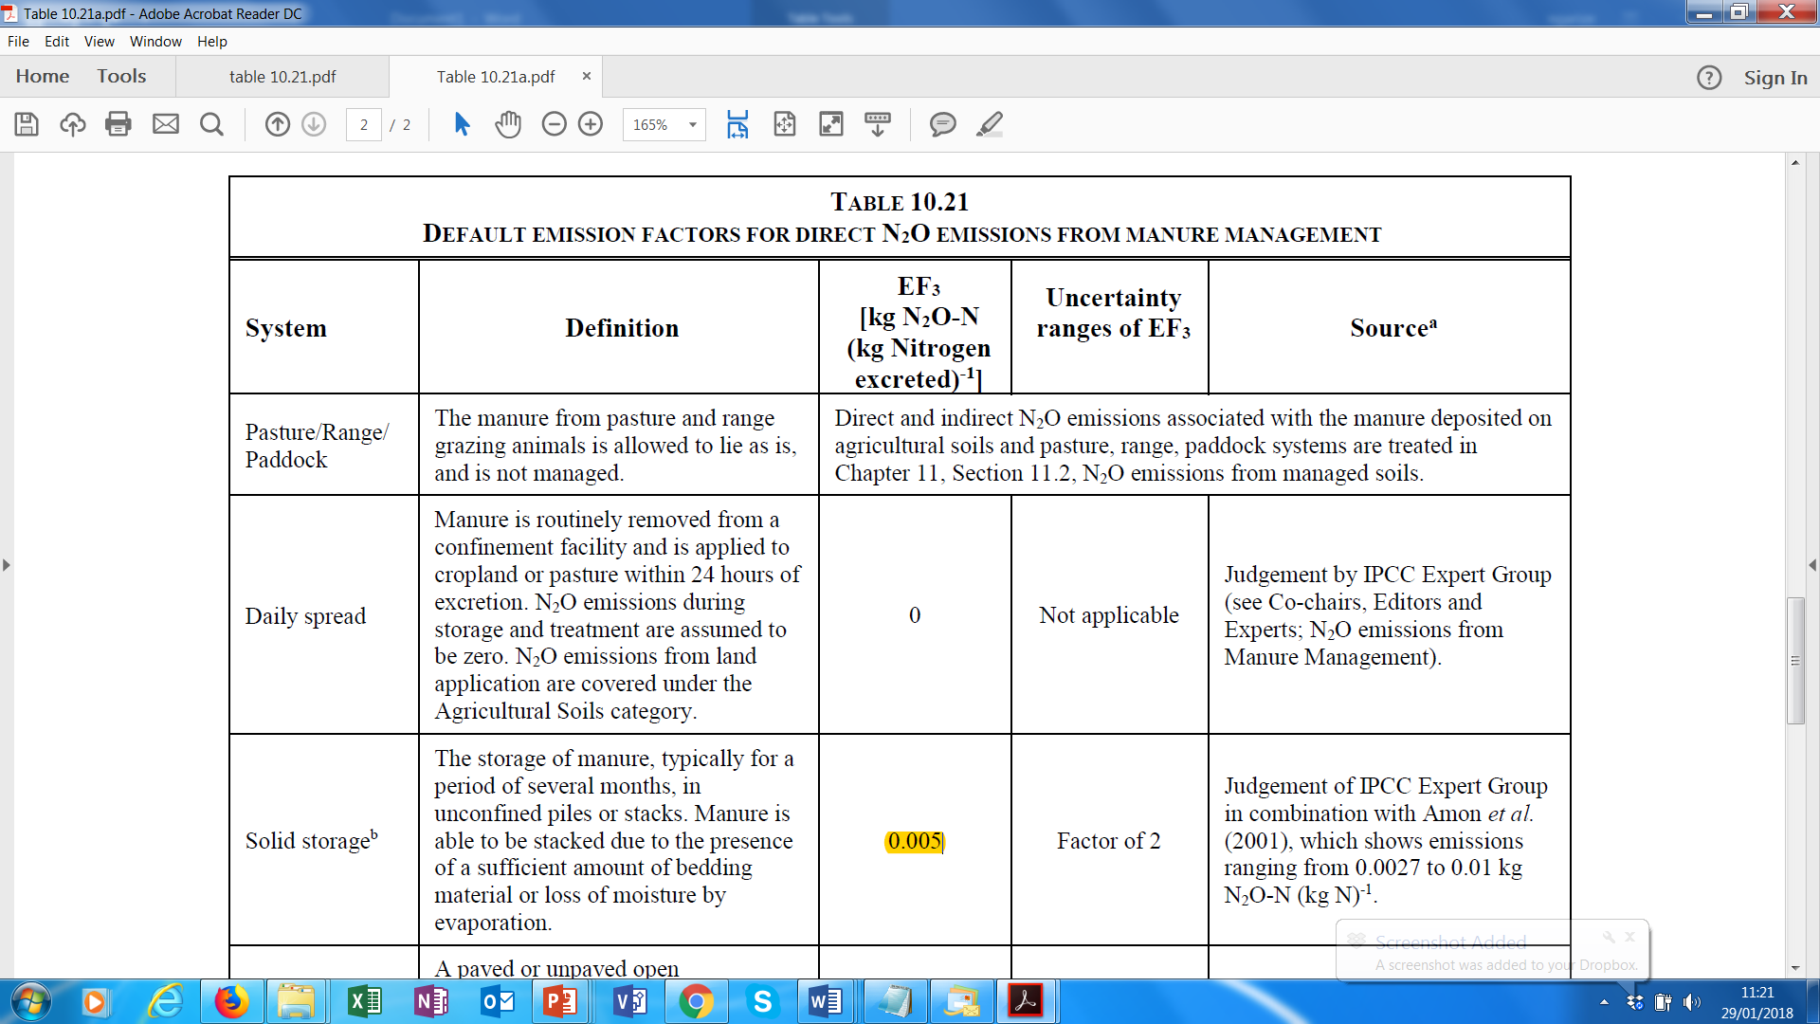
Manure Management: Direct (N₂O) Tier 1 (5)
EF_{3(S)} – Once the value of total N excretion is known, then the total amount of N excretion (from all livestock categories) in each manure management system needs to be multiplied by an emission factor, defined for each manure management system.
Default emission factors for each MMS are available in Table 10.21 of the 2006 IPCC Guidelines and are expressed as kg N₂O-N/kg N excreted. For example, the emission factor for manure management "Solid storage" is 0.005.

Slide 61
Manure Management: Direct (N₂O) Tier 1
Finally, the equation needs to be multiplied by this conversion factor…44/28…WHY?
EF_{3(S)} are expressed in terms of amount of nitrogen (N₂O -N). ​In order to obtain the amount of N₂O emissions the value should be multiplied by 44/28 where:​
44…is the molecular weight of N₂O [(14 • 2) + 16]
28…is the molecular weight of N₂ (14 • 2)
To be multiplied by 10⁻⁶ to convert in Gg

Slide 62
Choice of emission factors
Tier 1
  Annual nitrogen excretion for each livestock category defined by the livestock population characterisation.
    Country-specific values or from other countries with livestock with similar characteristics
    IPCC defaults of N excretion rates (2006 IPCC Guidelines) could be used with typical animal mass (TAM) values
  Default emission factors from the IPCC Guidelines

Slide 63
Choice of emission factors
Tier 2
Annual nitrogen excretion for each livestock category defined by the livestock population characterisation based on total annual N intake and total annual N retention data of animals.
Country-specific emission factors that reflect the actual duration of storage and type of treatment of animal manure in each system

Slide 64
Choice of activity data
Tier 1
  Animal population data according to basic characterization.
  Default or country specific manure management system usage data
Tier 2
  Animal population data according to single enhanced characterization.
  Country-specific manure management system usage data from national statistics, independent survey or expert judgement

Slide 65

3b. land

Slide 66
Outline - FOLU
Definition of basic concepts
Steps in preparing inventory estimates
Carbon pools definitions
Land use categories
Approaches to land representation and activity data (AD)
Land Representation: Why we need Land Stratification
Generic Methodological Guidance for All Land Categories
Methodological approaches used in the estimation of emissions/removals in FOLU sector
Cross-cutting issues
Exercise

Slide 67
Divide all land into managed and unmanaged lands
Develop a national land classification system for six LU classes
Compile data on LU/LUC for each land category
Estimate CO2 emissions/removals and non-CO2 emissions at apt. Tier (KCA)
Re-estimate if higher tier recommended by KCA
Estimate uncertainties
S
Sum CO2 emissions and removals and non-CO2 emissions for each land use and stratum
Report emissions/
removals in reporting tables
Document and archive all information
Set priorities for future inventories and revise KCA for future
Steps in a LULUCF Inventory Preparation
Notes:
Page 1.14 in Volume 4 part 1 of 2006 AFOLU , section 1.3.4- Steps in preparing inventory estimates- Summary below
Step 1: IPCC 2006 provides key category analysis approach. Inventory experts are encouraged to conduct key category analysis using 2006 GL. Estimate the share of LUCF sector to national GHG inventory
Step 2: Select the land-use categories (forest/plantations), vegetation types subjected to conversion (forest and grassland), changes in land-use/management systems (for soil carbon inventory)
Step 3: Assemble required AD, depending on tier selected, from local, regional, national and global databases, including EFDB
Step 4: Collect EF/RF, depending on tier level selected, from local/regional/national/global databases, including EFDB
Step 5: Estimate GHG emissions and removals
Step 6: Estimate uncertainty involved
Step 7: Report GHG emissions/removals
Step 8: Report all procedures, equations and sources of data adopted for GHG inventory estimation

Slide 68
Definition of Concepts
The land sectors is made of:
Emissions to the atmosphere GHG caused by losses of organic matter from terrestrial ecosystems…
and of carbon dioxide (CO₂) removals from the atmosphere as uptake by vegetation and stored in the organic matter
Organic matter is composed of organic compounds that are part of organisms such as plants and their remains. It is essentially composed of the four elements below; their weight in organic matter is also provided.
Carbon (C) 40-55%
Oxygen (O) 35-45%
Hydrogen (H) 3-5%
Nitrogen (N)1-4% %
These elements are constituents of the three important GHGs, that are reported in the land use sector, namely:
Carbon Dioxide (CO₂),
Methane (CH₄)
Nitrous Oxide (N₂O)
Notes:
Organic Matter: Organic matter is composed of organic compounds that are part of organisms such as plants and their remains.
Terrestrial ecosystems: A terrestrial ecosystem is an ecosystem found only on landforms. Six primary terrestrial ecosystems exist: tundra, taiga, temperate deciduous forest, tropical rain forest, grassland and desert.

Slide 69
Stratification of organic matter within 6 carbon pools
Carbon Pools
Since C is the most relevant component of the organic matter. The amount of organic matter in an ecosystem is regarded as a carbon stock (C Stock) that can be stratified into six so-called carbon pools present in the below image.
Carbon Pool: is a reservoir, that is component of the climate system where a GHG or a precursor of a GHG is stored. In particular carbon pools have the capacity to accumulate and release carbon dioxide.
Living Biomass (LB) includes:
1
Above-Ground Biomass (AB)
2
Below-Ground Biomass (BB)
Dead Organic Matter (DOM) includes:
3
Dead Wood (DW)
4
Litter (LI)
5
Soil Organic Matter (SOM)
6
Harvested Wood Products (HWP)
Notes:
Definitions:
Carbon Pool: is a a reservoir, that is component of the climate system where a GHG or a precursor of a GHG is stored. In particular carbon pools have the capacity to accumulate and release carbon dioxide.
Living Biomass (LB): is the organic matter accumulated in the tissues of vegetation originated from plant growth processes. The organic matter can be part of annual or perennial (e.g. wood) tissues.
Above-ground Biomass (AB): All biomass in living vegetation, including both woody and herbaceous tissues, that is above the ground level including stems, stumps, branches, bark, seeds, and foliage. Note: In cases where forest understory is a relatively small component of the above-ground biomass carbon pool, it is acceptable for the methodologies and associated data used to exclude it, provided the exclusion is implemented in a consistent manner throughout the inventory time series.
Below-ground Biomass (BB): All biomass of live roots. Fine roots of less than (suggested) 2mm diameter are often excluded because these often cannot be distinguished empirically from soil organic matter or litter.
Dead Wood (DW): Includes all non-living woody biomass not contained in the litter, either standing, lying on the ground, or in the soil. Dead wood includes wood lying on the surface, dead roots, and stumps larger than or equal to 10 cm in diameter (or the diameter specified by the country).
Litter (L): Includes all non-living biomass with a size greater than the limit for soil organic matter (suggested 2 mm) and less than the minimum diameter chosen for dead wood (e.g. 10 cm), lying dead, in various states of decomposition above or within the mineral or organic soil. This includes the litter layer as usually defined in soil typologies. Live fine roots above the mineral or organic soil (of less than the minimum diameter limit chosen for below-ground biomass) are included in litter where they cannot be distinguished from it empirically.
Soil Organic Matter (SOM): Includes organic carbon in mineral soils to a specified depth chosen by the country and applied consistently through the time series. Live and dead fine roots and DOM within the soil,that are less than the minimum diameter limit (suggested 2 mm) for roots and DOM are included with soil organic matter where they cannot be distinguished from it empirically. The default for soil depth is 30 cm. *Please note that throughout the text SOM is used to indicate the C pool and SOC to indicate the C stock contained in the SOM pool.
Harvested wood products (HWP): This is an anthropogenic C pool. HWP includes all wood material (including bark) that leaves harvest sites but remains in man-made products for different lengths of time. Other material left at harvest sites should be regarded as dead organic matter in the associated land-use category. Fuelwood is also not included in this pool.
Dead wood:
0.50 for Cropland, Grassland and Settlements (pages 5.14, 6.11, 8.21, Volume 4, 2006 IPCC Guidelines)
SOM mineral soils: 0.58 (page 2.38, Volume 4, 2006 IPCC Guidelines)
Peat: Table 7.5, Volume 4, 2006 IPCC Guidelines

Slide 70
IPCC Guidance on DOM and Soil C
Carbon Pools
Living biomass
Above ground biomass
- All living biomass above the soil incl. stem, stump, branches, bark, seeds & foliage
Below ground biomass
-All living biomass of live roots, often excl. fine roots of less than (suggested) 2 mm dia.
Soil C
organic C in mineral and organic soils (including peat) to a specified depth chosen by country (default depth 30 cm for Tier 1 & 2 methods)
incl. live fine roots if cannot be distinguished empirically
Dead Organic Matter
Dead wood
-All non-living woody biomass not litter either standing, lying on the ground, or in the soil;
-Incl. surface wood, dead roots, stumps larger than dia. used by country to distinguish from litter (e.g., 10 cm).
Litter
-All non living biomass of dia. < chosen by the country (e.g., 10 cm) lying dead above soil;
- Incl. litter, fumic and humic layers & live fine roots > dia. used to distinguish below ground biomass (e.g., 2 mm).
Notes:
The IPCC identifies 5 carbon pools for each land use category, carbon stock changes and E/R are estimated for each of the carbon pools
For some land use categories and estimation methods C stock changes may be based on the three aggregate carbon pools ( i.e., biomass, DOM and soils)
National circumstances may require modification of pools introduced here- when modifications are done it is good practice to report and document them clearly to ensure modified definitions are used consistently over time and to demonstrate that pools are neither omitted or double counted.
C stock changes associated with HWP products re normally reported at national scale.
When submitting their national GHGI countries are encouraged to report as many of their significant carbon pools as possible according to national circumstances
The carbon cycle includes changes in carbon stocks due to both continuous processes ( growth and decay) and disturbance events (fires, harvest).
Continuous processes can affect all forest carbon stocks year after year , while disturbance events are discrete and cause emissions. Therefore important that parties chose a methodology that measures changes in carbon stocks is able to collect data for both continuous and discrete events.

Slide 71
C stocks in C pools
C stock is the amount of C contained in the organic matter and is calculated by multiplying the organic matter by a conversion factor also referred as Carbon Fraction (CF); it is usually expressed in tonnes. To convert dry organic matter into carbon, the IPCC Guidelines provides default carbon fraction values for the below C pools.
Living Biomass:
  Table 4.3, Volume 4, 2006 IPCC Guidelines for Forest Land
  0.5 for woody biomass and 0.47 for herbaceous biomass for Grassland (page 6.29. Volume 4, 2006 IPCC Guidelines)
  0.5 for Flooded Lands (Equation 7.10, Volume 4, 2006 IPCC Guidelines)
  0.5 for Settlements (page 8.9, Volume 4, 2006 IPCC Guidelines)
Litter:
  0.37 (from Equation 2.19, Volume 4, 2006 IPCC Guidelines)
  0.4 for Cropland, Grassland and Settlements (pages 5.14,6.11, 8.21, Volume 4, 2006 IPCC Guidelines)
Dead wood:
  0.50 for Cropland, Grassland and Settlements (pages 5.14, 6.11, 8.21, Volume 4, 2006 IPCC Guidelines)
SOM in mineral soils: 0.58 (page 2.38, Volume 4, 2006 IPCC Guidelines)
Peat: Table 7.5, Volume 4, 2006 IPCC Guidelines
Notes:
Carbon Fraction (CF): conversion factor used to calculate the amount of C stock contained in organic matter.

Slide 72
C stocks in C pools
C pools exchanges GHG as removals from the atmosphere through photosynthesis and as emissions to the atmosphere through biochemical processes (decay of C stocks) and physiochemical process (fires).
Emissions occur as C stock losses from C pools while removals occur as C stock gains. Consequently C stock changes are a proxy for estimating GHG emissions/removals for land categories.
Both, C stock gains (positive sign) and C stock losses (negative sign) are multiplied by -44/12 to convert them in CO₂ removals and emissions respectively. Where 44 is the molecular weight of CO₂ and 12 is the atomic weight of C.
Further, transfers (as gains or losses) of organic matter among C pools occur as a consequence of mortality (natural and man-made) and decay, so determining C stock losses in the C pools from which the stock is transferred and C stock gains in the pools in which the C stock is transferred
Biomass is the only sink among C pools
Notes:
The C stock contained at a certain point in time in a C pool is a function of the use of the land. This includes the dynamic of the C stock and therefore, the so-called long term average. The use of land includes the management practices, as well as the regime of disturbances (e.g. climate, soil).
In addition, C pools have physical limits in their capacity to store carbon known as carbon saturation. Let’s examine this below following a logistic curve.
In the figure, you now see an example of the evolution of C stocks in a reforested land.
An initial phase of continuous accumulation over time (sigmoidal curve).
This is followed by a phase with alternate C stocks decrease, due to disturbances, and subsequent C stocks increase due to forest regrowth.

Slide 73
Carbon cycle processes: showing carbon stock flows into and out of carbon pools
Living Biomass
Countries can choose to account for HWP pool
Dead Organic Matter
Notes:
C pools exchanges GHG as removals from the atmosphere through photosynthesis and as emissions to the atmosphere through biochemical processes (decay of C stocks) and physiochemical process (fires).
Emissions materialize as C stock losses from C pools while removals materialize as C stock gains. Consequently C stock changes are a proxy for estimating GHG emissions/removals for land categories.
Both, C stock gains (positive sign) and C stock losses (negative sign) are multiplied by -44/12 to convert them in CO2 removals and emissions respectively. Where 44 is the molecular weight of CO₂ and 12 is the atomic weight of C.
Further, transfers (as gains or losses) of organic matter among C pools occur as a consequence of mortality (natural and man-made) and decay, so determining C stock losses in the C pools from which the stock is transferred and C stock gains in the pools in which the C stock is transferred
Biomass is the only sink among C pools
Carbon stock changes are estimated for all strata or subdivisions of land area ( e.g., climate zone, ecotype, soil type and management type) for a chosen land –use category
Carbon stock changes within a stratum are estimated by considering carbon cycle processes between the five carbon pool as shown in slide above ( adapted from 2006 GL Chapter 2 Part 1 , Vol 4, page 2.8)
This is a generalized flow chart of inputs and outputs from the system as well as possible transfers between the pools
Overall, carbon stock changes within a stratum are estimated by adding up changes in carbon pools.
Carbon stock changes in soil may be further disaggregated as to changes in carbon stocks in mineral and organic soils .
HWP are included separately as a carbon pool based on the COP decision 2/CMP.7 for the second commitment period of the KP.

Slide 74
The use of managed land as a proxy in estimating land-based emissions and removals (E/R)
Factors governing E/R can be both natural and anthropogenic and can be difficult to distinguish between causal factors
Inventory methods have to be operational, practical and globally applicable while being scientifically sound
IPCC Guidelines have taken the approach of defining anthropogenic greenhouse gas emissions by sources and removals by sinks as all those occurring on ‘managed land’
‘Managed land is land where human interventions and practices have been applied to perform production, ecological or social functions’
Managed land has to be nationally defined and classified transparently and consistently over time
GHG emissions/removals need not be reported for unmanaged land
Notes:
AFOLU sector has some unique characteristics with respect to developing inventory methods
Factors governing E/R can be both natural and anthropogenic and can be difficult to distinguish between causal factors
It is good practice for countries to quantify and track over time , the area of unmanaged land so that consistency in area accounting is maintained ad land use change occurs.
Approach of managed land as a proxy was first adopted in the GPG-LULUCF and is maintained in the 2006 guidelines
Local and short term variability in E/R due to natural causes can be substantial and the natural background of GHG E/R by sinks tend to average out over time and space so the E/R from managed land are predominant

Slide 75
Six land-use categories
Stock changes of C pools are estimated and reported for the six “top-level” land-use categories
Forest Land
Cropland
Grassland
Other land
Subdivide according to national circumstances
Settlements
Wetland
Notes:
Once a country has divided its managed from unmanaged lands it will have to further subdivide it’s national territory among the 6 land use categories defined by the IPCC for reporting of the GHG Inventory 2006).
The six land use categories form the basis of estimating and reporting of GHGs from land use and land use conversions
Each land use is further subdivided into land remaining in that category ( e.g FLRFL) and land converted to another category e.g. FL–CL)
Countries may choose to further stratify land in each category by climatic, or other ecological regions depending on the choice of the method and national circumstances
GHG E/R determined for each category/land use includes ( CO2 as carbon stock changes ) from biomass, dead organic matter and soils and non-CO2 emissions from burning depending on LU category

Slide 76
Land-use subcategories and carbon pools
Each land-use category is further subdivided into land remaining in that category (e.g., FL-FL) and land converted from one category to another (e.g., FL-CL) for estimation of C stock changes. The total CO₂ emissions/removals from C stock changes for each LU category is the sum of those from these two subcategories.
3B. Land
WL
OL
FL
CL
GL
SL
FL-FL
L-FL
Biomass
Soils
DOM

Slide 77
Total estimates for GHG are made up of subdivisions of land use categories
Land remaining in the same land use category
Total emissions from land use category
Land converted from one category to that category

Slide 78
Land Representation
In the 2006 GL Land representation is the analysis undertaken to identify and quantify human activities on land, as well as to track their changes over time.
This includes analysis of information, on land classification, land area data, and sampling that represents various land-use categories, this information is needed to estimate the carbon stocks, and the emission and removal of greenhouse gases associated with Forestry and Other Land Use (FOLU) activities.
The land representation results in a stratification of the total area of the country into strata (units of land) homogeneous for a number of variables, that explain the current level and dynamic of C stocks within the stratum, with the purpose of making the GHG inventory compilation practicable while enhancing accuracy of GHG estimates.
Land is characterized by bio-physical variables and various human activities. The variables for land stratification are listed below:
Biophysical characteristics
Land Use
Management practices and disturbances
Other category specific variables
Stratum: Unit of Land
Notes:
Definition:
Land representation: the analysis undertaken to identify and quantify human activities on land, as well as their changes over time.
Stratification: is the process of subdividing a population into subsets (strata), aimed at reducing the variability of the sub-population included in each stratum.
In practice, to achieve accuracy of estimates, when using data that are not homogeneous (e.g., this is the case for C stocks and C stock dynamics across a country’s area), data need first to be stratified so that each stratum is homogeneous, then GHG fluxes for each stratum are estimated and the national GHGI total is estimated by summing up the estimates prepared for each strata.
Strata (singular stratum): a stratum is a homogeneous population (e.g. vegetation, management practices) with respect to one or more variables.
Activity (in terms of land representation refers to): A practice or ensemble of practices that take place on a delineated area over a given period of time.
Unit of land: an area (a stratum) of the territory homogeneous for the variable of concern, in particular for C stock and C stock dynamic
Images:

Slide 79


Land Representation: Why we need Land Stratification
When estimating GHG emissions and removals, land areas are used as activity data (AD). As activity data, they represent the magnitude of a human activity that generates GHG emissions and/or removals during a given period of time.
This is why the stratification of land is a paramount tool to achieve accuracy of GHG estimates.
Example of a land representation and associated C stock changes below. This illustration below is an example of how land stratification correlates with the amount of C stocks found in a unit of land and their dynamic.
Forest Land Cropland
As you can see the conversion of land from forest land to cropland determines a negative C dynamic of C stocks (i.e. the amount of C stocks in this unit of land decreases across time).
Notes:
Stratification: is the process of subdividing a population into subsets (strata), aimed at reducing the variability of the sub-population included in each stratum.
In practice, to achieve accuracy of estimates, when using data that are not homogeneous (e.g., this is the case for C stocks and C stock dynamics across a country’s area), data need first to be stratified so that each stratum is homogeneous, then GHG fluxes for each stratum are estimated and the national GHGI total is estimated by summing up the estimates prepared for each strata.

Slide 80
Land Stratification – Bio-physical characteristics (1)
IPCC provide guidance for land stratification according to a number of variables as provided in previous slides (slide 83).
IPCC Land stratification by the biophysical characteristics variables include:
Climate
Ecological Zone
Soil Type
Bio-physical characteristics impact annual C stock gains and losses as well as the C stocks carrying capacity of land
The stratification of land by climate is important because temperature and water are the two main parameters that determine the accumulation of biomass and decay of organic matter on the land.
The IPCC recommends classifying land according to climate zones that are defined by a set of rules based on:
Annual mean daily temperature
Total annual precipitation
Total annual potential evapo-transportation (PET)
Elevation
The list of climate zones covering most managed lands:
Boreal
Cold temperate dry
Cold temperate wet
Warm temperate dry
Warm temperate moist
Tropical dry
Tropical moist
Tropical wet
Notes:
Definitions:
Bio-physical characteristics of terrestrial ecosystems -i.e. climate , soil and vegetation- impact the level and dynamic of carbon stocks and therefore are important variables for stratification. Consequently, the IPCC default stratification of land is based on these bio-physical elements (an example of a couple of strata based on purely bio-physical characteristics are a tropical mountain forest on high activity clay soil and a tropical rainforest on low activity clay soils)

Slide 81
Land Stratification – Bio-physical characteristics (2)
The stratification of land by ecological zone (or potential vegetation zone) is important since woody biomass is the second largest terrestrial C pool. The IPCC uses the Global Ecological Zone (GEZ) classification provided by the Food and Agriculture Organization (FAO) of the United Nations. Below are ecological zones provided by FAO:
Tropical rainforest
Tropical most deciduous forest
Tropical dry forest
Tropical shrubland
Tropical desert
Tropical mountain systems
Subtropical humid forest
Subtropical dry forest
Subtropical steppe
Subtropical desert
Subtropical mountain systems
Temperate oceanic forest
Temperate continental forest
Temperate steppe
Temperate desert
Temperate mountain systems
Boreal coniferous forest
Boreal tundra woodland
Boreal mountain systems
Polar
Notes:
Definitions:
Bio-physical characteristics of terrestrial ecosystems -i.e. climate , soil and vegetation- impact the level and dynamic of carbon stocks and therefore are important variables for stratification. Consequently, the IPCC default stratification of land is based on these bio-physical elements (an example of a couple of strata based on purely bio-physical characteristics are a tropical mountain forest on high activity clay soil and a tropical rainforest on low activity clay soils)

Slide 82
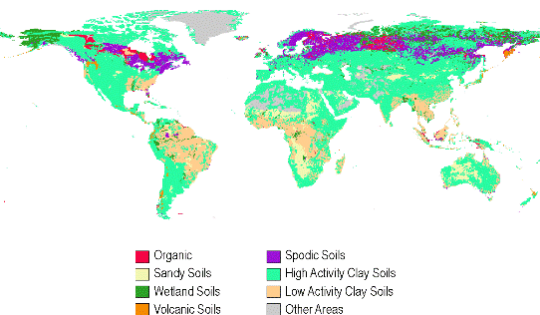
Land Stratification – Bio-physical characteristics (3)
The stratification of land by soil type is important because soil contains the largest portion of terrestrial C stocks in the Soil Organic Matter (SOM) carbon pool. Soil Organic Carbon (SOC) level and dynamic are influenced by the physical and bio-chemical characteristics of soil. The 2006 IPCC Guidelines classify country’s soils in default types derived from the World Harmonized Soil Database. IPCC provides methodological guidance on two soil types namely organic and mineral soils.
Notes:
Definitions:
bio-chemical characteristics of soil: impact the rate of humification of dead organic matter as well as of mineralization of humus.
SOC: Soil Organic Carbon, indicates the C stock in the soil organic matter pool
Bio-physical characteristics of terrestrial ecosystems -i.e. climate , soil and vegetation- impact the level and dynamic of carbon stocks and therefore are important variables for stratification. Consequently, the IPCC default stratification of land is based on these bio-physical elements (an example of a couple of strata based on purely bio-physical characteristics are a tropical mountain forest on high activity clay soil and a tropical rainforest on low activity clay soils)

Slide 83
Land Stratification – Land Use
IPCC provides guidance on stratifying land use in the following order:
Managed and unmanaged land
Six IPCC land use categories
“Land remaining in the same land-use category” and “Land converted into a new land use category”
Land conversion categories
Managed land are stratified (land use categories) according to their current land use (i.e. Forest land, Cropland, Grassland, Wetlands, Settlements, Other land), and changes in use over time. (second step)
Unmanaged lands are stratified (land use categories) according to their current cover (i.e. Forest land, Grassland, Wetlands, Other land)
Notes:
Definitions:
Managed land is land where human interventions and practices are or have been applied to perform production, ecological or social functions.
Unmanaged land: Unmanaged land is land where no human interventions and practices take place. For this type of land, no emissions and removals need to be reported. Nevertheless, it is good practice to track over time, the area of unmanaged land so that consistency in area accounting is maintained
Land use: is the socioeconomic use that is made of land (e.g. agriculture, forestry); at any one place, there may be multiple and alternate land uses (e.g. agroforestry).
Land cover is the observed (bio)physical cover on the Earth's surface. (for more information on how to objectively describe land cover, read about the Land Cover Classification System, founded by FAO) [link publication LCCS3 Classification Concepts, FAO 2015: http://www.fao.org/docrep/003/x0596e/x0596e01e.htm]
Forest land: includes all land with woody vegetation consistent with thresholds used to define forest land. It is sub-divided into managed and unmanaged.
Cropland: includes arable and tillage land, and agro-forestry systems where vegetation falls below the thresholds used for the forest land category
Grassland: includes rangelands and pasture land that is not considered cropland. It also includes systems with woody vegetation that fall below the threshold values used for Forest. It is sub-divided into managed and unmanaged
Wetlands: includes land that is covered or saturated by water for all or part of the year (e.g., peat land) and that does not fall into the forest land, cropland, grassland or settlements categories. It is sub-divided into managed and unmanaged
Settlements: includes all developed land, including transportation infrastructure and human settlements of any size, unless they are already included under other categories
Other land: includes bare soil, rock, ice, all land without significant carbon stocks, and all unmanaged land areas that do not fall into any of the other five categories

Slide 84
Land Stratification – Land Use
Can countries apply their own country specific land use definitions?
Yes- countries may apply their own country specific definitions as long as:
a hierarchical order is established among the country specific definitions
Country specific definitions need to cover the entire range of land uses represented in the country’s territory and avoid mixing areas with very different C stocks and C stock dynamics together in the same category
For example, the combination of both types of land, without C stocks (such as sands) and with significant C stocks (such as steppe), must be avoided.
Often country-specific definitions are based on land cover classes, and therefore need to be reconciled with IPCC land use categories.
For example FAO publishes area data on forest (FRA database) and non-forest categories (FAOSTAT database) such as arable land, permanent crops, etc.
Notes:
Definitions:
A hierarchical order is needed to avoid double counting of land. IPCC definitions embed the following hierarchical order: 1) Forest land, Cropland, Grassland, Settlements, Wetlands, Other land
Land cover is the observed (bio)physical cover on the Earth's surface. (for more information on how to objectively describe land cover, read about the Land Cover Classification System, founded by FAO) [link publication LCCS3 Classification Concepts, FAO 2015: http://www.fao.org/docrep/003/x0596e/x0596e01e.htm]

Slide 85
Land Stratification – Land Use Change (1)
The third step is to differentiate the land use categories according to their historical land uses.
Changes from a land use category to another causes changes in the level of C stocks (abrupt impact) and determines a dynamic in C stock changes across a transition period (lagged impact).
This means that land use history is an important factor when selecting the appropriate methodology for estimating GHG emissions and removals. Consequently, the IPCC stratifies land use category areas in two types shown here.
Land remaining in a land use category
(no conversion in the last 20 years)
Land converted into a new land use category
(conversion within the last 20 years)

Slide 86
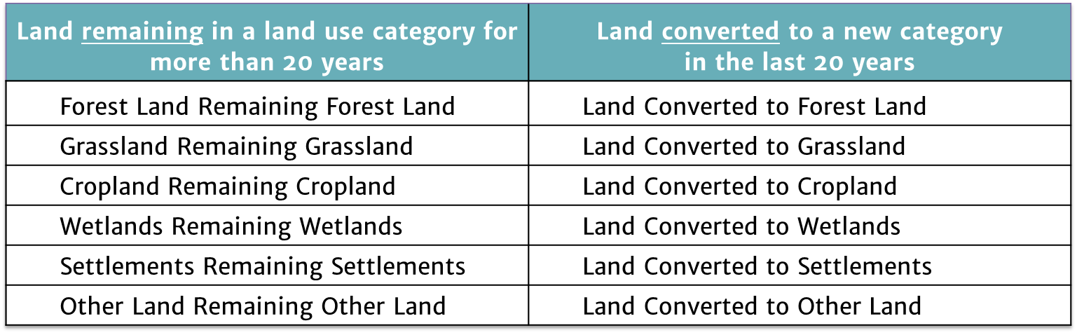
Land Stratification – Land Use Change (2)
Land conversion process:
The conversion process is tracked across a 20-year “transition period” (IPCC default). In such a period, the C stocks dynamic in the land conversion category (e.g. GL-FL) is different than the dynamic in the corresponding land remaining category (e.g. FL-FL).
Information on historical land use allows the application of different stock change factors according to different types of conversion. If the land use has not changed in the last 20 years, the land is reported under the category “Land remaining under the same land use.”
If the land use has changed in the last 20 years, the land is reported under the category “Land converted to the new land use” and in the relevant subcategory.
The fourth step is to differentiate land conversion categories according to the previous land use in the 30 land use change sub-categories. E.g. Forest land converted to Cropland

Slide 87
Land stratification – Land use versus Land cover
Using the example of an area covered by trees that is clear cut will help to understand the methodological difference between land cover and land use.
Applying a land cover classification, we may just estimate the loss of the biomass C stock of the tree cover. While applying a land use classification, we will estimate:
The loss of the biomass C stock
The gain of biomass C stock associated with the following vegetation regrowth (the type of which depends from the current land use e.g. forest regrowth in case of temporary loss of forest cover).
The change in the DOM C stock as difference between the C stocks in the previous and in the current land use.
The change in SOC as difference between the C stocks in the previous and in the current land use.

Slide 88
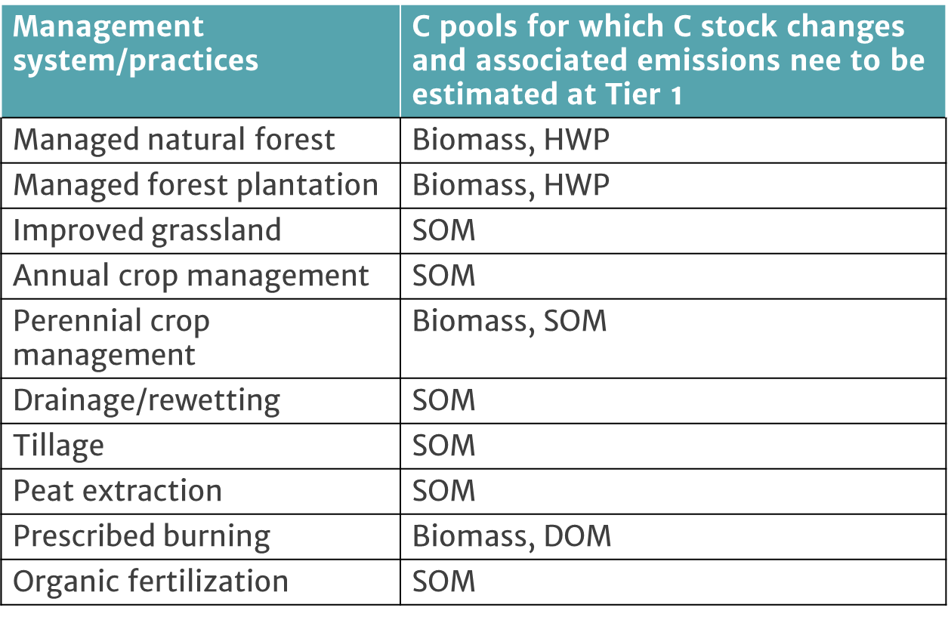
Land stratification – Management system/practices and disturbances
This table illustrates a list of default management systems/ practices provided by the IPCC guidelines.
The table reports which C pools are most affected by various management systems/practices and by their changes.
The stratification by the management system/ practices on land is a good proxy for the expected level and dynamic of C stocks, and therefore it can also be used as a further level of land stratification. Stratification by management system is required especially for the soil organic matter (SOM).

Slide 89
Land stratification – Disturbances
The frequency of fires in an ecosystem is a variable for stratification since it impacts the average long term C stocks, as well as the annual dynamic of C stocks
Other common disturbances are insects, pests and wind.
The variable for stratification by disturbances that applies to all land categories is fire. Fires can occur as a consequence of human activities and/or of natural events. Prescribed fires and wildfires should both be taken into account in the GHG Inventory when occurring on managed land.

Slide 90
Consistent land representation – Methodological Approaches
Consistency in land representation is key to ensure that no artefact trends in GHG estimates are caused by incomplete/inconsistent time series
The level of aggregation at which the land representation should be reported in the NGHGI is that of land use categories (the six land remaining categories and the associated thirty land-use change categories).
Approaches for land representation are applied to classify the territory, according with the stratification scheme applied, and to quantify the area of each unit of land.
A combination of approaches can be used to better adapt to data availability over time and space. Although, to ensure consistency of land representation, each unit of land identified must be reported with the same approach across the entire time series.
The most efficient tactic to build a consistent land representation is to apportion the land in macro-units of land homogeneous for climate, ecological zone and soil and to build a land representation for each of the macro-units.

Slide 91
Three approaches for Consistent Land Representation: Methodological Approaches
Approach 1
Net area of land use for various land use categories
No tracking of land use conversions
Only know areas of each land type at beginning and end
Approach 2
Tracking of land use conversion between land use categories on a non-spatially explicit basis
Also know areas of each transition between types
Approach 3
Tracking of land use conversion on a spatially explicit basis
Know changes on each parcel of land
Notes:
Approaches to land representation- Activity Data
According to the (IPCC, 2006) LULUCF, AD is defined as data on the magnitude of human activity resulting in emissions or removals taking place during a given period of time. In the LULUCF sector, data on land area, management systems, lime and fertilizer use, are examples of AD. The IPCC proposes three ‘Approaches’ (IPCC, 2006) to generate AD when referring to land identification, which are not presented hierarchically and are not mutually exclusive. National entities responsible for GHG inventories should select an approach according to national circumstances and capabilities.
Approach 1 represents land use area totals within a defined spatial unit, which is often defined by administrative borders, such as a country, a province or municipality. Only net changes in land use area can be tracked within the boundaries of the spatial unit through time following this approach. Consequently, the geographical location of each land use change is not known, and the exact changes that occur between land uses cannot be ascertained.
Approach 2 provides an assessment of both the gross and net losses or gains of the surface area for the categories of specific land uses and allows the determination of areas where these changes take place. This approach includes information on the conversions between categories, but tracks these changes without spatially-explicit data (i.e. the location of specific land uses and land-use conversions are not known).
Approach 3 is characterized by spatially explicit observations of land use categories and land use conversions, often through sampling at specific geographical points and/or complete (‘wall-to-wall’) mapping.
In summary: Approach 1 identifies the total change in area for each individual land use category within a country, but does not provide information on the nature and area of conversions between land uses. Approach 2 introduces tracking of land-use conversions between categories (but is not spatially explicit). Approach 3 extends Approach 2 by allowing land use conversions to be tracked on a spatially explicit basis (IPCC, 2006).

Slide 92
Approach 1
92

Slide 93
Approach 2
93

Slide 94
Approach 3: Spatially Explicit
94

Slide 95
Ex. # 1: Land Use matrix: Can you fill in the missing values?
Initial Final | FL | CL | GL | WL | SE | OL | Final Area
FL | 50 | 2 | 6 | 0 | 2 | 0 | ??
CL | 5 | 35 | 8 | 0 | 2 | 0 | 50
GL | 3 | 7 | ?? | 0 | 0 | 0 | 37
WL | 8 | 0 | 0 | 20 | 3 | 0 | 31
SE | 0 | 0 | 0 | 0 | 32 | 0 | 32
OL | 0 | 0 | 0 | 0 | 0 | 5 | 5
Initial Area | 66 | 44 | ?? | 20 | ?? | 5 | 215

Slide 96
And the answer is…
Initial Final | FL | CL | GL | WL | SE | OL | Final Area
FL | 50 | 2 | 6 | 0 | 2 | 0 | 60
CL | 5 | 35 | 8 | 0 | 2 | 0 | 50
GL | 3 | 7 | 27 | 0 | 0 | 0 | 37
WL | 8 | 0 | 0 | 20 | 3 | 0 | 31
SE | 0 | 0 | 0 | 0 | 32 | 0 | 32
OL | 0 | 0 | 0 | 0 | 0 | 5 | 5
Initial Area | 66 | 44 | 41 | 20 | 39 | 5 | 215

Slide 97

Consistent land representation – Reporting (1)
Reporting - Annual matrices of land use and land use change
Let’s identify how matrices are complied, what information they contain and what they look like by following the example below.
Inventory year is
Country X has been subdivided in a number of strata homogeneous by climate zone, ecological zone and soil type.
Then, for each stratum a time series of annual matrices has been prepared as shown in the below matrices. For instance, a stratum could be: Warm Temperate Moist climate zone (WTM), Temperate Mountain Systems ecological zone (TMS), and High Activity Clay soil type (HAC). As reported in the example below:

Slide 98
Consistent land representation – Reporting (2)
Inventory year is
How should I read matrices?
Note that a time series is composed by a number of tables corresponding to the number of years for which the land representation has to be built plus 19.
For example, the time series for the GHG inventory period 2005-2017 will be composed by 30 annual matrices (i.e. from matrix 1985-1986 till matrix 2015-2016)
Finally, data reported in the time series of annual matrices (1 time series for each combination of climate zone, ecological zone and soil type) are then aggregated according to GHGI category reporting (i.e., in land use and land-use change categories).
2006

Slide 99
Generic Methodological Guidance for All Land Categories

Slide 100
A simple first order approach in the IPCC Guidelines
The IPCC Guidelines make two assumptions:
  A) C_{flux} = ∆C_{stocks}
  B) Change in carbon stocks can be estimated from land use/change and management at various points in time, their impacts on carbon stocks and the biological response to them.
  (IPCC 2006 GL, page1.6, section 1.2.1, para 3)
Notes:
There are large uncertainties in estimating fluxes of CO2, C fluxes occur at widely varying spatial and temporal scales,
Direct Measurement of C fluxes extremely difficult due to heterogeneity of terrestrial ecosystems and uncertainty in measurements
A practical first order approach is to make assumptions about effects of land use change on carbon stocks and the subsequent biological response to a given land use., i.e.,
Flux of C assumed = changes in carbon stocks in existing biomass and soils.
Therefore in estimating GHG fluxes in the AFOLU sector the IPCC methodology makes 2 basic assumptions : (a) the flux of CO2 to or from the atmosphere is assumed to be equal to changes in carbon stocks in existing biomass and soils and (b) the changes in carbon stocks can be estimated by first establishing rates of change in land use and practice used to bring about change ( e.g., burning, clear-cutting, selective cut, e.t.c, ) The second assumptions or data are applied about their impact on carbon stocks and biological response to a given land use.
This first order approach is the foundation for the basic methodologies presented in the guidelines for calculating changes in carbon pools, this approach is generalized and applied to all carbon pools ( AGB, BGB, Dead wood, litter and soil) and subdivided as necessary to capture differences between ecosystem, climatic zones, and ,management practices).

Slide 101
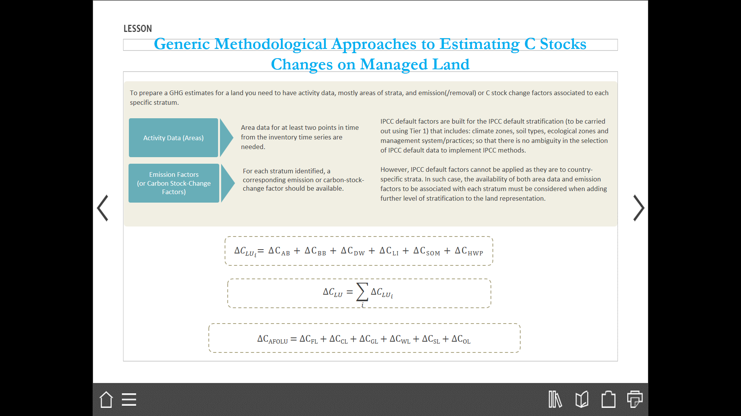
Generic Methodological Approaches to Estimating C Stocks Changes on Managed Land

Slide 102
Generic Approaches to Estimating C Stocks Changes on Managed Land: CO₂ Emissions from C stock changes on land
Annual carbon stock changes as sum for all land use categories: Equation 2.1 (2006 GL, pg 2.6)
Annual C stock changes for a land-use category - sum of each stratum within category: Equation 2.2 (2006 GL, pg 2.7)
Annual carbon stock changes for a stratum of a land-use category - sum of all carbon pools: Equation 2.3 (2006 GL, pg 2.7)
ΔC_{LAND} = ΔC_{FL} + ΔC_{CL} + ΔC_{GL} + ΔC_{WL} + ΔC_{SL}+ ΔC_{OL}
ΔC_{LU} = Σ ΔC_{LU i}
ΔC_{LUi} = ΔC_{AB} + ΔC_{BB} + ΔC_{DW} + ΔC_{LI} + ΔC_{SO}
Notes:
E/R of CO2 for the AFOLU sector are based on changes in ecosystem C stocks, and are estimated for each of the land-use category ( including Land remaining in land use category and land converted to another land use, (Equation 2.1, section 2.2.1 page 2.6, Vol 4 part 1, 2006 GL – Equa 2.1 annual C-stock changes for the entire AFOLU sector estimated as the sum of changes in all land use categories), INDICES denote the 6 land use categories
For each of the land use category, carbon stock changes are estimated for all strata or subdivisions of land area ( e.g., by climate zone, ecotype, soil type and management regime) for the chosen land-use category ( Equation 2.2, Vol 4, part 1, page 2.7, C_{LU} denotes carbon stock changes for land use (LU) category as defined in equation 2.2, LUi- denotes specific stratum)- Equa 2.2 Annual C- stock changes for land use category as a sum of changes in each stratum within a category). The carbon stock changes within a stratum are estimated by considering the carbon cycle processes between the five carbon pools ( see slide 25).
Overall, carbon stock changes within a stratum are estimated by adding up changes in all the five carbon pools as in equation 2.3 (equa., 2.3 annual carbon stock changes for the stratum of land use category as a sum of changes in all pools) Further carbon stocks in soil may further be disaggregated as changes in mineral and organic soils. HWP are also included as a carbon pool.

Slide 103
Generic approaches when estimating C stock changes (1)
In the land use sector, carbon stock changes are estimated to derive emissions and removals of CO₂, CH₄ and N₂O in each GHG inventory category.
The C stock changes in each category of the land use sector are estimated for each carbon pool by using two generic methodological approaches different and equally valid to estimating C stock changes as shown below.
Method 1 Method 2
Stock Difference Method is a stock-based approach, which estimates the difference in C stocks at two points in time.
Gain and Loss Method is a the process-based approach, which estimates the net balance of C stock additions to and removals from a carbon pool.

Slide 104
Generic approaches when estimating C stock changes (2)
h
t
e
w
k
o
a
r
1
2
t
G
p
h
u
g
C
u
o
r
h
t
Carbon
Carbon
Land Use
Stock in
Stock in
Disturbances
type
Harvest
year
1
Year
2
Difference between carbon stocks (Stock-Difference Method)
Sum of gains and losses (Gain-Loss Method)
Notes:
All estimates of changes in carbon stocks i.e., growth, internal transfers and emissions, are in units of carbon to make all calculations consistent. Data on biomass stocks, increments, harvests, e.t.c., can initially be in units of dry matter that need to be converted to tonnes of carbon for all subsequent calculations. ( see slide 57-59 for simplifying assumptions at tier 1).
There are 2 fundamentally different and equally valid approaches to estimating carbon stock changes. (i) the process based approach which estimates net balance of additions to and removals from a carbon stock (ii) the stock-based approach which estimates the difference in carbon stocks at two points in time.
In 2006GL the IPCC distinguishes between the stock change and the gain-loss methods for estimating emissions/removals of CO2 associated with annual rates of change in all carbon pools

Slide 105
Stock-Difference Method
Stock-Difference Method can be used where carbon stocks in relevant pools are measured at two points in time to assess carbon stock changes
C stock changes are estimated from measurements of C stocks at periodic intervals (t1, t2, …, tn) in the same area (i.e. area across which measuring C stocks at times t1 and t2 must be the same and be equivalent to the area of the stratum at the latest date i.e. t2).
The Stock-difference is often used with time series of national forest inventory data.
Where:
ΔC = annual carbon stock change in the pool, tonnes C yr⁻¹
C₁ = carbon stock in the pool at time t₁, tonnes C
C₂ = carbon stock in the pool at time t₂, tonnes C
Equation 2.5 page 2.10, Vol 4, 2006GL should be used for each land stratum when using the Stock-Difference Method.
∆C = (C₂ – C₁ )/(t₂ – t₁)
Notes:
Stratum (plural for strata): a stratum is a homogeneous population with respect to one or more of the variables (e.g. same vegetation type under same management practices).
Am alternative approach, the stock based approach “Stock Difference method” which can be used where carbon stocks in relevant pools are measured at two point sin time to assess carbon stock changes
Essentially, the stock difference method estimates E/R of CO2 as the difference in carbon stocks estimates made at two points in time, divided by the number of intervening years.
The carbon stocks estimates are commonly estimated from repeated field measurements of forest variables as part of the NFI or equivalent survey data. (RS data may also be useful).
IPCC notes that the stock change method provides good basis where there are relatively large increases or decreases in estimated biomass, or where countries have very accurate forest inventories
However, its important to note that NFI are usually established for forest resource management and therefore are more suitable for estimating standing merchantable biomass. They may not consider –non-commercial biomass components such of forest. I.e., impractical for NFI to monitor the pools of DOM or soil carbon, these pools will have to estimated by other means where they are not measured.
Although sample plots for NFI are usually geo-located, they do not deliver spatially explicit estimates, for example to track REDD+ activities drivers.
It may take 10 years or more to establish an NFI time series, of which alternatives need to be considered during this period when designing system for monitoring and estimate GHG.
Equation 2.5 page 2.10, Vol 4,Part 1, 2006GL- carbon stock change in a given pool as an annual average differences between estimates at two points in time (stock difference method).
If the C-stock changes are estimated on per hectare basis, then the value is multiplied by the total area within each stratum to obtain the total stock change estimate for the pool.
In some cases, the activity data may be in the form of country totals ( e.g. HWP) in which case the stock change estimates for that pool are estimated directly from the activity data after applying appropriate factors to convert to units of C mass.
When using the stock difference method for a specific land use categrory, it is important that the area of land in that category at times t₁ and t₂ are identical to avoid confounding stock change estimates in area chnages.

Slide 106
Gain-Loss Method
Gains-Loss Method involves tracking inputs and outputs from a C pools: e.g., gains from growth (increase of biomass) and transfer of carbon from another pool (e.g., transfer of carbon from the live biomass carbon pool to the dead organic matter pool due to harvest or natural disturbances) and loss due to harvest and mortality.
ΔC = annual carbon stock change in the pool, tonnes C yr⁻¹
ΔC_{G} = annual gain of carbon, tonnes C yr⁻¹
ΔC_{L} = annual loss of carbon, tonnes C yr⁻¹
Equation 2.4, page 2.9, Vol 4, 2006 GL
∆C = ∆C_{G} – ∆ C_{L}
Notes:
ΔCL = Losses (-) are annual decreases in C stocks in a pool and account for GHG emissions to the atmosphere
ΔCG = Gains (+) are annual increases in C stocks in a pool and account for growth and transfer to other carbon pools
Gains-loss method estimates annual E/R of CO2 as the sum of gains and losses in carbon pools occurring on areas of land subject to human activities
Changes in carbon pools are often estimated as the product of an area of land and an E/R factor that describes the rate of gain or loss in each carbon pool per unit of land area.
The gain-loss method does not require an NFI, although information from an NFI can be used to derive E/R factors, as well as provides insight into the causes of gains or losses of carbon pools.
To calculate E/R using the gains method , countries need activity data i.e, information about the extent of the activity, most activity data are areas sufficiently disaggregated so that they can be used to estimate emissions when combined with emission/removal factors, and other parameters which are usually expressed per unit area.
For the conversions from FL to other land use which are summed to calculate total deforestation, the gains-loss method multiplies areas of land use change which may be estimated from remote sensing/sample plots representative of strata subject to the process involved, by the difference in carbon stocks per unit area between forest and the new land use.
For FLRFL , the gains-loss method estimates the annual change in above ground biomass carbon as a the difference between the annual increment in carbon stocks due to growth and the annual decrease in stocks due to losses from processes such as commercial harvest , fuel wood removals and other disturbances such as fire and pest infection.
Gains are attributed to growth (increase in biomass) and to transfer of carbon from another pool- transfer of carbon from live biomass carbon pool to DOM due to harvest or natural disturbances). Gains are denoted with +ve sign
Losses can be attributed to transfers from one carbon pool to another ( e.g. the carbon in the slash during harvesting operation is aloss from ABGB pool) or emissions due to decay , harvest, burning) Losses are denoted by _ve sign.
Equation 2.4 , page 2.9, Vol 4, Part 1, 2006 GL, - annual carbon stock change in a given pool as a function of gains and losses (GAIN-LOSS METHOD)

Slide 107
Biomass: Land Remaining in a Land-use Category
Carbon stock change in biomass on Forest Land is likely to be an important sub-category due to substantial fluxes arising from management and harvest, natural disturbances, natural mortality and forest regrowth.
Changes in C stocks in biomass pool can be estimated using either Stock-Change or Gain-Loss method.
The Gain-Loss Method requires the biomass carbon loss to be subtracted from the biomass carbon gain.
Gain-Loss Method is the basis of Tier 1 method, for which default values for calculation of increment and losses are provided in the IPCC Guidelines.
Notes:
Methods to estimate GHG E/R in the AFOLU sector can be divided into two broad categories (i) methods that can be applied in a similar way for any of the types of land use (i.e., generic methods for FL, CL, GL, SL, WL and OL) and (ii) methods that only apply to a single land use or that are applied to aggregate data on a national level without specifying any land use type.
Changes in biomass carbon stocks – AGBM/BGBM - Plant biomass constitutes a significant carbon stock in many ecosystems Biomass is present in both AGBM/BGBM parts of annual and perennial plants. , However , biomass associated with annual and perennial herbaceous (i.e.,-non-woody) plants is relatively ephemeral (it decays and regenerates annually or very few years). Therefore, emissions from decay are balanced by removals due to regrowth making the overall net C stocks in biomass rather stable in the long term. FOR this reason the methods focus on stock changes in biomass associated with woody plants and trees.- which can accumulate large amounts of carbon over a lifespan.
Carbon stock changes in Forest land – are likely to be an important sub-category because of substantial fluxes owing to management and harvest, ND, natural mortality and forest regrowth.
For inventory purposes changes in carbon stock in biomass are estimated for (i) land remaining in same land use category and (ii) land converted to a new land use category. The reporting convention is that all E/R associated with the a land use change are reported in the new land use category.
In addition, land use conversions from FL to other land uses often result in substantial loss of biomass
Chapter of the IPCC 2006 GL provides mainly descriptions of generic methodologies under category (i) above for estimating ecosystem carbon stock changes as well as for estimating non- CO2 fluxes from fires.
These methods can be applied to nay of the six land use categories. Generic information include:
General framework for applying methods within specific land use categories
Choice of methods including equations and default values for tier 1 methods for estimating C-stock changes and non-CO2 emissions
General guidance on higher tiers
Use of IPCC EFDB
Uncertainty estimation
NOTE:- For Stock change method , in some cases primary data on biomass may be in the form of wood volume data for example forest surveys, in which case factors are provided to convert wood volume to carbon mass units ( see equation 2.8 b) page 2.12-13 Vol 4 Part 1 of 2006 GL ( more suitable for countries with NFI , Tier 3) or tier 2
NOTE: equation 2.7 page 2.12 Vol 4 part 1. Gains-Loss method- can be used by countries who do not have a NFI designed for estimating wood biomass stocks. Default data are provided for inventory compilers who do not have access to country specific data and also worksheets are provided ( See Annex 1 of Vol 4 part 2 of 2006 GL)

Slide 108

Gain & Loss method for Biomass C pool - Tier 1
The default IPCC method (Tier 1) for estimating biomass C stock changes (above-ground and below-ground) in a land remaining in a land-use category is to use Gain and loss method which is formulated using the equation 2.7:
The two elements in equation 2.7 are the annual increases (ΔC_{G}) and decreases in biomass due to biomass growth and loss (ΔC_{L}) .
ΔC_{G} = Σ _{i, j} (A_{i,j} G_{TOTALi,j} CF_{i,j}) (Equation 2.9)
ΔC_{L} = L_{wood−removals} + L_{fuelwood} + L_{disturbance} (Equation 2.11)
Notes:
Equation 2.7
$∆CB \text{= }\text{annual} \text{change} \text{in} \text{C} \text{stocks} \text{in} \text{biomass} \text{for} \text{each} \text{unit} \text{of} \text{land}\text{, }\text{tonnes} \text{C} \text{yr}\text{−1}$
$∆CG=$ annual increase in C stocks due to biomass growth stratified ecological zone (i) and climatic zone (j), tonnes C yr⁻¹
$∆CL$ = annual decrease in C stocks due to biomass loss, tonnes C yr⁻¹
Source: 2006 IPCC Guidelines Chapter 2 – pg. 2.12
Equation 2.9
$∆C_{G}$: annual increase in biomass C stocks due to biomass growth stratified by ecological zone (i) and climatic zone (j), tonnes C yr⁻¹
$A_{i,j}$: Area of land, ha
$G_{TOTAL}$: average annual biomass growth above and below-ground, tonnes d. m. ha⁻¹ yr⁻¹
CF : carbon fraction of dry matter, tonnes C (tonnes d.m.)⁻¹
Equation 2.11
∆C_{L}: annual decrease in C stocks due to biomass loss, tonne C yr⁻¹
L_{wood-removals}: annual C loss due to wood removals, tonne C yr⁻¹
L_{fuelwood}: annual biomass C loss due to fuelwood removals, tonne C yr⁻¹
L_{disturbance} : annual biomass C losses due to disturbances, tonne C yr⁻¹

Slide 109
Annual increase in biomass carbon stocks (Gain-Loss Method), ΔC_{G –} (Land remaining in same land use category)
ΔC_{G} = Σ _{i, j} (A_{i,j} G_{TOTALi,j} CF_{i,j})
Where:
ΔC_{G} = annual increase in biomass carbon stocks due to biomass growth in land remaining in the same
land-use category by vegetation type and climatic zone, tonnes C yr⁻¹
A = area of land remaining in the same land-use category, ha
G_{TOTAL}= mean annual biomass growth, tonnes d. m. ha⁻¹ yr⁻¹
i = ecological zone (i = 1 to n)
j = climate domain (j = 1 to m)
CF = carbon fraction of dry matter, tonne C (tonne d.m.)⁻¹
Equation 2.9, page 2.15, Vol 4, 2006 GL
Notes:
This is a tier 1 methodology, that when combined with default biomass growth rates, allows for any country to calculate the annual increase in biomass, using estimates of area and mean annual biomass increment for each land use type and stratum ( by climatic zone, ecological zone, vegetation type).
G_{total} is the total biomass growth expanded from above ground biomass growth (G_{w} ) to include below ground biomass growth.

Slide 110
Average annual increment in biomass (G_{TOTAL}): Tier 1
Where:
G_{TOTAL} = average annual biomass growth above and below-ground, tonnes d. m. ha⁻¹ yr⁻¹
G_{W} = average annual above-ground biomass growth for a specific woody vegetation type, tonnes d. m. ha⁻¹ yr⁻¹
R = ratio of below-ground biomass to above-ground biomass for a specific vegetation type, in tonne d.m. below-ground biomass (tonne d.m. above-ground biomass)⁻¹
(Equation 2.10, page 2.15, Vol 4, 2006 GL).
G_{TOTAL} = Σ{G_{W} • (1+ R)}
Notes:
Equation 2.9
∆𝐶𝐺= annual increase in C stocks due to biomass growth stratified by ecological zone (i) and climatic zone (j), tonnes C yr-1
𝐴_(𝑖,𝑗): Area of land, ha
𝐺_𝑇𝑂𝑇𝐴𝐿: average annual above-ground biomass growth (BW) for a specific woody vegetation type, w, corrected for above and below-ground biomass through the root-to-shoot ratio R (tonnes d.m. ha-1yr-1)
〖𝐶𝐹〗_(𝑖,𝑗): carbon stock content of biomass (tonnes C (tonnes d.m.)-1)
Equation 2.10
G_TOTAL: average annual above-ground biomass growth (BW) for a specific woody vegetation type, w, corrected for above and below ground biomass through the root-to-shoot ratio R (tonnes d.m. ha-1yr-1)
G_W: average annual above-ground biomass growth for a specific woody vegetation type
R = ratio of below-ground biomass to above-ground biomass, tonne d.m. below-ground biomass (tonne d.m. above-ground biomass)-1
G_{total} is the total biomass growth expanded from above ground biomass growth (G_{w} ) to include below ground biomass growth.
Following tier 1 method, this may be achieved directly by using default values of (G_{w} ) for naturally regenerated tress or broad categories of plantations together with R , the ratio of below-ground biomass to above ground biomass differentiated by woody vegetation type.

Slide 111
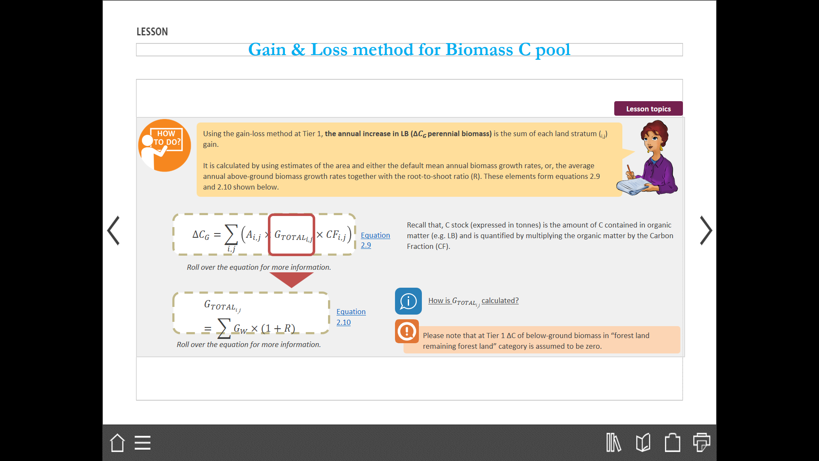
Gain & Loss method for Biomass C pool – Tier 1
Using the gain-loss method at Tier 1, the annual increase in Living Biomass (∆𝐶𝐺 perennial biomass) is the sum of each land stratum (i,j) gain.
The annual increase in Living Biomass is calculated by using estimates of the area and either the default mean annual biomass growth rates, or, the average annual above-ground biomass growth rates together with the root-to-shoot ratio (R). These elements form equations 2.9 and 2.10 (2006GL) shown below.
Notes:
Equation 2.9
$∆CG=$ annual increase in C stocks due to biomass growth stratified by ecological zone (i) and climatic zone (j), tonnes C yr⁻¹
$A_{i,j}$: Area of land, ha
$G_{TOTAL}$: average annual above-ground biomass growth (B_{W}) for a specific woody vegetation type, w, corrected for above and below-ground biomass through the root-to-shoot ratio R (tonnes d.m. ha⁻¹yr⁻¹)
${CF}_{i,j}$: carbon stock content of biomass (tonnes C (tonnes d.m.)⁻¹)
Equation 2.10
$G_{TOTAL}$: average annual above-ground biomass growth (B_{W}) for a specific woody vegetation type, w, corrected for above and below ground biomass through the root-to-shoot ratio R (tonnes d.m. ha⁻¹yr⁻¹)
$G_{W}$: average annual above-ground biomass growth for a specific woody vegetation type
R = ratio of below-ground biomass to above-ground biomass, tonne d.m. below-ground biomass (tonne d.m. above-ground biomass)⁻¹

Slide 112
Average annual increment in biomass (G_{TOTAL}): Tier 2 & 3
G_{TOTAL} = Σ{I_{V} • BCEF_{I} • (1+ R)}
I_{V} = average net annual increment for specific vegetation type, m³ ha⁻¹ yr⁻¹
BCEF_{I} = biomass conversion and expansion factor for conversion of net annual increment in volume
(including bark) to above-ground biomass growth for specific vegetation type, tonnes above-ground
biomass growth (m³ net annual increment)⁻¹
(Equation 2.10, page 2.15, Vol 4, 2006 GL).
Notes:
In tier 2 or 3 the net annual increment (Iv ) can be used with either basic wood density (D) and biomass expansion factor (BEFi ) or directly with biomass conversion and expansion factor (BCEFi) for conversion of annual net increment to above ground biomass increment for each vegetation type. ( Equation 2.10- page, 2.15, Vol 4, Part1, 2006GL).
Biomass expansion factor (BEFi ) expand the merchantable volume to total above ground biomass volume to account for non-merchantable components of increment. (BCEFi) is dimensionless, since they convert between units of weight.
Forest inventories and operational records usually document growing stock, net annual increment or wood removals in m³ of merchantable volume. This excludes non-merchantable volume above ground biomass components such as tree tops, braches, twigs, foliage, stumps and BG biomass components.
Assessment of biomass and carbon stocks and changes in contrast , focus on total biomass growth and biomass removals (harvest) including non-merchantable components expressed in tons of dry weight. Several methods may be used to derive forest biomass and its changes. ABGB and changes can be derived in two ways:
(i) Directly by measuring sample tree attributes in the field, such as diameters and heights and applying species specific allometric equations or biomass tables based on these equations once or periodically
(ii) Indirectly by transforming available volume data from forest inventories e.g., merchantable volume of growing stock, net annual increment or wood removals ( Somogyi et.al, 2006)
Approach 2 may achieve the transformation by applying biomass regression functions, which usually express biomass of species or species groups (t/ha) or its rate of change, directly as a function of growing stock density (m3/ha), and age, eco-regions or other variables
Commonly a single, discrete transformation factors is applied to merchantable volume to derive above-ground biomass and its changes:
(i) Biomass Expansion Factors (BEF) expand the dry weight³ of the merchantable volume of growing stock, net annual increment, or wood removals, to account for non-merchantable components of the tree, stand, and forest. Before applying such BEFs, merchantable volume (m³) must be converted to dry-weight (tonne) by multiplying with a conversion factor known as basic wood density (D) in (t/m³). BEFs are dimensionless since they convert between units of weight. This method gives best results, when the BEFs have actually been determined based on dry weights, and when locally applicable basic wood densities are well known.
(ii) Biomass Conversion and Expansion Factors (BCEF) combine conversion and expansion. They have the dimension (t/m³) and transform in one single multiplication growing stock, net annual increment, or wood removals (m³) directly into above-ground biomass, above-ground biomass growth, or biomass removals (t). BCEF are more convenient because they can be applied directly to VOL based forest inventory data and operational records without need of having to resort to basic wood densities. Mathematically BCEF and BEF are related by BCEF = BEF1 multiply by D (2006 GL, box 4.2, page 4.13)
If BCEF_{I} values are not available and if the biomass expansion factor (BEF) and basic wood density (D) values are separately estimated , then the following conversion can be used ;
BCEF = BEF₁.D
Estimates for BCEFI for woody (perennial) biomass on non-forest lands such as Grassland (savanna), Cropland (agro-forestry), orchards, coffee, tea, and rubber may not be readily available. In this case, default values of BCEFI from one of the forest types closest to the non-forest vegetation can be used to convert merchantable biomass to total biomass. BCEFI is relevant only to perennial woody tree biomass for which merchantable biomass data are available.
For perennial shrubs, grasses and crops, biomass increment data in terms of tonnes of dry matter per hectare may be directly available and in this case use of Equation 2.10 will not be required

Slide 113
Biomass carbon stocks losses (Gain-Loss Method), ΔC_{L}
ΔC_{L} = L_{wood−removals} + L_{fuelwood} + L_{disturbance}
The annual decrease in C stocks due to biomass losses (∆𝑪𝑳) in a land remaining in the same land-use category are estimated applying equation 2.11. The losses in biomass are due to, harvesting of wood (roundwood removals), fuelwood and disturbances,
Where:
ΔC_{L} = annual decrease in carbon stocks due to biomass loss in land remaining in the same land-use category, tonnes C yr⁻¹
L_{wood-removals} = annual carbon loss due to wood removals, tonnes C yr⁻¹
L_{fuelwood} = annual biomass carbon loss due to fuelwood removals, tonnes C yr⁻¹
L_{disturbance} = annual biomass carbon losses due to disturbances, tonnes C yr⁻¹
(Equation 2.11, Vol 4, Page 2.16 , 2006 GL)
Notes:
Loss estimates are also needed for calculating biomass carbon stock change using the Gain-Loss method , Note that the loss estimate is also needed when using the stock –difference method to estimate the transfers of biomass to DOM when higher tier estimation methods are used.
Annual biomass is the sum of losses form wood removal ( harvest) , fuel wood removal ( not counting fuelwood gathered from woody debris) and losses resulting from disturbances, such as fire, storm and insect and diseases, this relationship is shown in (Equation 2.11, Vol 4, Part 1 , Page 2.16 , 2006 GL)
Equations 2.11 and the following equations 2.12 to 2,14 are directly applicable to FL
The Equations 2.11 and the equations 2.12 to 2,14 can also be used for estimating losses from CL and GL if quantities of wood removal (harvesting) , fuelwood removal and loss due to disturbance are available for perennial wood biomass.
Default biomass carbon loss for values for woody crop species are provided for the tier 1 cropland methodology
The three items on the right hand of the equation 2.11 are obtained as given in equations 2.12-2.14

Slide 114
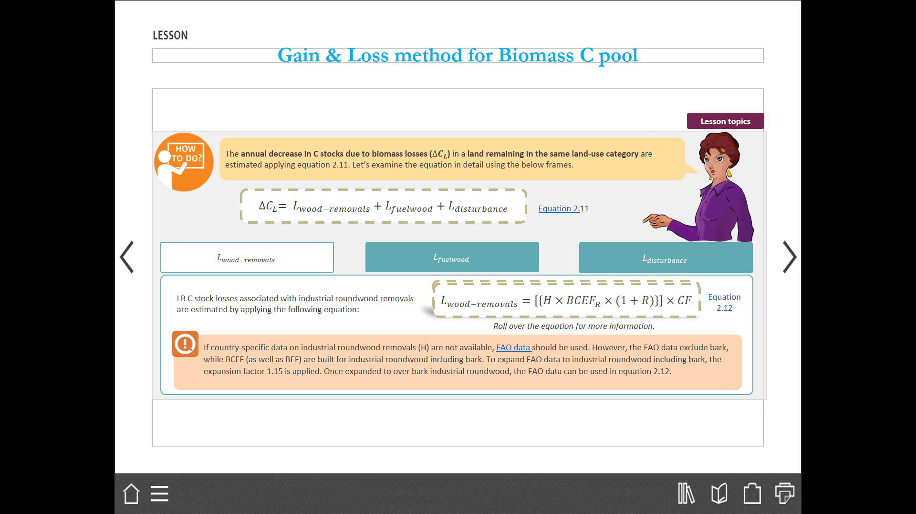
Gain & Loss method for Biomass C pool – Wood Removals
Biomass C stock losses associated with industrial roundwood removals are estimated by applying the following equation (2.12 , 2006GL):
If country-specific data on industrial roundwood removals (H) are not available, FAO data should be used. However, the FAO data exclude bark, while BCEF (as well as BEF) are built for industrial roundwood including bark. To expand FAO data to industrial roundwood including bark, the expansion factor 1.15 is applied. Once expanded to over bark industrial roundwood, the FAO data can be used in equation 2.12
Notes:
Equation 2.12
$L_{wood−removals}$: carbon loss due to wood removal, tonnes C yr⁻¹
H: estimate of annual roundwood removals, m³ yr⁻¹
R: Ratio of below to above-ground biomass, tonne d.m. below-ground biomass (tonne d.m. above-ground biomass)⁻¹
${BCEF}_{R}$: Biomass conversion and expansion factor for roundwood that is removed from the forest, tonnes biomass removal (m³ of removals)⁻¹
CF: carbon fraction in biomass, tonne C (tonne d.m.)⁻¹
Source: Source: 2006 IPCC Guidelines Chapter 2 page 2.17

Slide 115
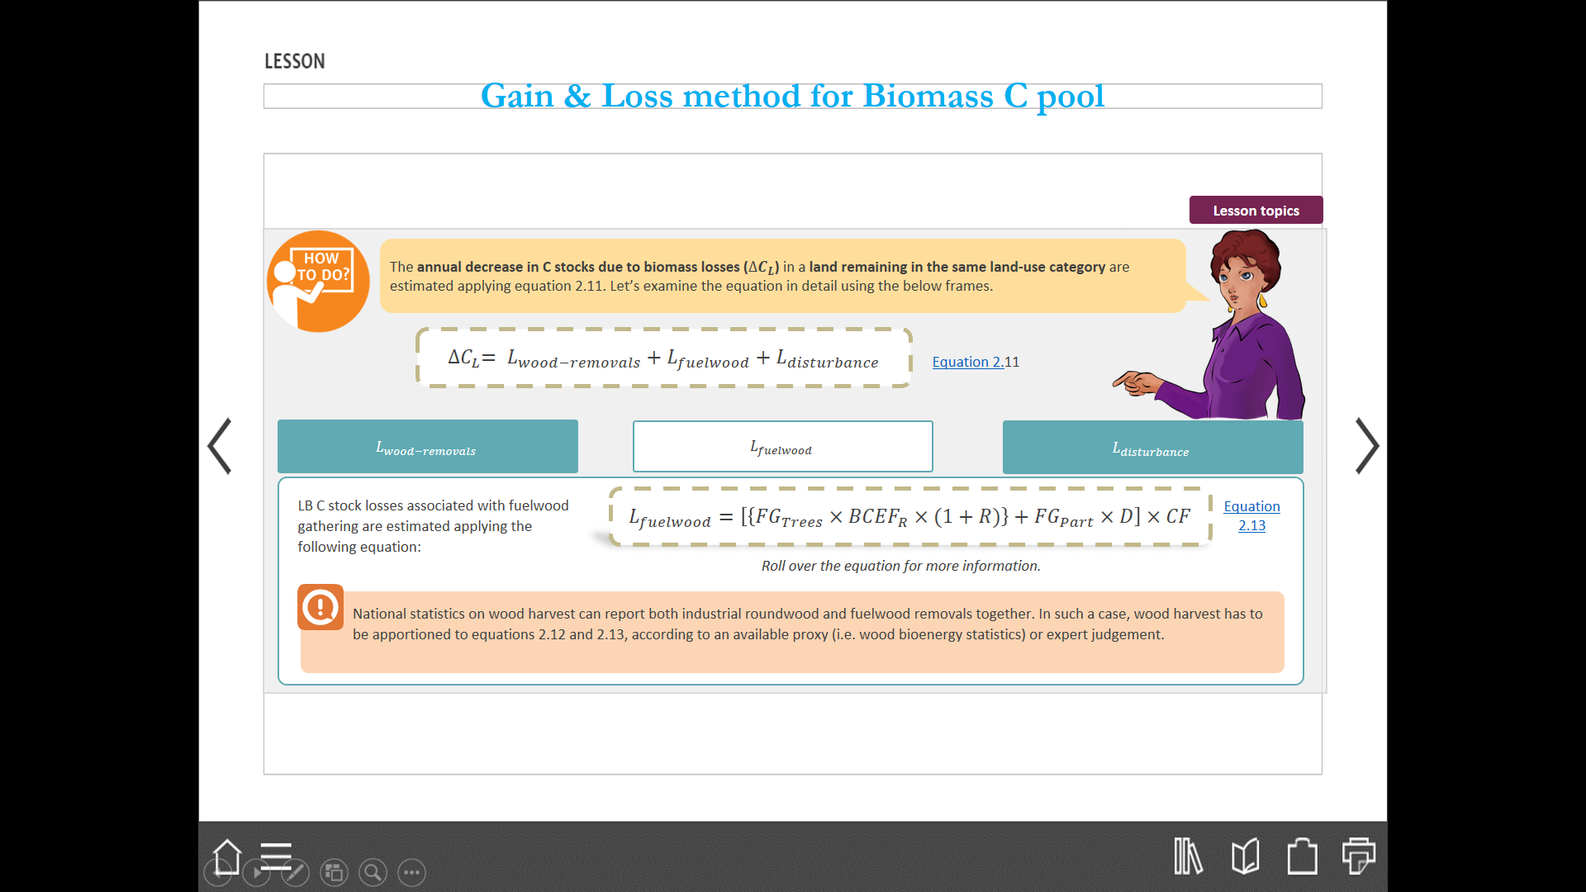
Gain & Loss method for Biomass C pool – Fuel wood
Biomass C stock losses associated with fuelwood gathering are estimated applying the following equation 2.13 (2006 GL):
National statistics on wood harvest can report both industrial roundwood and fuelwood removals together. In such a case, wood harvest has to be apportioned to equations 2.12 and 2.13, according to an available proxy (i.e. wood bioenergy statistics) or expert judgement.
Notes:
Equation 2.13
$L_{fuelwood}$: carbon loss due to fuelwood removals, tonnes C yr⁻¹
${FG}_{Trees}$: Annual volume of fuelwood of whole trees, m³ yr⁻¹ (refers to the volume of fuelwood produced by harvesting the entire tree)
${\text{BCEF}}_{\text{R}}\text{:} \text{Biomass} \text{conversion} \text{and} \text{expansion} \text{factor} \text{for} \text{fuelwood}\text{, }\text{tonnes} \text{biomass} \text{removal}\text{ (}\text{m}\text{3} \text{of} \text{removals}\text{)−1}$
R: Ratio of below-ground and above ground biomass, tonne d.m. below-ground biomass (tonne d.m above-ground biomass)⁻¹
${FG}_{Part}$: Annual volume of fuelwood of tree parts, m³ yr⁻¹ (refers to the volume of fuelwood produced by collecting a portion of trees (branches, the top portion of the stem) resulting from the harvesting of roundwood that are not included in the roundwood data)
D: the basic wood density, tonnes d.m. m⁻³
CF: carbon fraction in biomass, tonne C (tonne d.m.)⁻¹
Source: 2006 IPCC Guidelines Chapter 2 page 2.17

Slide 116
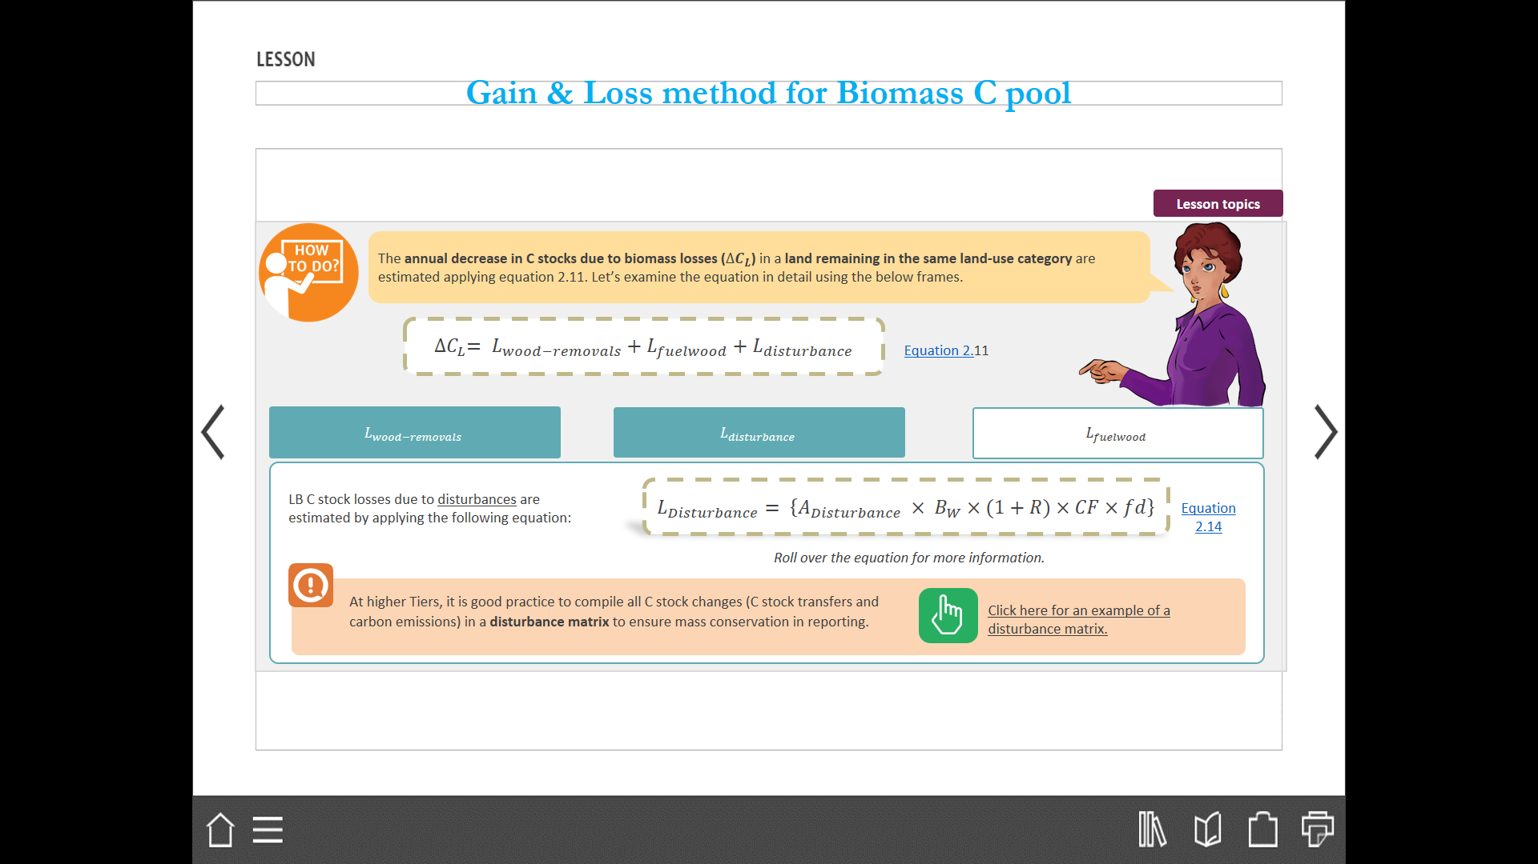
Gain & Loss method for Biomass C pool – Disturbances
Biomass C stock losses due to disturbances are estimated by applying the following equation 2.14 (2006GL):
At higher Tiers, it is good practice to compile all C stock changes (C stock transfers and carbon emissions) in a disturbance matrix to ensure mass conservativeness in reporting (see page 2.19 Table 2,1 (2006 GL) for an example of a disturbance matrix)
Notes:
Definitions:
Disturbances: In the specific case of losses from fire on managed land, including wildfires and controlled fires, this equation is used to provide input to the equation to estimate CO₂ and non-CO₂ emissions from fires (equation 2.27).
Equation 2.14
$L_{Disturbance}$: C stock loss associated with disturbances, tonnes C yr⁻¹
$A_{Disturbance}$: Area affected by disturbance, ha yr⁻¹
$B_{W}$: Average above ground biomass in the area affected by the disturbance, tonnes d.m. ha⁻¹
R: root-shoot ratio and CF, carbon fraction in biomass
CF: carbon fraction in biomass, tonne C (tonne d.m.)⁻¹
$fd$: Fraction of biomass lost in disturbance, it defines the proportion of biomass that is removed from the biomass pool. Lost biomass may subsequently be reported as instantaneously emitted to the atmosphere (e.g. fires) or as a C gain in (C transfer to) another pool (e.g. dead wood).
Source: 2006 IPCC Guidelines Chapter 2 page 2.18

Slide 117

Ex. # 2: Can you find the biomass C pool loss/gain?
Loss due to Harvest = 500 tonnes C yr-1
Growth = 200,000 tonnes C yr-1
Fuelwood removals = 300 tonnes C yr-1
Natural disturbance losses= 2000 tonnes C yr-1

Slide 118
And the answer is…
ΔC_{G} = 200,000 tonnes C yr⁻¹
ΔC_{L} = L_{wood −removals} + L_{fuelwood} + L_{disturbance}
= 500 + 300 + 2000
= 2800 tonnes C yr⁻¹
ΔC_{biomass} = ΔC_{G} – ΔC_{L}
= 200,000 – 2800 = 197200 tonnes C yr⁻¹
Notes:
The Answer is equation 2.11
ΔC_{L} = L_{wood −removals} + L_{fuelwood} + L_{disturbance}
The three items on the right hand of the equation 2.11 are obtained as given in equations 2.12-2.14
Note that we are using the Gain-loss method we need both growth ( gain ) and loss data
We are Given Growth as 242,000 tonnes C yr-1
Using equation ΔC_{L} = L_{wood −removals} + L_{fuelwood} + L_{disturbance ,} we can calculate loss
Such that ΔC_{biomass} = ΔC_{G} – ΔC_{L} using the gain -loss method

Slide 119
Stock Change Method
∆C = (C₂ – C₁)/(t₂ – t₁)
C = Σ_{i,j}(A_{i,j}●V_{i,j}●BCEF_{Si,j}●(1+R_{i,j})●CF_{i,j})
C = total carbon in biomass for time t₁ to t₂ [i = ecological zone i (i = 1 to n)
j = climate domain j (j = 1 to m)]
A = area of land remaining in the same land-use category, ha (see note below)
V = merchantable growing stock volume, m³ ha⁻¹
R = ratio of below-ground biomass to above-ground biomass, tonne d.m. below-ground biomass (tonne d.m. above-ground biomass)⁻¹
CF = carbon fraction of dry matter, tonne C (tonne d.m.)⁻¹
BCEF_{S} = biomass conversion and expansion factor
Equation 2.8 a and b, page 2.12, Vol 4, 2006 GL - ( land remaining in same land use category)
Notes:
An alternative approach, the stock based approach “Stock Difference method” which can be used where carbon stocks in relevant pools are measured at two point sin time to assess carbon stock changes
Essentially, the stock difference method estimates E/R of CO2 as the difference in carbon stocks estimates made at two points in time, divided by the number of intervening years.
The Stock difference method is applicable to countries with a NFI for forests and other land use categories, where the stocks of different biomass pools are measured at periodic intervals.
In some cases , primary data on biomass may be in the form of wood volume data, e.g., from forest surveys in which case factors are provided to convert wood volume to carbon mass units, as shown in equation 2.8 (b).
BCEF transform merchantable volume of growing stock directly into its above ground biomass.
However, if BCEFs are not available and if the biomass expansion factors (BEFs) and D values care separately estimated, the following conversion can be used: BCEFs = BEFs multiply by D. (BCEFs = BEFs .D)

Slide 120
Biomass: Land Converted to Other Land-Use Category – ( Tier 2 and 3)
ΔC_{B} = ΔC_{G} + ΔC_{CONVERSION} − ΔC_{L}
Where:
ΔC_{B} = annual change in carbon stocks in biomass on land converted to other land-use category, in tonnes C yr⁻¹
ΔC_{G} = annual increase in carbon stocks in biomass due to growth on land converted to another land-use
category, in tonnes C yr⁻¹
ΔC_{CONVERSION} = initial change in carbon stocks in biomass on land converted to other land-use category, in tonnes C yr⁻¹
ΔC_{L} = annual decrease in biomass carbon stocks due to losses from harvesting, fuel wood gathering and disturbances on land converted to other land-use category, in tonnes C yr⁻¹
^{(Equation} 2.15, page 2.20, Vol 4, 2006 GL)
Notes:
Methods for estimation of E/R of carbon resulting from land use conversion from one land use category to another , conversions can include from non-forest land to forest land, CL and FL to GL and GL to FL and CL
The CO2 E/R on land converted to a new land –use category include annual changes in carbon stocks in above ground and below ground biomass.
Annual carbon stock changes for each of these pools can be estimated by using Equation 2.4 (ΔCB = ΔCG - ΔCL), where ΔCG is the annual gain in carbon, and ΔCL is the annual loss of carbon. ΔCB can be estimated separately for each land use (e.g., Forest Land, Cropland, Grassland) and management category (e.g., natural forest, plantation), by specific strata (e.g., climate or forest type). ( see page 2.9 for equation 2.4)
Methods for estimating change in carbon stocks in biomass (ΔC_{B}) are:
i) Annual increase in carbon stocks in biomass, ΔCG
Tier 1: Annual increase in carbon stocks in biomass due to land converted to another land-use category can be estimated using Equation 2.9 described above for lands remaining in a category. Tier 1 employs a default assumption that there is no change in initial biomass carbon stocks due to conversion. This assumption can be applied if the data on previous land uses are not available, which may be the case when land area totals are estimated using Approach 1 or 2 described in Chapter 3 (non-spatially explicit land area data). This approach implies the use of default parameters in Section 4.5 (Chapter 4). The area of land converted can be categorized based on management practices e.g., intensively managed plantations and grasslands or extensively managed (low input) plantations, grasslands or abandoned croplands that revert back to forest and should be kept in conversion category for 20 years or another time interval. If the previous land use on a converted area is known, then the Tier 2 method described below can be used.
ii) Annual decrease in carbon stocks in biomass due to losses, ΔCL
Tier 1: The annual decrease in C stocks in biomass due to losses on converted land (wood removals or fellings, fuelwood collection, and disturbances) can be estimated using Equations 2.11 to 2.14. As with increases in carbon stocks, Tier 1 follows the default assumption that there is no change in initial carbon stocks in biomass, and it can be applied for the areas that are estimated with the use of Approach 1 or 2 in Chapter 3, and default parameters in Section 4.5.
iii) Higher tiers for estimating change in carbon stocks in biomass, (ΔCB)
Tiers 2 and 3: Tier 2 (and 3) methods use nationally-derived data and more disaggregated approaches and (or) process models, which allow for more precise estimates of changes in carbon stocks in biomass. In Tier 2, Equation 2.4 is replaced by Equation 2.15, where the changes in carbon stock are calculated as a sum of increase in carbon stock due to biomass growth, changes due to actual conversion (difference between biomass stocks before and after conversion), and decrease in carbon stocks due to losses. (Equation.2.15 , page 2.20, Vol 4 Part1, 2006GL)

Slide 121
Gain & Loss method for Biomass C pool in land under conversion
Biomass carbon stock changes in a land converted to a new land-use category, the IPCC default methodology uses a similar equation (Land remaining in same category) except with the addition of a third factor to calculate the abrupt C stock change associated with conversion (ΔC_{CONVERSION} ).
Please note that at Tier 1, in case of perennial vegetation the C stock of biomass (CB) in a land converted to a new land-use category is equal to the sum of annual ∆𝐶 calculated with equation 2.15.
Net C stock change associated with conversion is estimated in the year of conversion only, by using equation 2.16 (2006 GL) ( see next slide)
Notes:
Equation 2.16
${B_{After}}_{i}=$LB in land stratum (i) just after conversion (d.m.)
${B_{Before}}_{i}=$LB in land stratum (i) just before conversion (d.m.)
$∆{A_{T{O_}_{OTHERS}}}_{i}=$Area of land stratum (i) converted in the year
CF = Carbon fraction in biomass, tonne C (tonne d.m.)⁻¹

Slide 122
Initial change in biomass carbon stocks in Land Converted to Other Land-Use Category *
ΔC_{CONVERSION} = Σ_{i}(B_{AFTER} – B_{BEFORE}) ● ΔA_{TO OTHERS i} ● CF
Where:
ΔC_{CONVERSION} = initial change in biomass carbon stocks on land converted to another land category, tonnes C yr⁻¹
B_{AFTERi} = biomass stocks on land type i immediately after conversion, t d.m.ha⁻¹
B_{BEFOREi} = biomass stocks on land type i before conversion, t d.m. ha⁻¹
ΔA_{TO_OTHERSi} = area of land use i converted to another land-use category in a certain year, ha yr⁻¹
CF = carbon fraction of dry matter, tonne C (t d.m.)⁻¹
i = type of land use converted to another land-use category
(Equation 2.16, Page 2.20, Vol 4, 2006 GL)
Notes:
*Conversion to another land category may be associated with a change in biomass stocks, e.g., part of the biomass may be withdrawn through land clearing, restocking or other human-induced activities. These initial changes in carbon stocks in biomass (ΔCCONVERSION) are calculated with the use of Equation 2.16
The calculation of ΔCCONVERSION may be applied separately to estimate carbon stocks occurring on specific types of land (ecosystems, site types, etc.) before the conversion. The ΔA_{TO_OTHERSi} refers to a particular inventory year for which the calculations are made, but the land affected by conversion should remain in the conversion category for 20 years or other period used in the inventory. Inventories using higher Tier methods can define a disturbance matrix (Table 2.1) for land-use conversion to quantify the proportion of each carbon pool before conversion that is transferred to other pools, emitted to the atmosphere (e.g., slash burning), or otherwise removed during harvest or land clearing.
Owing to the use of country specific data and more disaggregated approaches, the Equations 2.15 and 2.16 provide for more accurate estimates than Tier 1 methods, where default data are used. Additional improvement or accuracy would be achieved by using national data on areas of land-use transitions and country-specific carbon stock values. Therefore, Tier 2 and 3 approaches should be inclusive of estimates that use detailed area data and country specific carbon stock values.

Slide 123
Change in C stocks in DOM: Land Remaining in the same land use category
The Tier 1 assumption for both dead wood and litter pools for all land-use categories is that their stocks are not changing over time if the land remains within the same land-use category.
Tier 2 methods for estimation of carbon stock changes in DOM pools calculate the changes in dead wood and litter carbon pools by either Gain-Loss Method or Stock-Difference Method (GPG LULUCF provides guidance on DOM only for FL)
These estimates require either detailed inventories that include repeated measurements of dead wood and litter pools, or models that simulate dead wood and litter dynamics.
Notes:
Tier 1 for land remaining in the same land use category - This is equivalent to the assumption that the carbon in non-merchantable and non-commercial components that are transferred to dead organic matter is equal to the amount of carbon released from dead organic matter to the atmosphere through decomposition and oxidation.
Countries that use Tier 1 methods to estimate DOM pools in land remaining in the same land-use category, report zero changes in carbon stocks or carbon emissions from those pools. Following this rule, CO2 emissions resulting from the combustion of dead organic matter during fire are not reported, nor are the increases in dead organic matter carbon stocks in the years following fire. However, emissions of non-CO2 gases from burning of DOM pools are reported.
For DOM tier 2 and 3 approaches require estimates of the transfer and decay rates as well as activity data on harvesting and disturbances and their impacts on the DOM pol dynamics.
Tier 2 methods for estimation of carbon stock changes in DOM pools calculate the changes in dead wood and litter carbon pools (Equation 2.17). Two methods can be used: either track inputs and outputs (the Gain-Loss Method, Equation 2.18) or estimate the difference in DOM pools at two points in time (Stock-Difference Method, Equation 2.19). These estimates require either detailed inventories that include repeated measurements of dead wood and litter pools, or models that simulate dead wood and litter dynamics.
It is good practice to ensure that such models are tested against field measurements and are documented. Figure 2.3 provides the decision tree for identification of the appropriate tier to estimate changes in carbon stocks in dead organic matter.

Slide 124
Gain-Loss Method
A = area of managed land,ha
DOM_{in} = average annual transfer into DW/litter pool (due to
mortality, slash due to harvest and natural disturbance),t d.m./ha/yr
DOM_{out} = average annual transfer out of DW/litter pool, t d.m./ha/yr
CF = carbon fraction of dry matter, tC/(t d.m.)
(Equation 2.18, page 2.23, Vol 4, 2006 GL)
∆C_{DOM} = [A ●(DOM_{in} – DOM_{out})] ● CF
Notes:
The net balance of DOM pools specified in Equation 2.18, requires the estimation of both the inputs and outputs from annual processes (litter fall and decomposition) and the inputs and losses associated with disturbances.
In practice, therefore, Tier 2 and Tier 3 approaches require estimates of the transfer and decay rates as well as activity data on harvesting and disturbances and their impacts on DOM pool dynamics.
Note that the biomass inputs into DOM pools used in Equation 2.18 are a subset of the biomass losses estimated in Equation 2.7. The biomass losses in Equation 2.7 contain additional biomass that is removed from the site through harvest or lost to the atmosphere, in the case of fire.

Slide 125
Stock-Difference Method
A = area of managed land, ha
DOM_{t1} = DW/litter stocks at time t₁ for managed land, t d.m/ha
DOM_{t2} = DW/litter stocks at time t₂ for managed land, t d.m/ha
T = (t₂-t₁) = time period between the two estimates of DOM, yrs.
CF = carbon fraction of dry matter, t C/(t d.m.)
(Equation 2.19, Page 2.23, Vol 4, 2006 GL)
∆C_{DOM} = [A ●(DOM_{t2} – DOM_{t1} )/T] ● CF
Notes:
The method chosen depends on available data and will likely be coordinated with the method chosen for biomass carbon stocks. Transfers into and out of a dead wood or litter pool for Equation 2.18 may be difficult to estimate.
The stock difference method described in Equation 2.19 can be used by countries with forest inventory data that include DOM pool information, other survey data sampled according to the principles set out in Annex 3A.3 (Sampling) in Chapter 3, and/or models that simulate dead wood and litter dynamics.
Note that whenever the stock change method is used (e.g., in Equation 2.19), the area used in the carbon stock calculations at times t1 and t2 must be identical. If the area is not identical then changes in area will confound the estimates of carbon stocks and stock changes. It is good practice to use the area at the end of the inventory period (t2) to define the area of land remaining in the land-use category.
The stock changes on all areas that change land-use category between t1 and t2 are estimated in the new land-use category, as described in the sections on land converted to a new land category.
See page 2.23 for Input of biomass to DOM- Equation 2.20 gives annual carbon in biomass transferred to DOM – pa 2.24, Vol 4, part 1, 2006GL.
EQUATION 2.20
ANNUAL CARBON IN BIOMASS TRANSFERRED TO DEAD ORGANIC MATTER
DOMin = {Lmortality + Lslash + (Ldisturbance • fBLol )}
Where:
DOMin = total carbon in biomass transferred to dead organic matter, tonnes C yr-1
Lmortality = annual biomass carbon transfer to DOM due to mortality, tonnes C yr-1 (See Equation 2.21)
Lslash = annual biomass carbon transfer to DOM as slash, tonnes C yr-1 (See Equations 2.22)
Ldisturbances = annual biomass carbon loss resulting from disturbances, tonnes C yr-1 (See Equation 2.14)
fBLol = fraction of biomass left to decay on the ground (transferred to dead organic matter) from loss
due to disturbance. As shown in Table 2.1, the disturbance losses from the biomass pool are
partitioned into the fractions that are added to dead wood (cell B in Table 2.1) and to litter (cell C),
are released to the atmosphere in the case of fire (cell F) and, if salvage follows the disturbance,
transferred to HWP (cell E).
Examples of the terms on the right hand side of Equation 2.20 are obtained in Equations 2.21 on annual biomass due to mortality and Equation 2.22 on annual carbon transfer to slash. ( page 2.24-2.25)

Slide 126
Change in C stocks in DOM: Land Converted to Other Land-use
The Tier 1 assumption is that DOM pools in non-forest land categories after the conversion are zero, i.e., they contain no carbon.
The Tier 1 assumption for land converted from forest to another land-use category is that all DOM carbon losses occur in the year of land-use conversion.
For land converted to Forest Land litter and dead wood carbon pools starting from zero carbon in those pools. DOM carbon gains on land converted to forest occur linearly, starting from zero, over a transition period (default assumption is 20 years)
Notes:
DOM for land conversion to a new land-use category
The reporting convention is that all carbon stock changes and non-CO2 greenhouse gas emissions associated with a land-use change be reported in the new land-use category. For example, in the case of conversion of Forest Land to Cropland, both the carbon stock changes associated with the clearing of the forest as well as any subsequent carbon stock changes that result from the conversion are reported under the Cropland category.
The Tier 1 assumption is that DOM pools in non-forest land categories after the conversion are zero, i.e., they contain no carbon. The Tier 1 assumption for land converted from forest to another land-use category is that all DOM carbon losses occur in the year of land-use conversion. Conversely, conversion to Forest Land results in buildup of litter and dead wood carbon pools starting from zero carbon in those pools. DOM carbon gains on land converted to forest occur linearly, starting from zero, over a transition period (default assumption is 20 years). This default period may be appropriate for litter carbon stocks, but in temperate and boreal regions it is probably too short for dead wood carbon stocks.
The estimation of carbon stock changes during transition periods following land-use conversion requires that annual cohorts of the area subject to land-use change be tracked for the duration of the transition period. For example, DOM stocks are assumed to increase for 20 years after conversion to Forest Land. After 20 years, the area converted enters the category Forest Land Remaining Forest Land, and no further DOM changes are assumed, if a Tier 1 approach is applied. Under Tier 2 and 3, the period of conversion can be varied depending on vegetation and other factors that determine the time required for litter and dead wood pools to reach steady state.

Slide 127
Biomass and DOM C stock changes
In summary, at Tier 1, Biomass C stock changes must be estimated for:
Forest land remaining forest land
Cropland remaining Cropland, limited to perennial crops
Each land use conversion from and to Forest land, Cropland, Grassland
In any other land use and land-use conversion Biomass C stocks are assumed to be not significant
In summary, at Tier 1, DOM C stock changes must be estimated for:
Each land use conversion from and to Forest land
In Forest land remaining Forest land DOM C stocks are assumed to be at long term equilibrium.
In any other land use and land-use conversion DOM C stocks are assumed to be not significant

Slide 128
Biomass and DOM C stock changes
Land remaining Land categories:
Tier 2 method:
  No C pool is assumed constant (except for OL)
  Country-specific parameters with more disaggregated AD
  Stock-Difference method
Land converted categories:
Tier 2 method:
  No C pools is assumed constant.
  C stocks before and following conversion can be non-zero.
  Country-specific parameters and more disaggregated AD.
Tier 3 method: nationally specific complex methods involving modelling and/or measurements

Slide 129
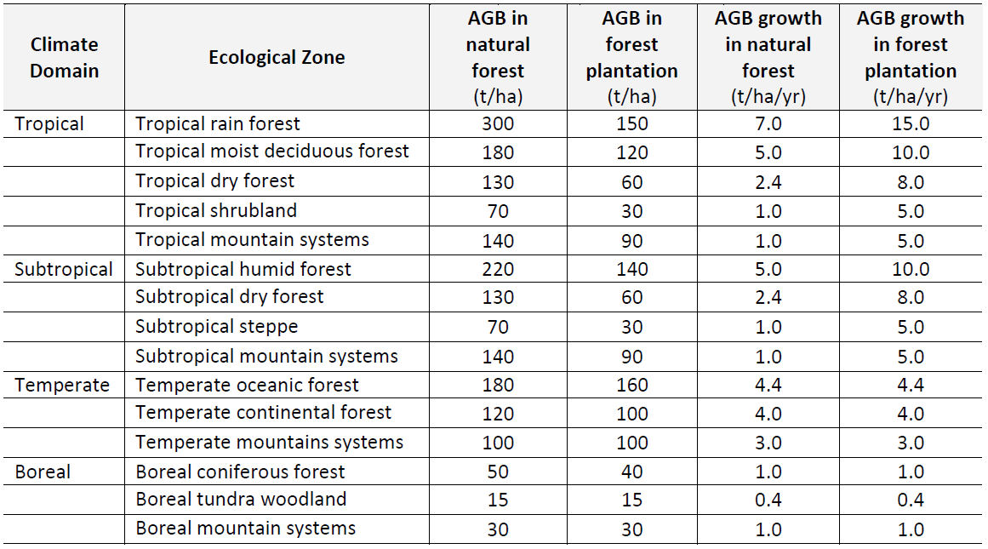
Examples of IPCC biomass default values
Estimates of carbon emissions and removals involve the multiplication of activity data and emission factors:
The amount of area undergoing a specific transition- this is called the Activity Data
The change in carbon pools association with that transition- this is called the Emissions Factor
The default carbon fraction = 0.47
Source: IPCC (2006) – Examples of default values for AGB and ABG increment taken from Tables 4.7, 4.8, 4.9, and 4.10
Notes:
Key Message: Here is an example of Tier one data from the IPCC- in this case estimated AboveGround Biomass for various broad forest classes. Emissions factors from deforestation would be calculated based on above ground biomass and an estimate of carbon density of 47%
Above ground biomass mass increment (growth) for the various forest classes could be used to estimate the impact of afforestation on national emissions.

Slide 130
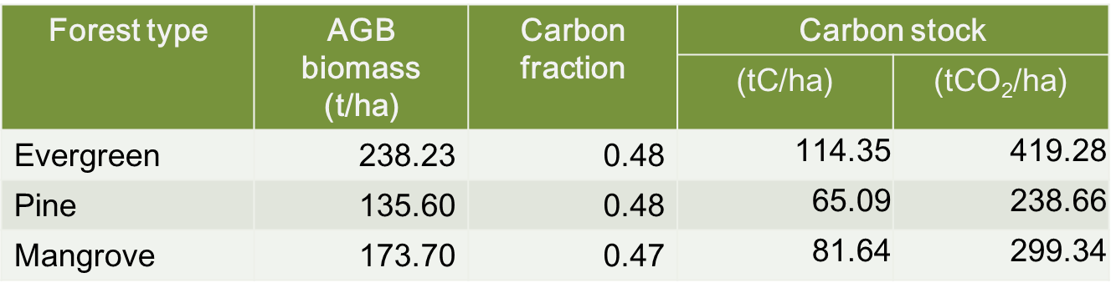
IPCC Tier 2 Biomass Values of Country XX
Note: To convert Biomass to carbon stock (tC/ha), multiply for example for Evergreen Forest type ABG: 238.23 by 0.48 (CF) = 114.35 tC/ha and then convert tonnes of carbon per ha to CO₂ emissions; multiply 114.35 by 44/12 = 419.28 tCO₂/ha
( IPCC default carbon fraction is 0.47, this can be variable as you can see in above example country specific values are 0.47-0.48)
Notes:
Key Message: Here is an example of Tier 2 data from Country XX- here the data are specific to national forest definitions and conditions.
Notes: The Tier 1 values for Tropical rain, moist and dry forest ranged from 130 to 300 t AGB Biomass per hectare where here we have 7 forest types with values that range from 34.9 to 238.2 t AGB Biomass. You can see how moving from one tier to the next will affect carbon accounting. Key to note here: we compared biomass but the true issue is carbon. The IPCC default is trees are 47% carbon ( carbon fraction of 0.47) and as you can see here that is also variable and measurements in Thailand vary from 0.47 to 0.51
Note to convert Biomass to carbon stock ( tC/ha) you multiply for example 238.23 by 0.48 (CF) = 114.35 tC/ha and to then convert tonnes of carbon per ha to co2 emissions you 114.35 by 44/12 = 419.28 tCo2/ha

Slide 131
Soil Organic Matter - SOM
Soil Organic Carbon (SOC) accumulates in the soil mainly from decomposition processes of plant tissues whose organic matter (dead wood and litter) decays as consequence of natural mortality and disturbances as well as human activities (e.g. harvesting).
SOC is mixed with the soil mineral fraction. Soil organic matter in soils is in a state of dynamic balance between inputs (litterfall and its decay/incorporation into the soil) and outputs (organic matter decay through respiration) of organic C.
The IPCC distinguishes two types of soils according to its SOC content these are, Organic and Mineral soils. Soil Organic Carbon - indicates the C stock in the Soil Organic Matter C pool
SOM is made up by various layers (e.g. humus horizon), and for mineral soils IPCC method estimates SOC changes till a depth of 30cm. There is no established standard depth for organic soils, given its high variability.
Notes:
POPUP
Soil Organic Carbon: indicates the C stock in the Soil Organic Matter C pool
mages:
Leaf Mold: https://www.flickr.com/photos/olivierh/5197208711/
Dead Wood: https://www.flickr.com/photos/91631986@N00/110603454/

Slide 132
Changes in soil C stocks
∆C_{soils} = ΔC_{Mineral} − L_{Organic} + ΔC_{Inorganic}
ΔCSoils = ΔCMineral − LOrganic + ΔCInorganic
Where:
ΔC_{Soils} = annual change in carbon stocks in soils, t C yr⁻¹
ΔC_{Mineral} = annual change in organic carbon stocks in mineral soils, t C yr⁻¹
L_{Organic} = annual loss of carbon from drained organic soils, t C yr⁻¹
ΔC_{Inorganic} = annual change in inorganic carbon stocks from soils, t C yr⁻¹ (assumed to be 0 unless using a Tier 3 approach)
Equation 2.24, page 2.29, Vol 4, 2006 GL
Notes:
Soil C inventories include estimates of soil organic C stock changes for mineral soils and CO2 emissions from organic soils due to enhanced microbial decomposition caused by drainage and associated management activity.
In addition, inventories can address C stock changes for soil inorganic C pools (e.g., calcareous grasslands that become acidified over time) if sufficient information is available to use a Tier 3 approach. The equation for estimating the total change in soil C stocks is given in Equation 2.24, page 2.29, Vol 4, Part 1, 2006GL
For Tier 1 and 2 methods, soil organic C stocks for mineral soils are computed to a default depth of 30 cm. Greater depth can be selected and used at Tier 2 if data are available, but Tier 1 factors are based on 30 cm depth. Residue/litter C stocks are not included because they are addressed by estimating dead organic matter stocks. Stock changes in organic soils are based on emission factors that represent the annual loss of organic C throughout the profile due to drainage.
No Tier 1 or 2 methods are provided for estimating the change in soil inorganic C stocks due to limited scientific data for derivation of stock change factors; thus the net flux for inorganic C stocks is assumed to be zero. Tier 3 methods can be used to refined estimates of the C stock changes in mineral and organic soils and for soil inorganic C pools.
Change in carbon stocks in soils (Background)
Both organic and inorganic forms of C are found in soils, land use and management typically has a larger impact on organic C stocks. Consequently, the methods provided in these guidelines focus mostly on soil organic C.
Overall, the influence of land use and management on soil organic C is dramatically different in a mineral versus an organic soil type. Organic (e.g., peat and muck) soils have a minimum of 12 to 20 percent organic matter by mass (see Chapter 3 Annex 3A.5, for the specific criteria on organic soil classification), and develop under poorly drained conditions of wetlands (Brady and Weil, 1999).
All other soils are classified as mineral soil types, and typically have relatively low amounts of organic matter, occurring under moderate to well drained conditions, and predominate in most ecosystems except wetlands.
Mineral soils
Mineral soils are a carbon pool that is influenced by land-use and management activities. Land use can have a large effect on the size of this pool through activities such as conversion of native Grassland and Forest Land to Cropland, where 20-40% of the original soil C stocks can be lost
Soil organic C stocks can change with management or disturbance if the net balance between C inputs and C losses from soil is altered. Management activities influence organic C inputs through changes in plant production (such as fertilization or irrigation to enhance crop growth), direct additions of C in organic amendments, and the amount of carbon left after biomass removal activities, such as crop harvest, timber harvest, fire, or grazing.
Decomposition largely controls C outputs and can be influenced by changes in moisture and temperature regimes as well as the level of soil disturbance resulting from the management activity.
Land-use change and management activity can also influence soil organic C storage by changing erosion rates and subsequent loss of C from a site; some eroded C decomposes in transport and CO2 is returned to the atmosphere, while the remainder is deposited in another location.
The net effect of changing soil erosion through land management is highly uncertain, however, because an unknown portion of eroded C is stored in buried sediments of wetlands, lakes, river deltas and coastal zones
Organic soils
Inputs of organic matter can exceed decomposition losses under anaerobic conditions, which are common in undrained organic soils, and considerable amounts of organic matter can accumulate over time.
The carbon dynamics of these soils are closely linked to the hydrological conditions, including available moisture, depth of the water table, and reduction-oxidation conditions. Species composition and litter chemistry can also influence those dynamics.
Carbon stored in organic soils will readily decompose when conditions become aerobic following soil drainage.
Drainage is a practice used in agriculture and forestry to improve site conditions for plant growth. Loss rates vary by climate, with drainage under warmer conditions leading to faster decomposition rates. Losses of CO2 are also influenced by drainage depth; liming; the fertility and consistency of the organic substrate; and temperature. Greenhouse gas inventories capture this effect of management.
While drainage of organic soils typically releases CO2 to the atmosphere, there can also be a decrease in emissions of CH4 that occur in un-drained organic soils. However, CH4 emissions from un-drained organic soils are not addressed in the inventory guidelines with the exception of a few cases in which the wetlands are managed.
Similarly, national inventories typically do not estimate the accumulation of C in the soil pool resulting from the accumulation of plant detritus in un-drained organic soils. Overall, the rates of C gain are relatively slow in wetland environments with organic soils, and any attempt to estimate C gains, even those created through wetland restoration, would also need to address the increase in CH4 emissions.

Slide 133
SOC changes (mineral soils) (1)
SOM in mineral soils includes SOC to a specified depth of 30 cm (or an alternative deeper depth as chosen by the country) and applied consistently through the NGHGI time series. The six types of mineral soils are listed below:
Sandy Soils
Volcanic Soils
High Activity Clay Soils
Low Activity Clay Soils
Wetlands Soils
Spodic Soils
Activities such as land use changes and land management activities lead to SOC Losses and Gains and associated GHG emissions and removals.
Notes:
Live and dead fine roots, as well as, dead organic matter (DOM) particles that are less than the suggested minimum diameter limit (2mm) are included in the SOM pool.
Definitions
Sandy soils: Soils that have a content of sand greater than 70% and a content of clay lower than 8%
Wetlands soil:​ Soils that are not sandy and that are saturated with groundwater for long enough periods to develop reducing conditions resulting in gleyic properties, including underwater and tidal soils. By World Reference Base for Soil resources (WRB) they are classified in Gleysols.
Volcanic soils: Soils that are not sandy, not gleysols and that accommodate soils that develop in glass-rich volcanic ejecta under almost any climate. By WRB they are classified in Andosols.
Spodic soils: Soils that are not sandy, not gleysols, not andisols and that have an illuvial horizon with accumulation of black organic matter and/or reddish Fe oxides. This illuvial horizon is typically overlain by an ash-grey eluvial horizon. Podzols occur in humid areas in the boreal and temperate zones and locally also in the tropics. By WRB they are classified in​ Podzols.
Low activity clay soils: Soils that are not sandy, not gleysols​, not andisols, not podzols and that have low cation exchange capacity.
High activity clay soils: Soils that are not sandy, not gleysols​, not andisols, not podzols and that have high cation exchange capacity.
Images
Sandy Soils: https://www.flickr.com/photos/fhmira/8541090653/in/photolist-e1KjFF-h6KXhq-dS2f5G-dQAQZ4-o3h5MZ-cHq7ZN-dqagCh-bACsqm-ao4PXf-dRjGxu-99UEu4-fGjGYJ-ncPUc9-hBpWzn-nfTFjP-oQacyg-99XMJh-e1bc9T-9C5joT-jURy2g-e1Crx1-dr3hsK-pJiY1X-tMCkxS-DQdqMg-ivVBaX-fDsm4e-dqRpTo-bJ5tv8-oKDPL9-b6nU26-fGjGPS-gsfZTX-ekaPy3-aoQKam-e7gPty-fgH44b-e7gP2G-dpeUdL-oPoK2v-anTW18-dtc96M-dPdSvw-fGjFZh-ioms5w-oBQQ8w-dC7d5a-nVqA64-qa5x1t-rix1x7/
Wetland Soil: https://www.flickr.com/photos/whatknot/6205909536/in/photolist-e9Hh42-b4Sq2H-asoUGh-aYWuyc-r5CRnk-e15mKY-e68vtJ-kpHm5H-pz2xpB-rU7TKi-dXJtRF-aeNNor-bwu9A6-8sukqB-oWmPjz-kpHkvB-g9KtM5-ekN4Y9-ekGiTZ-djrtyx-b8v9Pc-9yvZdK-o48Qy2-bwufL8-eLyni1-EoCQeH-kpKMRC-j257cX-9XPura-eM78yS-9dacir-fKQnkx-ekMWYG-q35G6W-yL2Wkf-9rZdgp-n3Lcz9-7JBbmc-eM78jW-nfLvVQ-9gq25p-kpKMf7-djruNT-Dnzuh2-ruysDr-B1rKBq-9zrXrE-Ems15E-bkTuAF-s7vubY/
Volcanic Soil: https://www.flickr.com/photos/gnuckx/3496388898/in/photolist-6vDZ4K-6jBcdf-6jTSMH-6jTAZF-6jK37J-6jJUCW-6jJTtS-7vVngv-6vJsWL-6jXL57-6jxLk8-6jBc3q-7vZd7Y-6jTGep-6jXJpQ-6A5qeu-6jTw8r-6jTMAi-6jY29y-6jXT4C-6vEftP-6vE5La-6jTTKP-7vUE6c-6jTvbB-6vHR7Q-6jTJZr-6jTEAZ-6vE8sr-6jXQ85-a8vp44-a8ycQ7-6wyJop-9GFHJr-a8vmSr-a8vq3r-6vEeAV-6jEJiX-a8yeUf-7vUScn-7vVzUF-6jY363-6jTKPH-6vDEy2-6jY6Zj-6jTBUt-6jTJ9p-6jXUBd-6jXFq9-6jTtda
Spodic Soils: https://commons.wikimedia.org/wiki/File:Spodosol.jpg
High-Activity Clay Soils: https://www.flickr.com/photos/macleaygrassman/7539902788/in/photolist-dVwx7u-dVr38v-ecDtau-ecDsBd-dVr3mR-ecxT4F-ibSRP6-cugSks-4QmCdP-cugTRs-ajNTMH-cugPM7-ecxP7K-7i93Gj-dVwD2E-5RCbbX-f6UpXb-f6UpZs-f6UpYo-f6Uq2u-5RGtA1-ffRFLF-7i58S4-f6Uq4j-f6Uq1G-ajNTpV-cuh1AY-cugYpW-7i93m1-4AXSnB-fGR3RX-CXNbB2-D3M2wA-e2xF8S-zQsGzc-zQoNGu-FGDhA-8kBbiV-AMExJJ-BcuYsJ-AFhUdP-A5EndL-zQmeim-BeNLhx-A6P9Cs-zQmSDo-zQtcC2-zQmpJw-A8Vp4X-zQn9xs/
Low-Activity Clay Soils: https://commons.wikimedia.org/wiki/File:Nc-red-clay-soil-2.jpg

Slide 134
SOC changes (mineral soils) (2)
SOC mineralization (the inverse of C stock accumulation) causes a net loss from SOM determining both CO₂ and N₂O (direct and indirect) emissions.
The SOM pool does not directly remove CO₂ from the atmosphere (such C sequestration is exclusive of the photosynthesis process in above-ground biomass).
However, the accumulation of C stocks in SOM prevents CO₂ (and N₂O) emissions that would result from their mineralization. And such negative CO₂ (and N₂O) emissions are actually counted as CO₂ (and N₂O) removals.
Notes:
Organic matter mineralization is the transformation of organic C and nutrients into inorganic forms

Slide 135
Mineral soils - Estimating emissions (1)
The default IPCC method (Tier 1) for estimating annual SOC change in SOM of mineral soils (∆𝐶_{𝑀𝑖𝑛𝑒𝑟𝑎𝑙}) is based on the stock difference method. It applies to each unit of land remaining in a land use category, where land management changes occur, and to any unit of land converted into a new land use category.
If no change has occurred, IPCC default methodology assumes that the long term net SOC change is null/zero.
This method compares the amounts of the SOC in mineral soils in the previous and current land use and management system/practices using the below equations. (see next slide for equation 2.25)
Notes:
Part of equation 2.25
SOC₀, SOC_{0-T}: soil organic carbon stock at two points in time (0 and 0-T) (tonnes C). Note that both are calculated as t C ha⁻¹ and then multiplied by the area of the land stratum;
T: number of years over a single inventory period (e.g. in case the GHG inventory is compiled every two years, T is equal to two years);
D: transition period needed for SOM to achieve the new equilibrium after a change (by default, 20 years). D is replaced by T if T>D;
SOC_{REF}: the reference carbon stock (tonnes C ha⁻¹); represent the C stock under natural vegetation, i.e. forest land and unmanaged grassland, for the specific combination of climate zone and soil type;
F_{LU:} dimensionless factor used to calculate the C stock level associated with a land use category;
F_{MG}: dimensionless factor used to calculate the C stock level associated with a land management regime;
F_{I}: dimensionless factor used to calculate the C stock level associated with a level of organic matter input;
A: land area, ha;
c,s,i: climate, soil, management system./practices
Mineral soils- Tier 1 Approach: Default Method
For mineral soils, the default method is based on changes in soil C stocks over a finite period of time. The change is computed based on C stock after the management change relative to the carbon stock in a reference condition (i.e., native vegetation that is not degraded or improved). The following assumptions are made:
(i) Over time, soil organic C reaches a spatially-averaged, stable value specific to the soil, climate, land-use and management practices; and
(ii) Soil organic C stock changes during the transition to a new equilibrium SOC occurs in a linear fashion.
Assumption (i), that under a given set of climate and management conditions soils tend towards an equilibrium carbon content, is widely accepted. Although, soil carbon changes in response to management changes may often be best described by a curvilinear function, assumption (ii) greatly simplifies the Tier 1 methodology and provides a good approximation over a multi-year inventory period, where changes in management and land-use conversions are occurring throughout the inventory period.
Using the default method, changes in soil C stocks are computed over an inventory time period. Inventory time periods will likely be established based on the years in which activity data are collected, such as 1990, 1995, 2000, 2005 and 2010, which would correspond to inventory time periods of 1990-1995, 1995-2000, 2000-2005, 2005-2010.
For each inventory time period, the soil organic C stocks are estimated for the first (SOC_{0-T}) and last year (SOC₀) based on multiplying the reference C stocks by stock change factors. Annual rates of carbon stock change are estimated as the difference in stocks at two points in time divided by the time dependence of the stock change factors.
For mineral soils, Tier 1 and 2 approaches that mostly assume a constant annual change in C stocks over an inventory time period based on a stock change factor. Essentially, Tiers 1 and 2 represent land-use and management impacts on soil C stocks as a linear shift from one equilibrium state to another, whilst-Tier 3 approaches for soil C involve the development of an advanced estimation system that will typically better capture annual variability in fluxes.
Tier 3 approaches can address this non-linearity using more advanced models than Tiers 1 and 2 methods, and/or by developing a measurement-based inventory with a monitoring network. In addition, Tier 3 inventories are capable of capturing longer-term legacy effects of land use and management. In contrast, Tiers 1 and 2 approaches typically only address the most recent influence of land use and management, such as the last 20 years for mineral C stocks.

Slide 136
Mineral soils - Estimating emissions (2)
ΔC_{Mineral} = (SOC₀ – SOC_{(0-T)})/D (or T)
SOC = ∑ (SOC_{REF} ● F_{ND/LU} ● F_{MG} ● F_{I} ● A)
T = Number of years between inventories (inventory time period), years (to be substituted for D if T > D; not done in GPG-LULUCF)
D = Time dependence of stock change factors (default = 20), years
SOC_{REF} = Reference C stock for a climate-soil combination, t C/ha
F_{ND/LU}, F_{MG}, F_{I} = Stock change factors for natural disturbance (or land use if it is not forest), management and organic matter input (GPG-LULUCF had an adjustment factor for the forest type and none for the input regime), dimensionless
A = Area of the stratum of forest/land use (with a common climate and soil type), ha.
Equation 2.25, Page 2.30, Vol 4, 2006 GL
Notes:
Inventory calculations are based on land areas that are stratified by climate regions (see Chapter 3 Annex 3A.5, for default classification of climate), and default soils types as shown in Table 2.3 (see Chapter 3, Annex 3A.5, for default classification of soils).
The stock change factors are very broadly defined and include: 1) a land-use factor (F_{LU}) that reflects C stock changes associated with type of land use, 2) a management factor (F_{MG}) representing the principal management practice specific to the land-use sector (e.g., different tillage practices in croplands), and 3) an input factor (F_{I}) representing different levels of C input to soil.
F_{ND} is substituted for F_{LU} in Forest Land to account for the influence of natural disturbance regimes (see Chapter 4, Section 4.2.3 for more discussion). The stock change factors are provided in the soil C sections of the land-use chapters. Each of these factors represents the change over a specified number of years (D), which can vary across sectors, but is typically invariant within sectors (e.g., 20 years for the cropland systems).
In some inventories, the time period for inventory (T years) may exceed D, and under those cases, an annual rate of change in C stock may be obtained by dividing the product of [(SOC₀ – SOC(₀ _{–T})) ● A] by T, instead of D. See the soil C sections in the land-use chapters for detailed step-by-step guidance on the application of this method.
The default reference C stocks and stock change factors are only appropriate for inventories using the default climate and soil types.

Slide 137
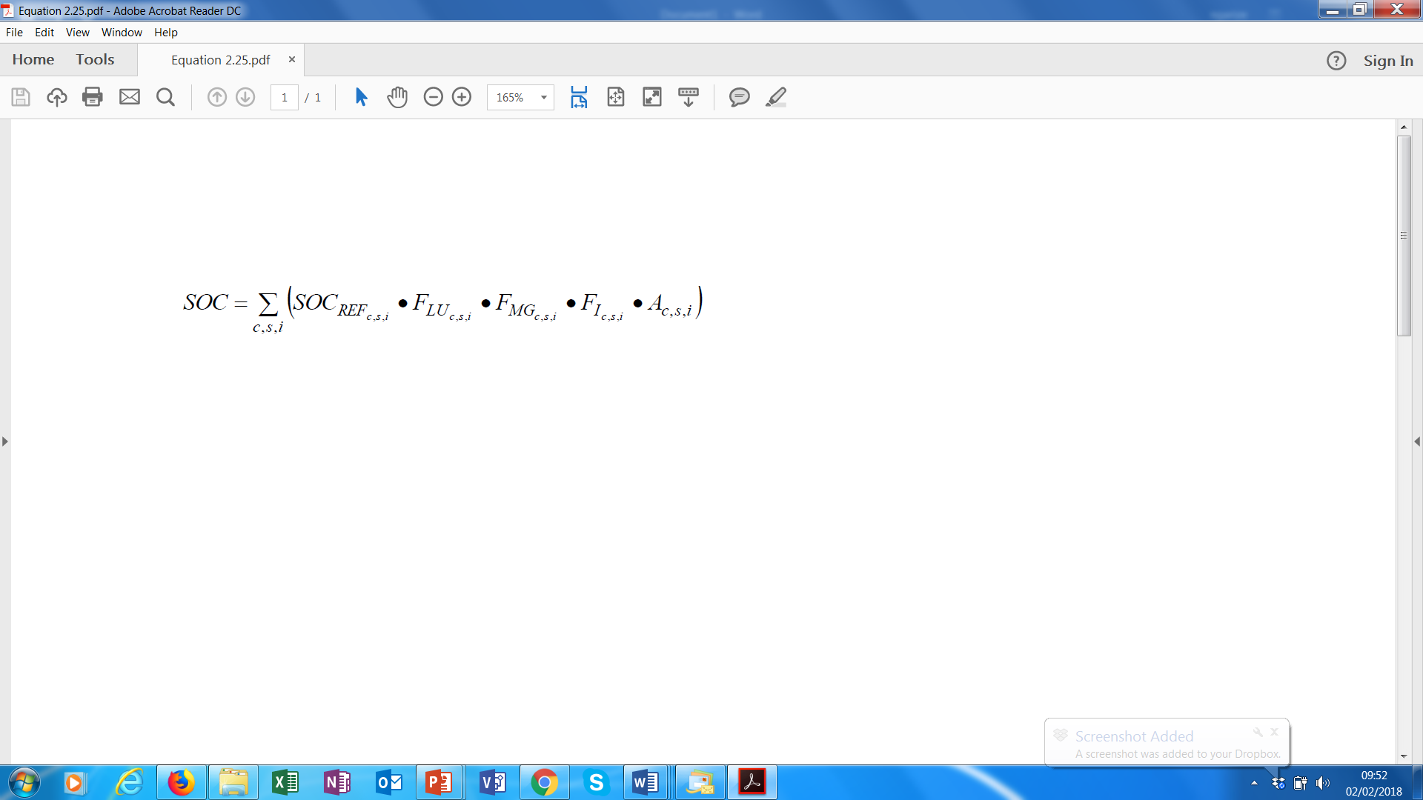
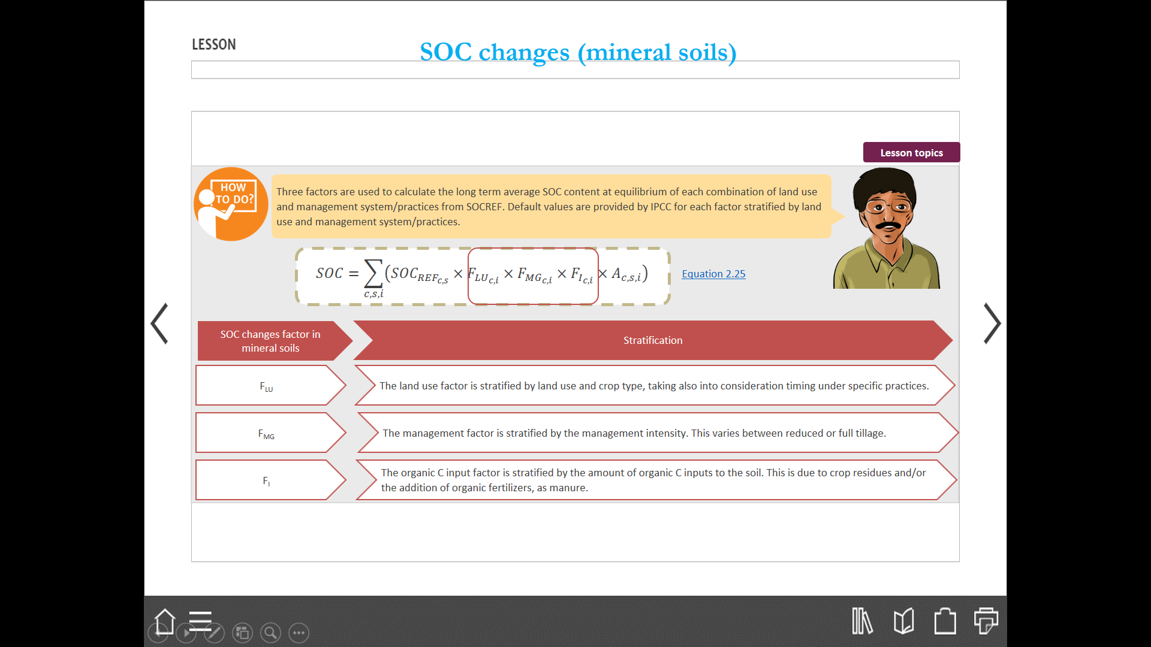
Mineral soils - Estimating emissions (3)
Three stock change factors are used to calculate the long term average SOC content at equilibrium of each combination of land use and management system/practices from SOC_{REF}. Default values are provided by IPCC for each factor stratified by land use and management system/practices.
Equation 2.25: Note Stock change factors are shown below:
Notes:
Equation 2.25
Equation 2.25
Annual change in organic carbon stocks in mineral soils
Where:
∆C_{Mineral} = annual change in carbon stocks in mineral soils, tonnes C yr⁻¹
SOC₀ = soil organic carbon stock in the last year of an inventory time period, tonnes C
SOC_{(0-T)} = soil organic carbon stock at the beginning of the inventory time period, tonnes C
SOC₀ and SOC_{(0-T)} are calculated using the SOC equation in the box where the reference carbon stocks and stock change factors are assigned according to the land-use and management activities and corresponding areas at each of the points in time (time = 0 and time = 0-T)
T = number of years over a single inventory time period, yr
D = Time dependence of stock change factors which is the default time period for transition between equilibrium SOC values, yr. Commonly 20 years, but depends on assumptions made in computing the factors F_{LU}, F_{MG} and F_{I}. If T exceeds D, use the value for T to obtain an annual rate of change over the inventory time period (0-T years).
c = represents the climate zones, s the soil types, and i the set of management systems that are present in a country.
SOC_{ref} = the reference carbon stock, tonnes C ha⁻¹ (Table 2.3)
F_{LU} = stock change factor for land-use systems or sub-system for a particular land-use, dimensionless
[Note: F_{ND} is substituted for F_{LU} in forest soil C calculation to estimate the influence of natural disturbance regimes.
F_{MG} = stock change factor for management regime, dimensionless
F_{I} = stock change factor for input of organic matter, dimensionless
A = land area of the stratum being estimated, ha. All land in the stratum should have common biophysical conditions (i.e., climate and soil type) and management history over the inventory time period to be treated together for analytical purposes.

Slide 138
Organic Soils (1)
Organic soils have organic matter accumulated over time under anaerobic conditions.
C dynamics of organic soils are closely linked to hydrologic conditions and C stored in organic soils readily decomposes in aerobic conditions following soil drainage.
Loss rates of organic C vary according to climate type, drainage depth, type of organic substrate and temperature.
Variations of SOC in organic soils are not estimated by physically measuring C stock changes, since it is very difficult to measure depth and carbon content of SOM in organic soils.
Therefore the general methodology used for estimating GHG emissions from organic soils is based on GHG emissions and/or removals measurements provided by the IPCC default values. The same methodology applies to land under conversion and to land remaining under previous land use and management system/practices

Slide 139
Organic Soils (2)
ΔC_{FFOrganic} = A_{Drained} ● EF_{Drainage}
Where:
ΔC_{FFOrganic} = CO₂ emissions from drained organic soils, t C/yr
A _{drained} = Area of drained organic soils, ha
EF_{Drainage} = EF for CO₂ from drained organic soils, t C/ha/yr
Equation 2.26, page 2.35, Vol 4 , 2006 GL
Notes:
Organic soils
The basic methodology for estimating C emissions from organic (e.g., peat-derived) soils is to assign an annual emission factor that estimates the losses of C following drainage. Drainage stimulates oxidation of organic matter previously built up under a largely anoxic environment. Specifically, the area of drained and managed organic soils under each climate type is multiplied by the associated emission factor to derive an estimate of annual CO2 emissions (source), as presented in Equation 2.26: Annual carbon loss from drained organic carbon (CO2).

Slide 140

3c. Aggregate sources and non-Co2 emissions on land

Slide 141
3C. Aggregate Sources and Non-CO₂ Emissions on Land
Emissions from Biomass Burning
Liming
Urea Application
Direct /Indirect
N₂O Emissions from Managed
Soils
Indirect N₂O Emissions from Manure Management
Rice Cultivations

Slide 142
Tier 1 – GHG emissions from on-site burning (1)
GHG emissions from on-site burning of organic matter (biomass, DOM, SOM peatlands) include CH₄, N₂O and CO₂
These emissions are produced by the combustion of organic matter, in the following activities
burning of agricultural residues,
burning of savannas,
peat fires and forests
and other land fires.
When burning annual biomass, CO₂ emissions are assumed balanced by removals following re-growth after one year. Thus, it is not required to be estimated. The same holds true for burning of savanna if the soil fertility is stable; if fertility is reduced, then CO₂ emissions should be calculated.
Off-site burning of biomass/DOM/peat has to be reported under the Energy sector; although for biomass and DOM only non-CO₂ GHG are reported while for peat also CO₂ emissions are reported.

Slide 143
Tier 1 – GHG emissions from on-site burning (2)
The amount of emissions is a function of the following information:
Area burnt
Density of fuel (biomass/DOM/peat) present on the area
Carbon content
Moisture content of the fuel
Type of fire
Completeness of combustion

Slide 144
Non-CO₂ Emissions
The Non-CO₂ emissions rate is generally determined by an emission factor for a specific gas (e.g., CH₄, N₂O) and source category and an area (e.g., for soil or area burnt) that defines the emission
Where:
Emission = non-CO₂ emissions, tonnes of the non-CO₂ gas
A = activity data relating to the emission source (can be area, or mass unit, depending on the source type)
EF = emission factor for a specific gas and source category, tonnes per unit of a source
Emission = A• EF

Slide 145
Tier 1 – GHG emissions from on-site burning (1)
Emissions from fire include not only CO₂, but also other GHGs, or precursors, due to incomplete combustion of the fuel, including carbon monoxide (CO), non-methane volatile organic compounds (NMVOC) and nitrogen (e.g. NO_{x}) species.
Non-CO₂ greenhouse gas emissions are estimated for all land use categories.
Notes:
In the 2006 Guidelines, fire is treated as a disturbance that affects not only the biomass (in particular, above-ground), but also the dead organic matter (litter and dead wood). For cropland and grassland having little woody vegetation, reference is
usually made to biomass burning, since biomass is the main pool affected by the fire.
Coverage of reporting: Emissions need to be reported for all fires on managed lands. In case of land-use change, any GHG emission from fire should be reported under the new land-use category. Emissions from wildfires that occur on unmanaged lands do not need to be reported, unless those lands are followed by a land-use change (i.e., become managed land).
Equivalence (synchrony) of CO2 emissions and removals: CO2 net emissions should be reported where the CO2 emissions and removals for the biomass pool are not equivalent in the inventory year. For grassland biomass burning and burning of agriculture residues, the assumption of equivalence is generally reasonable. In Forestland remaining Forest land, emissions of CO2 from biomass burning also need to be accounted for because they are generally not synchronous with rates of CO2 uptake.
This is especially important after stand replacing wildfire, and during cycles of shifting cultivation in tropical regions.
Fuels available for combustion: Factors that reduce the amount of fuels available for combustion (e.g., from grazing, decay, removal of biofuels, livestock feed, etc.) should be accounted for. A mass balance approach should be adopted to account for
residues, to avoid underestimation or double counting.
Annual reporting: countries should estimate and report greenhouse gas emissions from fire on an annual basis.

Slide 146
Tier 1 – GHG emissions from on-site burning (2)
Lfire = A ● MB ● Cf ● Gef ● 10⁻³
Where:
L_{fire} = amount of greenhouse gas emissions from fire, tonnes of each GHG e.g., CH₄, N₂O, etc.
A = area burnt, ha
M_{B} = mass of fuel available for combustion, tonnes ha⁻¹. This includes biomass, ground litter and dead wood. When Tier 1 methods are used then litter and dead wood pools are assumed zero, except where there is a land-use change.
C_{f} = combustion factor, dimensionless
G_{ef} = emission factor, g (kg dry matter burnt)⁻¹

Slide 147
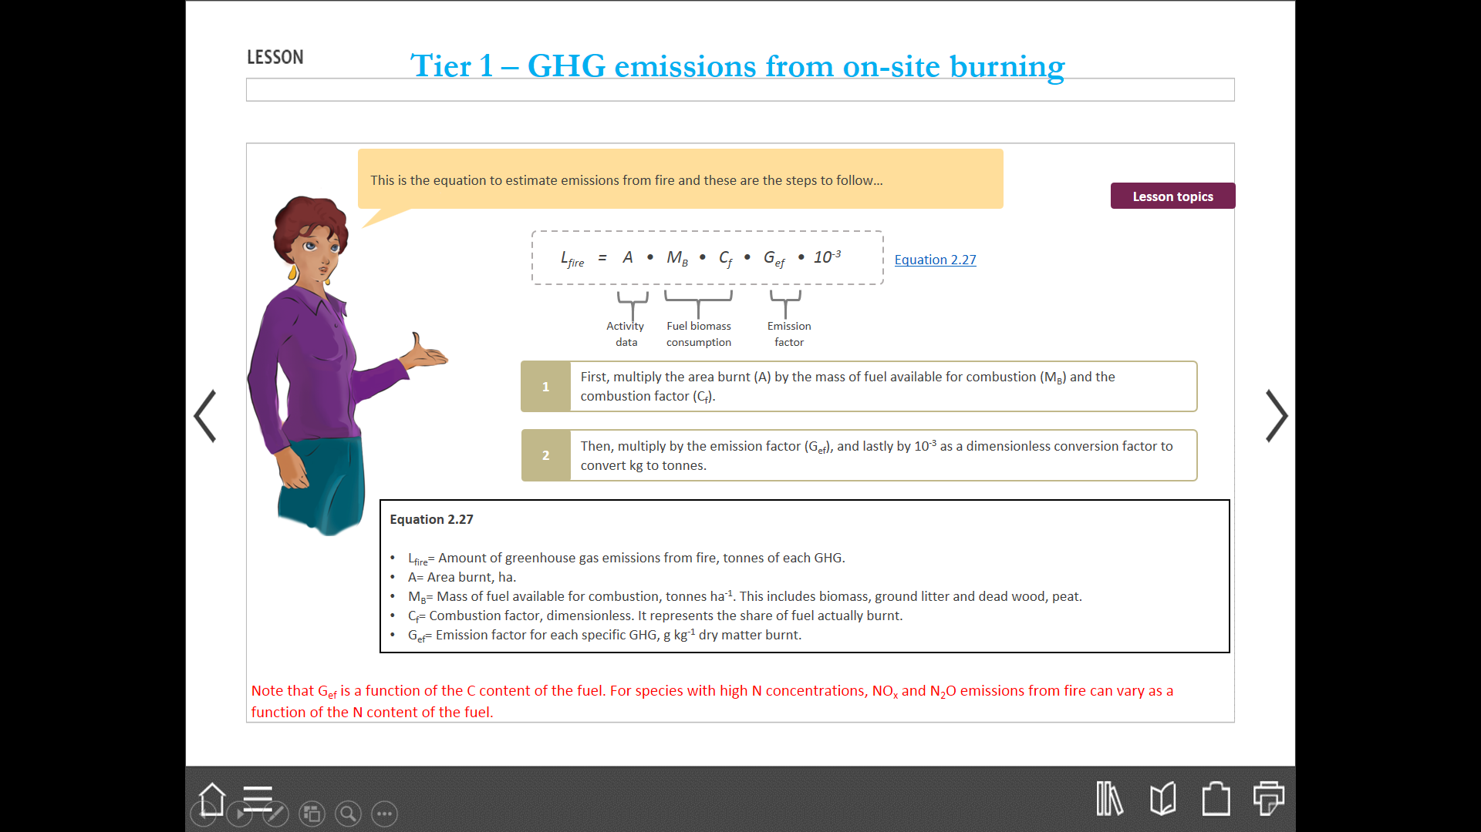
Tier 1 – GHG emissions from on-site burning (3)
In order to estimate emissions from fire use equation 2.27 (2006 GL) and to follow steps listed below:
Note that Gef is a function of the C content of the fuel. For species with high N concentrations, NOx and N₂O emissions from fire can vary as a function of the N content of the fuel.
Notes:
In the 2006 Guidelines, fire is treated as a disturbance that affects not only the biomass (in particular, above-ground), but also the dead organic matter (litter and dead wood). For cropland and grassland having little woody vegetation, reference is
usually made to biomass burning, since biomass is the main pool affected by the fire.
Coverage of reporting: Emissions need to be reported for all fires on managed lands. In case of land-use change, any GHG emission from fire should be reported under the new land-use category. Emissions from wildfires that occur on unmanaged lands do not need to be reported, unless those lands are followed by a land-use change (i.e., become managed land).
Equivalence (synchrony) of CO2 emissions and removals: CO2 net emissions should be reported where the CO2 emissions and removals for the biomass pool are not equivalent in the inventory year. For grassland biomass burning and burning of agriculture residues, the assumption of equivalence is generally reasonable. In Forestland remaining Forest land, emissions of CO2 from biomass burning also need to be accounted for because they are generally not synchronous with rates of CO2 uptake.
This is especially important after stand replacing wildfire, and during cycles of shifting cultivation in tropical regions.
Fuels available for combustion: Factors that reduce the amount of fuels available for combustion (e.g., from grazing, decay, removal of biofuels, livestock feed, etc.) should be accounted for. A mass balance approach should be adopted to account for
residues, to avoid underestimation or double counting.
Annual reporting: countries should estimate and report greenhouse gas emissions from fire on an annual basis.

Slide 148
Tier 1 – GHG emissions from on-site burning (4)
For emissions produced by burning of agricultural residues, activity data are the land area under each crop type for which agricultural residues are normally burnt.
Good practice suggests that 10% of the total harvested area is burnt.
Data on harvested area can be obtained from official national statistics or, if not available, from FAOSTAT.
In case of emissions deriving from burning of savanna, forests, peatlands and other land uses, activity data is the land area under each land use/vegetation type that is burnt; it can be derived from national statistics or remote sensing data.
If no national estimates are available, an international source such as the Global Fire Emission Database v.4 (GFED4) can be used.
Notes:
In the 2006 Guidelines, fire is treated as a disturbance that affects not only the biomass (in particular, above-ground), but also the dead organic matter (litter and dead wood). For cropland and grassland having little woody vegetation, reference is
usually made to biomass burning, since biomass is the main pool affected by the fire.
Coverage of reporting: Emissions need to be reported for all fires on managed lands. In case of land-use change, any GHG emission from fire should be reported under the new land-use category. Emissions from wildfires that occur on unmanaged lands do not need to be reported, unless those lands are followed by a land-use change (i.e., become managed land).
Equivalence (synchrony) of CO2 emissions and removals: CO2 net emissions should be reported where the CO2 emissions and removals for the biomass pool are not equivalent in the inventory year. For grassland biomass burning and burning of agriculture residues, the assumption of equivalence is generally reasonable. In Forestland remaining Forest land, emissions of CO2 from biomass burning also need to be accounted for because they are generally not synchronous with rates of CO2 uptake.
This is especially important after stand replacing wildfire, and during cycles of shifting cultivation in tropical regions.
Fuels available for combustion: Factors that reduce the amount of fuels available for combustion (e.g., from grazing, decay, removal of biofuels, livestock feed, etc.) should be accounted for. A mass balance approach should be adopted to account for
residues, to avoid underestimation or double counting.
Annual reporting: countries should estimate and report greenhouse gas emissions from fire on an annual basis.

Slide 149
Liming & Urea application (CO₂)
CO₂ emissions from the bicarbonates released from lime or urea application to soil
Where,
  M = annual amount of lime/urea applied (tyr⁻¹)
  EF = emission factor(t CO₂-C/tonne of lime or urea)
CO₂−C_{Emission} = M.EF_{lime /urea}

Slide 150
CO₂ Emissions from Liming
Liming is used to reduce soil acidity and improve plant growth in managed systems (mostly agricultural land and managed forests)
Addition of carbonates to soils in the form of lime ((e.g., calcic limestone ( CaCO₃) or dolomite (CaMg(CO₃)₂) leads to CO₂ emissions as the carbonate limes dissolve to release bicarbonates which evolves to CO₂ and water
Inventories can be developed using Tier 1, 2 or 3 approaches
It is good practice for countries to use higher tiers if CO₂ emissions from liming are a key source category.

Slide 151
Choice of emission factors
Tier 1
Default IPCC emission factors (EF) are 0.12 for limestone and 0.13 for dolomite.
Tier 2
Use of country specific data to differentiate sources with variable compositions of lime, different carbonate liming materials, overall purity and carbon content of liming materials.
Tier 3
Tier 3 based on estimating variables emissions from year to year and depends on site specific characteristics and environmental drivers
Notes:
Tier 1
Default emission factors (EF) are 0.12 for limestone and 0.13 for dolomite.
Tier 2
Derivation of emission factors using country-specific data could entail differentiation of sources with variable compositions of lime; different carbonate liming materials (limestone as well as other sources such as marl and shell deposits) can vary somewhat in their C content and overall purity. Each material would have a unique emission factor based on the C content.
Country-specific emission factors could also account for the proportion of carbonate-C from liming that is emitted to the atmosphere as CO2 (e.g., West and McBride, 2005). Dissolved inorganic C in soils can form secondary minerals and precipitate with the Ca or Mg that was added during liming. Furthermore, dissolved inorganic C (bicarbonate) can be transported with Ca and Mg through the soil to deep groundwater, lakes and eventually to the ocean (Robertson and Grace, 2004). In either case, the net emission of CO2 to the atmosphere is less than the original amount of C added as lime. Country-specific emission factors can be derived if there are sufficient data and understanding of inorganic carbon transformations, in addition to knowledge about transport of aqueous Ca, Mg, and inorganic C. It is good practice to document the source of information and method used for deriving country-specific values in the reporting process.
Tier 3
Tier 3 approaches are based on estimating variable emissions from year to year, which depends on a variety of site specific characteristics and environmental drivers. No emission factors are directly estimated.

Slide 152
Choice of activity data
Tier 1
National usage statistics for carbonate lime on amount applied to soils annually (more direct inference on application)
Annual sales of carbonate lime to infer the amount that is applied to soils (assumes all lime is sold to farmers, ranchers and foresters, etc.) is applied during that year
Availability computed based on new supply for the year ( annual domestic mining and import records) minus exports and usage in industrial processes.
Tier 2
In addition to tier 1 activity data, tier 2 may incorporate information on the purity of carbonates limes, site level and hydrological characteristics
Tier 3
Model based or direct measurements-based inventories
Notes:
Tier 1
Usage statistics may be gathered as part of the national census or enterprise records, while banks and the lime industry should have information on sales and domestic production.
Import/export records are typically maintained by customs or similar organizations in the government. It is good practice to average data records over three years (current year and two most recent) if emissions are not computed on an annual basis for reporting purposes.
Tier 2
In addition to the activity data that are described for Tier 1, Tier 2 may incorporate information on the purity of carbonate limes as well as site-level and hydrological characteristics to estimate the proportion of carbonate-C in lime applications that is emitted to the atmosphere.

Slide 153
Methodological Tiers - CO₂ Emissions from Liming
Tier 1.
-Estimate the total amount of carbonate containing lime applied annually to the soils in the country, differentiating between limestone and dolomite
Apply an overall emission factor (EF) of 0.12 for limestone and 0.13 for dolomite
Multiply the total amounts of limestone and dolomite by their respective emission factors and sum the two values to obtain the total CO2-C emissions
Tier 2
-Same as in tier 1 but incorporate country specific data to derive emission factors
Overall emission assumed to be less than tier 1 which assumes that all C in the applied lime is emitted as CO2 in the year of application
Tier 3
- Tier 3 methods use more sophisticated models or measurement procedures and procedural steps, including modelling carbon fluxes associated with primary and secondary carbonate mineral formation and dissolution in soils

Slide 154
CO₂ emissions from Urea fertilization
Urea is applied to soils during fertilization and leads to loss of CO₂ that was fixed in the industrial production process
CO₂ recovered for urea production is estimated in IPPU sector, CO₂ emissions from the application of urea are estimated and reported where they occur (Energy, AFOLU, Waste)
Inventories can be developed using tier 1, 2 and 3 approaches
It is good practice for countries to use higher tiers if CO₂ emissions from Urea fertilisation are a key source category.

Slide 155
Methodological tiers for CO₂ emissions from Urea fertilization
Tier 1.
- Estimate the total amount of urea applied to soils in the country (M)
-Apply an overall EF of 0.20 for urea ( equivalent to the carbon content of urea on atomic weight basis.
-Estimate the total CO₂-C emission based on the product of the amount of urea applied and the emission factors
Multiply by 44/12 to convert CO₂-C into CO₂
Tier 2
- Uses same procedural steps as tier 1 but incorporate country specific information to estimate EF
Tier 3
- More detailed models or measurements that incorporate the possibility of bicarbonate leaching to deep groundwater, and/or lakes and oceans
Notes:
Tier 1 - Multiply by 44/12 to convert CO2–C emissions into CO2. Urea is often applied in combination with other nitrogenous fertilizers, particularly in solutions, and it will be necessary to estimate the proportion of urea in the fertilizer solution for M. If the proportion is not known, it is considered good practice to assume that the entire solution is urea, rather than potentially under-estimating emissions for this sub-category.
Tier 3- CO2 emissions from urea applications could be estimated with more detailed models or measurements that incorporate the possibility of bicarbonate leaching to deep groundwater, and/or lakes and oceans, and thus not contributing to CO2 emissions, at least not immediately. Note that increases in soil inorganic C from urea fertilization do not represent a net removal of CO2 from the atmosphere. The removal is estimated in the IPPU Sector (Volume 3), and the computations for soils only provide estimates of the amount of emissions associated with this practice. See the Tier 3 section for soil inorganic C in Chapter 2 for additional discussion (Section 2.3.3 on Change in Soil C Stocks).

Slide 156
Choice of emission factors
Tier 1
The default emission factor (EF) is 0.20 for carbon emissions from urea applications
Tier 2
All C in urea may not be emitted in the year of application. If sufficient data and understanding of inorganic C transformation are available, country-specific specific emission factor could be derived.
It is good practice to document the source of information and method used for deriving country-specific values as part of the reporting process.
Tier 3
Tier 3 approaches are based on estimating variable emissions from year to year, which depends on a variety of site specific characteristics and environmental drivers. No emission factor is directly estimated.
Notes:
Tier 1
The default emission factor (EF) is 0.20 for carbon emissions from urea applications.
Tier 2
Similar to carbonate limes, all C in urea may not be emitted in the year of application. If sufficient data and understanding of inorganic C transformation are available, country-specific specific emission factor could be derived. It is good practice to document the source of information and method used for deriving country-specific values as part of the reporting process.
Tier 3
Tier 3 approaches are based on estimating variable emissions from year to year, which depends on a variety of site specific characteristics and environmental drivers. No emission factor is directly estimated.

Slide 157
Choice of activity data
Tier 1
Domestic production records and import/export data on urea can be used to obtain an approximate estimate of the amount of urea applied to soils on an annual basis (M)
Supplemental data on sales and/or usage of urea can be used to refine the calculation, instead of assuming all available urea in a particular year is immediately added to soils
Tier 2
In addition to tier1 information, Tier 2 may incorporate additional information on site-level and hydrological characteristics that were used to estimate the proportion of C in urea that is emitted to the atmosphere
Tier 3
Application of dynamic models and/or a direct measurement-based inventory
Notes:
Tier 1
Domestic production records and import/export data on urea can be used to obtain an approximate estimate of the amount of urea applied to soils on an annual basis (M). It can be assumed that all urea fertiliser produced or imported annually minus annual exports is applied to soils. However, supplemental data on sales and/or usage of urea can be used to refine the calculation, instead of assuming all available urea in a particular year is immediately added to soils. Regardless of the approach, the annual application estimates for urea fertilizers should be consistent between CO2 emission from urea and N2O emissions from soils.
Usage statistics may be gathered as part of the national census or through enterprise records, while banks and the fertilizer industry should have information on sales and domestic production. Import/export records are typically maintained by customs or similar organizations in the government. It is good practice to average data records over three years (current year and two most recent) if emissions are not computed on an annual basis for reporting purposes.
Tier 2
In addition to the activity data described for Tier 1, Tier 2 may incorporate additional information on site-level and hydrological characteristics that were used to estimate the proportion of C in urea that is emitted to the atmosphere.
Tier 3
For application of dynamic models and/or a direct measurement-based inventory in Tier 3, it is likely that more detailed activity data are needed, relative to Tier 1 or 2 methods, but the exact requirements will be dependent on the model or measurement design.

Slide 158
Direct N₂O emissions from managed soils
Nitrous oxide is produced naturally in soils through the processes of nitrification and denitrification.
The emissions of N₂O due to anthropogenic N inputs occur through both a direct pathway (i.e. directly from the soils to which the N is added), and through two indirect pathways (i.e. through volatilisation as NH3 and NOx and subsequent redeposition, and through leaching and runoff)

Slide 159
Improvements in 2006 IPCC Guidelines over GPG 2000
Full sectoral coverage of direct/indirect N₂O emissions;
Revised emission factors for nitrous oxide from agricultural soils based on extensive literature review; and
Removal of biological nitrogen fixation as a direct source of N₂O because of the lack of evidence of significant emissions arising from the fixation process.

Slide 160
Methodological tiers - Direct N₂O emissions from managed soils
Tier 1.
-Applies to countries in which either N₂O emissions managed soils are not a key category or country-specific emission factors do not exist.
-use of IPCC defaults with national statistics or data from international datasets
Tier 2
-more detailed emission factors and corresponding activity data are available to a country than are presented in involving further disaggregation of the terms e.g., emission factors and activity data are available for the application of synthetic fertilisers and organic N (F_{SN} and F_{ON}) under different conditions i.
Tier 3
-Tier 3 includes models and monitoring networks tailored to address national circumstances in relation to soil and environmental variables, repeated over time, driven by high-resolution activity data and disaggregated at sub-national level. Models should be validated by representative experimental models.
Notes:
In most soils, an increase in available N enhances nitrification and denitrification rates which then increase the production of N2O. Increases in available N can occur through human-induced N additions or change of land-use and/or management practices that mineralise soil organic N.
The following N sources are included in the methodology for estimating direct N2O emissions from managed soils:
• Synthetic N fertilisers (FSN);
• Organic N applied as fertiliser (e.g., animal manure, compost, sewage sludge, rendering waste) (FON);
• Urine and dung N deposited on pasture, range and paddock by grazing animals (FPRP);
• N in crop residues (above-ground and below-ground), including from N-fixing crops 2 and from forages during pasture renewal 3 (FCR);
• N mineralisation associated with loss of soil organic matter resulting from change of land use or management of mineral soils (FSOM); and
• Drainage/management of organic soils (i.e., Histosols) 4 (FOS).

Slide 161
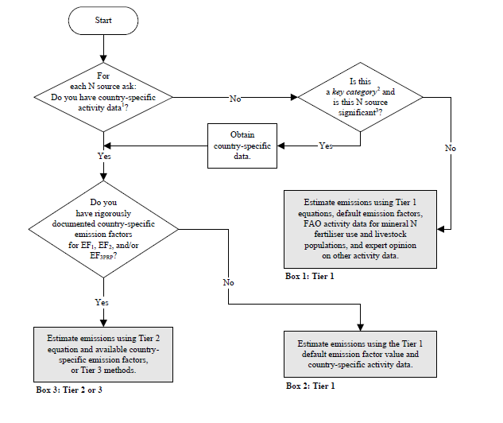
Decision tree for direct N₂O emissions from soils

Slide 162
Choice of emission factors
Three emission factors required:
  EF₁ represents the amount of N₂O emitted from the various nitrogen additions to soils;
  EF₂ represents the amount of N₂O emitted from cultivation of organic soil; and
  EF_{3PRP}) estimates the amount of N₂O emitted from urine and dung N deposited by grazing animals on pasture, range and paddock.
Country-specific factors should be used as far as possible in order to reflect the specific conditions of a country and the agricultural practices involved with suitable disaggregation
Data from countries with similar conditions or IPCC defaults can be used if national data is unavailable.
Notes:
Tier 1 and Tier 2
Three emission factors (EF) are needed to estimate direct N2O emissions from managed soils. The default values presented here may be used in the Tier 1 equation or in the Tier 2 equation in combination with country-specific emission factors.
The first EF (EF1) refers to the amount of N2O emitted from the various synthetic and organic N applications to soils, including crop residue and mineralisation of soil organic carbon in mineral soils due to land-use change or management.
The second EF (EF2) refers to the amount of N2O emitted from an area of drained/managed organic soils, and the third EF (EF3PRP) estimates the amount of N2O emitted from urine and dung N deposited by grazing animals on pasture, range and paddock. Default emission factors for the Tier 1 method are summarised in Table 11.1.
In the light of new evidence, the default value for EF1 has been set at 1% of the N applied to soils or released through activities that result in mineralisation of organic matter in mineral soils 8.
In many cases, this factor will be adequate, however, there are recent data to suggest that this emission factor could be disaggregated based on (1) environmental factors (climate, soil organic C content, soil texture, drainage and soil pH); and (2) management-related factors (N application rate per fertiliser type, type of crop, with differences between legumes, non-leguminous arable crops, and grass) (Bouwman et al., 2002; Stehfest and Bouwman, 2006).
Countries that are able to disaggregate their activity data from all or some of these factors may choose to use disaggregated emission factors with the Tier 2 approach.
The default value for EF2 is 8 kg N2O–N ha-1 yr-1 for temperate climates. Because mineralisation rates are assumed to be about 2 times greater in tropical climates than in temperate climates, the emission factor EF2 is 16 kg N2O–N ha-1 yr-1 for tropical climates 9. Climate definitions are given in Chapter 3, Annex 3A.5.
The default value for EF3PRP is 2% of the N deposited by all animal types except ‘sheep’ and ‘other’ animals. For these latter species, a default emission factor of 1% of the N deposited may be used 1

Slide 163
Choice of activity data
Several types of activity data are required, including:
  N inputs from application of synthetic fertilisers (F_{SN}), animal manure (F_{AM})
  mineralisation of crop residues returned to soils (F_{CR})
  soil nitrogen mineralisation due to cultivation of organic soils (F_{OS})
  Urine and dung from grazing animals (F_{PRP})
The data sources are:
  Synthetic fertiliser consumption data (F_{SN}) should be collected from official statistics (e.g. national bureaux of statistics) or International Fertiliser Industry Association (IFIA), FAO.
  F_{AM} should be calculated from the manure excreted and managed in MMS
  F_{CR} from crop production data (national or FAO) and IPCC default fractions.
  The area (in hectares) of organic soils cultivated annually (F_{OS}) can be obtained from official national statistics.
  Urine and dung from grazing animals (F_{PRP}) can be calculated from number of livestock, N excretion rates and fractions of manure deposited on pastures.
Notes:
Tiers 1 and 2
This section describes generic methods for estimating the amount of various N inputs to soils (FSN, FON, FPRP, FCR, FSOM, FOS) that are needed for the Tier 1 and Tier 2 methodologies (Equations 11.1 and 11.2).
F_{SN} = annual amount of synthetic fertiliser N applied to soils, kg N yr-1
F_{ON} = annual amount of animal manure, compost, sewage sludge and other organic N additions applied to soils (Note: If including sewage sludge, cross-check with Waste Sector to ensure there is no double counting of N2O emissions from the N in sewage sludge), kg N yr-1
F_{CR} = annual amount of N in crop residues (above-ground and below-ground), including N-fixing crops, and from forage/pasture renewal, returned to soils, kg N yr-1
F_{SOM} = annual amount of N in mineral soils that is mineralised, in association with loss of soil C from soil organic matter as a result of changes to land use or management, kg N yr-1
F_{OS} = annual area of managed/drained organic soils, ha (Note: the subscripts CG, F, Temp, Trop, NR and NP refer to Cropland and Grassland, Forest Land, Temperate, Tropical, Nutrient Rich, and Nutrient Poor, respectively)
F_{PRP} = annual amount of urine and dung N deposited by grazing animals on pasture, range and paddock, kg N yr-1 (Note: the subscripts CPP and SO refer to Cattle, Poultry and Pigs, and Sheep and Other animals, respectively)

Slide 164


Direct N₂O emissions from managed soils
Where:
N₂O_{Direct} –N = annual direct N₂O–N emissions produced from agricultural soils, kg N₂O–N yr⁻¹
N₂O–N_{Ninputs} = annual direct N₂O–N emissions from N inputs to agricultural soils, kg N₂O–N yr⁻¹
N₂O–N_{OS} = annual direct N₂O–N emissions from agricultural organic soils, kg N₂O–N yr⁻¹
N₂O–N_{PRP} = annual direct N₂O–N emissions from urine and dung inputs to grazed soils, kg N₂O–N yr⁻¹
F_{SN} = annual amount of synthetic fertiliser N applied to agricultural soils, kg N yr⁻¹
F_{ON} = annual amount of animal manure, compost, sewage sludge and other organic N additions applied to agricultural soils, kg N yr⁻¹
F_{CR} = annual amount of N in crop residues (above-ground and below-ground), including N-fixing crops, and from forage/pasture renewal, returned to soils, kg N yr⁻¹

Slide 165
F_{SOM} = annual amount of N in mineral soils that is mineralised, in association with loss of soil C from soil organic matter as a result of changes to land use or management, kg N yr⁻¹
F_{OS} = annual area of managed/drained agricultural organic soils, ha (Note: the subscripts CG, Temp, Trop, NR and NP refer to Cropland and Grassland, Temperate, Tropical, Nutrient Rich, and Nutrient Poor, respectively)
F_{PRP} = annual amount of urine and dung N deposited by grazing animals on pasture, range and paddock, kg N yr⁻¹ (Note: the subscripts CPP and SO refer to Cattle, Poultry and Pigs, and Sheep and Other animals, respectively)
EF₁ = emission factor for N₂O emissions from N inputs, kg N₂O–N (kg N input)⁻¹ (Table 11.1)
EF_{1FR} is the emission factor for N₂O emissions from N inputs to flooded rice, kg N₂O–N (kg N input⁾⁻¹
(Table 11.1) 5
EF₂ = emission factor for N₂O emissions from drained/managed organic soils, kg N₂O–N ha⁻¹ yr⁻¹; (Note: the subscripts CG, Temp, Trop, NR and NP refer to Cropland and Grassland, Temperate, Tropical, Nutrient Rich, and Nutrient Poor, respectively)
EF_{3PRP} = emission factor for N₂O emissions from urine and dung N deposited on pasture, range and
paddock by grazing animals, kg N₂O–N (kg N input)⁻¹; (Note: the subscripts CPP and
SO refer to Cattle, Poultry and Pigs, and Sheep and Other animals, respectively)

Slide 166
Indirect N₂O emissions from managed soils (3)
In addition to the direct emissions of N₂O from managed soils that occur through a direct pathway (i.e., directly from the soils to which N is applied), emissions of N₂O also take place through two indirect pathways:
  volatilisation of N as NH₃ and oxides of N (NOx), and the re-deposition as NH₄+ and NO₃ onto soils and the surface of lakes and other waters;
  leaching and runoff from land of N.

Slide 167
Volatilisation (N₂O) – Tier 1
Where:
N₂O_{(ATD)}–N = annual amount of N₂O–N produced from atmospheric deposition of N volatilised from
soils, kg N₂O–N yr⁻¹
F_{SN} = annual amount of synthetic fertiliser N applied to soils, kg N yr⁻¹
Frac_{GASF} = fraction of synthetic fertiliser N that volatilises as NH₃ and NOx, kg N volatilised (kg of N
applied)⁻¹
F_{ON} = annual amount of managed animal manure, compost, sewage sludge and other organic N additions applied to soils, kg N yr⁻¹
F_{PRP} = annual amount of urine and dung N deposited by grazing animals on pasture, range and paddock, kg N yr⁻¹
Frac_{GASM} = fraction of applied organic N fertiliser materials (F_{ON}) and of urine and dung N deposited by grazing animals (F_{PRP}) that volatilises as NH₃ and NOx, kg N volatilised (kg of N applied or deposited)⁻¹
EF₄ = emission factor for N₂O emissions from atmospheric deposition of N on soils and water surfaces, [kg N–N₂O (kg NH₃–N + NOx–N volatilised)⁻¹]
Equation 11.9 (2006 GL)

Slide 168
Leaching/Runoff (N₂O) – Tier 1
Where:
N₂O_{(L)}–N = annual amount of N₂O–N produced from leaching and runoff of N additions to agricultural soils in regions where leaching/runoff occurs, kg N₂O–N yr⁻¹
F_{SN} = annual amount of synthetic fertiliser N applied to soils in regions where leaching/runoff occurs, kg N yr⁻¹
F_{ON} = annual amount of managed animal manure, compost, sewage sludge and other organic N additions applied to soils in regions where leaching/runoff occurs, kg N yr⁻¹
F_{PRP} = annual amount of urine and dung N deposited by grazing animals in regions where leaching/runoff occurs, kg N yr⁻¹
F_{CR} = amount of N in crop residues (above- and below-ground), including N-fixing crops, and from
forage/pasture renewal, returned to soils annually in regions where leaching/runoff occurs, kg N yr⁻¹
F_{SOM} = annual amount of N mineralised in mineral soils associated with loss of soil C from soil organic
matter as a result of changes to land use or management in regions where leaching/runoff occurs, kg N yr⁻¹
Frac_{LEACH-(H)} = fraction of all N added to/mineralised in soils in regions where leaching/runoff
occurs that is lost through leaching and runoff, kg N (kg of N additions)⁻¹
EF₅ = emission factor for N₂O emissions from N leaching and runoff, kg N₂O–N (kg N leached and
Runoff)⁻¹
Equation 11.10 (2006 GL)

Slide 169
Volatilisation (N₂O) – Tier 2
Where:
N₂O_{(ATD)}–N = annual amount of N₂O–N produced from atmospheric deposition of N volatilised from
Agricultural soils, kg N₂O–N yr⁻¹
F_{SNi} = annual amount of synthetic fertiliser N applied to soils under different conditions i, kg N yr⁻¹
Frac_{GASFi} = fraction of synthetic fertiliser N that volatilises as NH₃ and NOx under different conditions i,
kg N volatilised (kg of N applied)⁻¹
F_{ON} = annual amount of managed animal manure, compost, sewage sludge and other organic N additions
applied to soils, kg N yr⁻¹
F_{PRP} = annual amount of urine and dung N deposited by grazing animals on pasture, range and paddock,
kg N yr⁻¹
Frac_{GASM} = fraction of applied organic N fertiliser materials (F_{ON}) and of urine and dung N deposited by
grazing animals (F_{PRP}) that volatilises as NH₃ and NOx, kg N volatilised (kg of N applied or
deposited)⁻¹
EF₄ = emission factor for N₂O emissions from atmospheric deposition of N on soils and water surfaces,
[kg N–N₂O (kg NH₃–N + NOx–N volatilised)⁻¹]
Equation 11.11 (2006 GL)

Slide 170
Methodological Tiers
Tier 1.
-Applies to countries in which either indirect N2O emissions managed soils are not a key category or country-specific emission factors do not exist.
-Uses IPCC defaults with national statistics or data from international datasets.
Tier 2
-more detailed emission factors and corresponding activity data are available to a country than are presented in involving further disaggregation of the terms e.g., emission factors and activity data are available for the application of synthetic fertilisers and organic N (FSN and FON) under different conditions i
Tier 3
-Tier 3 includes models and monitoring networks tailored to address national circumstances of rice cultivation,
repeated over time, driven by high-resolution activity data and disaggregated at sub-national level.

Slide 171
Choice of emission factors
Emission factors and parameters required for indirect N₂O from soils are:
  EF associated with volatilised and re-deposited N (EF₄)
  EF associated with N lost through leaching/runoff (EF₅)
  fractions of N that are lost through volatilisation (Frac_{GASF} and Frac_{GASM}) or leaching/runoff (Frac_{LEACH-(H)})
Country-specific values for EF₄ should be used with great caution because of the special complexity of trans-boundary atmospheric transport.
Notes:
Choice of emission factors, volatilisation and leaching factors
The method for estimating indirect N2O emissions includes two emission factors: one associated with volatilised and re-deposited N (EF4), and the second associated with N lost through leaching/runoff (EF5). The method also requires values for the fractions of N that are lost through volatilisation (FracGASF and FracGASM) or leaching/runoff (FracLEACH-(H)). The default values of all these factors are presented in Table 11.3.
Note that in the Tier 1 method, for humid regions or in dryland regions where irrigation (other than drip irrigation) is used, the default FracLEACH-(H) is 0.30. For dryland regions, where precipitation is lower than evapotranspiration throughout most of the year and leaching is unlikely to occur, the default FracLEACH is zero. The method of calculating whether FracLEACH-(H) = 0.30 should be applied is given in Table 11.3.
Country-specific values for EF4 should be used with great caution because of the special complexity of transboundary atmospheric transport. Although inventory compilers may have specific measurements of N deposition and associated N2O flux, in many cases the deposited N may not have originated in their country.
Similarly, some of the N that volatilises in their country may be transported to and deposited in another country, where different conditions that affect the fraction emitted as N2O may prevail. For these reasons the value of EF4 is very difficult to determine, and the method presented in Volume 1, Chapter 7, Section 7.3 attributes all indirect N2O emissions resulting from inputs to managed soils to the country of origin of the atmospheric NOx and NH3, rather than the country to which the atmospheric N may have been transported.

Slide 172
Choice of activity data
The activity data requirements for indirect N₂O are the same as those for direct N₂O from managed soils.
Notes:
Choice of activity data
The data sources are:
Synthetic fertiliser consumption data (F_{SN}) should be collected from official statistics (e.g. national bureaux of statistics) or International Fertiliser Industry Association (IFIA), FAO.
F_{AM} should be calculated from the manure excreted and managed in MMS
F_{CR} from crop production data (national or FAO) and IPCC default fractions.
The area (in hectares) of organic soils cultivated annually (F_{OS}) can be obtained from official national statistics.
Urine and dung from grazing animals (FPRP) can be calculated from number. of livestock and N excretion rates.

Slide 173
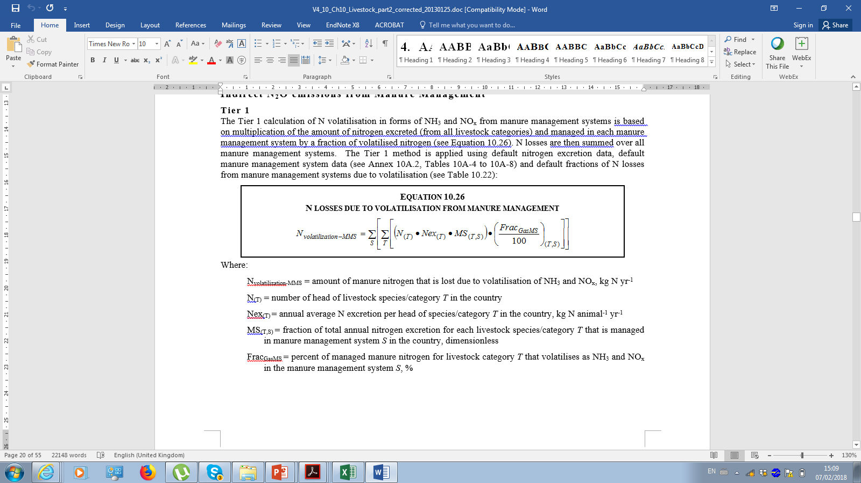
Indirect N₂O emissions from manure management (1)
Where:
N_{volatilization-MMS} = amount of manure nitrogen that is lost due to volatilisation of NH₃ and NO_{x}, kg N yr⁻¹
N_{(T)} = number of head of livestock species/category T in the country
Nex_{(T)} = annual average N excretion per head of species/category T in the country, kg N animal⁻¹ yr⁻¹
MS_{(T,S)} = fraction of total annual nitrogen excretion for each livestock species/category T that is managed in manure management system S in the country, dimensionless
Frac_{GasMS} = percent of managed manure nitrogen for livestock category T that volatilises as NH₃ and NO_{x} in the manure management system S, %
Notes:
Choice of activity data
The data sources are:
Synthetic fertiliser consumption data (F_{SN}) should be collected from official statistics (e.g. national bureaux of statistics) or International Fertiliser Industry Association (IFIA), FAO.
F_{AM} should be calculated from the manure excreted and managed in MMS
F_{CR} from crop production data (national or FAO) and IPCC default fractions.
The area (in hectares) of organic soils cultivated annually (F_{OS}) can be obtained from official national statistics.
Urine and dung from grazing animals (FPRP) can be calculated from number. of livestock and N excretion rates.

Slide 174
Indirect N₂O emissions from manure management (2)
The Tier 1 method is applied using default Nex values, default MMS data (2006 GL, Annex 10A.2, Tables 10A-4 to 10A-8) and default fractions of N losses from MMS due to volatilisation (2006 GL, Table 10.22)
Tier 2 method would follow the same calculation equation as Tier 1 but include the use of country-specific data for some or all of variables
Indirect emissions of N₂O from leaching and runoff from manure management should be considered part of a Tier 2 or Tier 3 method
Default EFs for indirect N₂O emissions from manure management are the same as EFs for indirect N₂O emissions from soils (see 2006 GL, Table 11.3)
Notes:
Choice of activity data
The data sources are:
Synthetic fertiliser consumption data (F_{SN}) should be collected from official statistics (e.g. national bureaux of statistics) or International Fertiliser Industry Association (IFIA), FAO.
F_{AM} should be calculated from the manure excreted and managed in MMS
F_{CR} from crop production data (national or FAO) and IPCC default fractions.
The area (in hectares) of organic soils cultivated annually (F_{OS}) can be obtained from official national statistics.
Urine and dung from grazing animals (FPRP) can be calculated from number. of livestock and N excretion rates.

Slide 175
CH₄ emissions from rice (1)
2006 GL incorporate various changes as compared to the 1996 Guidelines and the GPG 2000, namely:
i) revision of emission and scaling factors derived from updated analysis of available data,
(ii) use of daily – instead of seasonal – emission factors to allow more flexibility in separating cropping seasons and fallow periods,
(iii) new scaling factors for water regime before the cultivation period and timing of straw incorporation, and
(iv) inclusion of Tier 3 approach in line with the general principles of the 2006 revision of guidelines.
v) The revised guidelines also maintain the separate calculation of N₂O emission from rice cultivation (as one form of managed soil) which is dealt with in Chapter 11.
Notes:
These new guidelines for computing CH4 emissions incorporate various changes as compared to the 1996 Guidelines and the GPG2000, namely:
(i) revision of emission and scaling factors derived from updated analysis of available data,
(ii) use of daily – instead of seasonal – emission factors to allow more flexibility in separating cropping seasons and fallow periods,
(iii) new scaling factors for water regime before the cultivation period and timing of straw incorporation, and
(iv) inclusion of Tier 3 approach in line with the general principles of the 2006 revision of guidelines.
v) The revised guidelines also maintain the separate calculation of N2O emission from rice cultivation (as one form of managed soil) which is dealt with in Chapter 11.

Slide 176
CH₄ emissions from rice (2)
Anaerobic decomposition of organic material in flooded rice fields produces methane (CH₄), which escapes to the atmosphere primarily by transport through the rice plants.
The annual amount of CH₄ emissions from a given area of rice is a function of:
Cultivation period (days).
Water regimes (before and during cultivation period).
Organic amendments applied to the soil.
Others (soil type, temperature, rice cultivar).
It is important to note that upland rice fields do not produce significant quantities of CH₄.
Notes:
These new guidelines for computing CH4 emissions incorporate various changes as compared to the 1996 Guidelines and the GPG2000, namely:
(i) revision of emission and scaling factors derived from updated analysis of available data,
(ii) use of daily – instead of seasonal – emission factors to allow more flexibility in separating cropping seasons and fallow periods,
(iii) new scaling factors for water regime before the cultivation period and timing of straw incorporation, and
(iv) inclusion of Tier 3 approach in line with the general principles of the 2006 revision of guidelines.
v) The revised guidelines also maintain the separate calculation of N2O emission from rice cultivation (as one form of managed soil) which is dealt with in Chapter 11.

Slide 177

CH₄ emissions from rice: Estimating emissions (1)
CH₄ emissions from rice cultivation are given by:
Where:
CH_{4 Rice} = annual methane emissions from rice cultivation, Gg CH₄ yr⁻¹
EFijk = a daily emission factor for i, j, and k conditions, kg CH₄ ha⁻¹ day⁻¹
tijk = cultivation period of rice for i, j, and k conditions, day
Aijk = annual harvested area of rice for i, j, and k conditions, ha yr⁻¹
i, j, and k = represent different ecosystems, water regimes, type and amount of organic amendments, and
other conditions under which CH₄ emissions from rice may vary
Equation 5.1 (2006 GL)

Slide 178
CH₄ emissions from rice: Estimating emissions (2)
What do the conditions i, j, and k represent in equation 5.1?
These variable represent the conditions that influence CH₄ emissions from rice cultivation
Variable i - Water Regime
Variable j - Organic Amendment to Soils
Variable k - Other Conditions
Combination of (i) ecosystem type (i.e., irrigated, rainfed, and deep water rice production) and, (ii) flooding pattern (continuously/ intermittently flooded, regular rainfed, drought prone, and deep water).
The impact on CH₄ emissions depends on type and amount of the applied material, that can either be of (i) endogenous (straw, green manure, etc.) or (ii) exogenous origin (compost, farmyard manure, etc.)
It is known that other factors, such as soil type, rice cultivar or sulphate containing amendments can significantly influence CH₄ emissions.

Slide 179
CH₄ emissions from rice: Estimating emissions (3)
In order to estimate emissions from rice cultivation, use equation 5.1 (2006 GL)and apply the following steps:
Due to the complexity and variability of rice production management, it is good practice to stratify the total harvested area into sub-units according to the i, j and k conditions, as well as the cultivation period and the emission factor (e.g., harvested areas under different water regimes).
For each sub-unit, calculate the emissions by multiplying the respective emission factor by the cultivation period (t) and the annual harvested area (A).
Then, sum the emissions from each sub-unit of harvested area to determine the total annual national emissions in rice cultivation.

Slide 180
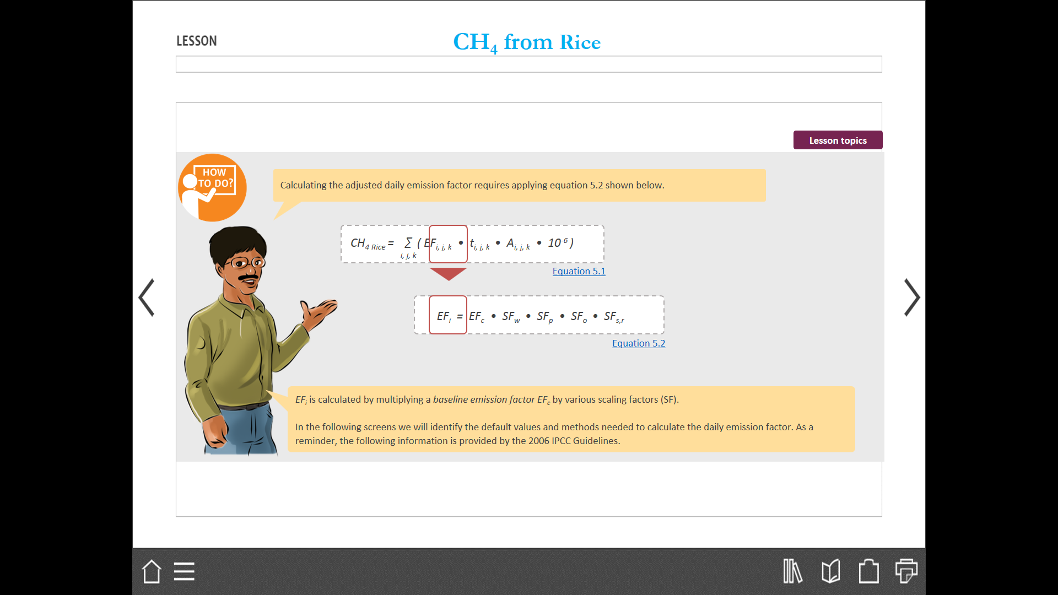
CH₄ emissions from rice: Estimating emissions (4)
Calculating the adjusted daily emission factor requires applying equation 5.2 shown below
EFi is calculated by multiplying a baseline emission factor EFc by various scaling factors (SF).
Default values and methods needed to calculate the daily emission factors are provided by the 2006 IPCC Guidelines.

Slide 181
CH₄ emissions from rice: Estimating emissions adjusted daily emission factor
Where:
EFi = adjusted daily emission factor for a particular harvested area
EFc = baseline emission factor for continuously flooded fields without organic amendments
SFw = scaling factor to account for the differences in water regime during the cultivation period
SFp = scaling factor to account for the differences in water regime in the pre-season before the cultivation period
SFo = scaling factor should vary for both type and amount of organic amendment applied
SFs,r = scaling factor for soil type, rice cultivar, etc., if available
Equation 5.2 (2006 GL)

Slide 182
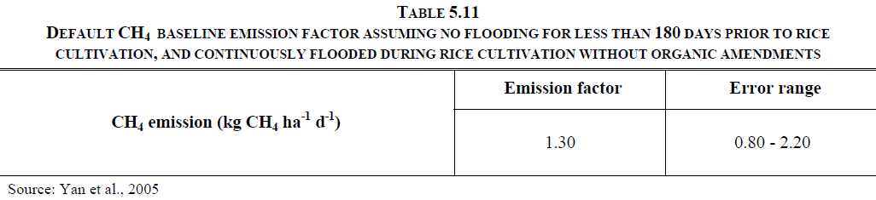
CH₄ emissions from rice: Components of Equation 5.2 (2006 GL) (1)
The Baseline emission factor is for continuously flooded fields without organic amendments.
The default value for EFc could be found in Table 5.11 shown below.
This variable is used as a starting point and is then adjusted according to the scaling factors.
It applies to areas with no flooded fields for less than 180 days, prior to rice cultivation and continuously flooded during the rice cultivation period without organic amendments.
EF_{c}
Baseline emission factor
EF_{i} = EF_{c} • SF_{w} • SF_{p} • SF_{o} • SF_{s,r}

Slide 183
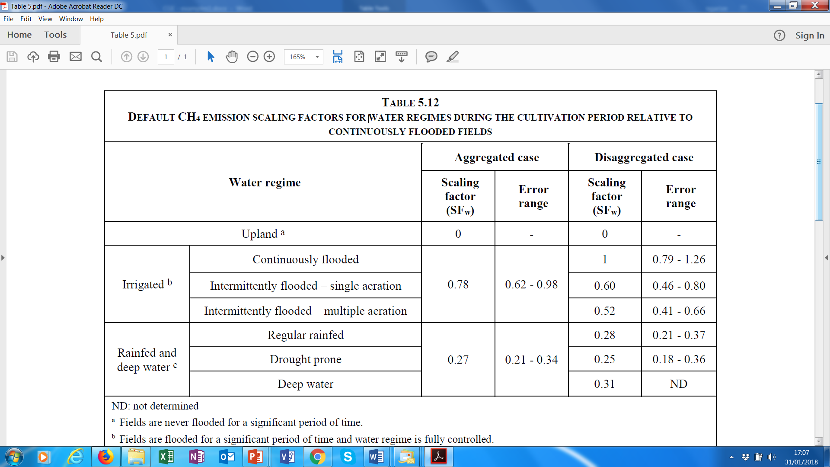
CH₄ emissions from rice: Components of Equation 5.2 (2006 GL) (2)
Scaling factor to account for the differences in water regime during the cultivation period
It is good practice to collect more disaggregated activity data on water regime during the cultivation and apply disaggregated scaling factors whenever possible.
When activity data are only available for rice ecosystem types, and not disaggregated for flooding patterns, use aggregated scaling factor.
SF_{W}
Water during cultivation
EF_{i} = EF_{c} • SF_{w} • SF_{p} • SF_{o} • SF_{s,r}

Slide 184
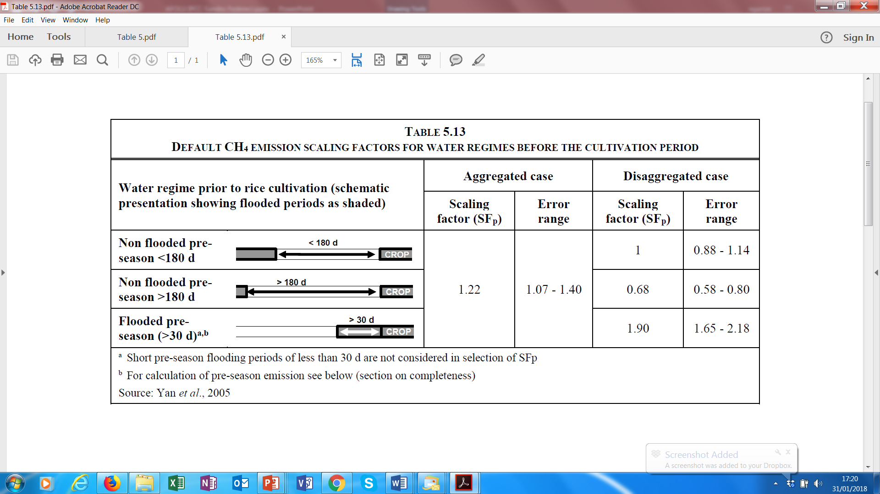
CH₄ emissions from rice: Estimating emissions (5)
Scaling factor to account for the differences in water regime in the pre-season before during the cultivation period.
SF_{p}
Water before cultivation
EF_{i} = EF_{c} • SF_{w} • SF_{p} • SF_{o} • SF_{s,r}

Slide 185
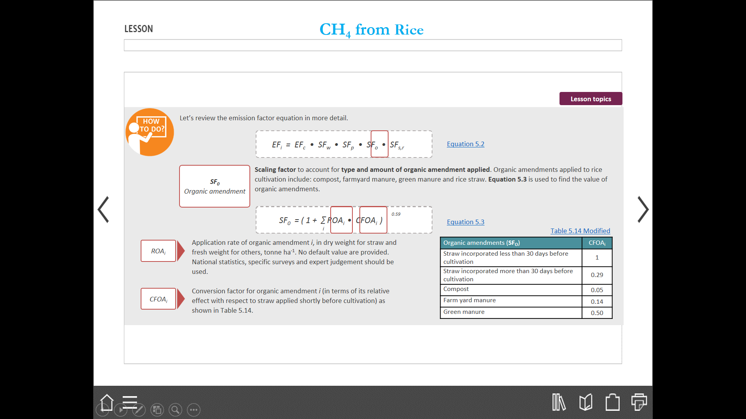
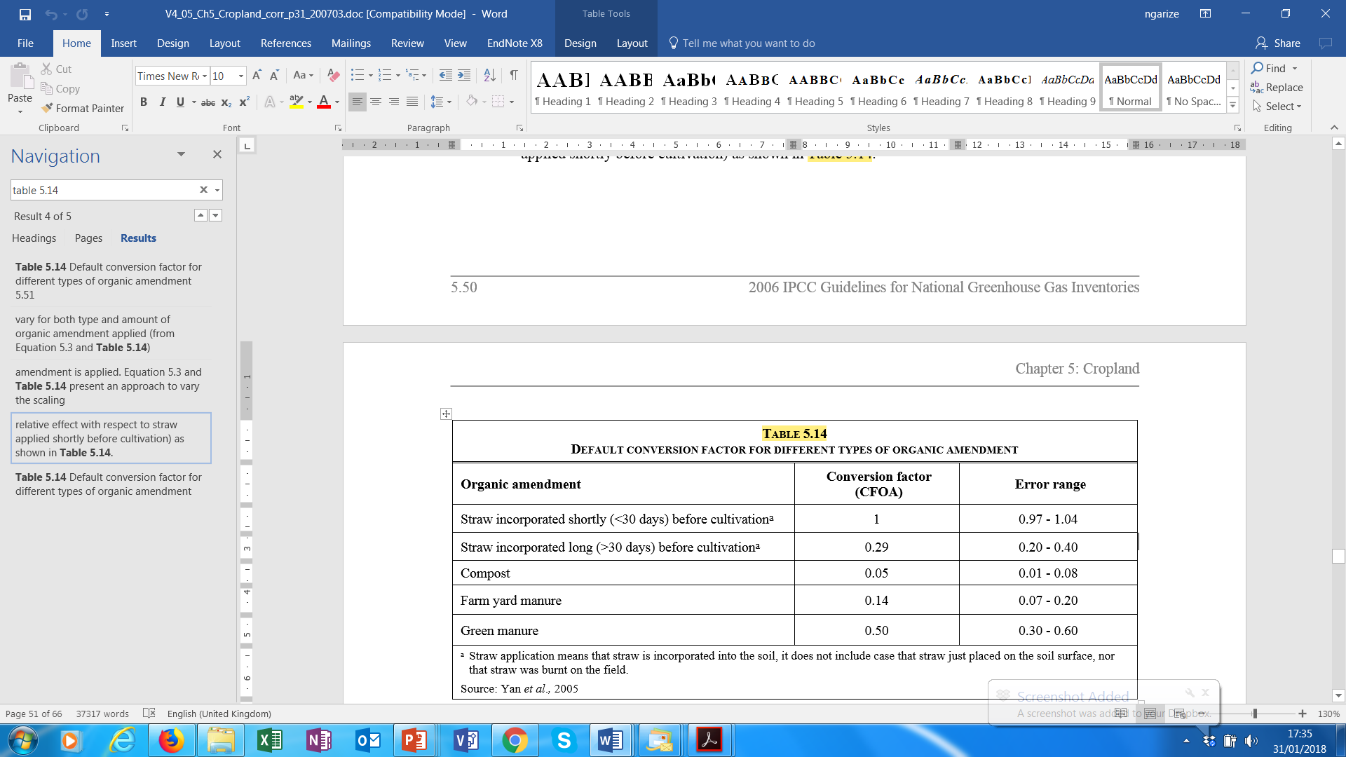
CH₄ emissions from rice: Estimating emissions (6)
Scaling factor to account for type and amount of organic amendment applied. Organic amendments applied to rice cultivation include: compost, farmyard manure, green manure and rice straw. Equation 5.3 (2006 GL) below is used to find the value of organic amendments.
. Application rate of organic amendment i, in dry weight for straw and fresh weight for others, tonne ha-1. No default value are provided. National statistics, specific surveys and expert judgement should be used
Conversion factor for organic amendment i (in terms of its relative effect with respect to straw applied shortly before cultivation) as shown in
Table 5.14 (2006 GL)
SF₀
Organic amendment
EF_{i} = EF_{c} • SF_{w} • SF_{p} • SF_{o} • SF_{s,r}
ROA_{i}
CFOA_{i}

Slide 186
CH₄ emissions from rice: Estimating emissions (7)
Scaling factor to account for soil type, rice cultivar, etc.
SF_{s, r}
Other conditions
Equation 5.2
EF_{i} = EF_{c} • SF_{w} • SF_{p} • SF_{o} • SF_{s,r}
Both experiments and mechanistic knowledge confirm the importance of these factors, but large variations within the available data do not allow to define reasonably accurate default values.
IPCC guidance suggests that country-specific scaling factors should only be used if they are based on well-researched and documented measurement data, and if they are stratified by soil type and rice cultivar, at least.

Slide 187
CH₄ emissions from rice: Estimating emissions (8)
Activity Data, is primarily based on harvested area statistics and should be available from a national statistics agency, as well as complementary information on cultivation period and agronomic practices.
The activity data should be stratified according to the stratification of the scaling factors (i.e. cropping practices and water regime).
Harvested area should, at a minimum, be disaggregated by three baseline water regimes as listed below:
Irrigated.
Upland
Rainfed and Deep Water
If these data are not available in-country, they can be obtained from international data sources: e.g., International Rice Research Institute (IRRI), which include harvest area of rice by ecosystem type for major rice producing counties, a rice crop calendar for each country, and other useful information, and the FAOSTAT. Moreover table 4-11 of the Revised 1996 IPCC Guidelines provides data on harvested area and on ecosystem type by country or region.
∑
CH_{4 Rice} = ( EF_{i, j, k} • t_{i, j, k} • A_{i, j, k} • 10⁻⁶ )
_{i, j, k}

Slide 188
Methodological Tiers - CH₄ emission from rice cultivation
Tier 1.
-Applies to countries in which either CH₄ emissions from rice cultivation are not a key category or country specific
emission factors do not exist.
-The disaggregation of the annual harvest area for at least three baseline water regimes including irrigated, rainfed, and upland.
-Emissions adjusted by multiplying a baseline default emission factor by scaling factors
Tier 2
-follows the same calculation equation as Tier 1 but would include the use of country-specific EFs.
Tier 3
-Tier 3 includes models and monitoring networks tailored to address national circumstances of rice cultivation, repeated over time, driven by high-resolution activity data and disaggregated at sub-national level.

Slide 189
Choice of emission factors
Tier 1
  A baseline emission factor for no flooded fields for less than 180 days prior to rice cultivation and continuously flooded during the rice cultivation period without organic amendments (EFc)
  Scaling factors are used to adjust the EFc to account for the various conditions, e.g..: water regime during and before cultivation period and organic amendments
Tier 2
  country-specific emission factors from field measurements that covering the conditions of rice cultivation in the country
  Country-specific definition of the baseline management and scaling factors for other conditions.
Tier 3 are based on a thorough understanding of drivers and parameters and involve advanced modelling/monitoring frameworks.

Slide 190
Choice of activity data
Activity data are primarily based on harvested area statistics, available from a national statistics agency as together with information on cultivation period and agronomic practices.
The activity data should be broken down by regional differences in rice cropping practices or water regime.
National data is preferable but if not available, international datasets e.g., IRRI and FAOSTAT can be used especially with Tier 1 methods.
The use of locally verified areas correlated with available data for emission factors under differing conditions such as climate, agronomic practices, and soil properties is very useful especially for higher tier methods.

Slide 191
Cross Cutting issues - Uncertainty Assessment
Broad sources of uncertainty are:
  Uncertainty in land-use and management activity and environmental data (land area estimates, fraction of land area burnt etc.)
  Uncertainty in the stock change/emission factors for Tier 1 or 2 approaches (carbon increase and loss, carbon stocks, and expansion factor terms)
  Uncertainty in model structure/parameter error for Tier 3 model-based approaches, or measurement error/sampling variability associated with a measurement-based inventories
Uncertainty can be reduced by: using higher tier methods; more representative parameter values; and AD at higher resolution.
Notes:
It is good practice to report uncertainties associated with the estimates of E/R, and inventory compilers need to understand what the sources of uncertainties are.
E/R may be based on use of different approaches, including measurements from randomly selected target population, measurements from typical sites taken to represent all sites under analysis, model output
Very important that uncertainties estimates of all different input data be accounted for, if quantitative data not available then exert judgement may be used

Slide 192
Cross Cutting issues - Completeness
To ensure completeness it is good practice to include all land categories, C pools and non-CO₂ emissions occurring in a country.
If there are omissions, it is a good practice to collect additional activity data and related emission factors and other parameters for the next inventory particularly if the category/pool is a key category.
It is a good practice to document and explain reasons for all omissions.

Slide 193
Cross Cutting issues - Time-series Consistency
It is good practice to ensure time-series consistency by using the same sources of data and methods across the time series.
It is a good practice to recalculate emissions/removals in case there are changes in the sources of data (e.g., improved data from national forest inventories) and methods using time-series consistent methods.
Some ways of ensuring time series consistency in LULUCF are:
  Keeping track of the land transitions through a Land Use Change Matrix;
  Keeping track of C stocks in land-use categories before and after transitions; and
  Using a common definition of climate and soil types for all land-use categories.
  EFs and parameters (e.g., methane conversion factors) used to estimate emissions must reflect the change in management practices

Slide 194
QA/QC
It is good practice to perform quality control checks through Quality Assurance (QA) and Quality Control (QC) procedures, and expert review of the emission estimation procedures.
Tier 1 QC procedures are routine and consistent checks to: ensure data integrity, correctness and completeness; identify and address errors and omissions; and to document and archive inventory material and record all QC activities.
It is a good practice to employ additional category-specific Tier 2 QC checks especially for higher tier methods.
QA/QC procedures should be clearly documented for each land-use subcategory (e.g., FL-FL and L-FL etc.).

Slide 195
Reporting and Documentation
The national inventories of anthropogenic emissions and removals from AFOLU sector should be reported according to the relevant reporting guidelines in the form of reporting tables accompanied by an inventory report.
An inventory report should clearly explain the assumptions and methodologies used to facilitate replication and assessment of the inventory by users and third parties including: basis for methodological choice, emission factors, activity data and other estimation parameters, including appropriate references and documentation of expert judgements, QA/QC plan, verification, recalculations and uncertainty assessment as well as other qualitative information in sectoral volumes.

Slide 196
Summary of key messages - Agriculture (3A and 3C)
Main source/sink categories are:
LIVESTOCK EMISSIONS
(i) Enteric fermentation (CH₄)
(ii) Manure management (CH₄ and N₂O)
Non- LIVESTOCK EMISSIONS
(iii) Rice Cultivation (CH₄)
(iv) Liming and Urea Application (CO₂)
(v) Biomass Burning
(vi) Direct/Indirect N₂O from Managed soils

Slide 197
Summary - FOLU Key messages (3B)
Land use and management have significant impact on GHG E/R
FOLU E/R significant in most countries
2006 IPCC Guidelines refer to sources and sinks associated with GHG emissions/removals from human activities on managed land
Important to stratify land in accordance with IPCC guidance
Follow guidance on consistent representation of land to ensure emissions/removals are estimated with a high degree of accuracy
Changes in carbon stocks can be estimated by establishing rates of change in land use and practices that bring about change in land use

Slide 198
Summary - FOLU Key messages
IPCC methods estimates carbon stocks for land that remain in same land use category and land converted into that category
The IPCC identifies 5 carbon pools for each land use category, carbon stock changes and E/R are estimated for each of the carbon pools
Select method of estimation (equations), based on tier level selected, quantify emissions/removals for each land-use category, carbon pool
The total CO₂ emissions/removals from C stock changes for each LU category is the sum of those from the two subcategories
Consider cross cutting issues such as KCA, Uncertainty analysis

Slide 199
Thank you !!
Any Questions?
Guidelines in all UN languages can be downloaded from:
http://www.ipcc-nggip.iges.or.jp/

